Slide 1
From Monolithic to Microservices: A Quiz Application Journey
Priyadharshini Damodharan
Nov 17th 2024

Slide 2
Problem Statement
The quiz application aimed to provide users with an engaging platform to take quizzes on various topics, featuring dynamic question generation and scoring.
Tech Stack:
Java – Spring Boot
Lombok Library – Simplifies boilerplate code.
Spring JPA – Database interaction using Java Persistence API.
PostgreSQL – Relational database management system.
Netflix Eureka – Service discovery for microservices.
OpenFeign – Declarative REST client for inter-service communication.
Spring Cloud Gateway – API Gateway for routing and load balancing.
Main Idea:
Initially to build as a monolithic quiz application, later refactor to microservices for better scalability and flexibility.
End Product:
The backend was developed with no user interface. Postman and web browsers were used for testing API endpoints and functionality, including adding questions, creating quizzes by category, getting quiz questions, and retrieving quiz scores.
Tech Stack:
Java – Spring Boot
Lombok Library
Spring Data JPA
Spring Web
PostgreSQL

Slide 3
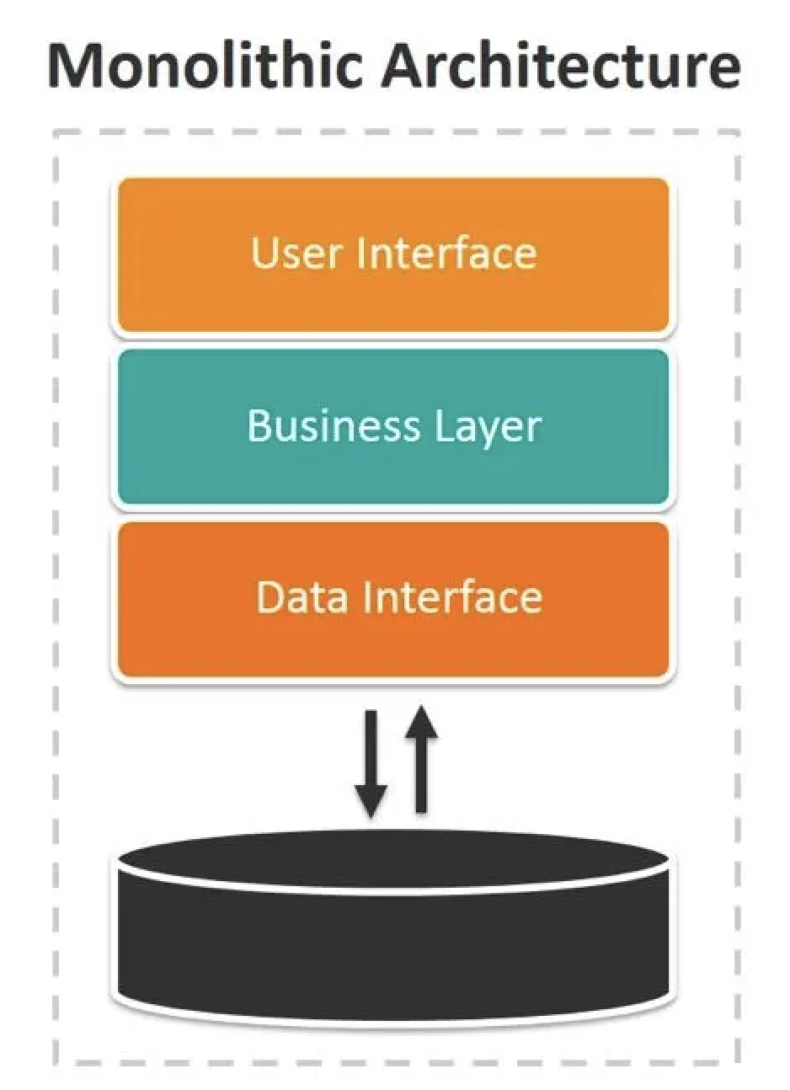
What is Monolithic Architecture?
A monolithic structure, all in one place, Where components unite, no complex interface.
Tightly coupled and big, all parts depend, Scaling and changes often hard to amend.

Slide 4
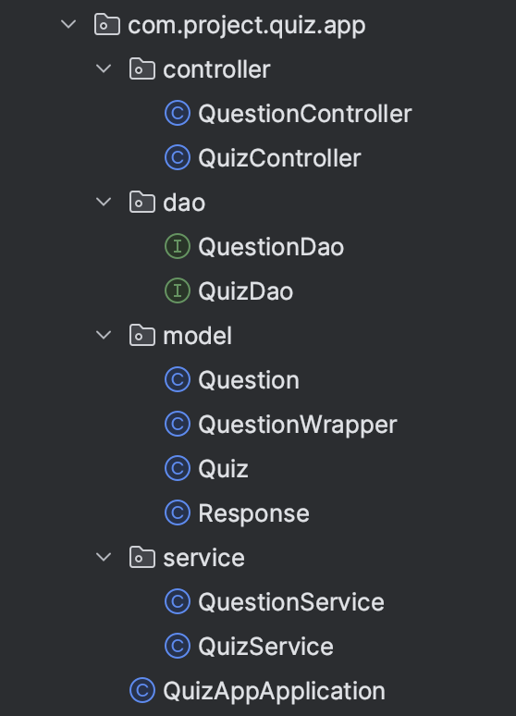
Project Structure
Layered Architecture Components:
Controller Layer: Handles incoming HTTP requests and sends responses.
Service Layer: Contains the business logic of the application.
DAO (Data Access Object) Layer: Manages database interactions.
Model Layer: Defines the data structure of the application.

Slide 5
Question Controller & Service
Controller Layer:
Endpoints implemented:
/question/allQuestions (GET) - Fetch all questions.
/question/category/{category} (GET) - Fetch questions by category.
/question/add (POST) - Add a new question.
/question/update/{id} (PUT) - Update an existing question.
• • /question/delete/{id} (DELETE) - Delete a question.
Service Layer:
Handles logic for adding, updating, and deleting questions.
Uses QuestionDao for database interaction and ensures proper HTTP responses (e.g., 200 OK, 201 Created, 404 Not Found).
Error handling with appropriate messages (e.g., "Error adding question", "Question not found").

Slide 6
Data Layer (DAO & Entity)
Question Entity:
@Entity annotation marks the Question class as a JPA entity.
DAO Layer:
QuestionDao extends JpaRepository for basic CRUD operations.
Custom queries (e.g., findRandomQuestionsByCategory) are implemented using @Query for fetching questions randomly by category.
• ORM automatically manages the data layer, handling operations like saving new questions, findbyId, findbyCategory, or updating existing ones using save.

Slide 7
Quiz Controller & Service
Service Layer:
Manages the creation of quizzes by fetching random questions from the QuestionDao based on category.
Uses QuizDao for database interaction and ensures proper HTTP responses (e.g., 200 OK, 201 Created, 404 Not Found).
Calculate Results:
Fetches questions associated with the quiz.
Compares user responses with the correct answers stored in the Question entity.
Calculates the total number of correct answers and returns the result.
Controller Layer:
Endpoints implemented:
/quiz/create (POST): Create a quiz with random questions.
/quiz/get/{id} (GET): Retrieve questions for a specific quiz.
• • /quiz/submit/{id} (POST): Calculate quiz results based on user responses.

Slide 8
Data Models:
Question: Represents a quiz question entity with fields for question title, options, correct answer, difficulty level, and category.
Quiz: Represents a quiz entity containing multiple questions, leveraging a many-to-many relationship with Question.
ORM Configuration: JPA annotations to map these entities to the database tables.
Database Interaction:
Configuration: Connected to PostgreSQL and managed schema updates automatically via application.properties.
Tables: questions and quizzes created and managed by Hibernate.
Data Operations: Includes CRUD operations and custom queries for data retrieval.

Slide 9
Work Flow
Quiz Controller ----> Quiz Service ----> Quiz DAO
|
v
Fetch Quiz by ID
|
v
Quiz Entity ----> Questions (Many-to-Many)
|
v
QuestionWrapper (Excludes Answer)
|
v
Return QuestionWrapper List to Quiz Controller
|
v
Return Response to User (Questions for Quiz)

Slide 10
User Requests Quiz:
User sends an HTTP request to QuizController to get a quiz by its ID (e.g., /quiz/get/{id}).
QuizController calls QuizService to fetch the quiz details.
QuizService Fetches Quiz Questions Without Answers:
QuizService fetches the quiz entity by its ID from QuizDao.
The quiz entity retrieved includes a list of associated questions due to the many-to-many relationship.
The many-to-many relationship between Quiz and Question works as follows:
A Quiz can have multiple Questions, and a Question can belong to multiple Quizzes.
The relationship is represented with the @ManyToMany annotation in JPA.
JPA automatically creates a join table (e.g., quiz_question) with two foreign key columns: quiz_id and question_id.
QuizService calls QuestionService to wrap these questions using QuestionWrapper to exclude the correct answers.
QuestionService interacts with QuestionDao to fetch the questions based on quiz ID and other parameters.
The questions are wrapped in QuestionWrapper and sent back to QuizService.
QuizService formats the response and sends it back to QuizController, which then returns the response to the user.

Slide 11
WorkFlow
User Submits Quiz Responses:
User submits their responses for the quiz by sending an HTTP request to QuizController (e.g., /quiz/submit/{id}).
QuizController calls QuizService to calculate the result of the quiz based on the user responses.
QuizService Calculates the Result:
QuizService fetches the quiz entity and its associated questions again from QuizDao.
For each question, QuizService checks the user’s response against the correct answer field in the Question entity.
QuizService calculates the total number of correct answers.
QuizService sends the result to QuizController, which then returns the result to the user.

Slide 12
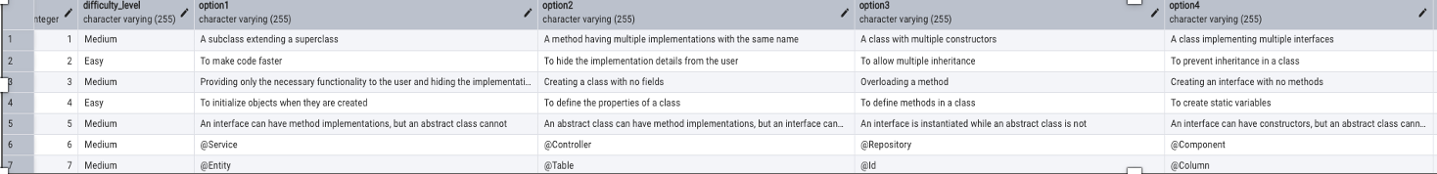
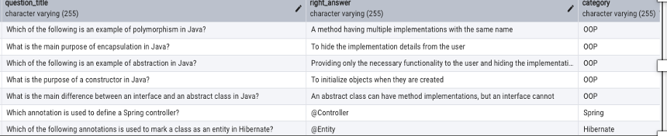
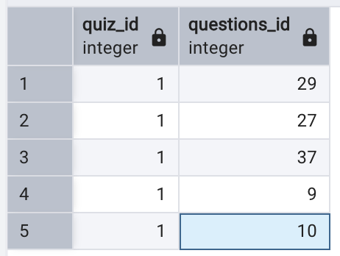
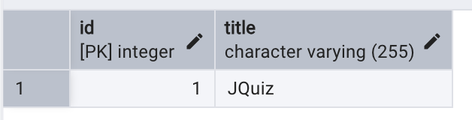
Tables
A join table automatically created by JPA to manage the many-to-many relationship between Quiz and Question.

Slide 13
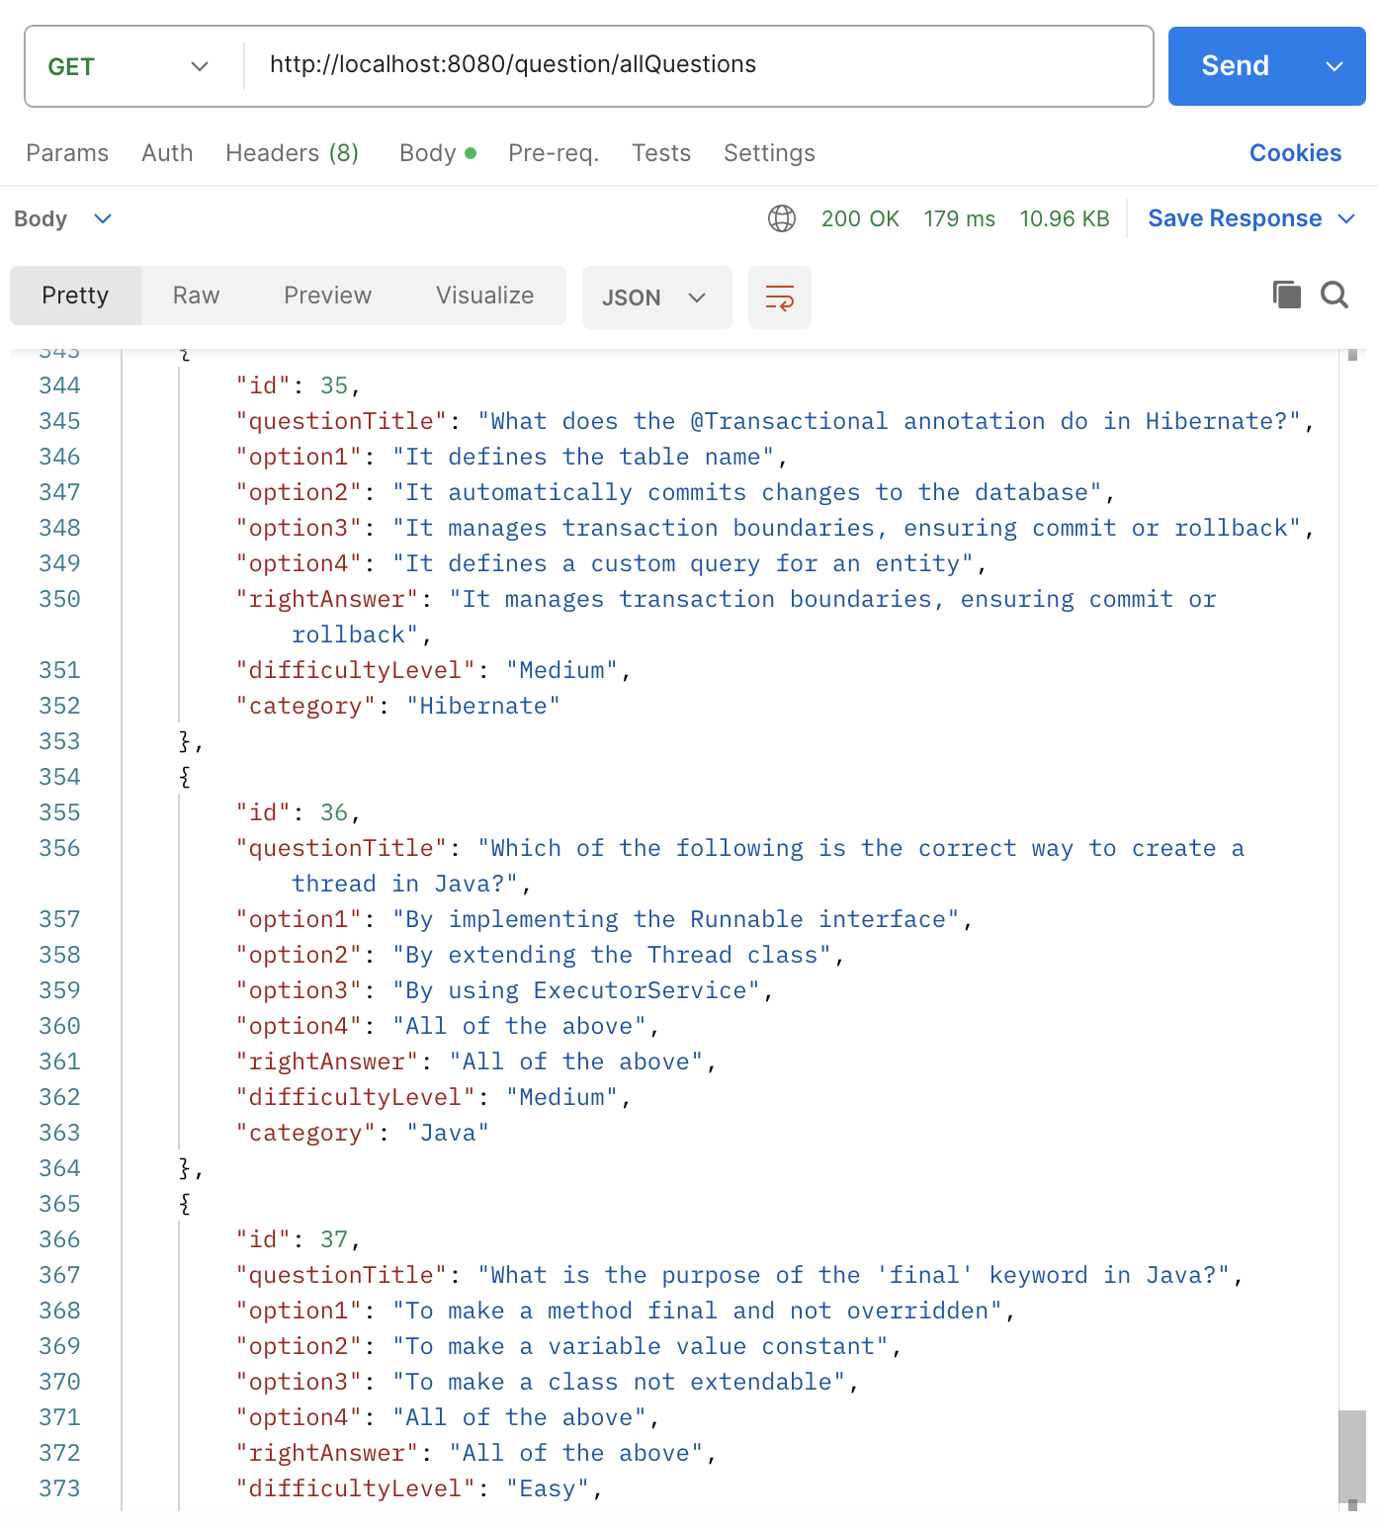
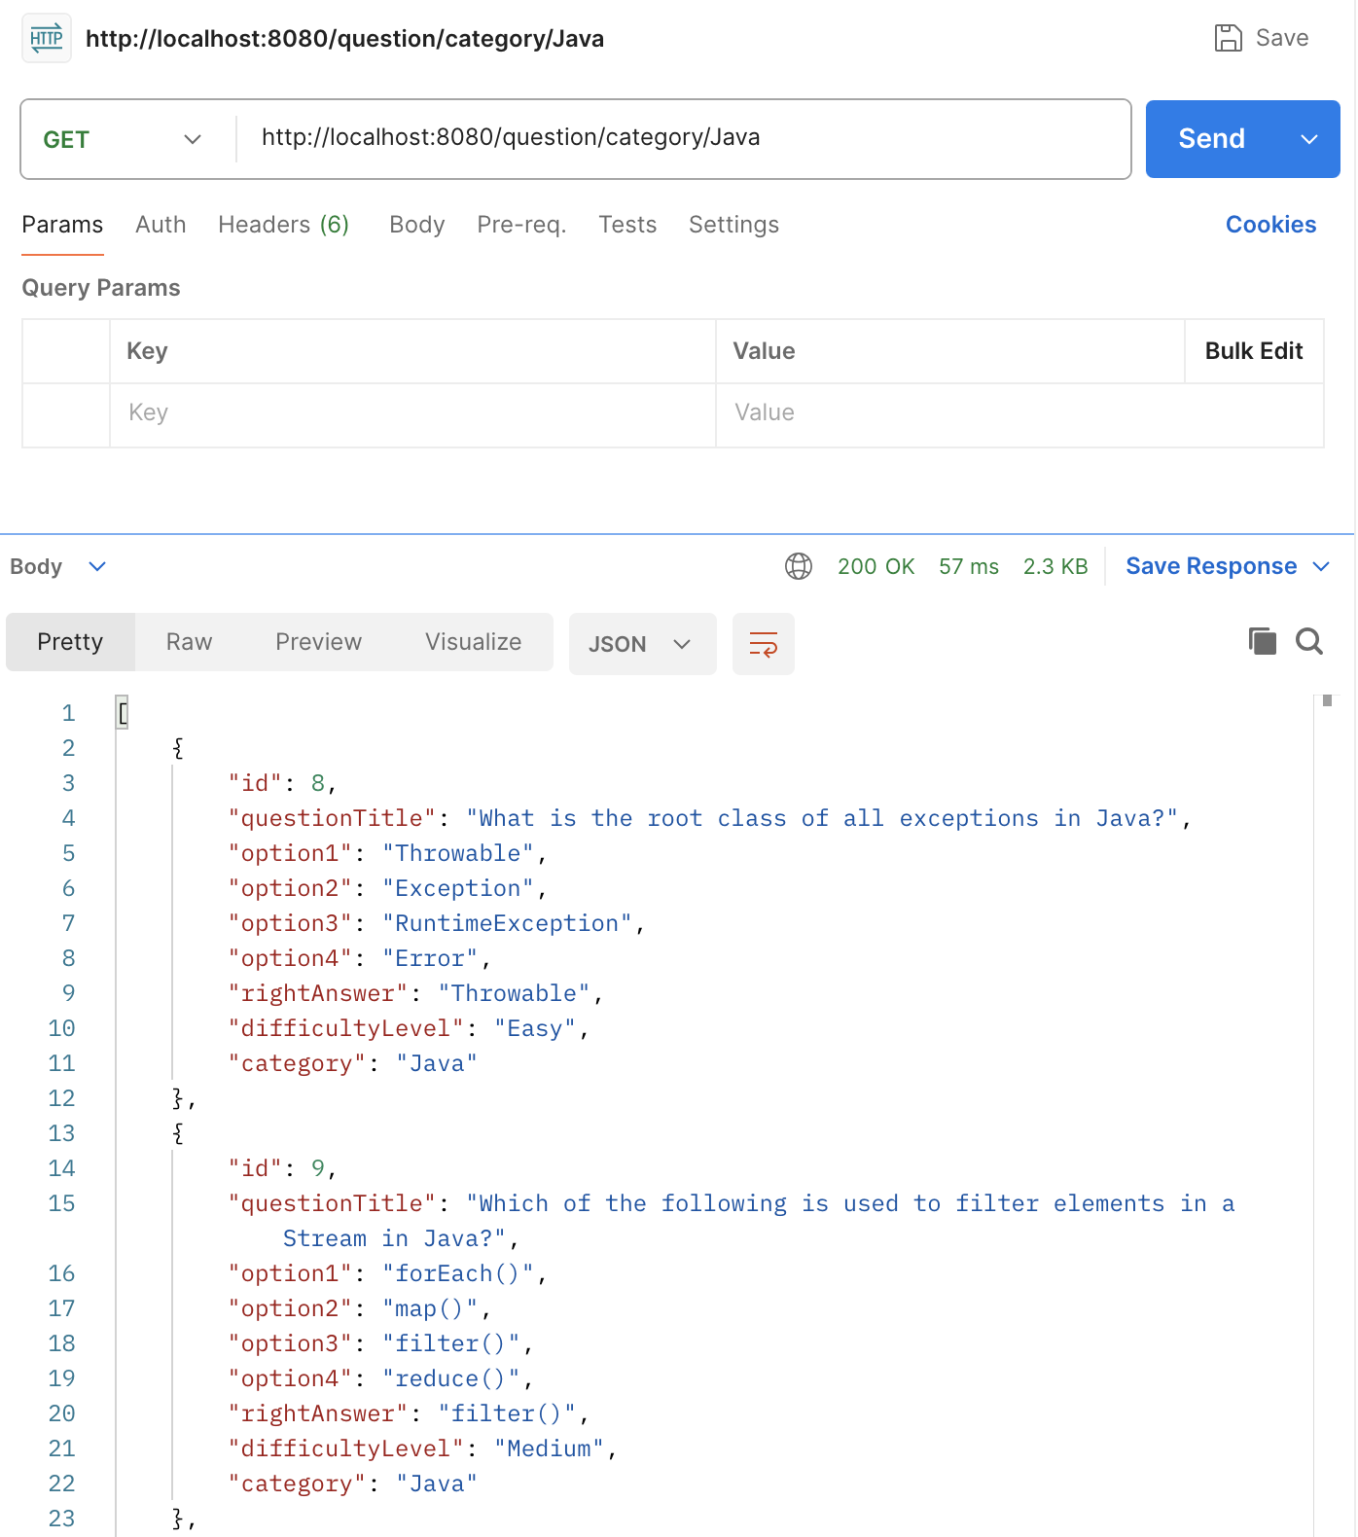
Testing Endpoints

Slide 14
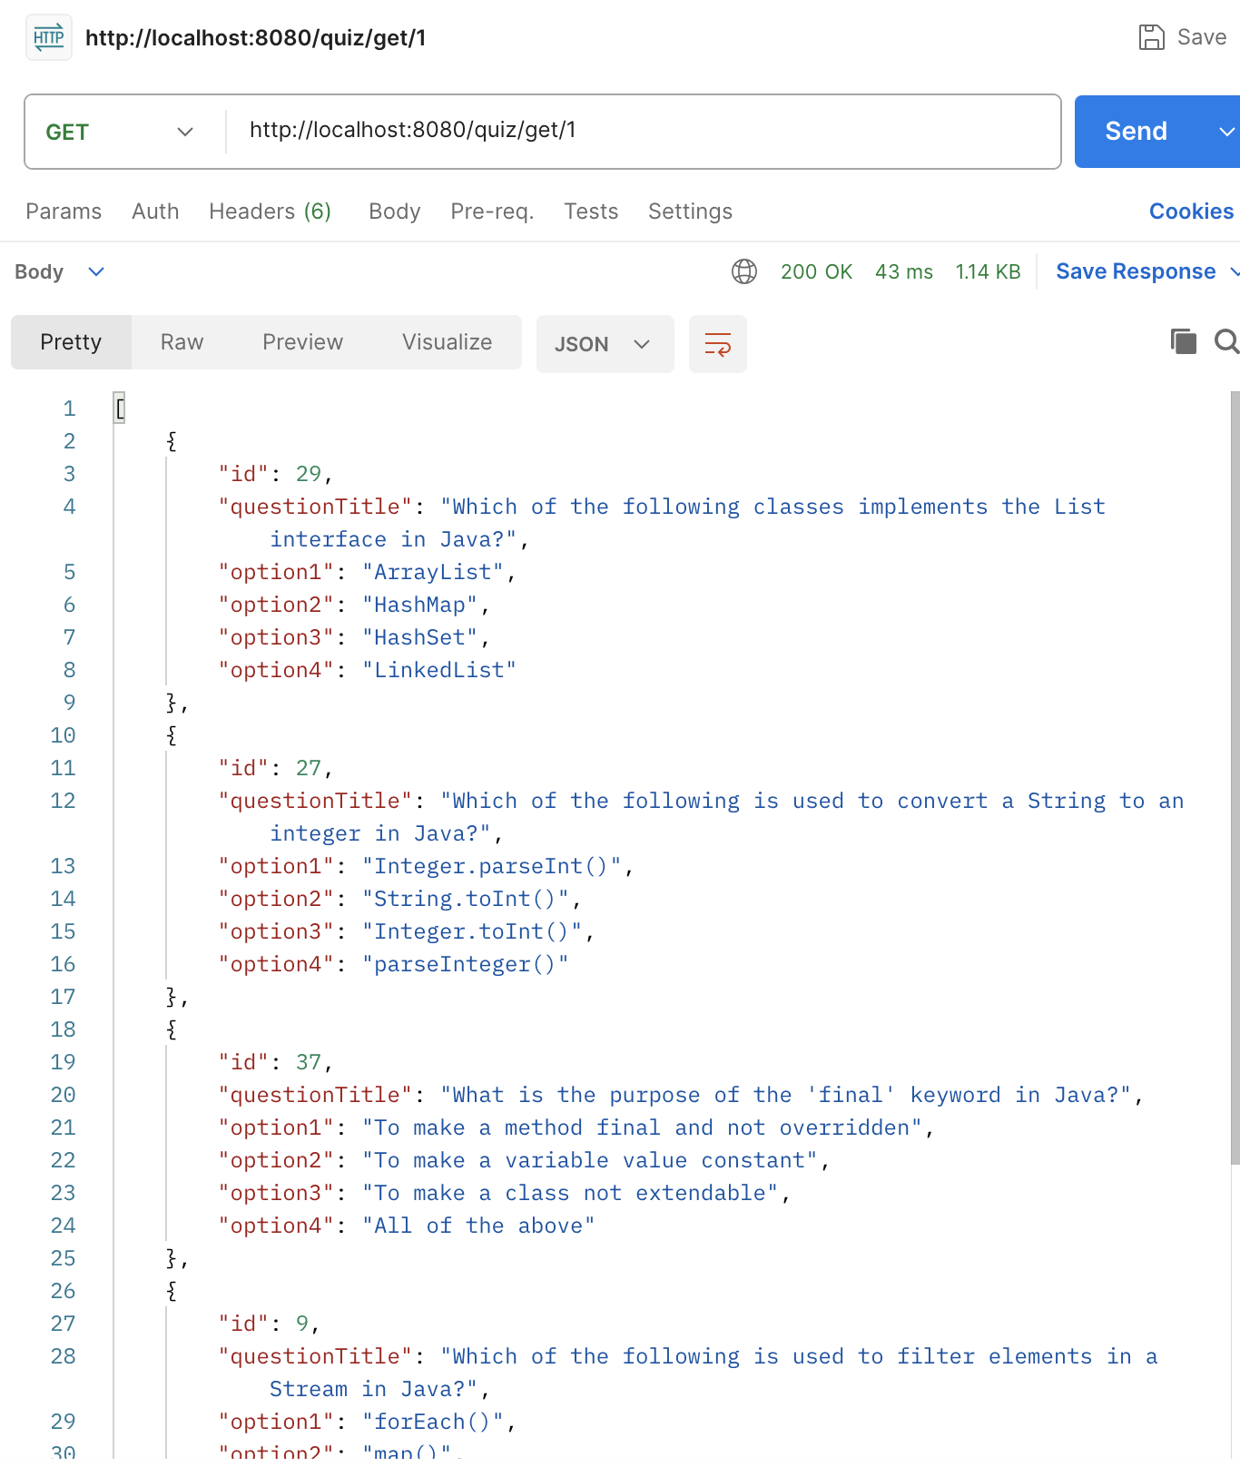
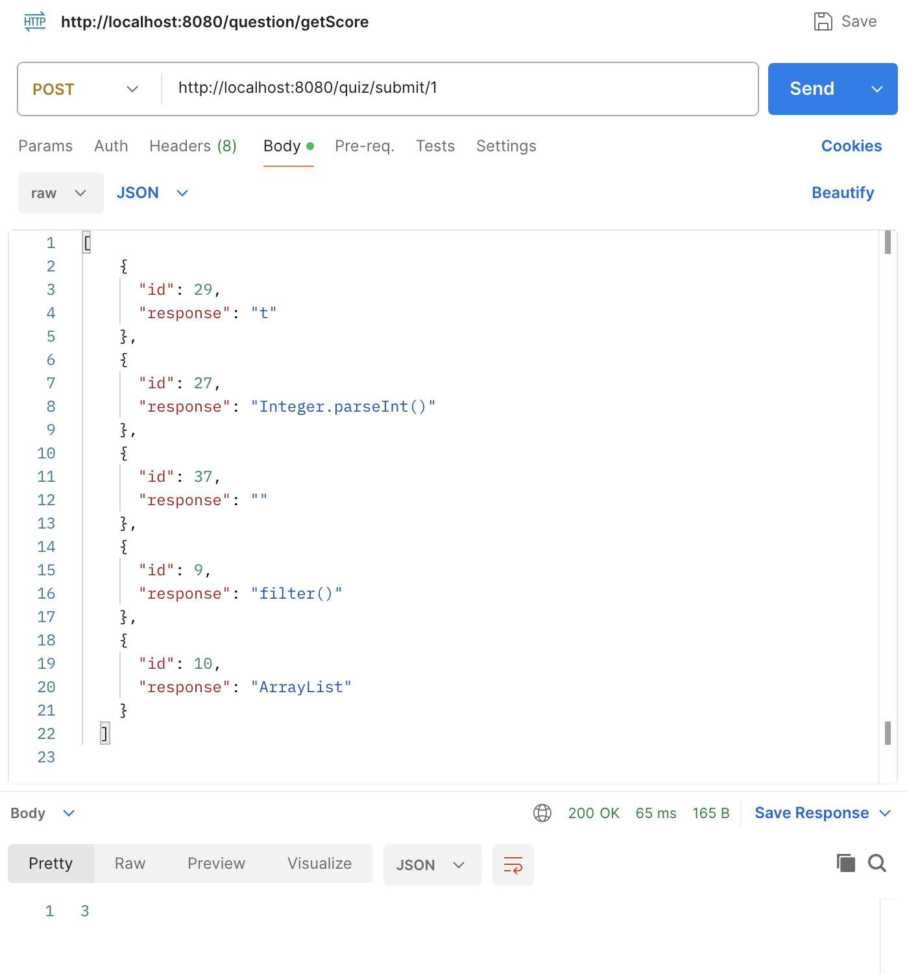

Slide 15
Problems of Monolithic architecture
Scalability: Difficult to scale individual components without scaling the entire application.
Maintenance: Updating one part requires redeploying the whole application, leading to downtime.
Tight Coupling: Components are interdependent, making it hard to isolate issues and add new features.
Development Bottlenecks: A growing codebase slows down development and increases the risk of conflicts.
Deployment: Single deployment unit complicates continuous deployment and increases failure risks.
Flexibility: Limited ability to use different technologies for specific parts of the application.

Slide 16
Transition to Microservices

Slide 17
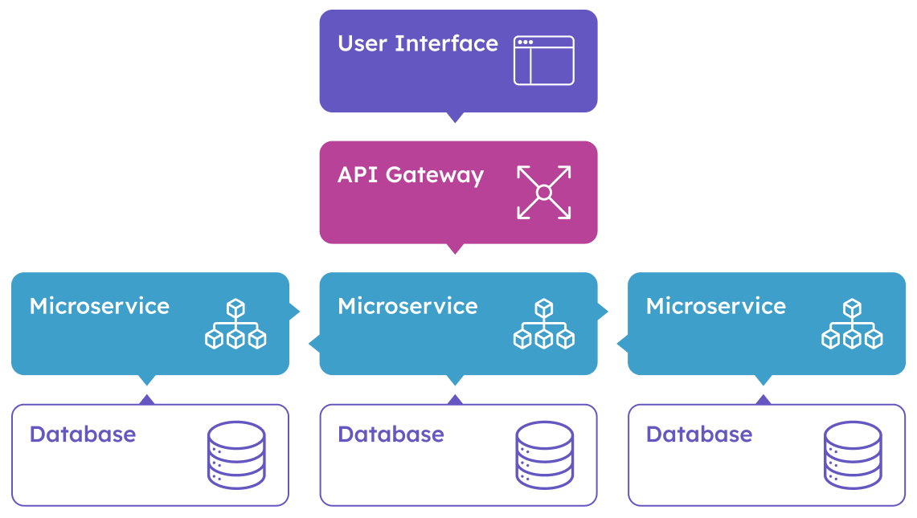
What is microservice?​
A microservice is an architectural style that structures an application as a collection of small, autonomous services. Each service is focused on a specific business function and can be developed, deployed, and scaled independently.

Slide 18
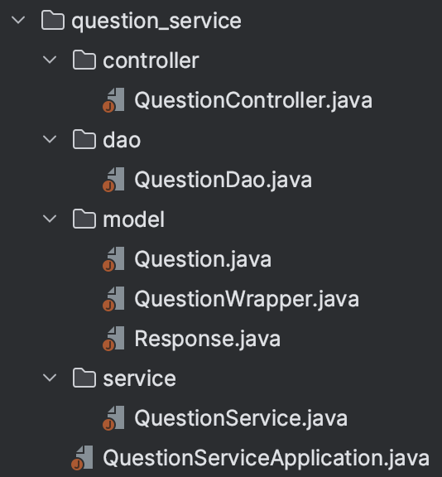
Migrating Question Microservice
Separate Database:
New Functionalities added: Random Question ID Generation, Fetch Questions by IDs, Score Calculation

Slide 19
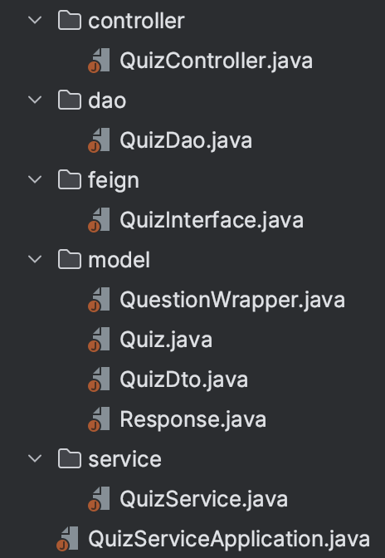
Migrating Quiz microservice
Separate database
Communication via Feign Client:
QuizService now uses Feign Client to interact with QuestionService for:
Fetching random question IDs based on category and number of questions.
Retrieving detailed questions using the IDs.
Calculating the score by sending user answers.

Slide 20
Added Service Communication in Question Microservice:
OpenFeign Used for declarative REST client to facilitate service-to-service communication.
Netflix Eureka Client: Registers the Question service with Eureka for service discovery, enabling dynamic communication between services by name.
QuizDTO:
A QuizDTO is used to carry quiz data (category, num of questions, title) between services.
Many-to-Many to ElementCollection:
Replaced Many-to-Many relationship with @ElementCollection for question IDs.
So, instead of having a direct Many-to-Many relationship (which would involve joining tables and handling entire objects), you're now working with a list of IDs stored as a simple collection. The QuestionService will handle retrieving full Question entities when needed based on those IDs.

Slide 21
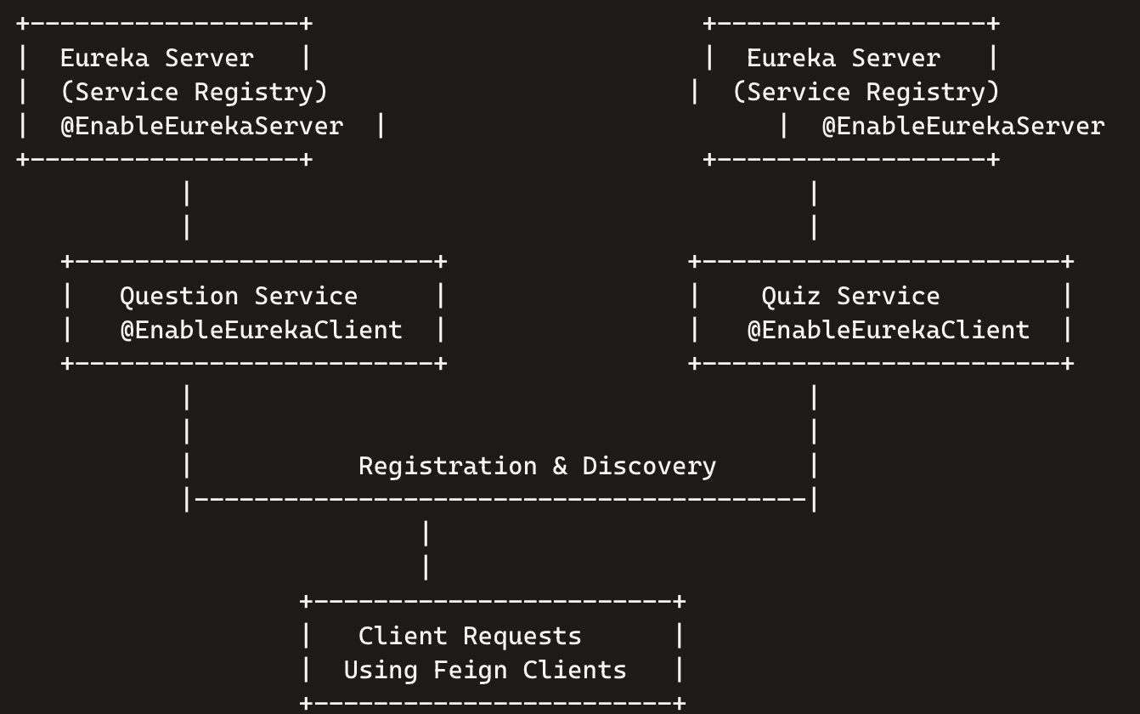
Service
Discovery with
Netflix Eureka​
@EnableEurekaServer
Service Discovery:
Netflix Eureka: A REST-based service that provides service discovery and registration.
Purpose: Allows microservices to find and communicate with each other without hardcoding hostname and port.
Central Registry: Maintains a registry of available services.

Slide 22
Configuration:
API Gateway Settings:
spring.cloud.gateway.discovery.locator.enabled=true: Enables service discovery for routing.
spring.cloud.gateway.discovery.locator.lower-case-service-id=true: Normalizes service IDs to lowercase.
Dependencies:
spring-cloud-starter-gateway: Enables API Gateway functionality.
spring-cloud-starter-netflix-eureka-client: Allows the API Gateway to register with Eureka.
Load Balancing & API Gateway
Flow:
The API Gateway registers with Eureka upon startup.
When a request is received, the API Gateway queries Eureka for the relevant service.
Eureka returns available service instances, and the API Gateway routes the request to one of them.
Load balancing is handled automatically by Spring Cloud Gateway.

Slide 23
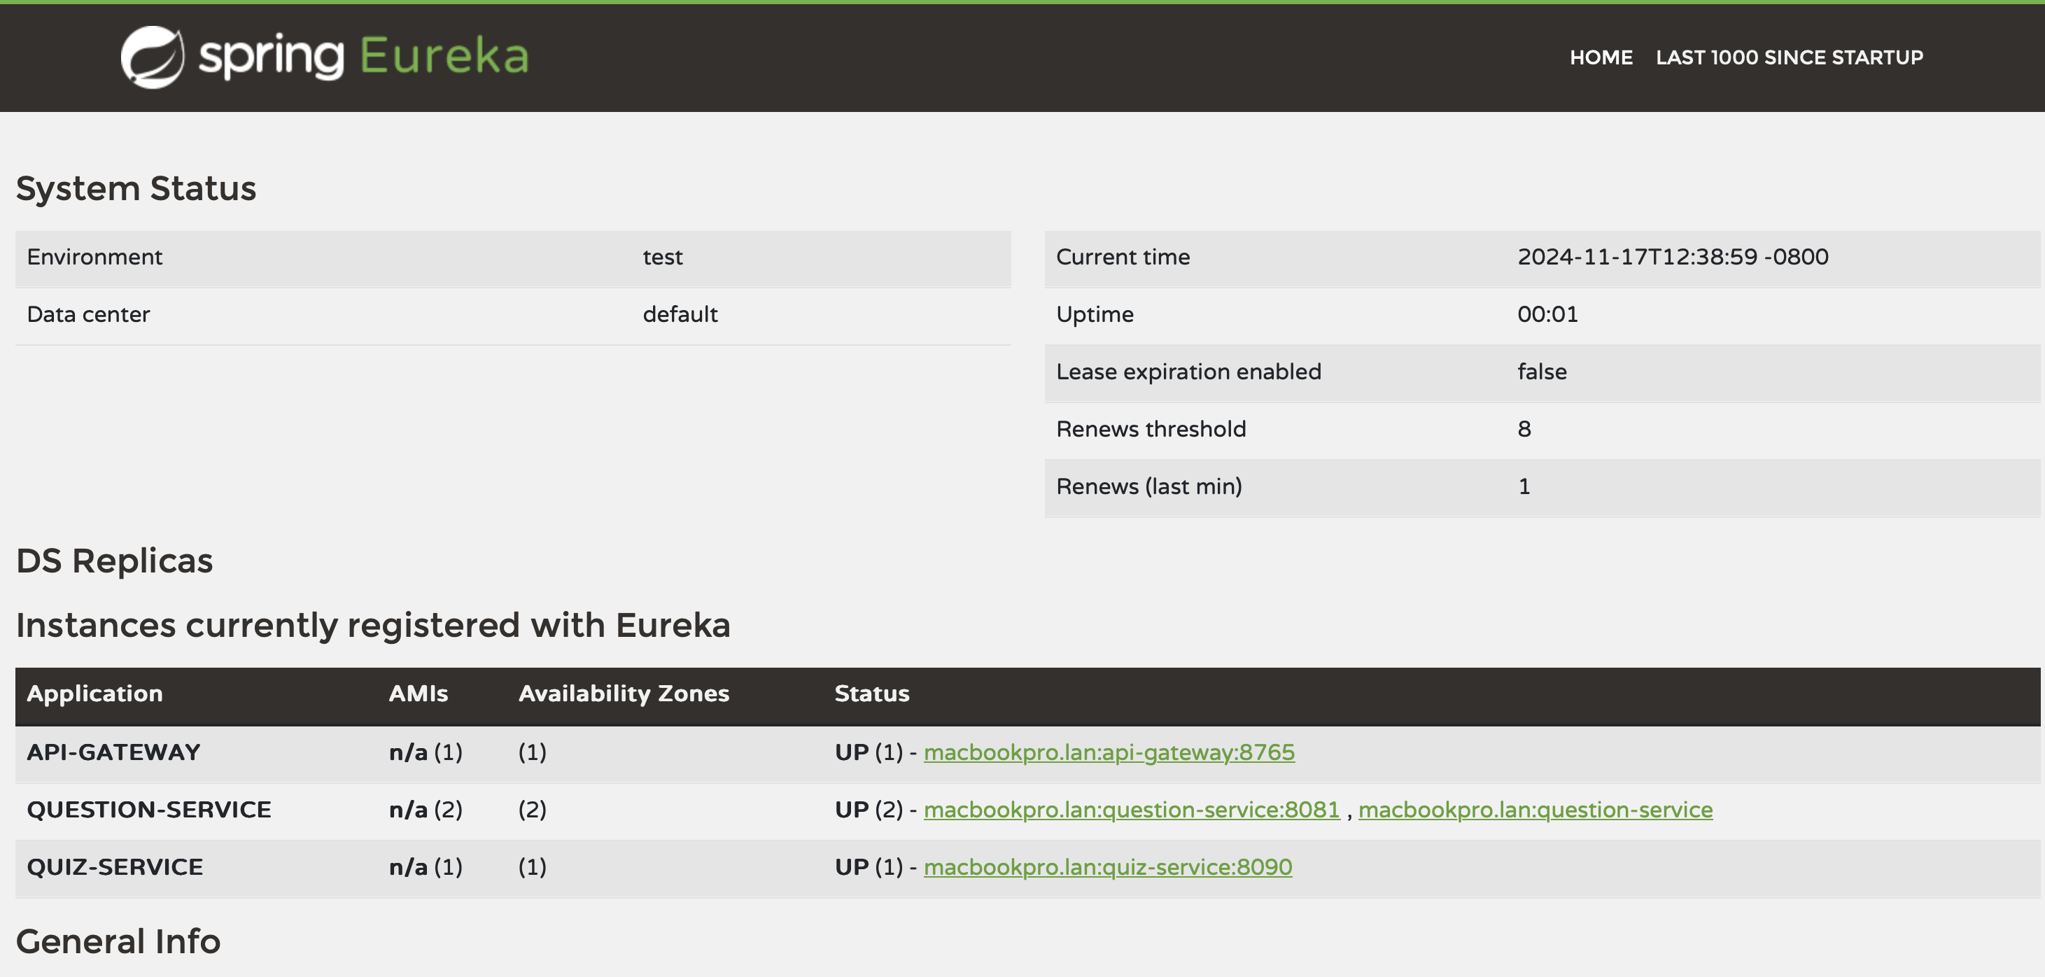
Eureka Service Registry

Slide 24
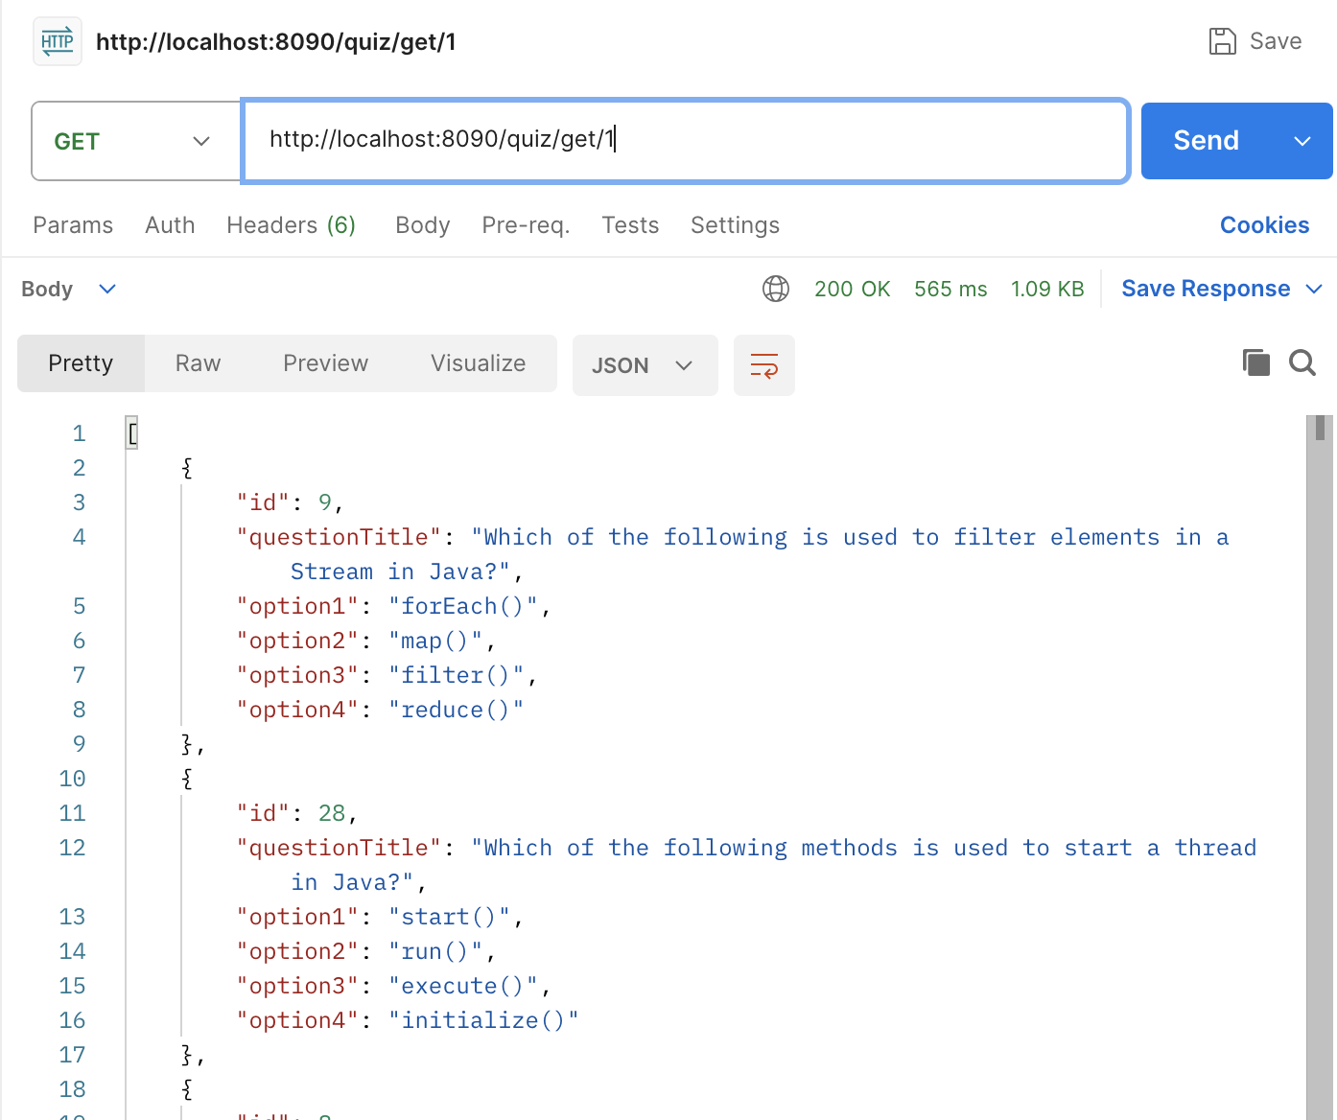

Slide 25
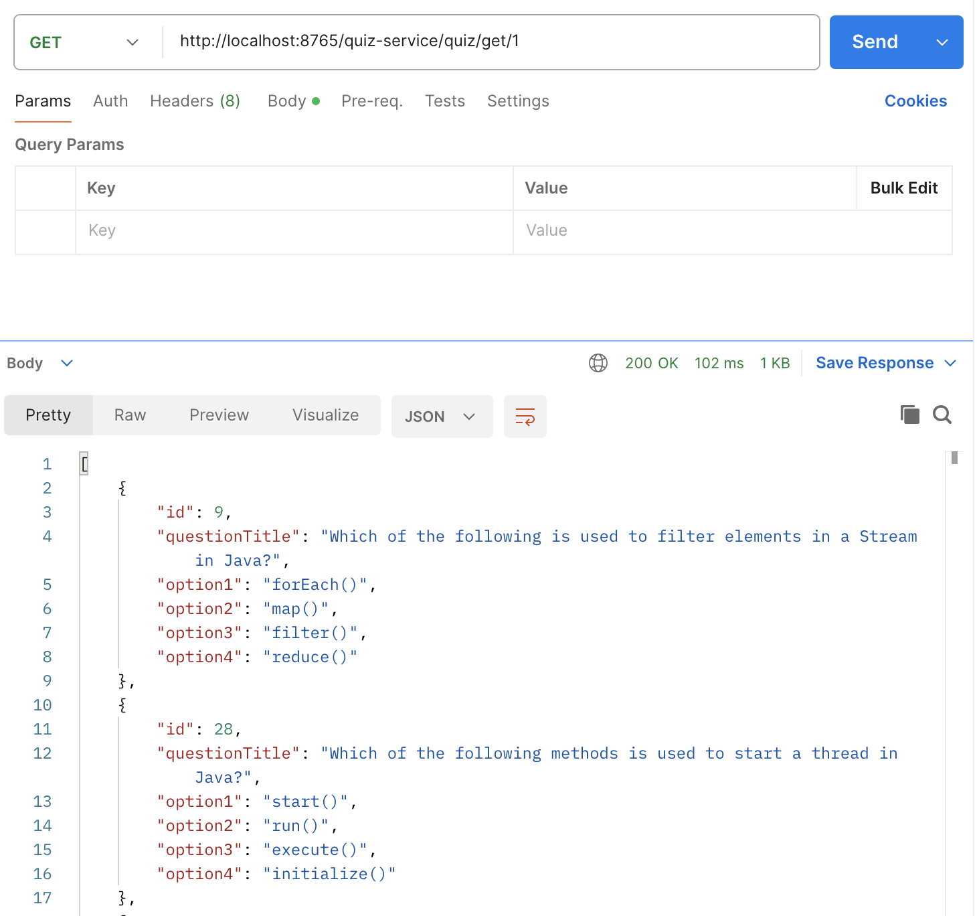
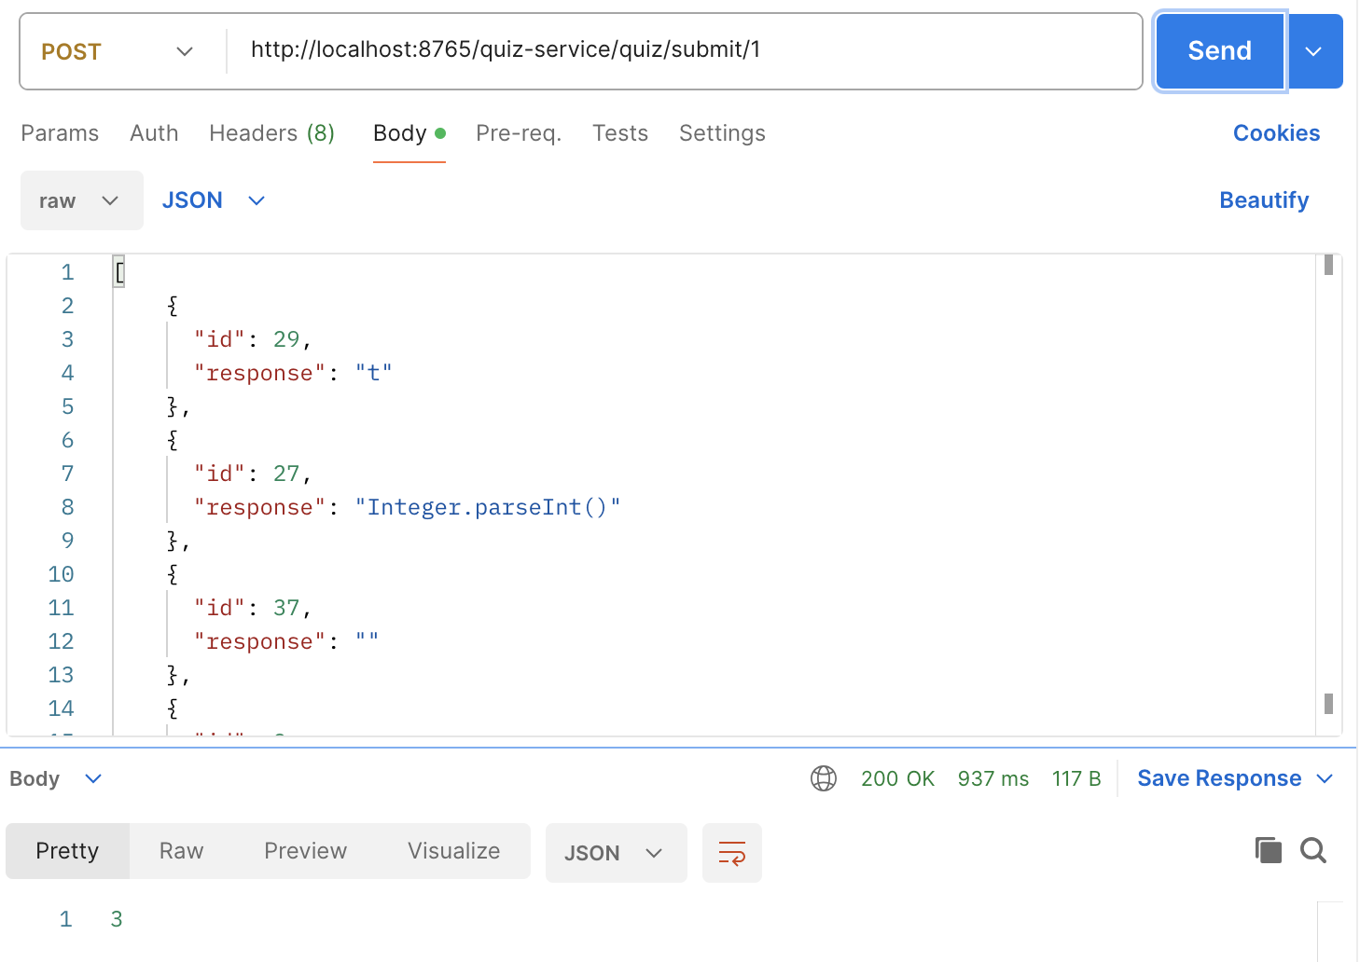

Slide 26
Future Work
Create User Interface​
Implement roles like – admin to create quizzes : users to answer quizzes.​
Implement security: Spring Security/Oauth/JWT for secure login ​
Explore other service registry - Consul for service discovery​
Add health check endpoints to monitor service status​
Use Redis for caching frequently used quiz data​

Slide 27
Conclusion
The shift from monolithic to microservices improved scalability, flexibility, and maintainability.
The new architecture allows better management of independent services, making it easier to scale and update individual components.
Postman testing validated the functionality of individual services. This refactor paves the way for future scaling and feature additions.

Slide 28

Q&A

Slide 29
Thank you.

