Slide 1

College in the time of COVID-19
Seismic shifts in higher education
prompted by the challenges
of remote learning
Adam Jones, Belisario Montesinos, and Priya Seejoor

Slide 2
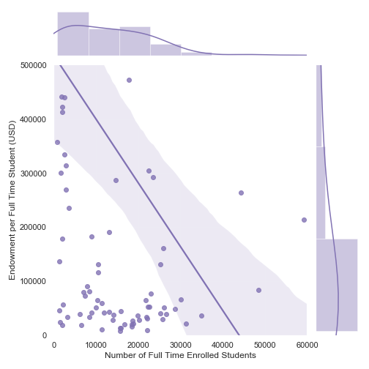
Which schools are thriving during the pandemic?
Small Schools with large endowments (NESCAC, small liberal arts colleges) will adapt and prosper during this pandemic.
Larger universities with lower-moderate endowments per students also appear to fare well
Linear regression + marginal distribution reinforces above points, proving that cash is key to these institutions continued prosperity.
Most ‘Well-Endowed’ universities are Harvard, Princeton & Yale
The largest state schools set to thrive are Texas A&M, University of Texas-Austin, and University of Michigan-Ann Arbor

Slide 3
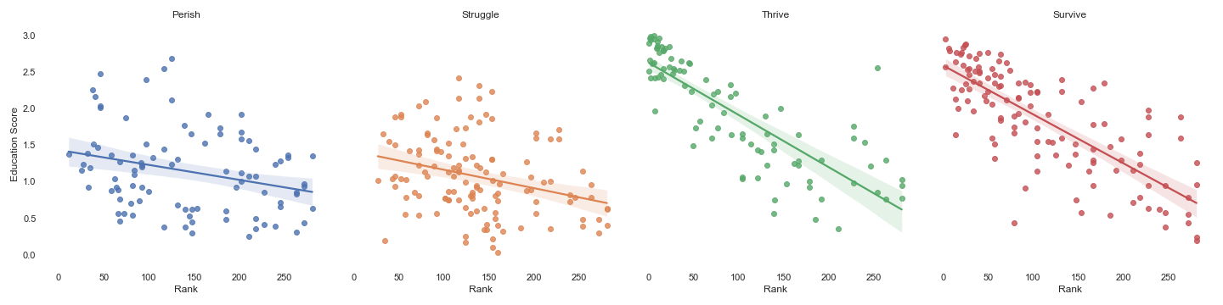
How do national rankings affect survivability?
There is a clear correlation between top ranking universities and high education score, when it comes to predicting survival of universities during the pandemic.
When examining the right two graphs you can noticeably see how in the upper left quadrants, there’s a cluster of dots. This represents the most highly ranked schools with high education scores, which are more likely to survive/ thrive.
In short, elite and well-known institutions are likely to survive, as degrees from these institutions are still desirable, and quality of education is perceived to be high at these colleges.

Slide 4
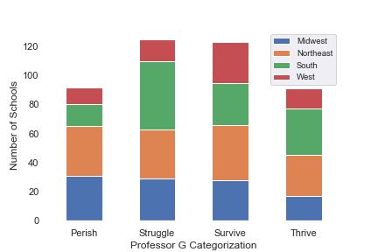
What are the implications on a regional level?
Of the schools predicted to perish during the pandemic, many are located in the Northeast and Midwest
Clear correlation between survivability and value-to-cost ratio
Generally speaking, schools that will perish have a low value-to-cost ratio (<0.25)
Colleges in Southern and Western states have a high average value-to-cost ratio (>1.18)
Many schools will struggle, but southern schools appear to be disproportionately affected
Struggling schools tend to be smaller, and will have to lean heavily on endowments to weather the storm

Slide 5



Thank you!
Adam Jones
Linkedin
GitHub
Priya Seejoor
Linkedin
GitHub
Belisario Montesinos
Linkedin
GitHub
Source:USS University, https://www.profgalloway.com/uss-university
Languages Used: Python
Packages: Seaborn, Matplotlib

