Slide 1
Building a Restaurant Recommendation System based on Yelp Dataset
DATA 240 – Project Presentation
Professor: Shayan Shams
San Jose State University
Iqra Bismi, Priya Khandelwal, Saniya Lande, Shilpa Shivarudraiah

Slide 2

Background
Yelp is a popular online platform providing user-generated reviews and ratings for various businesses, including restaurants
Building a recommendation system using Yelp's dataset can help users make informed decisions while selecting restaurants
The project aimed to explore machine learning techniques such as collaborative filtering, content-based filtering, and hybrid modeling to develop an efficient restaurant recommendation system
DATA240 Project Presentation
Building a Restaurant Recommendation System based on Yelp Dataset

Slide 3

Motivation
To Utilize the review data available in Yelp dataset to develop a more effective and efficient restaurant recommendation system.
Review data can improve restaurant recommendations by extracting information about users' preferences and needs from reviews, which can lead to more personalized and relevant recommendations.
Our approach aims to improve upon the limitations of existing recommendation systems, such as data sparsity and cold start problems, by leveraging the review data to generate more accurate and diverse recommendations.
DATA240 Project Presentation
Building a Restaurant Recommendation System based on Yelp Dataset

Slide 4
Literature Review
Technique Used | Dataset Used | Approach | Pros | Cons
Content-based Similarity calculation Weighted based calculations (rating & price) | Data collected from: Google maps, Facebook, Food panda. Initial 3000 restaurant data. After cleaning 1600 restaurant data used. | Content-based filtering model to recommend top similar restaurants. Weighted score = (avg_rating x 0.90 + avg_price x 0.10) | Personalized recommendation based on user’s preference. Avoids cold-start problems | Limited quantity & quality of available data may affect the accuracy and scope of recommendation.
Rating LDA model for collaborative filtering | MovieLens 100K dataset | User Based Collaborative Filtering | Incorporates semantic information through topic modeling using LDA | Lack comprehensive comparison of the hybrid approach with other state-of-the-art recommendation algorithms.
(FLAME) Aspect-Based Opinion Mining Collaborative filtering | Yelp, Tripadvisor | Recommendation Aspect Based Opinion Mining, Consider rating as well as reviews on items | The FLAME model combines two powerful techniques, aspect-based opinion mining and collaborative filtering, to enhance recommendation accuracy. | FLAME's probabilistic modeling approach is computationally intensive, particularly when handling large-scale datasets.
Memory Based Collaborative Filtering | MovieLens Dataset | Uses exponential functions for determining the optimal number of common items | Reduction in sparsity problems | Adoption of exponential similarity in practical recommendation systems is limited and not preferred.
DATA240 Project Presentation
Building a Restaurant Recommendation System based on Yelp Dataset

Slide 5

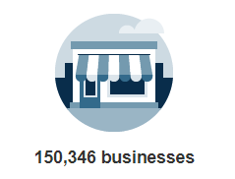
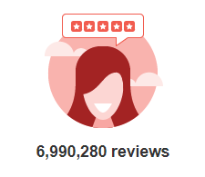
Dataset Description
Acquired data from Yelp Website. It consists of a subset of businesses, reviews, and user data
Business.json
Consists of information about 150,346 businesses
Includes attributes like location, ratings, review count, price range, ambience, type of cuisine, etc.
Reviews.json
Consists of 6,990,280 reviews
Includes details about the user, ratings, business id, user-generated reviews, etc.
DATA240 Project Presentation
Building a Restaurant Recommendation System based on Yelp Dataset

Slide 6
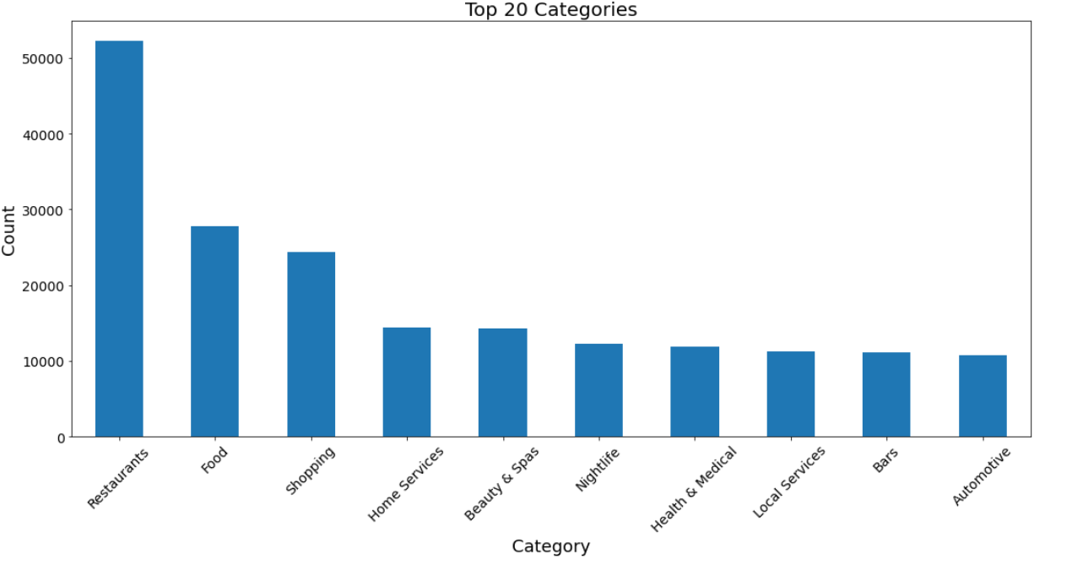
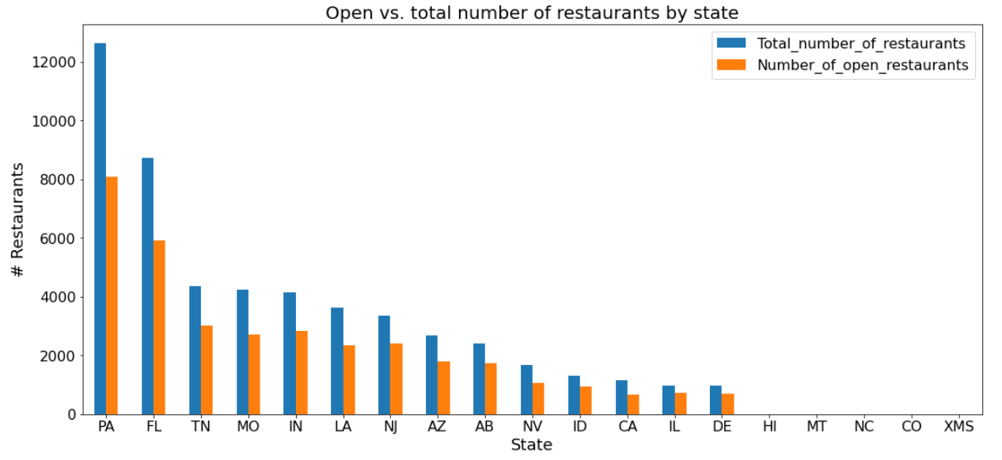
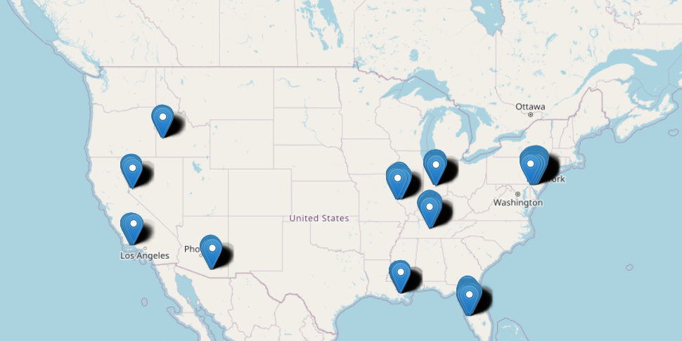
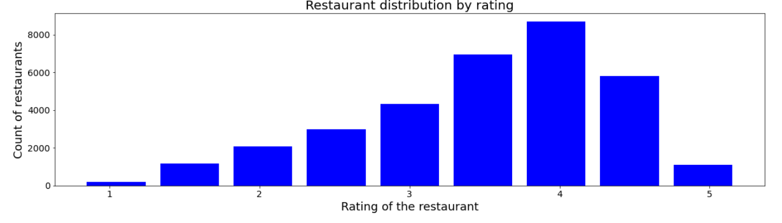
Exploratory Data Analysis – Business dataset
Restaurants in USA
DATA240 Project Presentation
Building a Restaurant Recommendation System based on Yelp Dataset

Slide 7
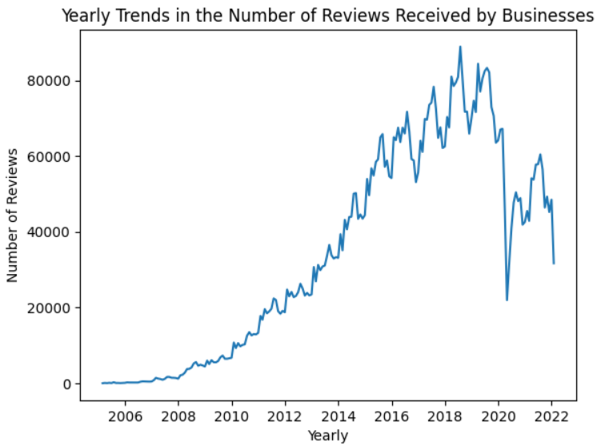
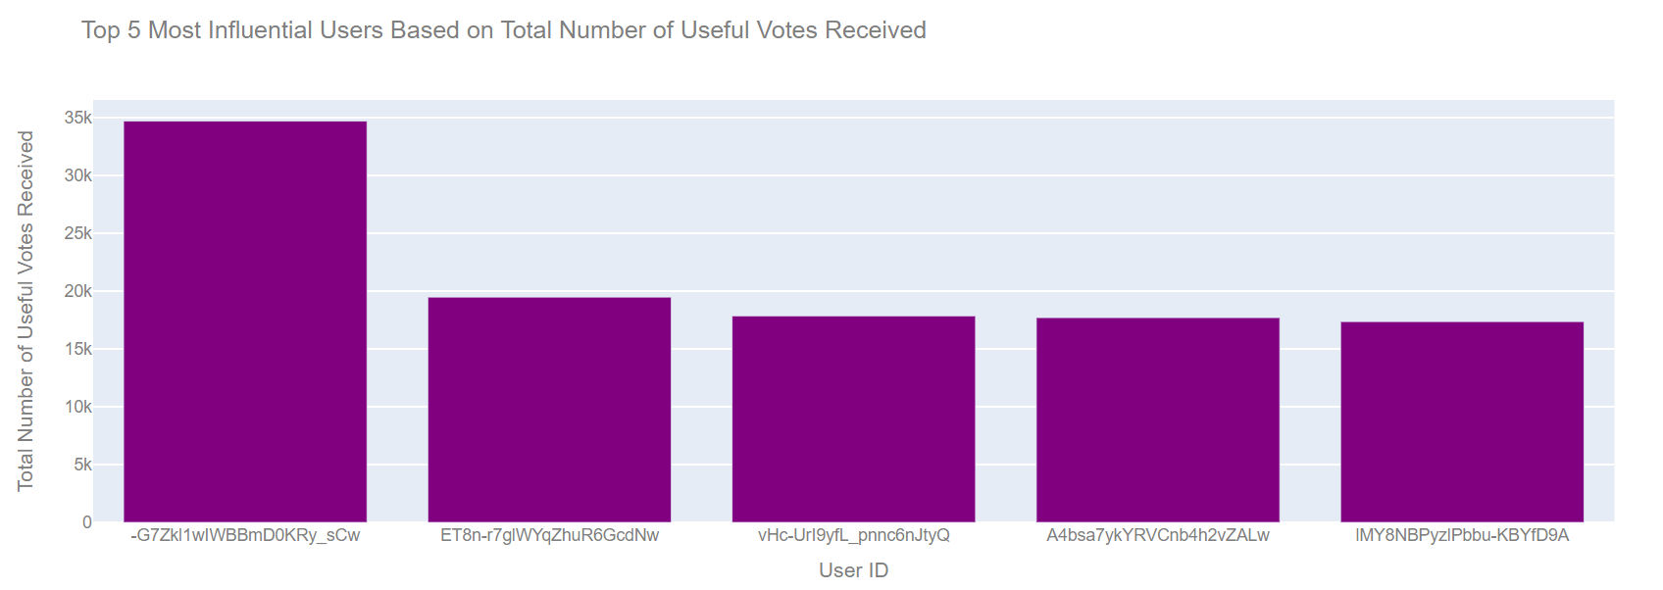
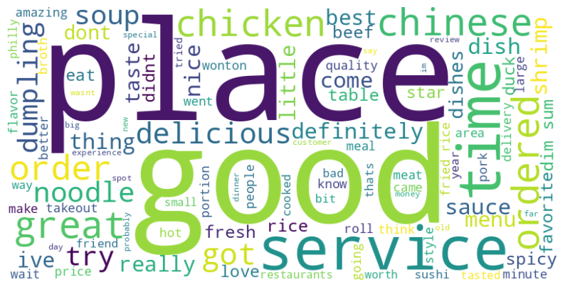
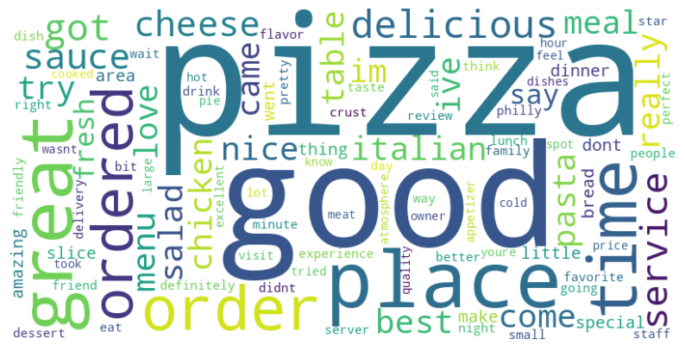
Exploratory Data Analysis – Reviews Dataset
Chinese Cuisine
Italian Cuisine
DATA240 Project Presentation
Building a Restaurant Recommendation System based on Yelp Dataset

Slide 8
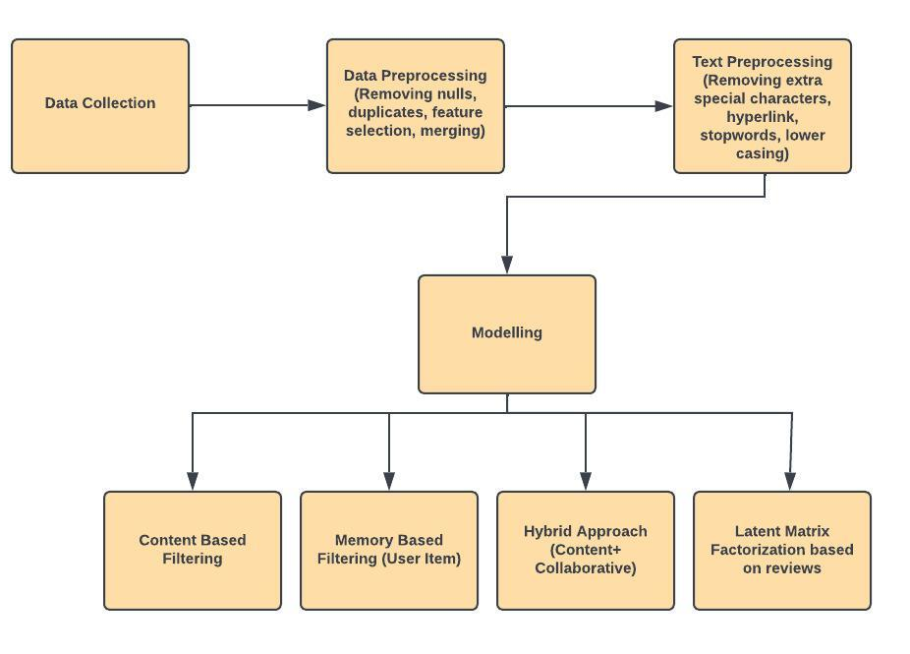

Methodology
DATA240 Project Presentation
Building a Restaurant Recommendation System based on Yelp Dataset

Slide 9
Data Pre-processing
Drop the instances with null categories
(150243, 14)
Filtered the data to keep only the
Restaurant businesses
(52286, 14)
Dropped the closed Restaurants
(35004, 14)
Retained the businesses present in the USA
(33267, 14)
Filtered the businesses for the state of Pennsylvania as
it contains majority count of restaurants
(8072, 14)
Splitted the category attribute into separate columns to
extract the cuisine type information
(8072,54)
Save as csv file
DATA240 Project Presentation
Building a Restaurant Recommendation System based on Yelp Dataset

Slide 10
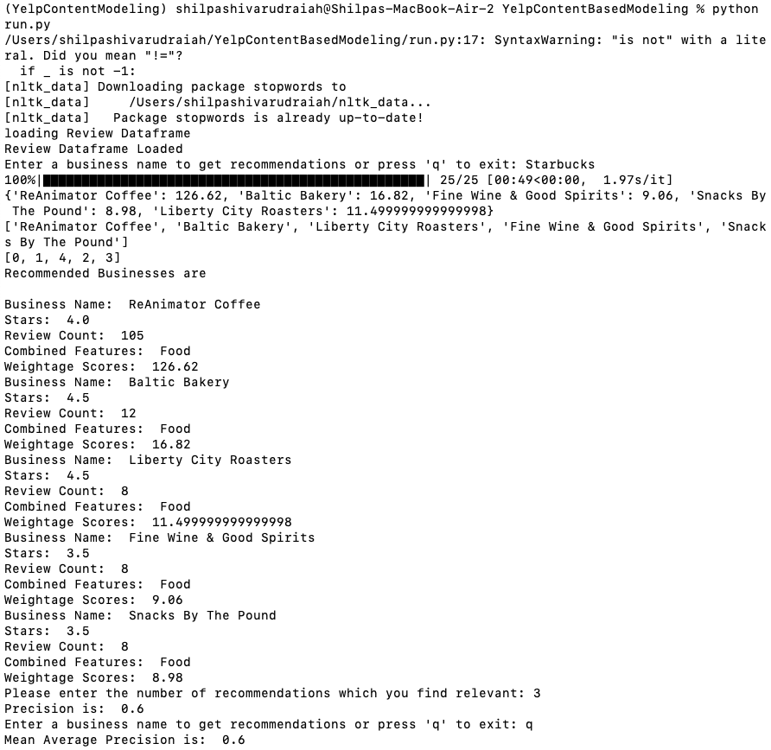
Content-based Filtering
User Input
Pre-processing Business Data
Combined Features
Count Vectorizer - Document Matrix
Cosine Similarity Score
Top 5 Restaurants
Review Dataset
Sentiment Analysis
Weighted Score (0.5 x Similarity_Score + 0.3 * (stars *review_count) + 0.2 * (number of positive/5))
Top 5 Recommendations
DATA240 Project Presentation
Building a Restaurant Recommendation System based on Yelp Dataset

Slide 11

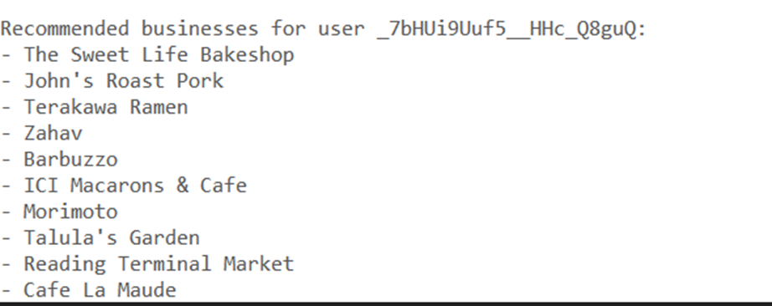
Memory-based Collaborative Filtering
User Input
Create User-Restaurant Matrix
Calculate cosine similarity between given user id and other users based on the ratings
Find the top K similar users for a given user
Include ratings of businesses made by these similar users
Calculate the mean rating for each business
Recommend top 5 business with highest mean rating
DATA240 Project Presentation
Building a Restaurant Recommendation System based on Yelp Dataset

Slide 12

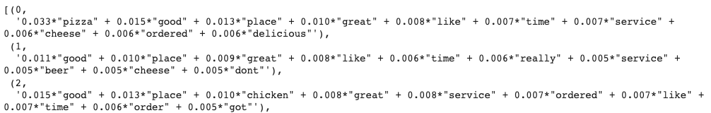
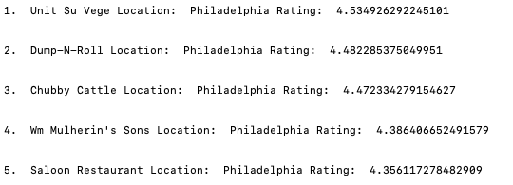
Hybrid Model
Model Architecture
Query
DATA240 Project Presentation
Building a Restaurant Recommendation System based on Yelp Dataset
Notes:
So this is ths hybrid model by combining taking both rating and review into analysis.
We have tried to build this model as user friendly as it could be.
So in this first stage, user can give input whether they want to search for any location specific or cuisine specific restaurant. Also , it common that while giving the query user might make some spelling mistake.
So in this first stage, we have incorporated this fuzz words methods, so even if the the spelling is wrong, the model will calculate the similarity score between cuisine and the query and will give the best match.
And this is optional so if the user doesn’t mention any rating or review then he will still relevant recommendation,
In the second stage, I have used lda for topic modelling ie. for identifying the 10 topics from the review and sentiment analyser to find the positive and negative score.
So after preprocrosing the review as discussed earlier, psotive and negative socre will be calculated.
And by converting it to numeric form using lda, we have identified the topic from the review wrt resturants. And here I AM calucaltig a weighted score. Taking the weightage of words from topic and multiplying it will positive and negative score.
So this is how the topic look like. 0 indiecated topic 1, and in this we can the weightage for most frequent words in topic. Such as pizzam good place and this is probabilistic score.
Afert finding the weighted socre, we are fetching the names of top 20 restuarants.
In the last, these top 20 restruant alogn with user id , rating and predicted topics are passed to svd++ to predicnt the rating and give top 10 recommendation based on highest rating.
So this model is highely efficient as it is taking both reviews, and rating but there is one drawback it is not able user query such as if the user types I want to go a restruant with a beautifyl view so we cannot get results using this model. So to overcome this limitation, it will be discussed further.

Slide 13
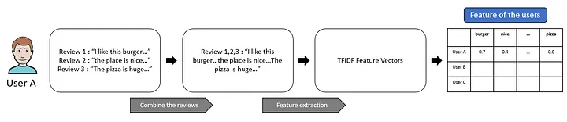
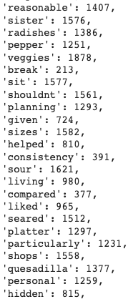
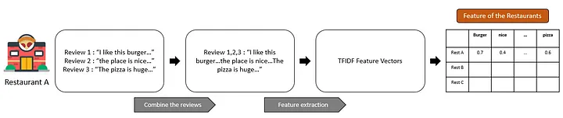
Latent Factor Collaborative filtering with regularization
DATA240 Project Presentation
Building a Restaurant Recommendation System based on Yelp Dataset

Slide 14
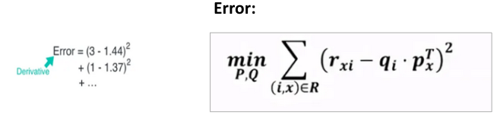
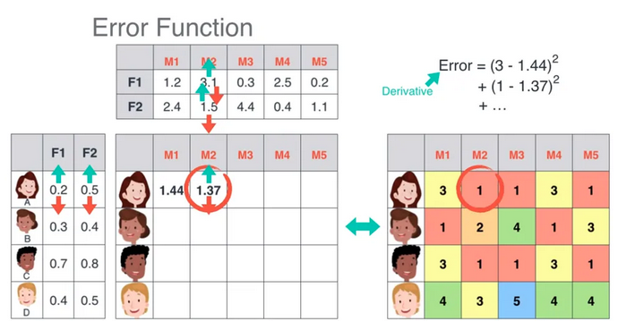
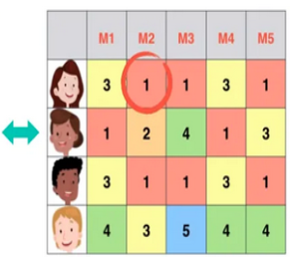
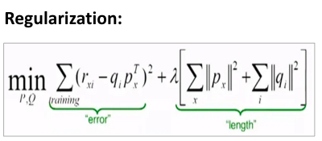
Matrix Factorization and Calculate the Error to Optimize Prediction

Slide 15
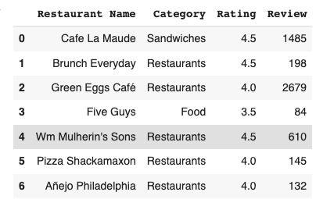
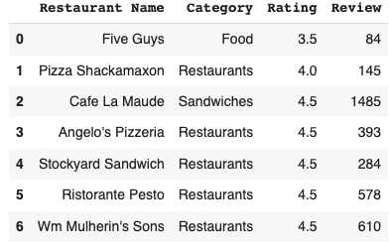
Output
DATA240 Project Presentation
Building a Restaurant Recommendation System based on Yelp Dataset

Slide 16
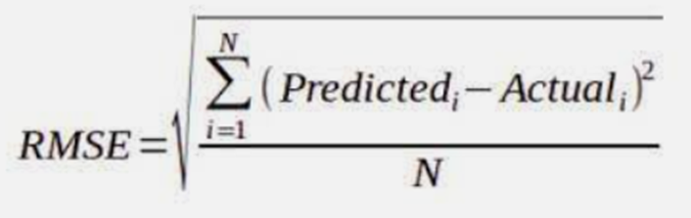

Evaluation Metric
To evaluate the accuracy of the recommendation systems on test data:
Predict the ratings that a user would give to a business they have not yet predicted
Calculate RMSE by taking the difference between the actual and predicted ratings
The lower the RMSE the better !!
Method | RMSE
User based Memory Collaborative Filtering | 1.06
Hybrid Model ( LDA ,SVD++) | 0.74
Latent Matrix Factorization | 0.69
DATA240 Project Presentation
Building a Restaurant Recommendation System based on Yelp Dataset

Slide 17
Conclusion
Implemented four models using different approaches including content based, memory-based, model (matrix factorization), and LDA, expecting different inputs and give restaurant recommendations
The utilization of the different model allowed for a thorough exploration of all dimensions of the data, leading to the attainment of satisfactory results, thereby concluding the project successfully
This project offers users the accessibility to utilize a recommendation system with a wide range of inputs, enabling them to utilize the application in various aspects
DATA255 Project Presentation
Building a Restaurant Recommendation System based on Yelp Dataset

Slide 18
Future Improvements
Enhance recommendation systems by integrating content-based filtering, query-based techniques on reviews, and hybrid approaches for more diverse applications
Implement mechanisms to capture real-time user feedback and adapt the recommendation model accordingly
Experiment with more advanced collaborative filtering techniques, such as deep learning-based models (e.g., Neural Collaborative Filtering), to capture complex user-item interactions
Explore techniques like distributed computing, parallelization, or model compression to ensure the system can handle growing user bases and handle real-time recommendations efficiently
DATA240 Project Presentation
Building a Restaurant Recommendation System based on Yelp Dataset

Slide 19
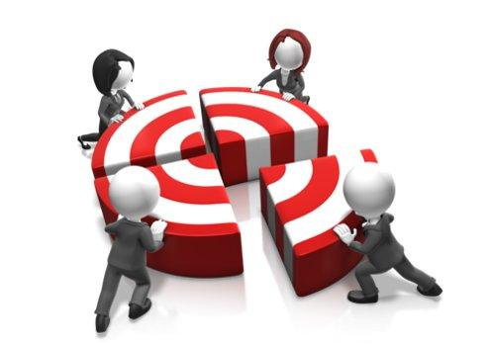
Team Contribution
Team Member | Contributions
Data Collection & Pre-processing | Iqra, Priya
Exploratory Data Analysis | Saniya, Shilpa
Data Transformation + Modelling - Content based | Shilpa
Data Transformation + Modeling- Memory based | Saniya
Data Transformation + Modelling- Knowledge Based + Content Filtering + Collaborative Filtering | Iqra
Data Transformation + Modeling- Collaborative filtering with latent vector and regularization | Priya
DATA240 Project Presentation
Building a Restaurant Recommendation System based on Yelp Dataset

Slide 20
References
Ahmed, T., Akhter, L., Talukder, F. R., Hasan-Al-Monsur, N., Rahman, H., & Sattar, A. (2021). Restaurant Recommendation System in Dhaka City using Machine Learning Approach. In 2021 10th International Conference on System Modeling & Advancement in Research Trends (SMART). https://doi.org/10.1109/smart52563.2021.9676197
Wu, Y., & Ester, M. (2015, February). Flame: A probabilistic model combining aspect based opinion mining and collaborative filtering. In Proceedings of the eighth ACM international conference on web search and data mining (pp. 199-208)
https://www.youtube.com/watch?v=ZspR5PZemcs
https://towardsdatascience.com/how-to-build-a-restaurant-recommendation-system-using-latent-factor-collaborative-filtering-ffe08dd57dca
Chaohui Liu, Xianjin Kong, Xiang Li, Tongxin Zhang, "Collaborative Filtering Recommendation Algorithm Based on User Attributes and Item Score", Scientific Programming, vol. 2022, Article ID 4544152, 7 pages, 2022. https://doi.org/10.1155/2022/4544152
Zhou, X., & Wu, S. (2016). Rating LDA model for collaborative filtering. Knowledge Based Systems, 110, 135–143. https://doi.org/10.1016/j.knosys.2016.07.020
DATA240 Project Presentation
Building a Restaurant Recommendation System based on Yelp Dataset

Slide 21

Thank you
Comparative Performance Analysis - Cassandra Vs MongoDB

