Slide 1
The next 700 Compiler Correctness Theorems (Functional Pearl)
Daniel Patterson & Amal Ahmed, Northeastern University
ICFP 2019
Priya Srikumar, Cornell University
Summer PLDG 2020

Slide 2
A history
1967 – Proving a compiler for arithmetic expressions correct
1973 – Statement of whole-program compiler correctness theorem
2006 – CompCert C Compiler
2011 – CompCert has no miscompilation errors; GCC/LLVM do
…and we’re off!
Notes:
John McCarthy + James Painter F. Lockwood Morris
Xavier Leroy
Xuejun Yang, Yang Chen, Eric Eide, and John Regehr

Slide 3
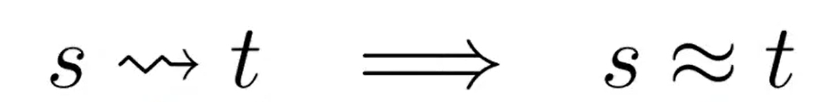

What is compiler correctness?
Semantics preserving

Slide 4

What is compiler correctness?
Compiling from source to target

Slide 5

What is compiler correctness?
preserves the behavior of
refines
defined for whole programs only
Notes:
Now we can understand what whole program compiler correctness looks like…

Slide 6
Whole program compiler correctness
Notes:
Great, but this is not real world. People realized this and there has been work with varying levels of…

Slide 7
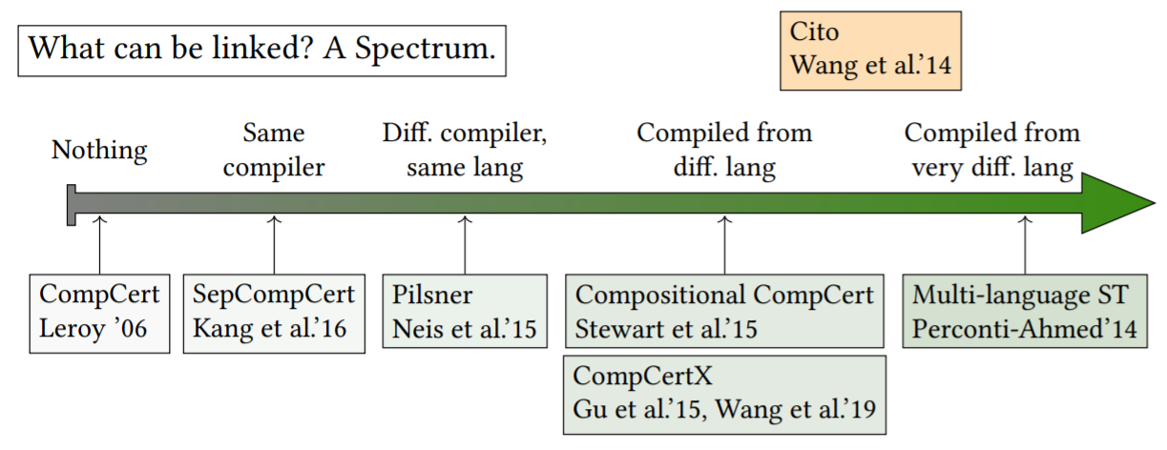
7
Notes:
Now that we know some of the ways linking can happen Going to refer to compilers that can do more than compile whole programs (separate compilation or linking) as COMPOSITIONAL in the sense that they are composing code components.

Slide 8
What makes linking hard to verify?
What does relatedness look like?
What does linking look like?
How do we know a theorem is well-stated?
Notes:
Going to do a brief overview of recent compositional compiler correctness work, going down the spectrum of what we can link with. First, let’s consider code compiled by the same compiler…

Slide 9
SepCompCert
CompCert compiler doesn’t restrict to whole programs
But its correctness theorem does!
SepCompCert reveals bugs in CompCert
CCC theorems need to reflect actual compiler use
Notes:
Read-only memory analysis was not valid in presence of linking

Slide 10
Pilsner
PILS (parametric inter-language simulation) relation
When are target modules related to source modules?
Provably transitive between stages of multi-pass compiler
Notes:
Cross language logical relations used to prove transformations correct, and had been applied to single-pass compilers.
But the approach hadn’t yet scaled to multi-pass compilers due to the fact that proving that source language code being related to intermediate language code and intermediate language code being related to target language code together implied that the source language code and the target language code were behaviorally related as well was complicated. The solution to this was…
This approach, while innovative, did have limitations in terms of usability…

Slide 11
Pilsner
Need to find source module which is related to given target module
Hard to do! (hand-compilation?)
Limited to source language’s representability
Generalizes over compilers with the same PILS relation
Not likely to have many of these
Notes:
In both SepCompCert and Pilsner, we need to directly provide a source language component to which our target language component we’d like to link with could be behaviorally related to, either by literally compiling with the same compiler or proving a relation holds. This gives us…

Slide 12
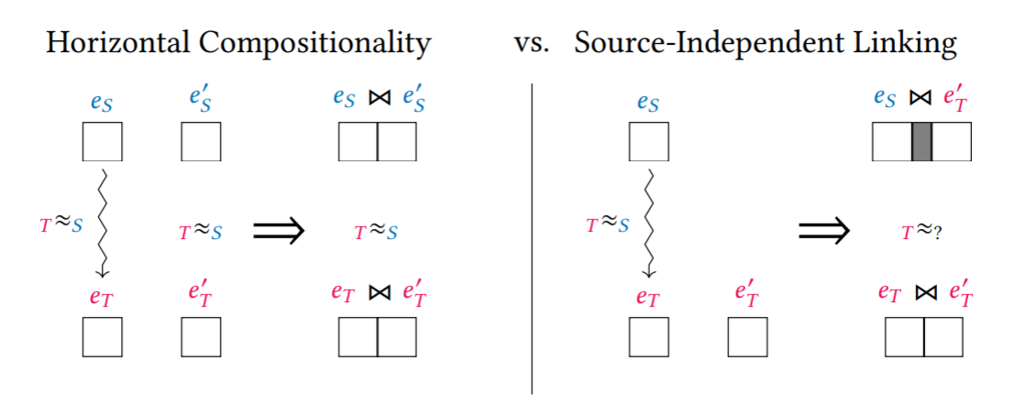

SepCompCert, Pilsner
Notes:
The next two approaches support source-independent linking and do this via providing an “adapter blob”. The first permits linking with code written in a different language with the same source language expressiveness…

Slide 13
Compositional CompCert
Interaction semantics for “language independent linking”
Allows linking with code in any CompCert language
Interaction protocol (requires same memory model)
Contextual equivalence in terms of interaction semantics
Expressed directly in Coq ( )
Semantic multi-language
Notes:
Coq is fabric we use to reason about source and target language relation
Next work takes on the task of verifying compiler linking with target language code that contains expressive power not in the source language. To do this, they make explicit the context in which a piece of code is evaluated within the language of reasoning about linking…

Slide 14

Source-Target Multi-language
Syntactic multi-language
add boundary terms which embed S terms in T contexts
Compiler correctness then becomes
Notes:
The formalisms for each of these CCC theorems are vastly different. It’s impossible to directly compare them… we are in want of a more general framework for assessing the utility of theorems.

Slide 15
What makes a good CCC theorem?
Encompasses a variety of realistic compilers
Backwards-compatible with past (C)CC work
Straightforward to understand
Notes:
Now that we know how a general framework would serve us well, what are we going to need to instantiate such a framework? For a compiler, we will need to understand…

Slide 16
What are the pieces of a CCC theorem?
What can we link with?
What language are we linking in?
How do we transform target code to this language?
How does linking operate?

Slide 17


Linking set Elements are target component and witness pairs

Slide 18

ST Linking Medium language for linking source component with a component with behavior equivalent to target component

Slide 19




Lift function can use to generate

Slide 20


Notes:
Top one makes a STLM program To make these symbols more concrete, we will look at a simple instantiation.

Slide 21
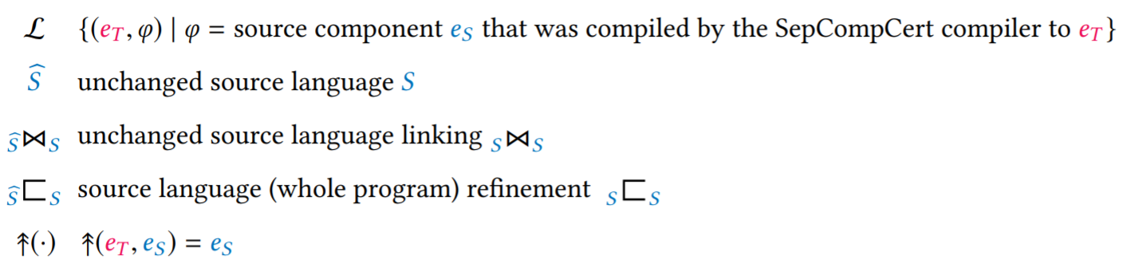
SepCompCert CCC Instantiation
Notes:
What do we actually want to say about this compiler, that is, how do we put these parts together?

Slide 22
GOAL:
Define partial program refinement in terms of

Slide 23











Slide 24
Compositional compiler correctness

Slide 25
There exists a lift function, for any source component and any linkable target component, s.t. linking the target component with a compiled source component refines* lifting the target component and linking it with that source component.

Slide 26
refines*: linking is a partial function that can fail If language linking validation doesn’t fail, and we get a whole program, we get semantics preservation from the source component linked with the lifted target component to the compiled source component linked with the target component.

Slide 27

The empty component can be linked.
Notes:
Used to prove CCC implies whole program correctness

Slide 28

Anything the compiler outputs can be linked.
Notes:
This is how compilers work! Also, even if failed, CCC implies separate compilation because of this.

Slide 29

The lift function ensures that the empty component in the target language is lifted to the empty component in the ST linking medium.
Notes:
Well-defined lift function + CCC implies whole program correctness

Slide 30

Linking a program with the empty component preserves the program’s semantics.
Notes:
Important to ensure source-STLM linking is well-defined; we impose no other restrictions on definition

Slide 31
Lifting is the inverse of compiling.
If a target component refines
a compiled source component,
then the lift of the target component should refine
the source component.
Notes:
Cs, ct are contexts in each language in order to make whole programs and make the semantic inverse work

Slide 32
SepCompCert CCC Instantiation

Slide 33
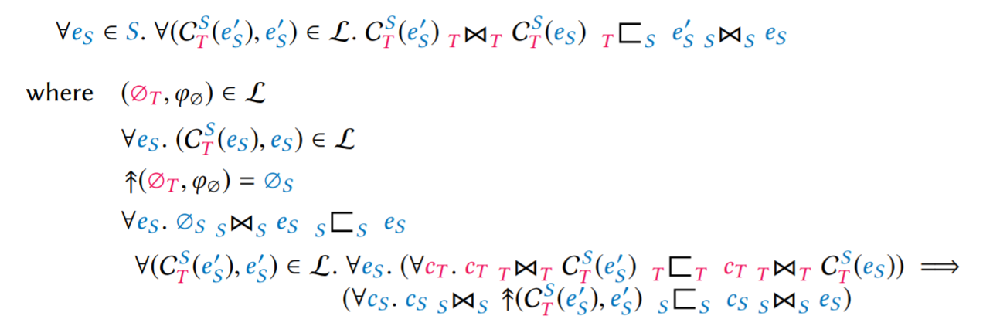
SepCompCert correctness → CCC
Notes:
WTS separate compilation preserves refinement. Implied by SCC correctness.

Slide 34
What is needed to understand CCC?
There’s an upper bound on how much formalism we can take
Explicit parameters
Good for users!
Good for researchers!
Notes:
Users: what do I understand, what can I ignore? Researchers: how much of the formalism is needed to believe the proof?

Slide 35




