Slide 1
Semantic code search via equational Reasoning
Varot Premtoon, James Koppel, Armando Solar-Lezama
Massachusetts Institute of Technology
PLDI 2020
Priya Srikumar
Cornell University
Fall PLDG 2020

Slide 2
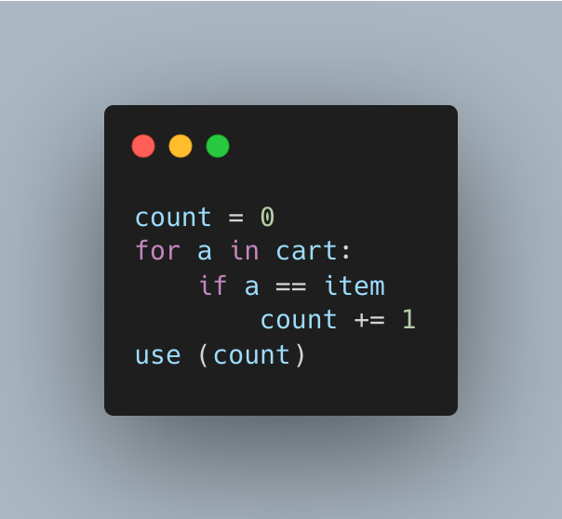

Slide 4
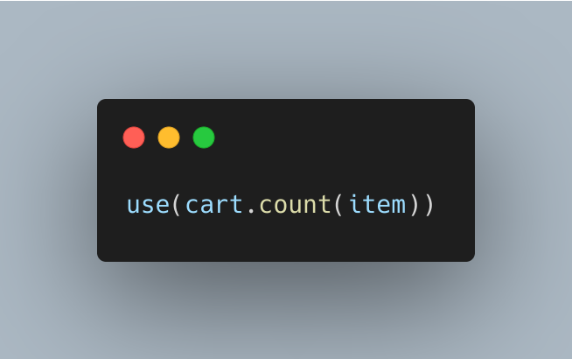

Slide 5
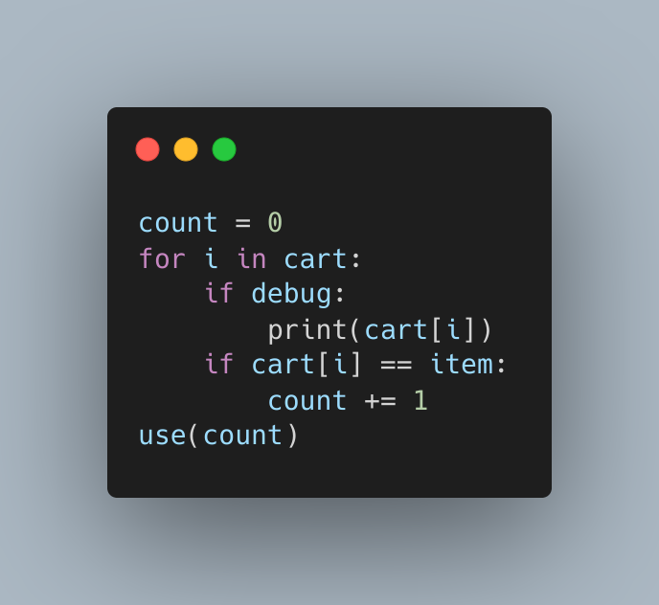

Slide 6
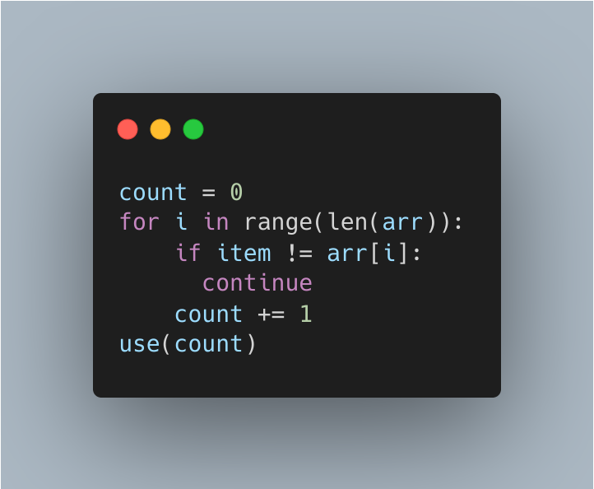

Slide 7
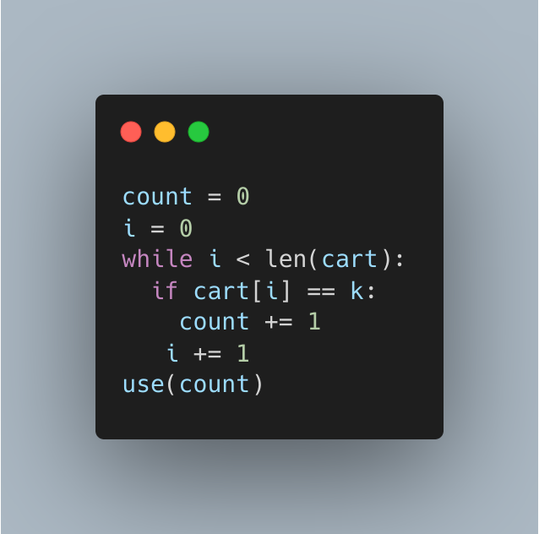

Slide 8
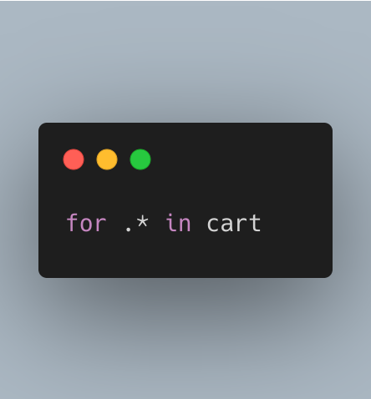

Slide 9
Semantic code search
Scope
Query type
Performance needs
Notes:
scope: single codebase vs the web query: natural language, program fragrment, test cases
performance needs: fast/imprecise vs slow/accurate
here: single codebase, code searches for refactoring -- want exact semantic matches and we’ll pay for it!

Slide 10
You Only Grep Once

Slide 11
Rules
YOGO
Matcher
Search pattern
Translator
Source files
Match results

Slide 12
Operational evaluation
Search patterns gleaned from common StackOverflow questions
YOGO times out on 1% of the methods searched
False negatives due to tool incompleteness and reasoning limitations

Slide 13
Graal
13 static analyzers on top of Graal’s bytecode analysis
YOGO analyzed 1.2 million LOC in 2.5 hours on 30 AWS instances
Generalizing one of the analyzers’ queries revealed a bug it missed!
YOGO query was 60 lines; the analyzer was 330 lines
Notes:
GraalVM is a Java VM and JDK built by Oracle
designed to support language-interoperability and ahead-oftime compilation; its compiler is written in Java.

Slide 14
Usability evaluation
YOGO was straightforward enough to use that the authors outsourced Graal query coding; it only took 3 days to learn!

Slide 15
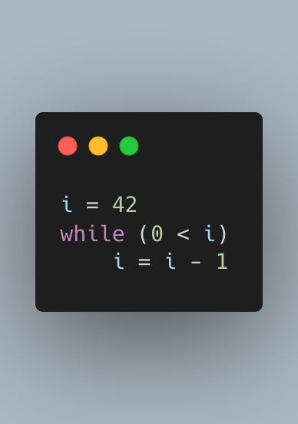
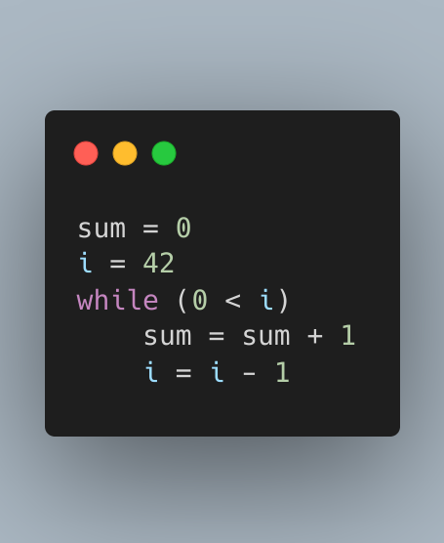

Slide 16
ENTRY
sum = 0
i = 42
while 0 < i
sum = sum + 1
i = i - 1
Notes:
Data dependence + control dependence = interleaving okay! But arithmetic/boolean identities or isomorphic loop structures are not going to work here.
So we either miss a lot of semantic matches using PDGs or get a lot of false positives by grep-ing.

Slide 17
Program Expression Graphs give us an efficient procedure for code equivalence.

Slide 18
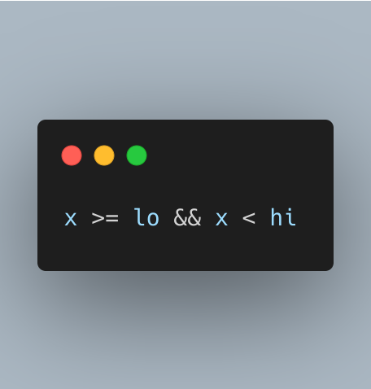
Notes:
Flip inequality, nest as two if statements, chain the inequality, transform inequality to booleans Positive and negative forms of this bound checking + variants with no common tokens can be matched! How?
Use YOGO’s DSL to make a query to it, of course!

Slide 19
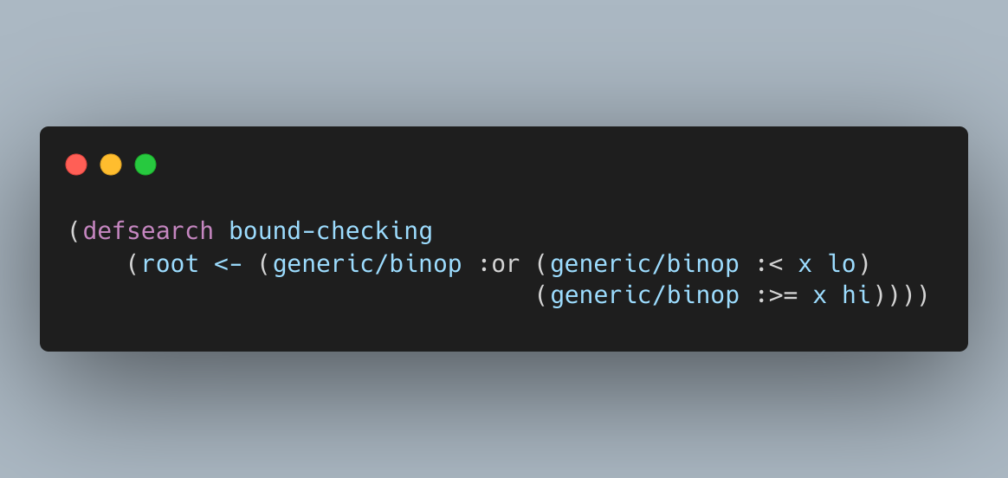
Notes:
With this query, all that is needed is a general set of rules and the files/language desired.
General rules have boolean/arithmetic isomorphisms, i.e. De Morgan’s law. There are also Java and Python specific rule sets. These rules libraries can be augmented by expert users in order to make semantic querying easier for all users.
Let’s see how YOGO determines that this query is equivalent to the code x >= lo && x < hi.

Slide 20
x
lo
hi
x
lo
hi
<
>=
>=
<
and
not
not
or
not
Notes:
Program Expression Graphs take a program’s semantics and turn them into dataflow, even stateful/loopy programs. By applying simple rewrite rules to the graph, we can find equivalent code fragments and get something called an equivalence graph that effectively represents all such fragments.
First, YOGO will apply De Morgan’s law and extends the PEG with these nodes. We add a dashed line between the and and the not to indicate that code that reaches those two nodes are equivalent. Then, we apply the fact that “not a >= b === b < a”. This gives us these sets of nodes to add, again with equivalence lines.

Slide 21
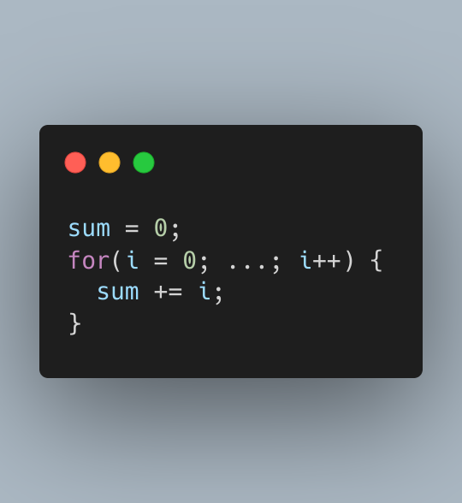
Notes:
I will refer the audience to the paper for a detailed explanation of the denotations of stateful operations. Importantly, the denotations only serve as a framework for proving correctness of equational rules; PEGs are never evaluated in YOGO. Let’s look at how loops are handled in PEGs.

Slide 22
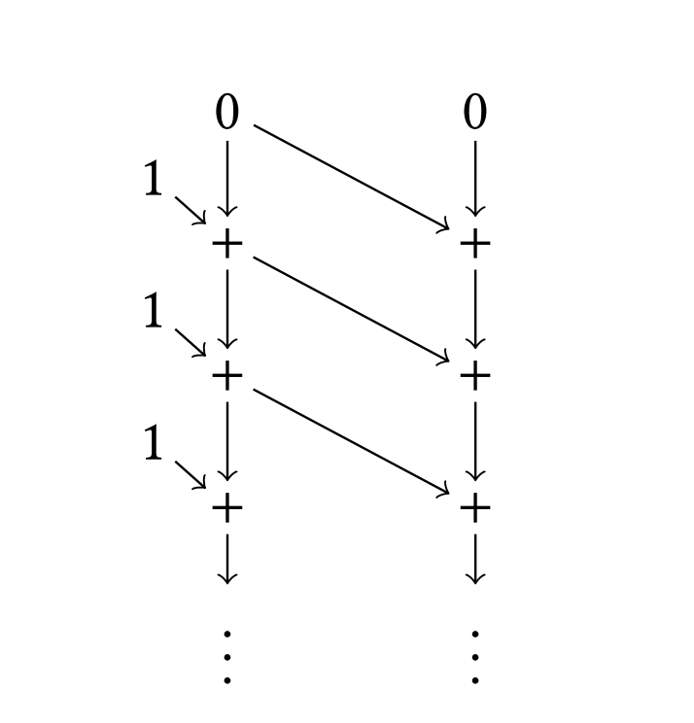
Notes:
A regular dataflow graph will have an infinite number of nodes. But there’s clearly a pattern here we can exploit!

Slide 23
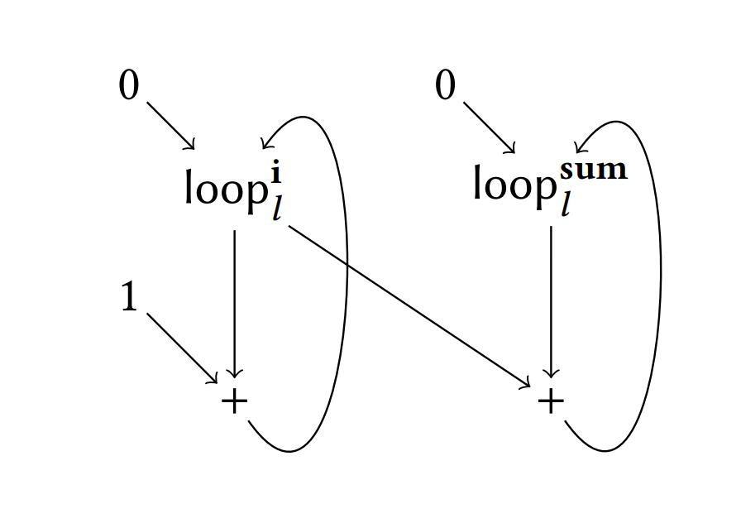
Notes:
What’s happening here? A node in the PEG is not actually a single value, as we've seen up until now. Rather, a node is a (possible infinite) sequence of values parametrized by a vector of natural numbers that indicate what iteration index each loop is in. Here, that vector is just one natural number, since there’s only one loop. So loop^i_l denotes the value of i in an iteration of loop l.

Slide 25
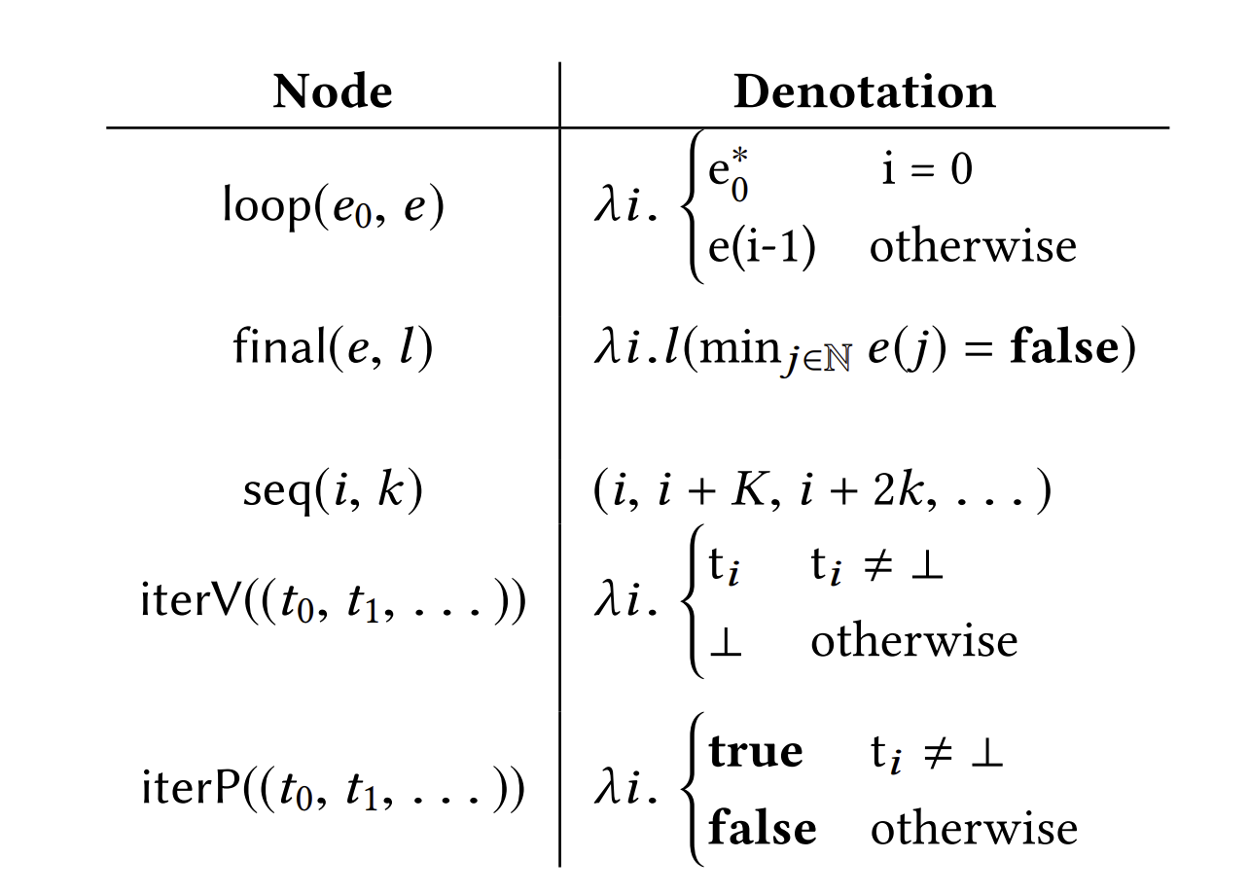
Notes:
loop(e0, e) is an infinite sequence with first element e0 and successive elements computed by e. final(e, l) is the result of iterating over loop l until e is false. It’s interesting to note that even though loop nodes represent infinite sequences, YOGO can still find value sequence that a single loop expression takes, independent in part from the rest of the loop. But that’s not all.

Slide 26
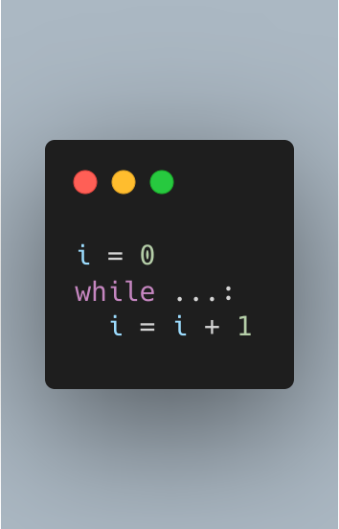
Notes:
This piece of code is actually expressing a more abstract concept than a while loop. It’s a sequential counter!

Slide 27
High-level concepts can be identified as dataflow patterns.

Slide 28
Notes:
seq(i, k) is an infinite sequence of values as described.

Slide 29
Notes:
iterV(seq(i, k) is a value that is i in the loop’s first iteration, i + k in the second, and so on. This makes it really easy to construct a rewrite rule that equates a loop incrementing a value to iterating through a sequence. We can use this to write lots of other rules to recognize varying loop structures, even across languages!
iterP is like iterV, but returns true if the element t_i exists.

Slide 30



Notes:
There is also the question of side conditions, which aren’t expressible in the current language of nodes we have. For conditions such as loop invariance, pure functions, or function independence, there are annotation nodes called auxiliary facts which serve to provide YOGO with more information that may be retrieved from other static analyzers.
With that, we’re pretty much ready to tackle the array frequency count problem we saw at the beginning of this talk. Let’s look at the YOGO query that characterizes all 5 code fragments we saw earlier.

Slide 32
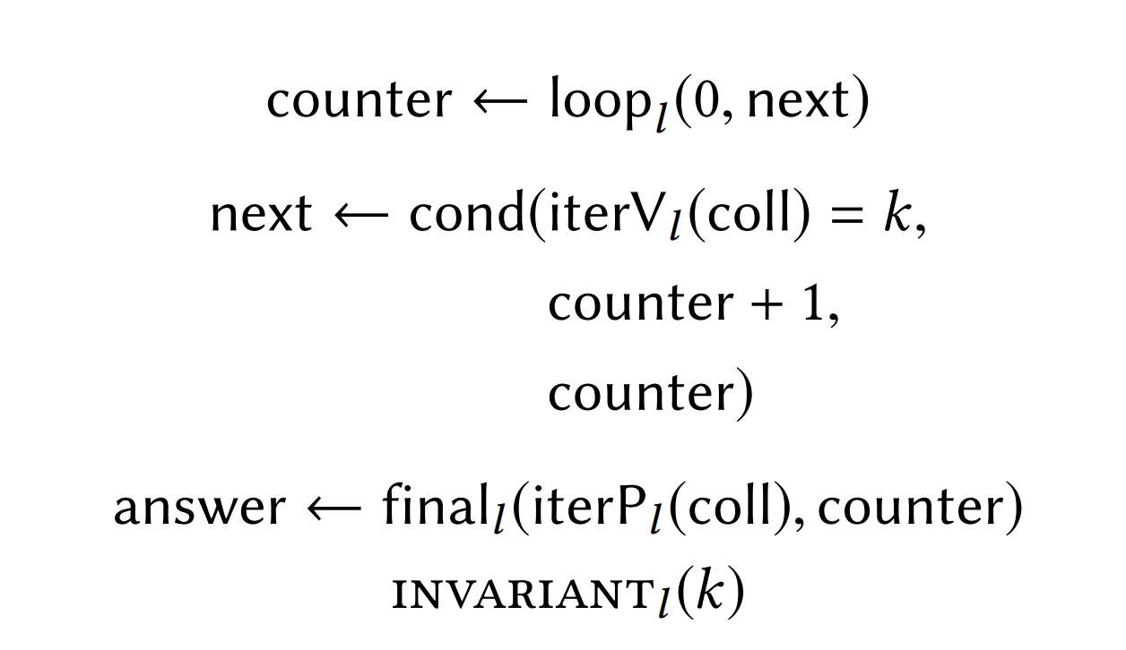

Slide 33
Notes:
The first line is saying that any PEG matching this query has a node counter whose initial value is 0 and whose sequential values may be computed by the expression next.
The second line requires that next must be a conditional node, with a guard comparing between a node k and the current element of the sequence coll. If true, the cond node is the value of incrementing the counter. If false, it’s the value of the counter.
The third line is asking about the value of counter at the end of the loop. Finally, the annotation invariant_l(k) says that k, or the item we’re counting, doesn’t change.

Slide 34
Conceptual rewrite soundness
WTS: Code refines behavior of concept specification
Rewrites must be sound wrt their concept’s state specification
Rule writers prove soundness; users enjoy the benefits!

Slide 35
Key contributions
Coarser notion of equality supports hierarchical abstraction
Higher-level denotations in the DSL = more abstract representations
Not a fixed set of equational rules! User-defined rewrite rules

Slide 36
Limitations
Rewriting is hard: syntactic differences, interleaving, overlapping
DSL cannot handle arbitrarily-nested expressions i.e. f(g(x))
Impure function calls assume no relation between memory states
Interprocedural patterns not supported; cause graph explosion

Slide 37
Comparison to other code search methods
Static analysis abstractions are too coarse
SMT methods struggle with loops and function calls
Other searches do not scale well

Slide 38
Reflections
Code searcher + bug finder
Generality makes abilities hard to characterize
Presents a technique with a lot of reusability

Slide 39






