Slide 1

Analytix Envisage 2021
Analysis Report on Cyber Security

Slide 2
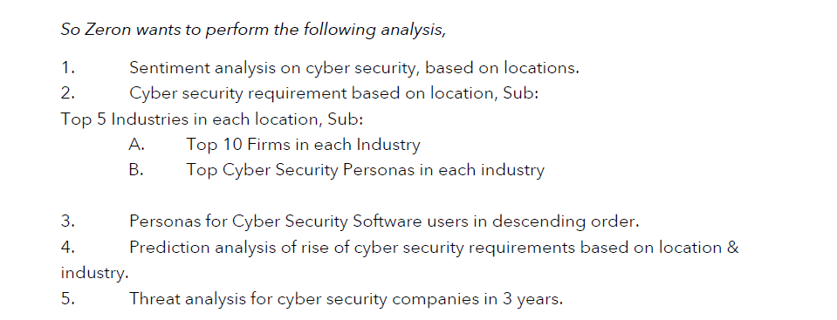
Problem Statement

Slide 3
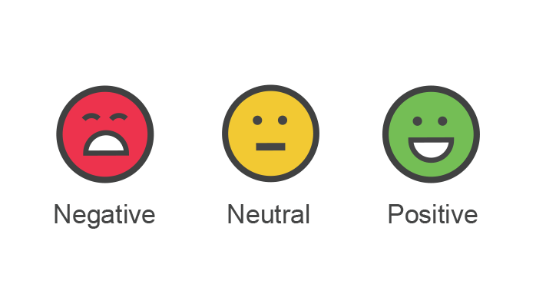
Sentiment Analysis on
CYBER SECURITY
On the basis of location and industry:
1. Information Technology Industry
Locations with positive sentiment –
Africa, Amsterdam, Arizona, Australia, Brazil, Burleson, Carrollton, Clarksville, Columbia, Dublin, Egypt, Florida
Locations with neutral sentiment –
Singapore, Botswana, California, Canada, Colorado, Dubai, England, Finland
Locations with negative sentiment – null
2.Financial Services Industry​
Locations with positive sentiment – ​
Arizona, Bahrain, Colorado, Dubai, Florida, Georgia, Israel, Las Vegas , maryland
​
Locations with neutral sentiment – ​
Beachwood, California, England, India, Massachusetts, Michigan
​
Locations with negative sentiment – null ​

Slide 4
Sentiment Analysis on
CYBER SECURITY
On the basis of location and industry:
1. Government Sector Industry
Locations with positive sentiment –
Alexandria, Australia, Arizona, Australia, California, Canada, Columbia, England, Florida
Locations with neutral sentiment –
Colorado, India, Israel, Istanbul
Locations with negative sentiment – null
2. Retail Industry​
Locations with positive sentiment – ​
Africa, Arizona, Austria, Dubai, Florida
​
Locations with neutral sentiment – ​
Alabama, Colorado, England, India
​
Locations with negative sentiment – null ​
**Other industries do not have much influence on Sentiment analysis on Cyber Security

Slide 5
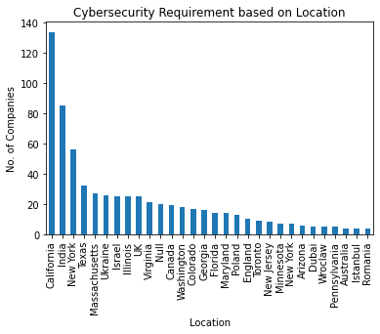
Cyber Security Requirement
Based on location

Slide 6
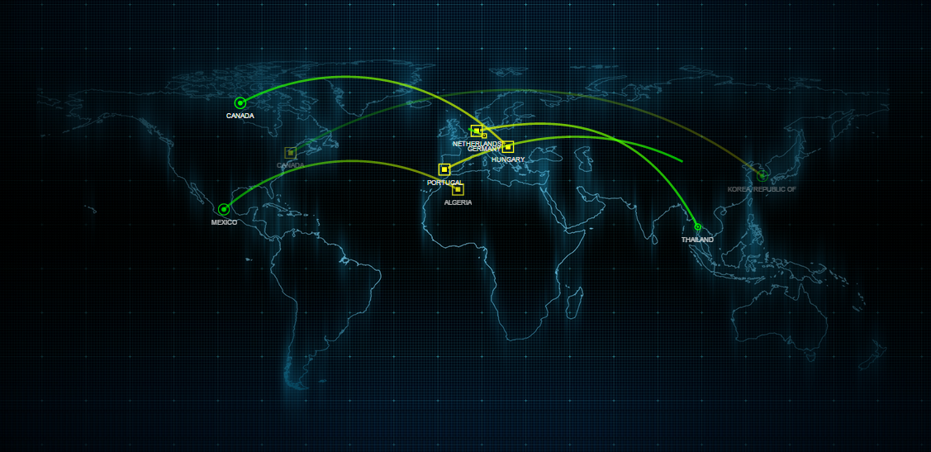
Top 3 Locations :
California
India
New York

Slide 7

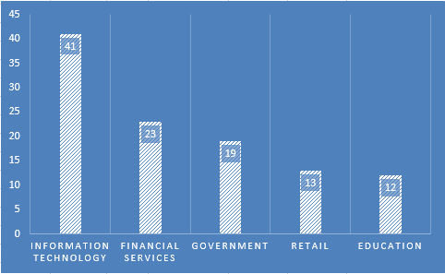
Top 5 Industries of California

Slide 8

Top 10 firms in Information Technology- California
Qualys
Intel Security Group
McAfee
ValiMail
Vectra
OneLogin
Checkr
learFuze Networks, Inc
Breeze IT, Inc.
Netskope

Slide 9

Top 10 firms in Financial Services- California
Coalition
Axis Security
Okta
SPsoft
ZAG Technical Services
CPI Solutions
Orca Security
MNS Group
Mitek
Unit21

Slide 10

Top 10 firms in Government Sector- California
DataEndure
IT Hatch Solutions Inc.
SugarShot
Lookout
RiskIQ
A10 Networks
Ubiq Security
Safe Security (formerly Lucideus)
Palo Alto Networks
Voyagent, Inc

Slide 11

Top 10 firms in Retail Industry- California
Cloudflare
Barracuda
FenceCore IT Solutions
BlairSammons.com
Isovalent
SentinelOne
CyberDuo
Safe Base
Sumo Logic
Be Structured Technology Group, Inc.

Slide 12

Top 10 firms in Education Industry- California
Cisco
A10 Networks
The Azure Cloud Experts
Exabeam
GoGuardian
briteCITY
ANiMODUS
Leverage IT Consulting
DCG Technical Solutions, Inc
Framework Security

Slide 13
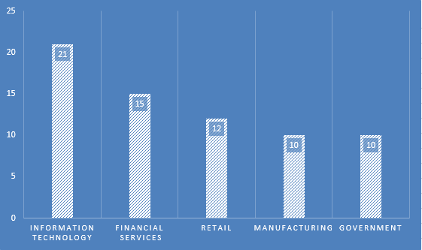
Top 5 Industries of India

Slide 14
Top 10 firms in Information Technology- India
Alchetron
K7 Computing
Geeks Solutions
ImpactQA
Reputation BUILDUP
ConvoSync Solutions
Vervali Systems Pvt Ltd
Exploit Hunters India
ARMOUR INFOSEC PRIVATE LIMITED
Xeliumtech Solutions

Slide 15
Top 10 firms in Financial Services- India
Infrassist Technologies Pvt. Ltd.
IARM Information Security
XenonStack
Real Secure IT Infrastructure LLC
Rapid7
WeSecureApp
Arcon TechSolution
SNDK Corp
MSPAssist
Webshup

Slide 16
Top 10 firms in Retail Industry-
India
Everdata Technologies
Ndimensionz Solutions Pvt Ltd.
Sattrix
Vervali Systems Pvt. Ltd.
ISHIR
MIT Group
Varutra Consulting Pvt. Ltd.
MattsenKumar LLC
Seconaize
Great Software Laboratory

Slide 17

Top 10 firms in Manufacturing Industry-
India
XenonStack
Your Server Doctor
Cyberops Infosec LLP
ToggleNow Software Solutions Pvt Ltd.
Terralogic
Technologics and Controls
Compufy Technolab LLP.
Happiest Minds Technologies
Enfini Labs Tech Consultant
ilantus

Slide 18
Top 10 firms in Government Sector- India
Techvedic
CiELO Technologies
Cyber Security Hive
Threatsys Technologies Pvt. Ltd
Calpion
Kratikal
Aurionpro
MailXaminer
Lucideus
TECHERA SECURITIES

Slide 19
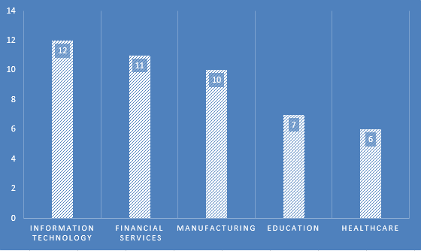
Top 5 Industries of New York

Slide 20
Top 10 firms in Information Technology- New York
Deloitte
Axionus
DefenseStorm
Dragos
Ethyca
HYPR
SecurityScorecard
Siemplify
Digital Edge Ventures
Iospa Tech LLC

Slide 21
Top 10 firms in Financial Services-
New York
HackerOne
M6iT
JS Technology Group
Carden IT LLC
Context Information Security
CRA | Computer Resources of America
Prove
Kualitatem Inc.
7Clouds
RCS Professional Services

Slide 22
Top 10 firms in Manufacturing Industry-
New York
SCADAfence
Dysnix
Red Key Solutions
Reflexions
Leveldesk
iterasec
Claroty
Imagis
Booz Allen
IntSights

Slide 23
Top 10 firms in Education Industry-
New York
IBM iX
Bit by Bit Computer Consultants
SecurityScorecard
Herjavec Group
Havoc Shield
Axonius
TRINUS Technologies
**More data not found

Slide 24

Top 10 firms in Healthcare Industry- New York
UnderDefense
Electric
Middleground Technologies
Dathena Science
SimplicIT
ImpactQA
**More data not found

Slide 25

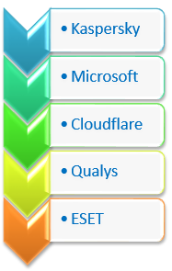
Personas for
Cyber Security Software users
in descending order.

Slide 26

References
https://cybersecurityventures.com/cybersecurity-500/
https://www.esecurityplanet.com/products/top-cybersecurity-companies/
Ratings have been taken from-
https://www.glassdoor.co.in/member/home/companies.htm

Slide 27
Thank You
Analysis Done By
1. Vikas Kumar Saw
2. Priyasu Guin
3. Uttkarsh Ranjan

