Slide 1
KARNAUGH MAP MINIMIZER
DATA STRUCTURES AND ALGORITHMS
19BCE1853-Arsh
19BCE1858-Shruti
19BPS1054-Priyadarshini.s

Slide 2
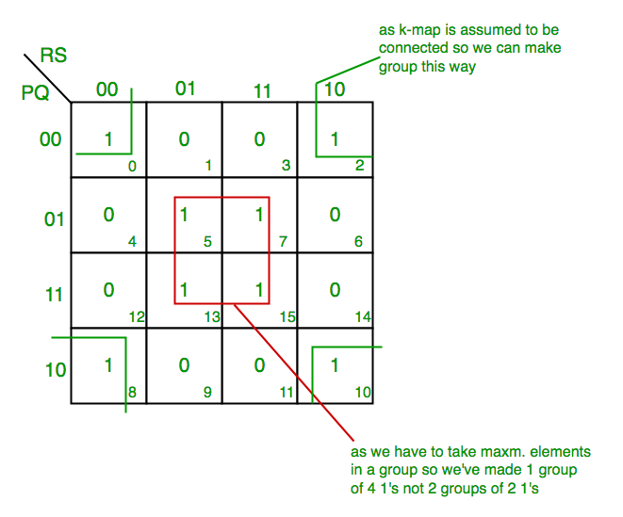
PROBLEM STATEMENT:
This project is developed to solve Karnaugh map using Quine-Mc luscky algorithm and Petrick’s method.

Slide 3
OUR APPROACH:
Divide all the minterms (and don’t cares) of a function into groups
Merge minterms from adjacent groups to form a new implicant table
Repeat step 2 until no more merging is possible
Put all prime implicants in a cover table (don’t cares excluded)
Identify essential minterms, and hence essential prime implicants
Add prime implicants to the minimum expression of F until all minterms of F are covered.
So after simplification through QM method, a minimum expression for the function F is found.

Slide 4
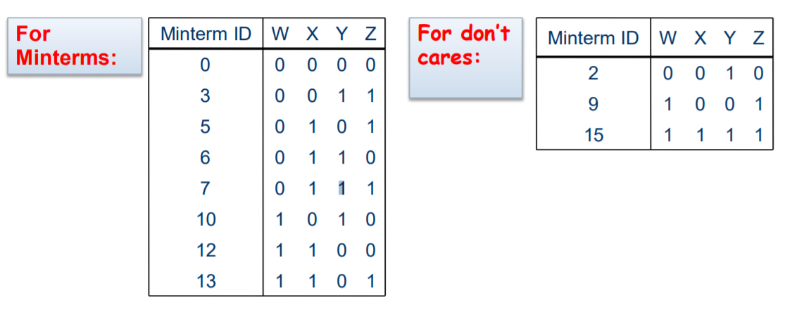
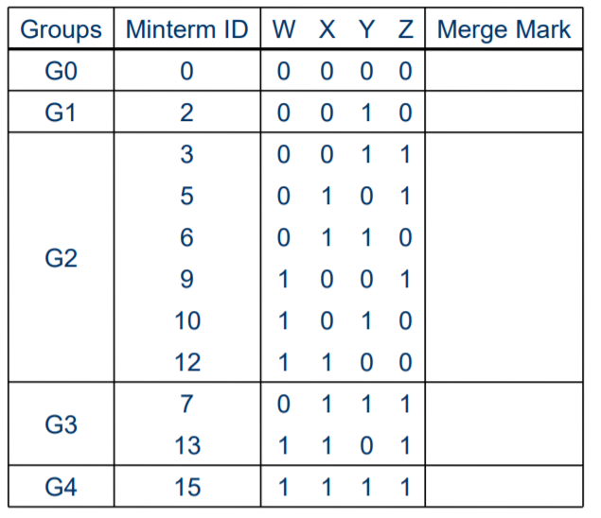
Let us consider a function :
F(W, X,Y,Z) =∑m(0,3,5,6,7,10,12,13)+∑d(2,9,15)

Slide 5
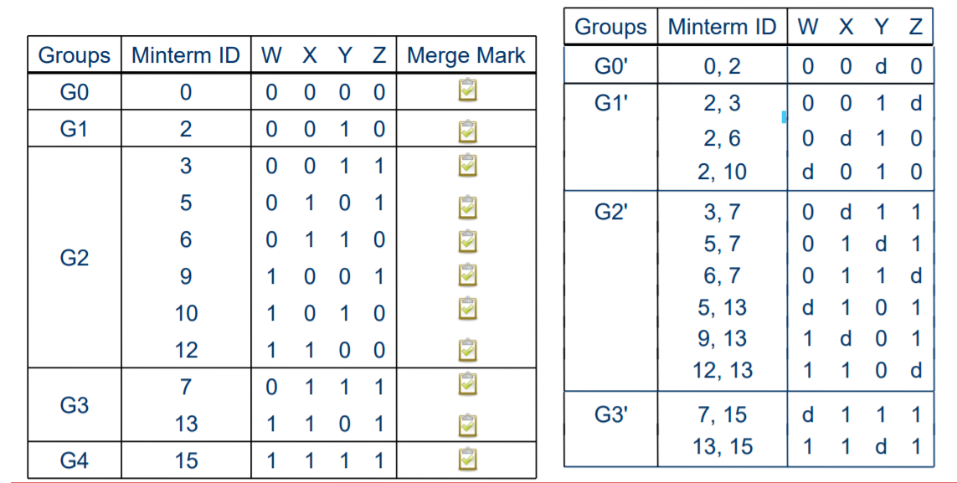
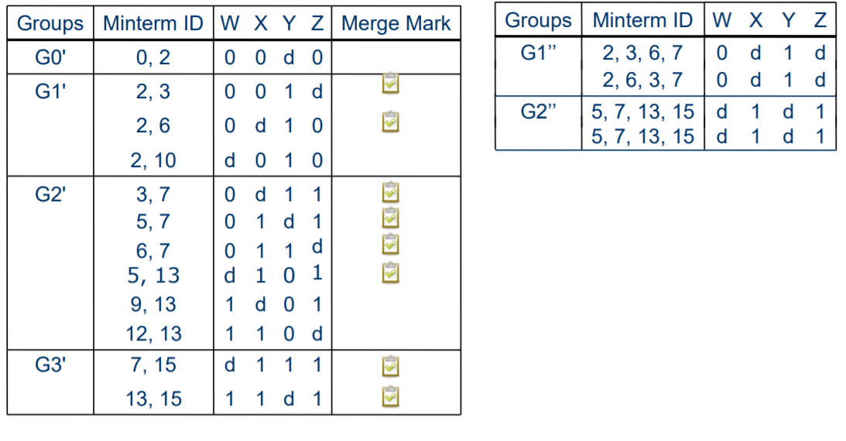
Step 2:
Step 3:

Slide 6
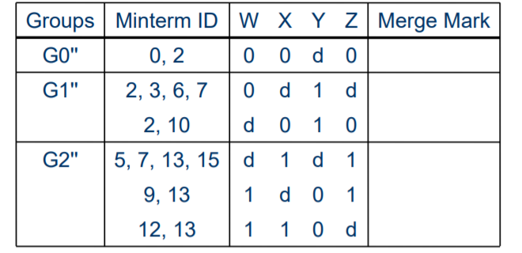
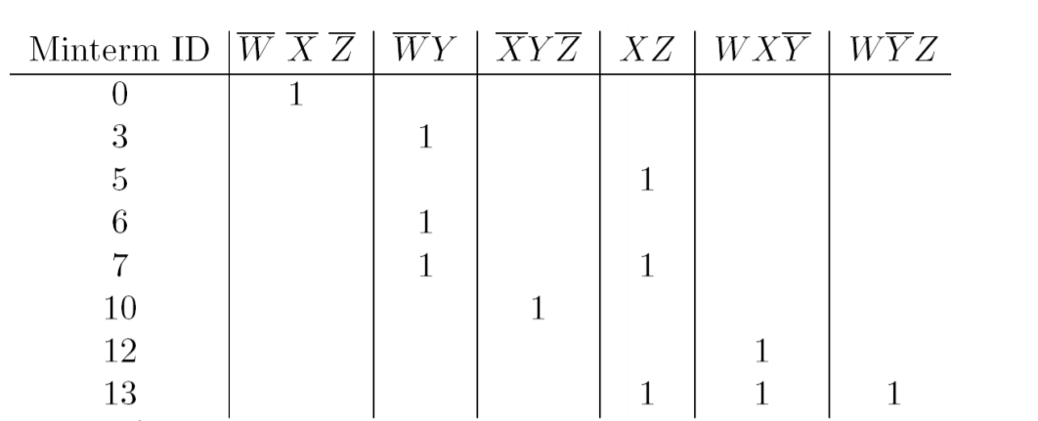
No more merging possible!
Step 4:

Slide 7
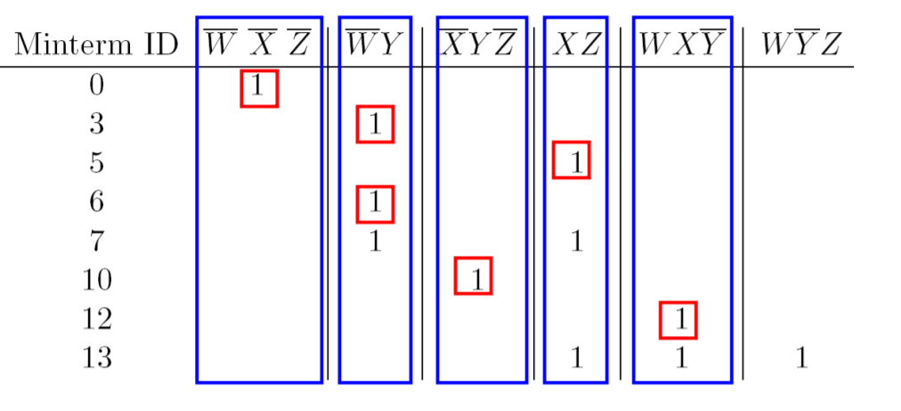
Step 5:
Already covered all minterms!
Therefore , minimum expression for F(W, X, Y, Z) is: F(W, X ,Y, Z) =W’ X’ Z’ +W’Y + X’Y Z’ + XZ +WX Y’

Slide 8
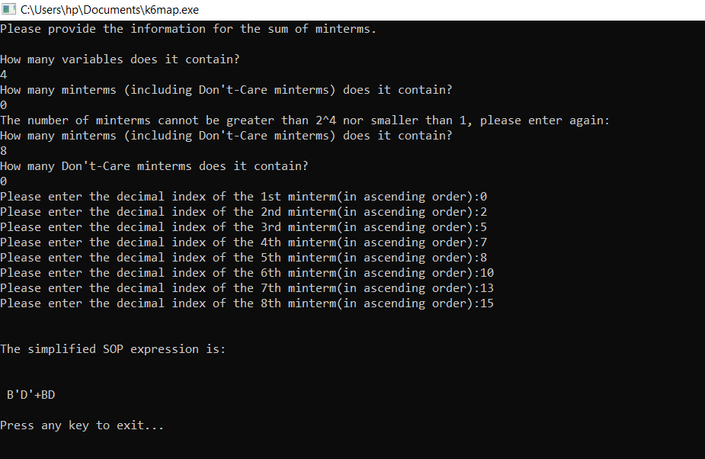
SAMPLE INPUT & OUTPUT:
INPUT: F(P,Q,R,S)=∑(0,2,5,7,8,10,13,15)

Slide 9
THANK YOU!

