Slide 1


FNCE 3490 – DATA SCIENCE AND BUSINESS ANALYTICS
MARYAM MAJEED | PRIYA SUCHAK | SHANTANU INDRA

Slide 2

YELP
PROJECT GOALS
1.
Introduction to Yelp and its dataset
2.
Dataset Analysis
3.
Factors defining quality of reviews
4.
Rating Prediction

Slide 3


YELP
MISSION
Connecting people with
great local businesses
Businesses, both small and large, use Yelp
platform to engage with consumers at the critical moment when they are deciding where
to spend their money.

Slide 4


YELP
YELP
INSIGHTS
2.2M reviews and 591K tips by 552K users for 77K businesses
566K business attributes, e.g., hours, parking availability, ambience
Aggregated check-ins over time for each of the 77K business
27% of consumers regularly use online reviews to determine whether a local business is a good business (vs. 22% in 2010)
There’s a decline in the number of reviews being read by consumers – they are forming opinions faster and trusting reviews more.
The continued growth of mobile internet usage suggests that more and more consumers will be searching and finding local businesses online

Slide 5

DATASET
ANALYSIS

Slide 6
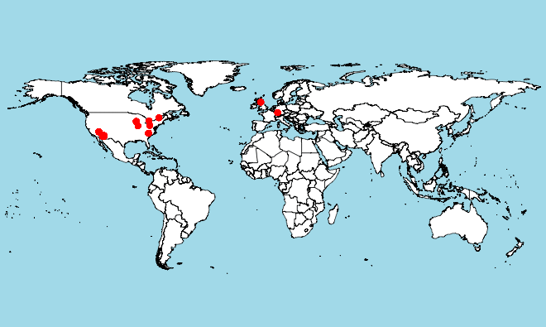

ANALYSIS
BUSINESS DISTRIBUTION

Slide 7
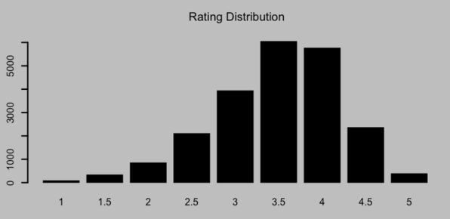
ANALYSIS
DISTRIBUTION OF RATINGS
No of Restaurants
Ratings

Slide 8
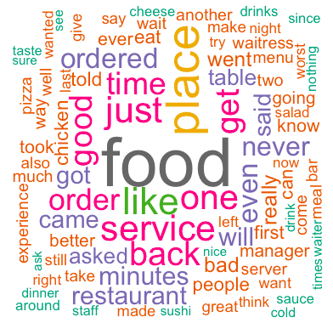

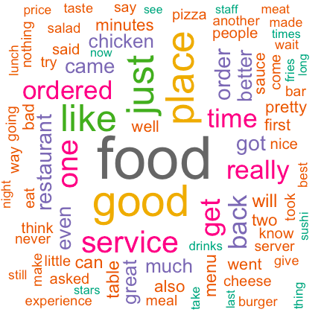
WORDCLOUDS
RATING 1
RATING 2

Slide 9

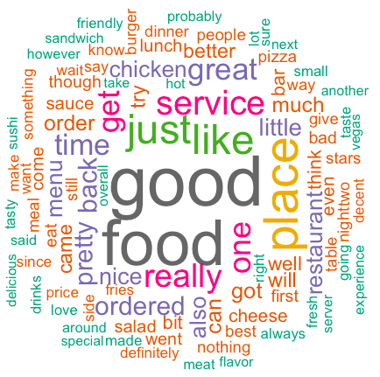
WORDCLOUDS
RATING 3

Slide 10
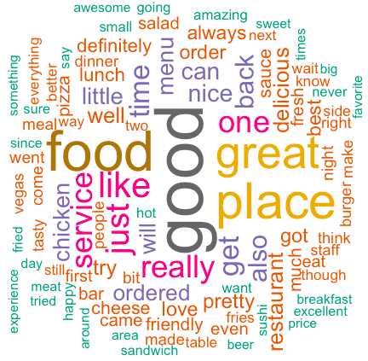
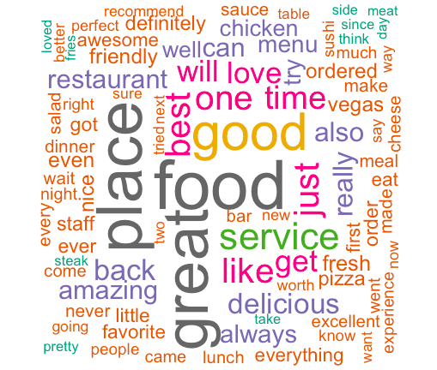
WORDCLOUDS
RATING 4
RATING 5

Slide 11


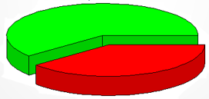
ANALYSIS
MOOD SCORING OF RATING 3
POSITIVE
NEGATIVE

Slide 12
QUALITY OF
REVIEWS

Slide 13
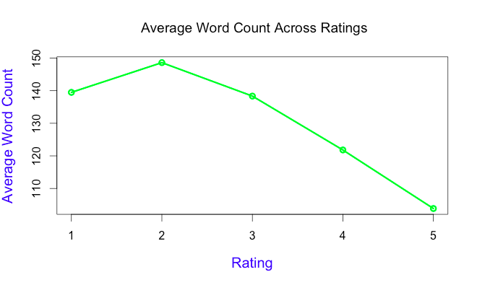
ANALYSIS
WORDCOUNT vs RATING
Analysis: Lower ratings have longer review texts, as the users describe the reasons for low rating which is untrue for higher ratings

Slide 14
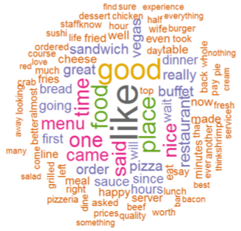
ANALYSIS
TOP 25 REVIEWS

Slide 15
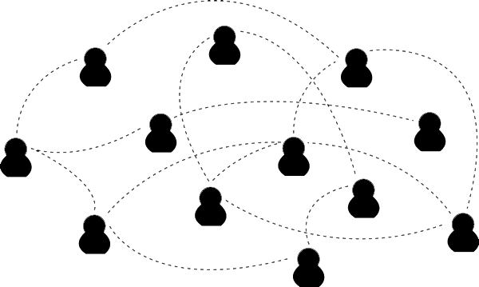
ANALYSIS
READABILITY: GUNNING FOG INDEX
Gunning Fog Index measures ‘Readability’ of text
Index estimates the years of formal education needed to understand the text on a first reading
A fog index of 12 requires the reading level of a U.S. high school senior (approx. 18 years old)
Texts for a wide audience generally need a fog index less than 12
Texts requiring near-universal understanding generally need an index less than 8

Slide 16
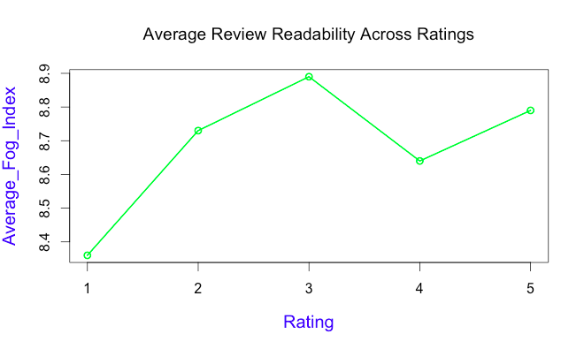
ANALYSIS
FOG INDEX vs RATING
Analysis: On average a yelp review has readability of a ‘High School Freshman student’

Slide 17
RATING
PREDICTION

Slide 18
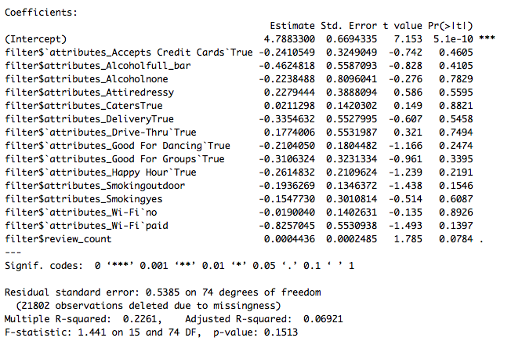
PREDICTION
FACTORS AFFECTING RESTAURANT’S RATING
Analysis:
Do’s:
Drive through
Catering
Free Wi-Fi
Review counts
Don’ts:
Smoking zone
Bar incidents
Dance Floor

Slide 19
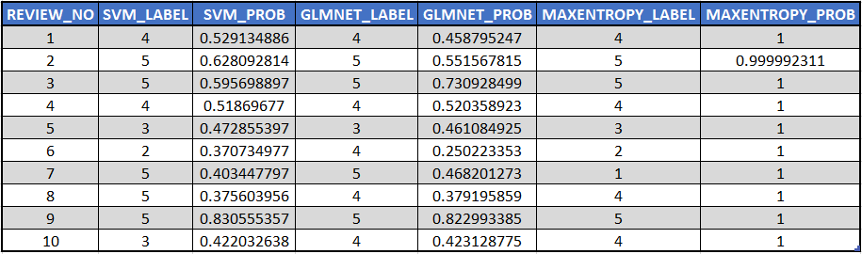

PREDICTION
RATING PREDICTION WITH RTEXT TOOLS
Analysis: All 3 models predict similarly with no major distinguishing factors

Slide 20
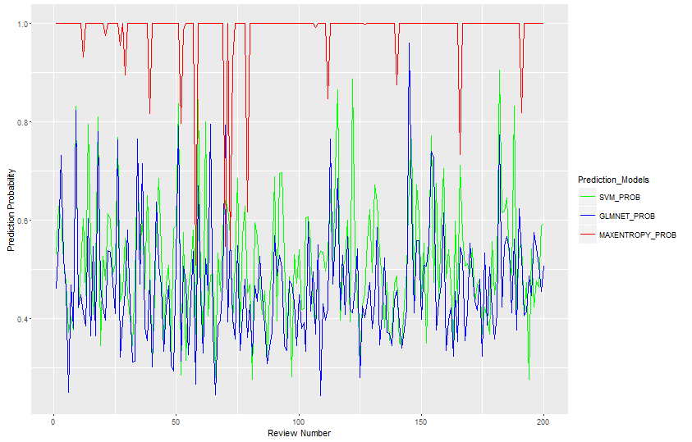
PREDICTION
PROBABILITY ACROSS TEST DATA
Prediction Probability
Review #

Slide 21
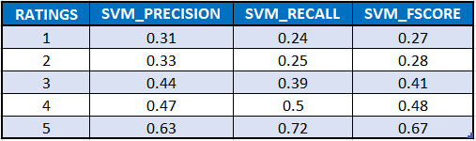
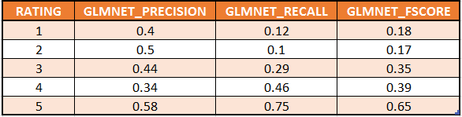

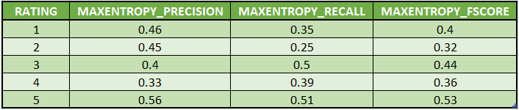
PREDICTION
MODEL PERFORMANCE
Analysis:
Highest level of performance is indicated by F score value of 1 and lowest level of performance by 0

Slide 22
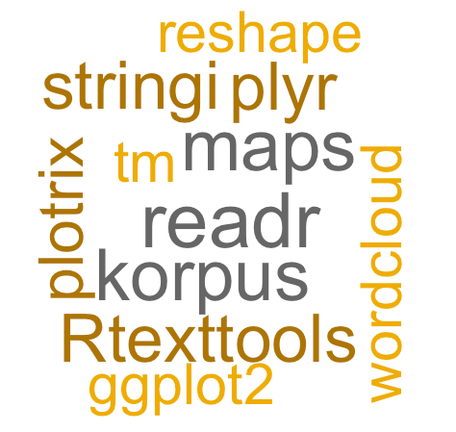
UTILS
PACKAGES USED
readr
koRpus
RTextTools
stringi
plotrix
maps
ggplot2
reshape
plyr
tm
wordcloud

Slide 23
THANK YOU!!
QUESTIONS??

