Slide 1

Online Signature Verification
Under the guidance and supervision of:
Dr. Sonali Agarwal
IIIT - Allahabad
Lavan Kumar - IIT2014078
Sharath Chandra - IIT2014056
Priyatham - IIT2014057

Slide 2
Introduction
Signatures can be broadly categorized into two categories
1) Offline Signatures
2) Online Signatures
Offline signatures are those that take place on paper and analysis of them can be carried out only when information of a signature on paper is somehow extracted and stored digitally.
Online Signatures on the other hand are signatures that take place on an electronic device that are capable of recording the movement of signature at a fixed interval of time, digitally.
Therefore, x-y coordinates of the user’s signatures along with attributes like pressure, time and pen up/down are also acquired.

Slide 3

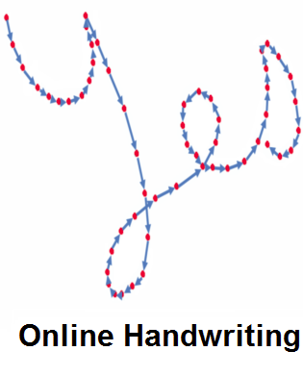
Online Signature
Offline Signature
ImageSource:^{[16]}
ImageSource:^{[16]}

Slide 4
Motivation
Biometric recognition and verification systems have existed for over a century and are extremely crucial to every industry to keep their information and data secure.
There are many biometric verification systems like finger print scanning, face recognition, iris scanning, and voice recognition etc.
But cost of deploying for some systems is extremely high and some of the systems are not portable.
In-order to find a middle ground between efficiency, effectiveness in mass quantity and portability, we take a deeper look into signature verification which can be deployed using mobile devices to produce fruitful results.

Slide 5
Literature Survey
Sl.No | Title/Broad Area and year of publication | Details about Frameworks/Algorithms used | Details about Tools, Datasets | Summary of the research outcome
1. | Online Signature Verification on Mobile Devices-2014 | An online signature is represented with a discriminative feature vector derived from attributes of several histograms that can be computed in linear time. The resulting signature template is compact and is verified with other signature for genuine or forgery. | The algorithm was first tested on the well-known MCYT-100 and SUSIG data sets | The results demonstrate the problem of within-user variation of signatures across multiple sessions and the effectiveness of cross session training strategies to alleviate these problems
2. | Embedded System for Biometric Online Signature Verification -2014 | 1. Field-programmable gate arrays (FPU) 2. Vector floating-point unit (VFPU) 3. DTW 4. Gaussian mixture model (GMM) | MCYT-100 data set of signatures | Acceptance rate And rejection rate are calculated.
3. | Dynamic Signature Verification System Based on One Real Signature-2016 | 1. Dynamic time wrapping. 2. Hidden Markov model | MCYT-100 data set of signatures | Experimental results suggest that our system, with a single reference signature, is capable of achieving a similar performance to standard verifiers trained with up to five signature specimens

Slide 6
Literature Survey
Sl.No | Title/Broad Area and year of publication | Details about Frameworks/Algorithms used | Details about Tools, Datasets | Summary of the research outcome
4. | Dynamic Signature Verification System Based on One Lengedre polynomials Based feature extraction for online signature verification .Consistency analysis of feature combinations- 2014 | 1. Legendre polynomials 2. Support Vector Machines 3. Random Forests. | SigComp2011 dataset, it consists of Chinese and western dataset. | Results show that there is a good correlation between the consistency factor and the verification errors, suggesting that consistency values could be used to select the optimal feature combination.
5. | Offline Handwritten Signature Verification using Neural Network-2015 | 1.Neural network technique 2.Resilient back-propagation 3.Radical basic function | Using a database of 2106 signatures containing 936 genuine and 1170 forgeries | The accuracy of their system is 86.25. Their neural network says whether a signature is forged or genuine.
6. | Online Signature Verification Based on DCT and Sparse Representation-2015 | 1) Discrete Cosine Transform 2) Sparse Representation | Sabancı University’s Signature Database (SUSIG)-Visual and SVC2004 databases, | Proposed method authenticates persons very reliably with a verification performance which is better than those of state-of-the-art methods on the same databases.
7. | Robust Score Normalization for DTW-Based On-Line Signature Verification-2015 | 1. Dynamic time wrapping 2. Score normalization | SUSIG and MCYT dataset of signatures | The results demonstrate that score normalization is a key component for signature verification and that the proposed two-stage normalization achieves some of the best results on these difficult data sets both for random and for skilled forgeries

Slide 7
Literature Survey
Sl.No | Title/Broad Area and year of publication | Details about Frameworks/Algorithms used | Details about Tools, Datasets | Summary of the research outcome
8. | Offline Handwritten Signature Verification System Using a Supervised Neural Network Approach - 2014 | 1) Artificial neural network based on the well-known Back-propagation algorithm is used for recognition and verification. 2) To test the performance of the system, the False Reject Rate, the False Accept Rate, and the Equal Error Rate (EER) are calculated. | Dataset of 1524 signatures from various resources | The experimental results for the accuracy speed and throughput showed excellent measurements that are comparable to the benchmark algorithms in the domain.
9. | New method for the on-line signature verification based on horizontal partitioning - 2014 | Flexible Mamdani-type neuro-fuzzy system is used | SVC2004 and BioSecure Database | Simulations have shown that velocity signal plays more important role than pressure signal in the classification process of dynamic signature.
10. | Identity authentication using improved online signature verification method - 2005 | 1) Dynamic time wrapping 2) Bayes Classifier 3) SVM 4) Principal component Analysis | A data set of 94 people and 619 test signatures (genuine signatures and skilled forgeries) from various resources. | 1.4% overall error rate in classifying the signatures (genuine and forgeries).

Slide 8
Problem Statement
The problem is to verify whether given signature is genuine or forgery of a particular user.

Slide 9
Methodology
We implemented two methods :
Method 1
Data Acquisition
Data Pre-processing
Feature Extraction
Feature Modelling
Classification
Fig. 3: Image shows the flow chart of proposed methodology

Slide 10
Data Acquisition
We did our process on two datasets :
SUSIG online dataset
Data collected from Android Application

Slide 11
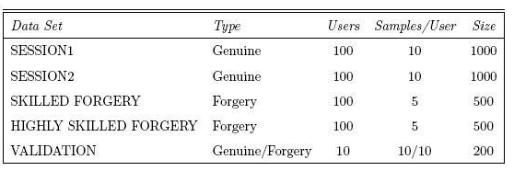
Information of Dataset Acquired
(SUSIG Online Signature Dataset)
100 people - 2000 genuine and 1000 skilled forgery signatures.
Visual and Blind subcorpus.
X, Y, TStamp, Pressure, Pen Up/Down
ImageSource:^{[17]}
Dataset Link : http://biometrics.sabanciuniv.edu/susig.html ^{[17]}

Slide 12
Signature Representation
X = {x1, x2, . . . , xn},
Y = {y1, y2, . . . , yn},
P = {p1, p2, . . . , pn}
X , Y represents coordinates of a signature at n instances.
P represents pressure values at n instances of a signature.
X , Y , P collectively represent a users signature

Slide 13
Data Pre-processing
The following are the steps in data pre-processing :-
1) Filtering
2) Linear Interpolation
3) Size Normalization

Slide 14
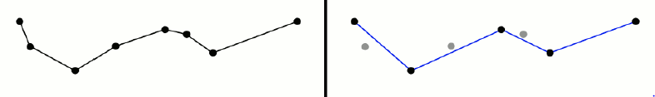
Data Pre-processing
Filtering:
Filtering is done to remove noise from signature
Ramer-Douglas-Peucker algorithm is used for filtering
After applying number of coordinates decreased in signature
Signature looks crisp and noise is removed
Fig. 5 (Left) Curve before applying Ramer-Douglas-Peucker Algorithm
(Right) Curve after applying Ramer-Douglas-Peucker Algorithm (ImageSource:^{[16]} )

Slide 15
Data Pre-processing
Linear Interpolation:
Since we need constant number of points for every signature
of any individual, interpolation is done to find unknown points in
the signature
Linear Interpolation is used to find those points
Size Normalization:
Size normalization is done because no individual can do
signatures of same size every time he does signature
Hence Size normalization is necessary
Every point is normalized between 0 and 1

Slide 16
Feature Extraction
Following are the list of features that were taken into consideration :-
1) 250 interpolated and scaled x coordinates
2) 250 interpolated and scaled y coordinates
3) Pressure
4) Number of pen-up’s and downs

Slide 17
Feature Modelling
After feature extraction we will have 10 genuine and 10 forgery signature files. Now we combine all the genuine and forgery files into one file and add an additional feature at the end which represents whether the signature is genuine or forgery by setting a 1 or 0 for that feature. Now for all users we make each file and make this as a final feature vector.

Slide 18
Classification
Support Vector Machine :
Support Vector Machine is a classification algorithm which is used to find the optimal separating hyper-plane (example, a plane in a 3-dimensional space) that maximizes the margin (distance between the hyper-plane’s and the closest data point) of the training data because it classifies unseen data to the best of its abilities. SVM finds a linear separating hyper-plane with the maximum margin in the higher dimensionally.

Slide 19

Classification
Random Forest Classifier:
Random forest grows several classification trees. It works as follows:
1) Let D be the training Dataset and it generates k bootstrap samples of D. Each
bootstrap sample D(i) consists same number of tuples as that of D by
sampling and replacing from D (i.e, some original tuples and some duplicated
tuples of D).
2) For each D(i) a decision tree is constructed and k decision trees are formed.
3) Decision tree algorithm uses Gini index for tree generation.
Where, pi is the probability of a tuple that belong to a class in training dataset D.

Slide 20


Gini index gives the impurity of a dataset D.
This gives the Gini index of d by binary split on A( attribute) and splits into D1 and D2.
This gives the reduction in impurity by splitting D on attribute A.
To classify a given test tuple X, each tree classification result is counted and X is classified with a class having the maximum count.

Slide 21
Method 2 in Methodology
As in the above method we use the data but without performing pre-processing we directly split the data into bins and make feature vectors.
Feature vector is concatenation of bins of different attributes of the signature.
The attributes taken are k^{th} derivative of x and y coordinates, as well as k^{th} derivatives of pressure.
X^{k} = { x_{i}^{k} | x_{i}^{k} = x_{i+1}^{k-1} – x_{i}^{k-1} }
Y^{k} = { y_{i}^{k} | y_{i}^{k} = y_{i+1}^{k-1} – y_{i}^{k-1} }
P^{k} = { p_{i}^{k} | p_{i}^{k} = p_{i+1}^{k-1} – p_{i}^{k-1}}
F = { B₁│|B₂|│|B₃|│ … . │| B_{k} | }
Where k represents total no of histograms and vector B_{i} contains bin frequencies of an i^{th} histogram. Therefore, an online signature is represented by a feature vector F which consists of bin information.

Slide 22
Software and Hardware Requirements
Software and Hardware Requirements
Software Requirements
Python 2
Hardware Requirements
5.0” or 5.5” LCD display smart-phone with high processing power.
OS: Ubuntu
Dataset Requirements
SUSIG Online Signature Dataset (5000 Signatures)
Dataset Link : http://biometrics.sabanciuniv.edu/susig.html ^{[17]}
Self-developed data set (100-150 Signatures)

Slide 23
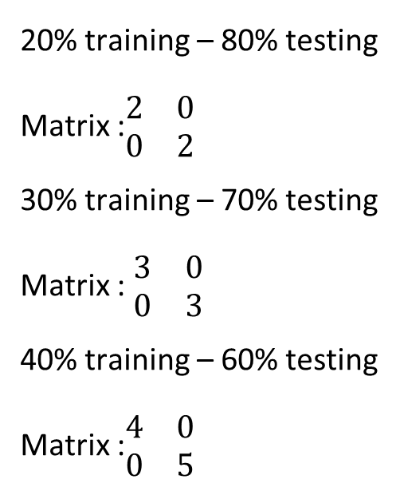
Results
SUSIG Dataset :
20% training – 80% testing
Matrix :$\begin{matrix}2 & 0 \\ 0 & 2\end{matrix}$
30% training – 70% testing
Matrix : $\begin{matrix}3 & 0 \\ 0 & 3\end{matrix}$
40% training – 60% testing
Matrix :$\begin{matrix}4 & 0 \\ 0 & 5\end{matrix}$

Slide 24
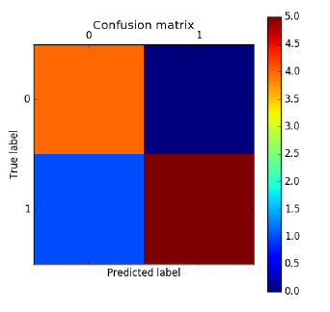
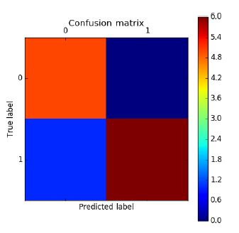
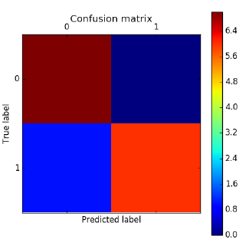
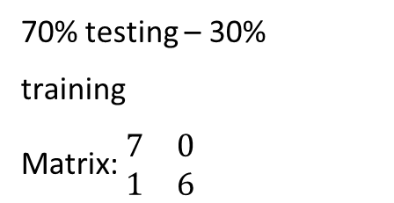
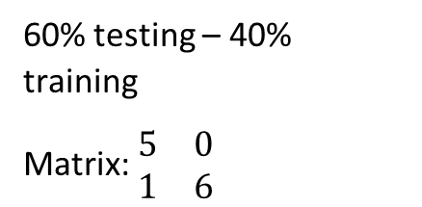
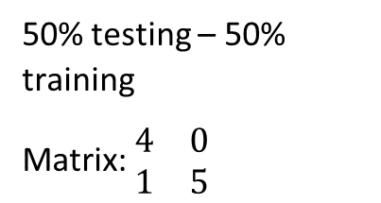
50% testing – 50% training
Matrix: $\begin{matrix}4 & 0 \\ 1 & 5\end{matrix}$
60% testing – 40% training
Matrix: $\begin{matrix}5 & 0 \\ 1 & 6\end{matrix}$
70% testing – 30%
training
Matrix: $\begin{matrix}7 & 0 \\ 1 & 6\end{matrix}$

Slide 25
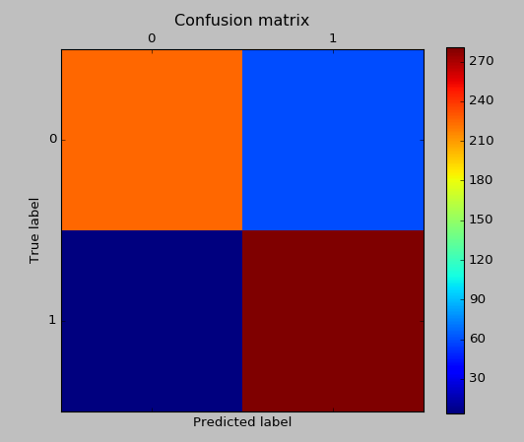
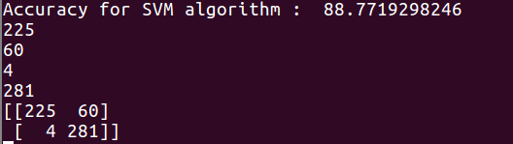
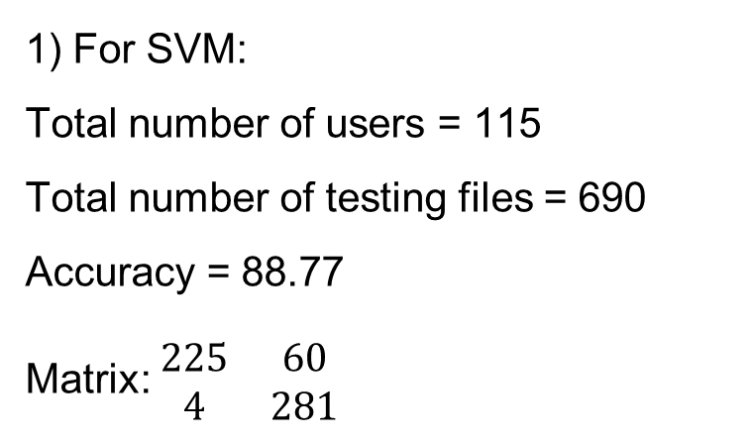
Cumulative Results :
1) For SVM:
Total number of users = 115
Total number of testing files = 690
Accuracy = 88.77
Matrix: $\begin{matrix}225 & 60 \\ 4 & 281\end{matrix}$

Slide 26
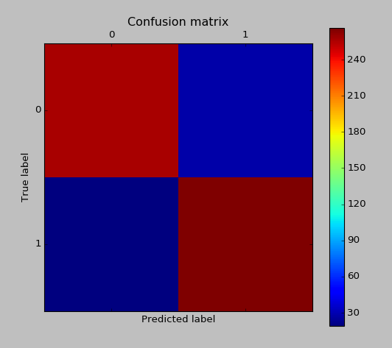
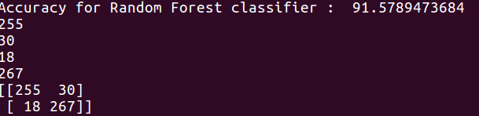
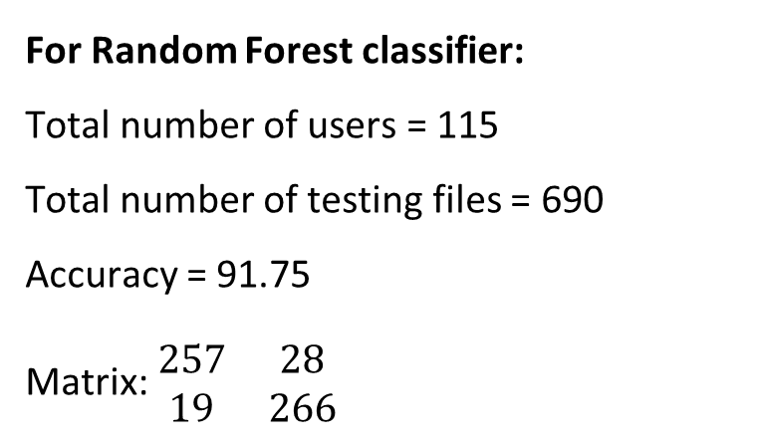
For Random Forest classifier:
Total number of users = 115
Total number of testing files = 690
Accuracy = 91.75
Matrix: $\begin{matrix}257 & 28 \\ 19 & 266\end{matrix}$

Slide 27
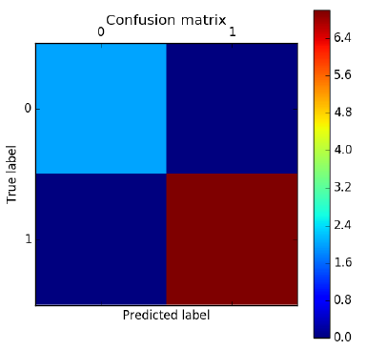
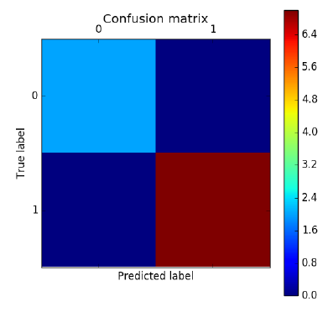
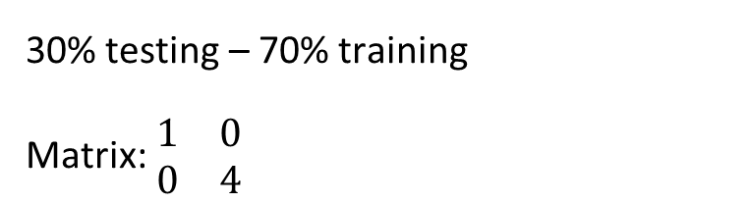
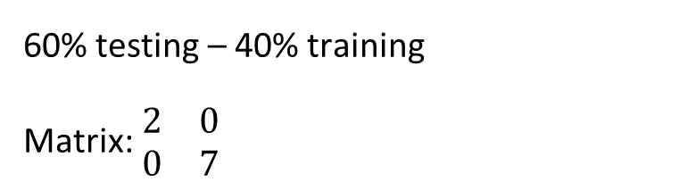
Dataset collected by our Android Dataset :
30% testing – 70% training
Matrix: $\begin{matrix}1 & 0 \\ 0 & 4\end{matrix}$
60% testing – 40% training
Matrix: $\begin{matrix}2 & 0 \\ 0 & 7\end{matrix}$

Slide 28
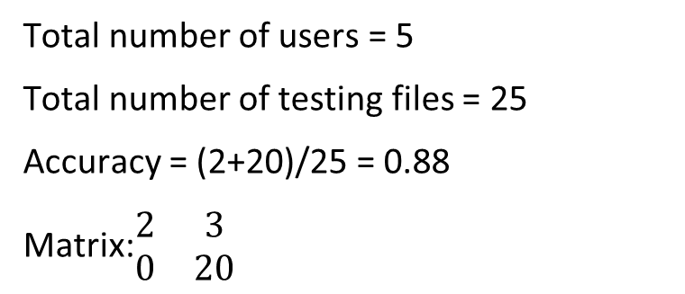
Cumulative Results :
Total number of users = 5
Total number of testing files = 25
Accuracy = (2+20)/25 = 0.88
Matrix:$\begin{matrix}2 & 3 \\ 0 & 20\end{matrix}$

Slide 29
Comparison
Table. 2: Table showing accuracy using different methods and classifiers
Methods | SVM | Random Forest
Method-1 | 80.1 | 83.3
Method-2 | 88.64 | 91.13

Slide 30
Conclusion
It can be concluded from the above table that Method-2 got higher accuracies than Method-1 and also Random Forest out performs SVM in both the methods. Hence it is better to use Random Forest algorithm for online signature verification. We are acquiring good accuracies comparable to other algorithms in this field.

Slide 31
References
[1] Napa Sae-Bae and Nasir Memon, “Online Signature Verification on Mobile Devices”, IEEE transactions on
information forensics and security, Vol. 9, No. 6, June 2014.
[2] Mariano López-García, Rafael Ramos-Lara, Oscar Miguel-Hurtado, and Enrique Cantó-Navarro, “Embedded
System for Biometric Online Signature Verification”, IEEE Transactions on industrial informatics, Vol. 10,
NO. 1, February 2014.
[3] Moises Diaz, Andreas Fischer, Miguel A. Ferrer, Réjean Plamondon, “Dynamic Signature Verification System
Based on One Real Signature”, IEEE Transactions on Cybernetics 2016.
[4] Marianela Parodi, Juan C.Gómez, “Legendre polynomials based feature extraction for online signature verification.
Consistency analysis of feature combinations”, Elsevier Volume 47, Issue 1, January 2014, Pages 128-140.
[5] Pallavi V. Hatkar, Prof.B.T.Salokhe, Ashish A.Malgave, “Offline Handwritten Signature Verification using Neural
Network”, International Journal of Innovations in Engineering Research and Technology [IJIERT], Vol 2, Issue 1,
Jan 2015.
[6] Yishu Liu, Zhihua Yang, and Lihua Yang, “Online Signature Verification Based on DCT and Sparse
Representation”, IEEE Transactions on Cybernetics,Vol 45, No. 11, Nov 2015.
[7] Andreas Fischer, Moises Diaz, Rejean Plamondon, Miguel A. Ferrer, “Robust Score Normalization for
DTW-Based On-Line Signature Verification”, 2015 13th International Conference on Document Analysis and
Recognition (ICDAR).

Slide 32
References
[8] Krzysztof Cpałka, Marcin Zalasiński, “On-line signature verification using vertical signature partitioning”,
Elsevier Volume 41, Issue 9, July 2014, Pages 4170 - 4180.
[9] Mujahed Jarad, Dr. Nijad Al-Najdawi, Dr. Sara Tedmori, “Offline Handwritten Signature Verification System
Using a Supervised Neural Network Approach”, IEEE 2014 6th International Conference on CSIT.
[10] Alisher Kholmatov, Berrin Yanikoglu, “Identity authentication using improved online signature verification
method”, Elsevier Volume 26, Issue 15, November 2005, Pages 2400-2408
[11] Krzysztof Cpałka, Marcin Zalasiński, Leszek Rutkowski, “New method for the on-line signature verification
based on horizontal partitioning”, Elsevier Volume 47, Issue 8, August 2014, Pages 2652-2661.
[12] D.S. Guru and H.N. Prakash, “Online Signature Verification and Recognition : An Approach Based on Symbolic
Representation”, IEEE Transactions on Pattern Analysis and Machine Intelligence, Vol. 31, No. 6, June 2009.
[13] Christian Gruber, Thiemo Gruber, Sebastian Krinninger, and Bernhard Sick, “Online Signature Verification with
Support Vector Machines Based on LCSS Kernel Functions”, IEEE Transactions on Systems, Man and
Cybernetics – Par: B Cybernetics, Vol. 40, No. 4, Aug 2010.
[14] J.G.A. Dolfing, E.H.L. Aarts and J.J.G.M. van Oosterhout, “On-line Signature Verification with Hidden Markov
Models”, Fourteenth International Conference on Pattern Recognition, 20 Aug 1998.
[15] Hao Feng, Chan Choong Wah, “Online signature verification using a new extreme points warping technique”,
Elsevier Volume 24, Issue 16, December 2003, Pages 2943-2951.

Slide 33
References
[16] Mokrzycki, Wojciech & M, Samko. (2012). New version of Canny edge detection algorithm. 533-540.
[17] @article{SUSIG, author="Kholmatov, A. and Yanikoglu, B.", Title="SUSIG: an on-line signature
database, associated protocols and benchmark results", journal="Pattern Analysis and Applications",
volume = {12}, number = {3}, year = {2009}, pages = {227-236}}
[18] @article{author = “Alexandre KOWALCZYK”,link = “https://www.svm-tutorial.com/2015/06/svm-
understanding-math-part-3”, year = {2015}}

Slide 34
THANK YOU

