Slide 1
FOOD BUSINESS-NEW YORK

Slide 2
Predicting a suitable place for food business
New York is considered as financial capital of America and it is also a best place for small businesses those runs shop in Main Streets.
It has five boroughs namely, Manhattan, Queens, Brooklyn, Bronx, Staten Island.
There are many small scale business run by people in New York like jewellery, saloons,
brewery, florist shops, and restaurants, which is considered as the most common business.

Slide 3
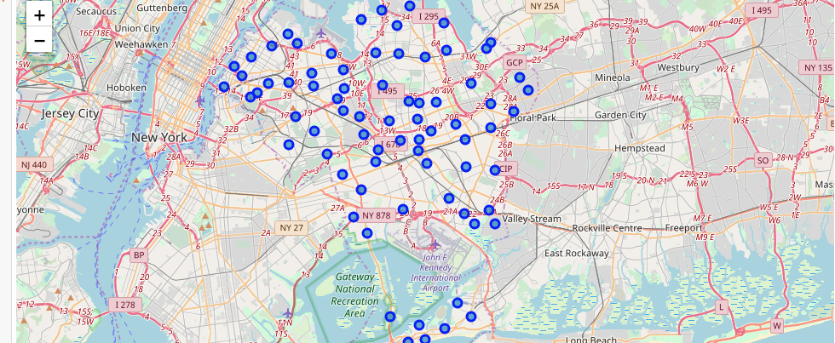

Slide 4
Problem
A businessman wants to open a restaurant in a prime location of New York that meets people expectations for unique cuisine and quality food and inturn make a profitable business.

Slide 5
Data Acquisition and cleaning
Requried data’s are collected
Missing data’s are filled
Duplicates and unwanted data’s are removed

Slide 6
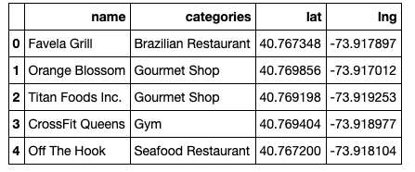
Data Analysis
Exploring Queens
Detail study gives the information about “Neighborhood”, “Venues”

Slide 7
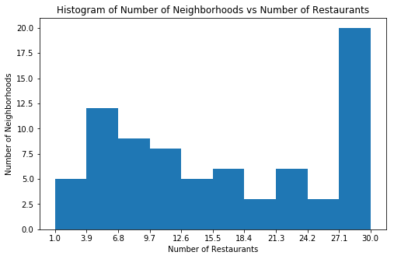
Relationship between Neighborhood and Restaurants
Number of restaurants in each neighbourhood

Slide 8
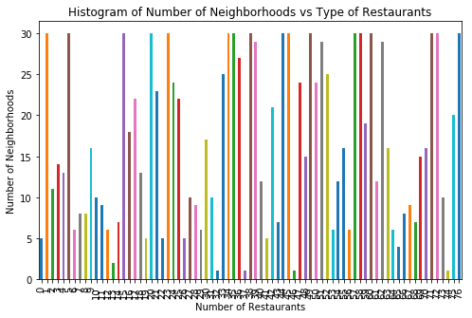
Restaurants are groped based on cuisine and number cuisines in the Neighborhood is found.

Slide 9
The information about the top five restaurant and bottom five restaurant in each neighbourhood is collected.
Information about the menus, unique recipe, kids special, of each cuisine is collected.

Slide 10
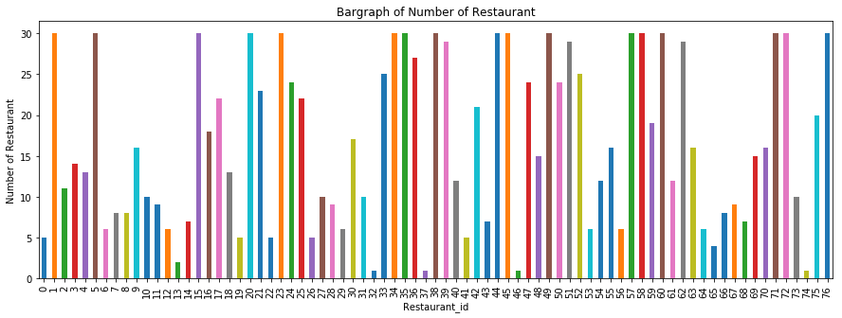

Slide 11
Relationship with population
Total number of population and number of restaurant in each neighborhood is evaluated.
Number of restaurant per 1000 people is calculated.
Number of people in each race and the corresponding number of cuisine is calculated.
Number of cuisine per 1000 people of particular race is calculated.
percentage of people who likes to go near to have their food and the percentage of people who likes to go for nearby restaurant

Slide 12
Age of the population is noted.
The neighborhood with more number of venues like theatre, gym, park, museum etc are the places where more number of people will come.

Slide 13
conclusion
Based upon analysis done with neighborhood, population, restaurant etc we found that “Astoria” is a best place to open a restaurant.

