Slide 1

NAMMA YATRI BUSINESS LEADERSHIP INSIGHTS
BY
PRIYADHARSHNI V
RUSHITHA
RINKLE DAS

Slide 2
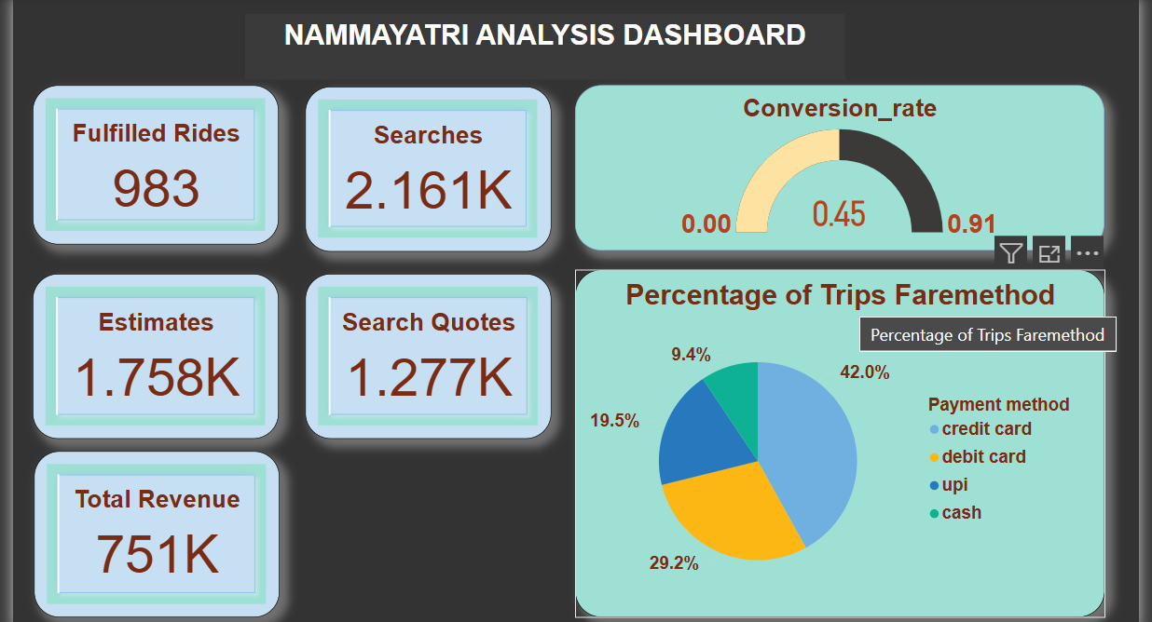

Slide 3
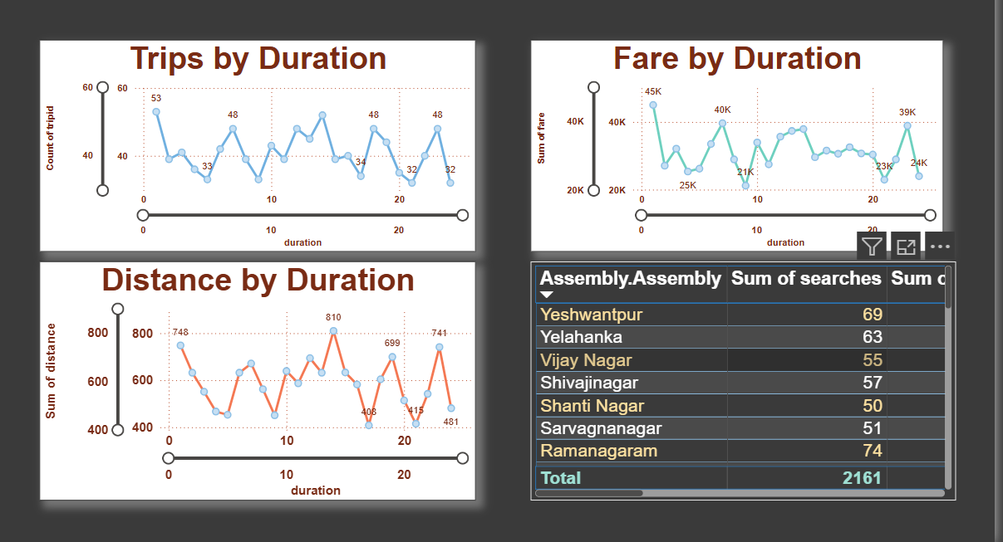

Slide 4
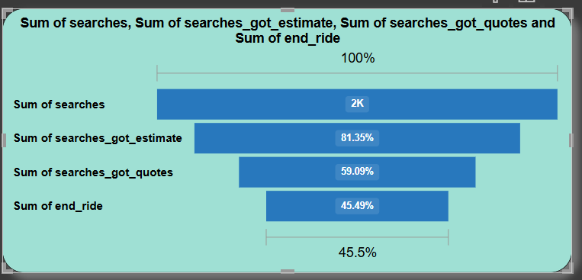

Slide 5
Executive Summary
Namma Yatri has a ~45% ride fulfillment rate.
Major drop-offs in the booking funnel post quote.
Opportunity to optimize service coverage and conversion.

Slide 6

Current Platform Performance
Searches: 2,161K
Fulfilled Rides: 983
Revenue: ₹751K
UPI Usage: 42%
High-demand zones: Ramanagaram, Yeshwantpur

Slide 7
Customer Behavior Trends
UPI dominates payments, followed by card methods.
Most rides are 10–20 minutes, the typical urban commute pattern.
Wait times and driver availability affect conversion.

Slide 8
Operational Challenges
High drop-off after ride quotes.
Inconsistent driver supply in peak zones.
Low fulfillment in some high-search areas.

Slide 9
Strategic Focus Areas
Improve driver availability where demand peaks.
Introduce funnel optimization (quotes to fulfillment).
Encourage UPI via incentives or reward programs.

Slide 10
Business Impact Goals
Target conversion rate: from 45% to 60%.
Increase completed rides per day.
Reduce cancellations and drop-offs.

Slide 11
Recommendations Summary
Deploy more drivers in high-demand locations.
Offer customer incentives post-quote stage.
Promote UPI via cashback or digital rewards.

Slide 12
Next Steps
Implement pilot improvements in one zone.
Track conversion funnel metrics post-intervention.
Plan quarterly performance reviews aligned with KPIs.

