Slide 1

NAMMA YATRI BUSINESS LEADERSHIP INSIGHTS
BY
PRIYADHARSHNI V

Slide 2
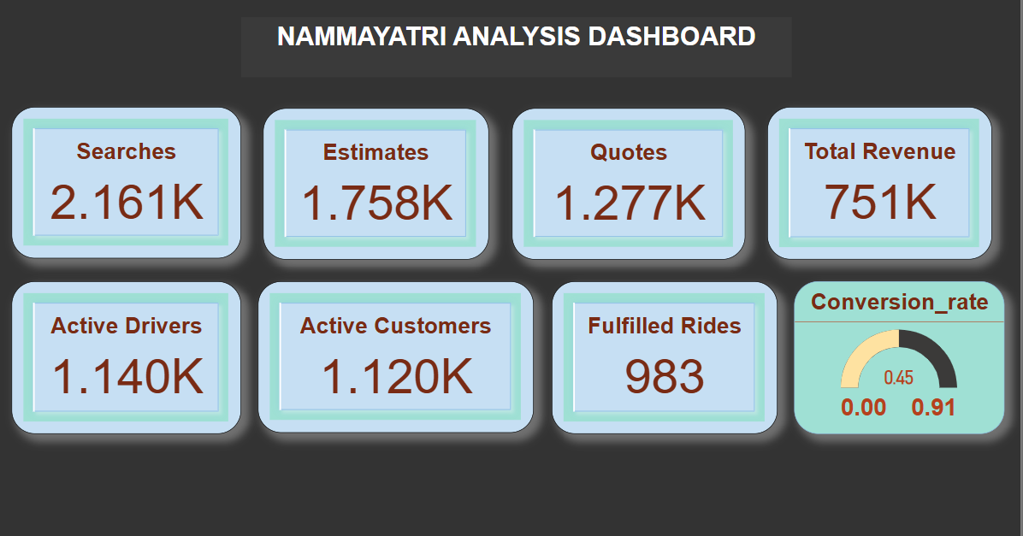

Slide 3
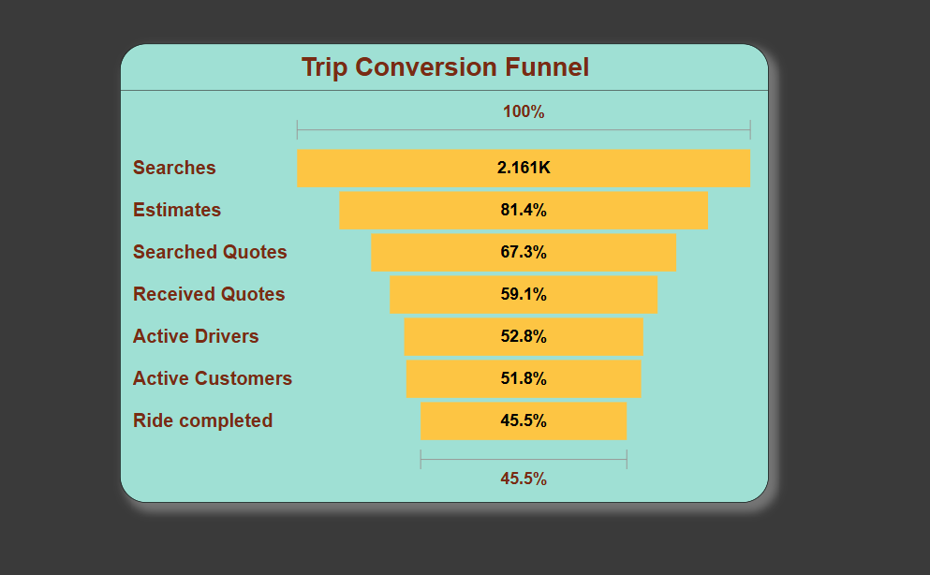

Slide 4
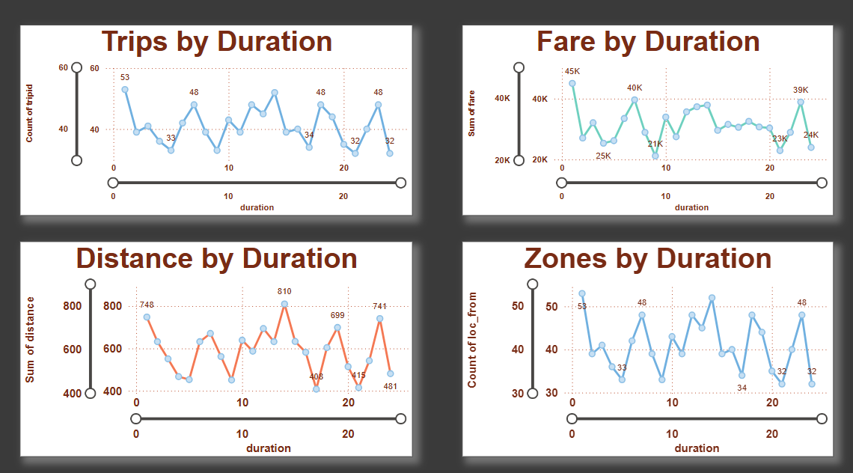

Slide 5
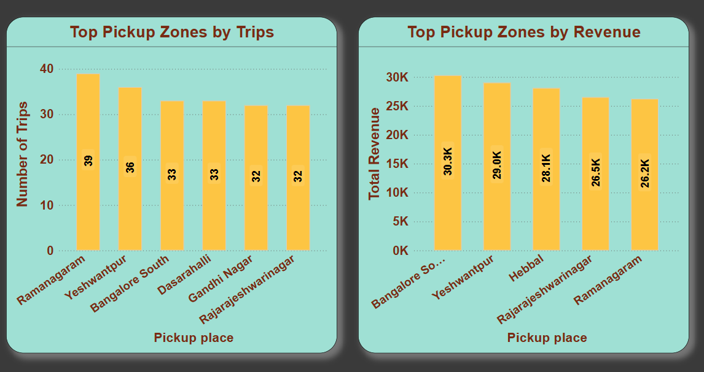

Slide 6
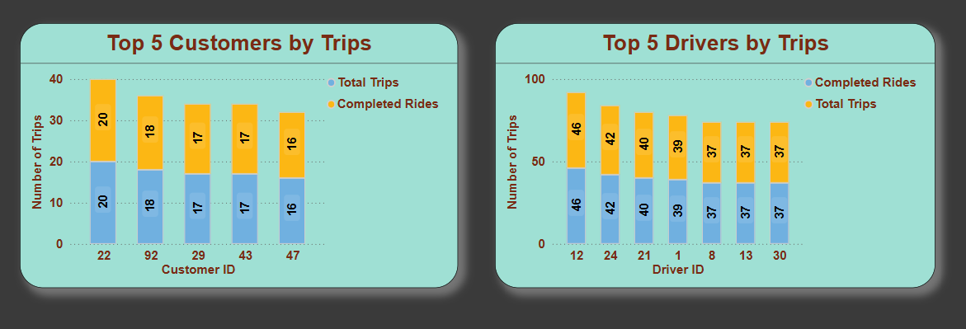

Slide 7
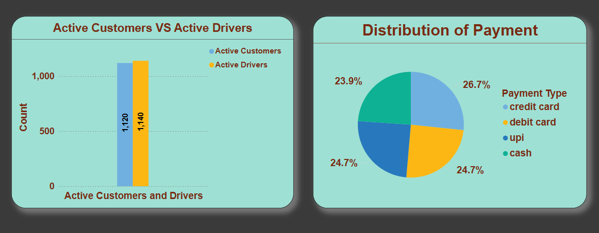

Slide 8
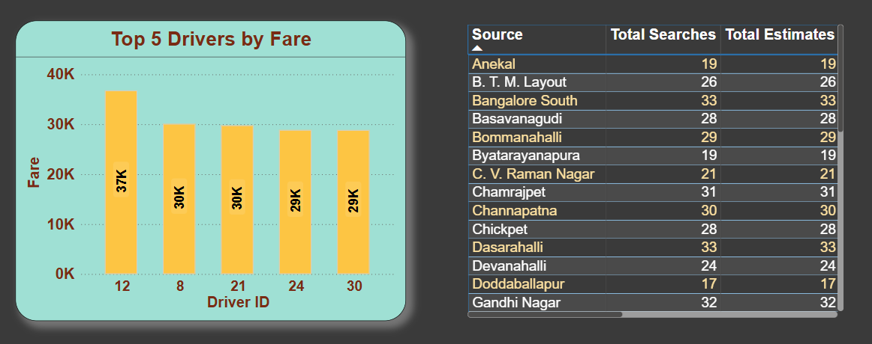

Slide 9
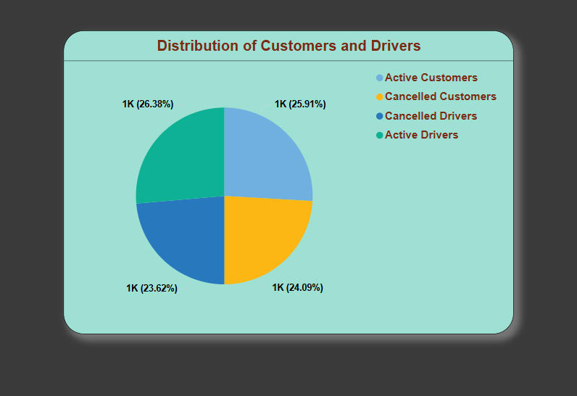

Slide 10
Executive Summary
Namma Yatri has a ~45% ride fulfillment rate.
Major drop-offs in the booking funnel post quote.
Opportunity to optimize service coverage and conversion.

Slide 11

Current Platform Performance
Searches: 2,161K
Fulfilled Rides: 983
Revenue: ₹751K
UPI Usage: 42%
High-demand zones: Ramanagaram, Yeshwantpur

Slide 12
Customer Behavior Trends
UPI dominates payments, followed by card methods.
Most rides are 10–20 minutes, the typical urban commute pattern.
Wait times and driver availability affect conversion.

Slide 13
Operational Challenges
High drop-off after ride quotes.
Inconsistent driver supply in peak zones.
Low fulfillment in some high-search areas.

Slide 14
Strategic Focus Areas
Improve driver availability where demand peaks.
Introduce funnel optimization (quotes to fulfillment).
Encourage UPI via incentives or reward programs.

Slide 15
Business Impact Goals
Target conversion rate: from 45% to 60%.
Increase completed rides per day.
Reduce cancellations and drop-offs.

Slide 16
Recommendations Summary
Deploy more drivers in high-demand locations.
Offer customer incentives post-quote stage.
Promote UPI via cashback or digital rewards.

Slide 17
Next Steps
Implement pilot improvements in one zone.
Track conversion funnel metrics post-intervention.
Plan quarterly performance reviews aligned with KPIs.

