Slide 1

NAMMA YATRI TECHNICAL PPT
BY
PRIYADHARSHNI

Slide 2
Introduction
EDA performed on Namma Yatri ride data.
Objective: Uncover demand patterns, analyze ride behavior, and optimize service delivery.

Slide 3
Data & Tools Used
Power BI dashboard and dataset from ZIP archive.
Time, fare, payment, and distance data used.
Power BI used for all visualizations.

Slide 4
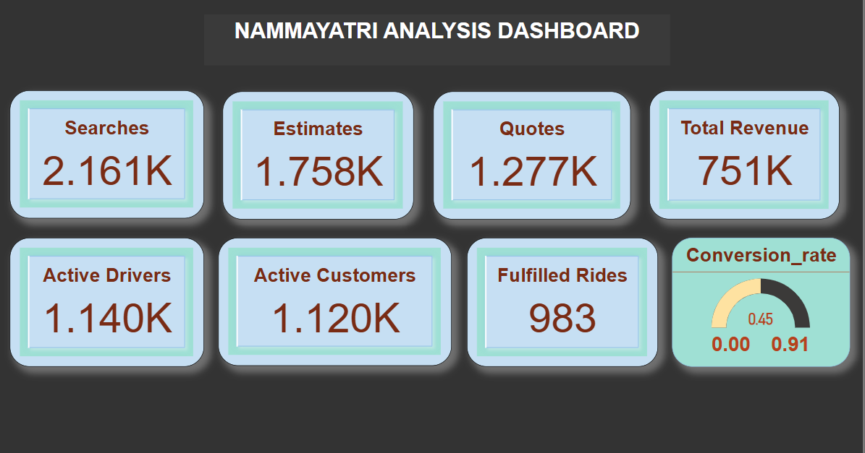

Slide 5
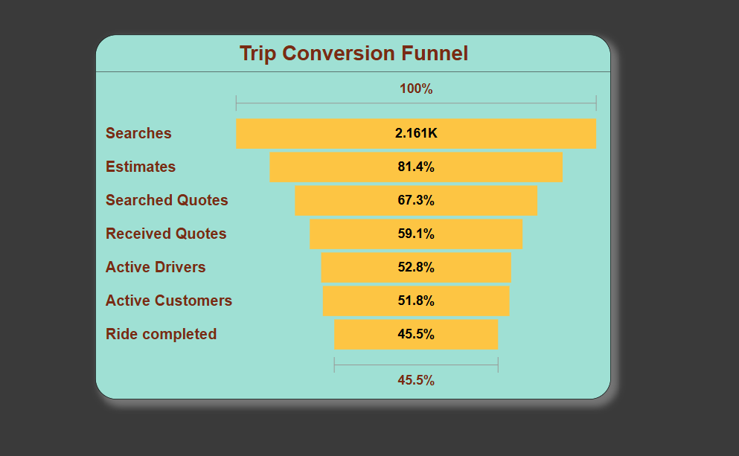

Slide 6
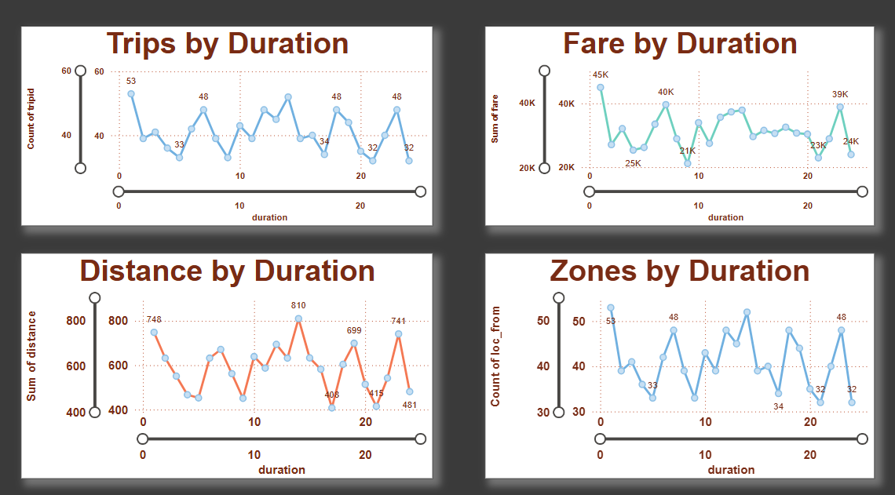

Slide 7
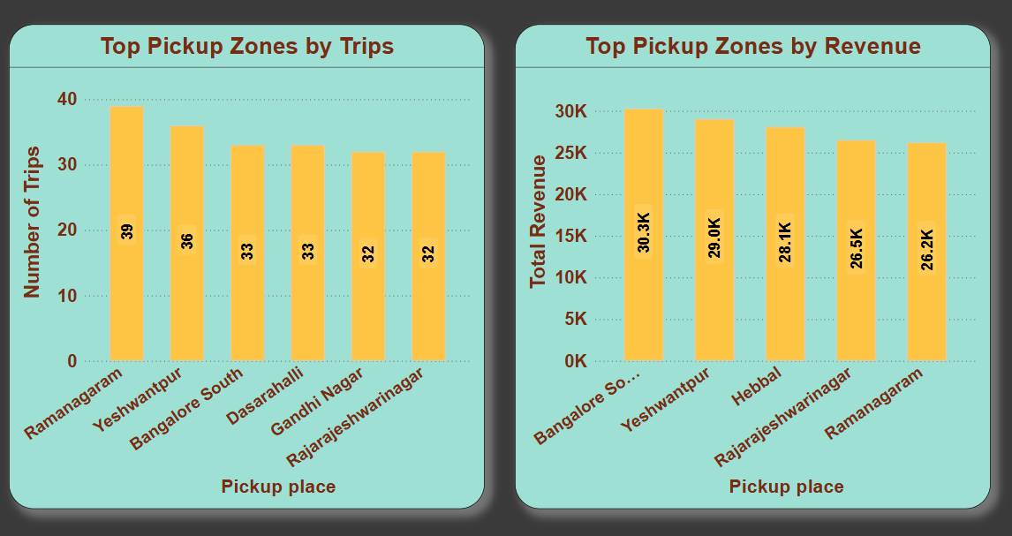

Slide 8
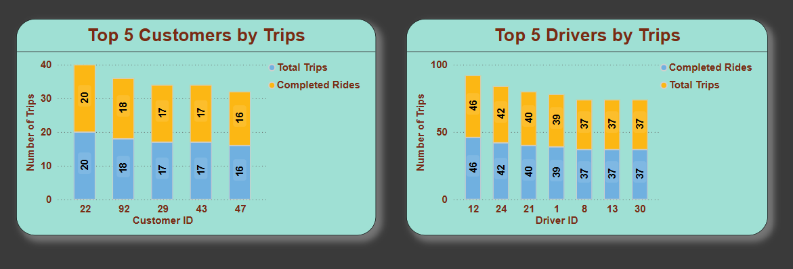

Slide 9
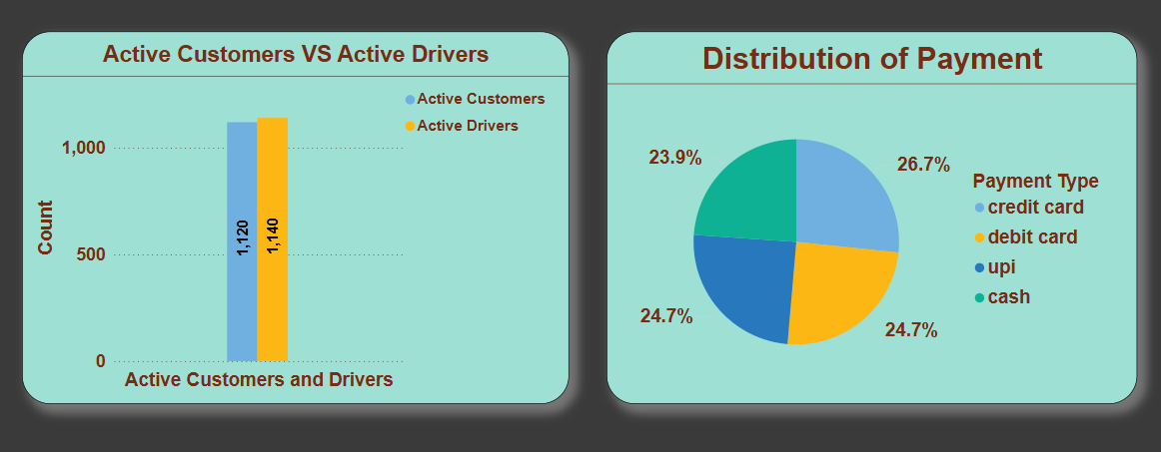

Slide 10
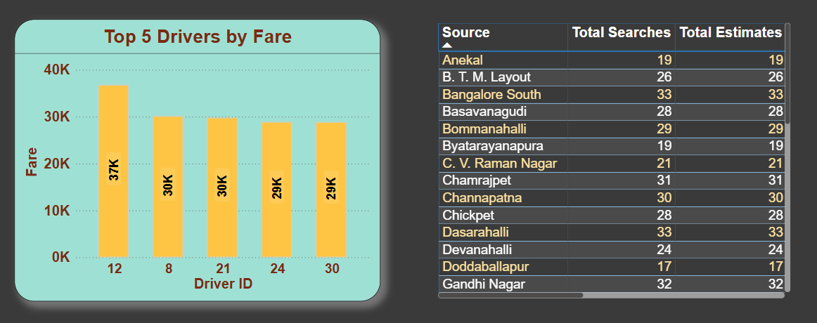

Slide 11
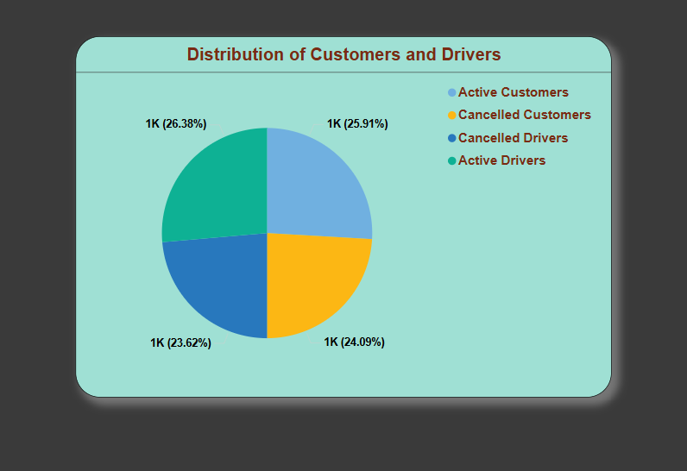

Slide 12
Data Preparation Steps
Cleaned data: removed nulls and invalid records.
Generated time features (hour, day).
Categorized payment methods and outcomes.

Slide 13
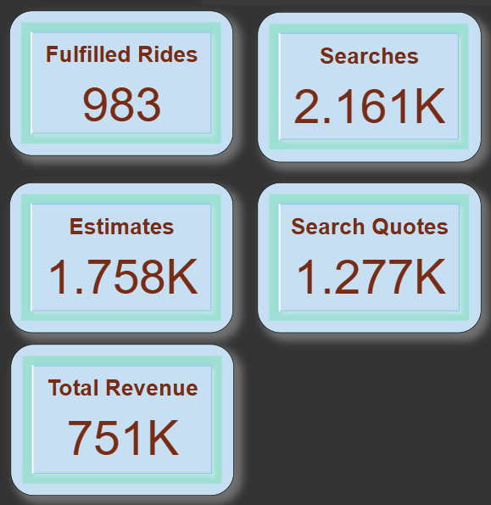
Univariate Analysis
Total searches: 2.161K | Fulfilled: 983 (~45% conversion).
Duration peaks: short and mid-length trips (~10–20 mins).
Credit card is the dominant payment method (42%).

Slide 14
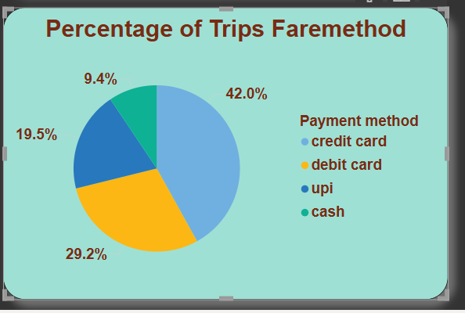
Segmented & Bivariate Analysis
Demand peak: 10–20 min trips also lead in revenue.
Payment method trends by completion: Credit Card higher.
Zone-wise demand: Ramanagaram, Yeshwantpur, Yelahanka.

Slide 15
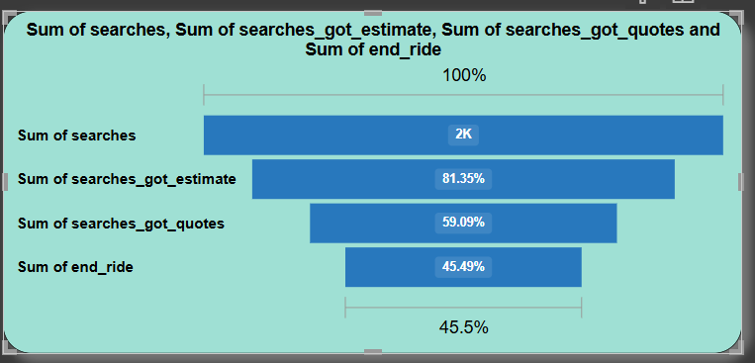
Conversion Funnel Insights
Search → Estimate → Quote → Fulfilled (45%).
Major drop-offs post-quote—possible driver or wait time issues.

Slide 16
Key Metrics from Dashboard
Revenue: ₹751K
Credit : 42%, Debit: 29%, UPI: 19%, Cash: 9%
Distance peak at 10-min duration (810 units approx.)

Slide 17
Data-Driven Recommendations
Optimize driver availability in top zones.
Reduce conversion funnel drop-offs via app improvements.
Enhance digital payment adoption.
Continuously collect feedback from users and drivers and incorporate it into the optimization process.

