Slide 1



MedInsight
Stroke Risk Screening and Explainable Prediction System
Presented by
Priyodarshini Banerjee
BCA - 5th Semester
Under the Guidance of
SK Anarul
Ardent Computech Pvt. Ltd.

Slide 2

Introduction
Stroke Risk
Stroke is a serious health condition influenced by demographic, medical and lifestyle factors.
Machine Learning
ML can identify patterns in patient data to support stroke-risk prediction.
MedInsight
An explainable ML based system providing risk prediction, probability estimation and SHAP based insights.

Slide 3

Class Imbalance
01
Stroke datasets contain far fewer stroke cases than non-stroke cases, making minority class prediction challenging.
Missed Stroke Cases
02
High accuracy alone may hide poor detection of actual stroke cases especially false negatives.
Problem Statement
Limited Interpretability
03
Prediction results may not clearly show which patient features influenced the model's decision.
Research Gap
04
Existing approaches may focus on prediction performance but provide limited minority class detection and interpretability. MedInsight integrates class imbalance handling, risk prediction and SHAP based explanation.

Slide 4

Objectives
Develop MedInsight
Provide Explainability
01
04
Develop an ML based system for stroke-risk screening using patient demographic, medical and lifestyle data.
Use SHAP based Explainable AI to identify factors influencing model predictions.
Prepare & Analyse Data
02
Perform data preprocessing and exploratory analysis to identify patterns and prepare the dataset for modelling.
Deploy for Screening
05
Compare & Select Models
Develop an interactive Streamlit application for prediction, analytics and personalised guidance as a screening and decision support tool.
03
Handle class imbalance, compare classification models using multiple metrics and select the final model.

Slide 5



Proposed System: MedInsight
01
Patient Input
02
Data Preprocessing
03
ML Model Development
Demographic, medical and lifestyle data entered through the Streamlit interface.
  Missing value handling
  Encoding
  Train-test split
  Feature scaling
  Class imbalance handling
  Train & compare 6 ML models
  Evaluate using multiple metrics
  Hyperparameter tuning
  Select Tuned Balanced Logistic Regression
05
Streamlit Application
04
Explainability & Analytics
  Stroke prediction & probability
  Risk assessment & personalised guidance
  Downloadable PDF assessment report
  SHAP based explanations
  Feature importance
  Model analytics
  Performance visualisations

Slide 6
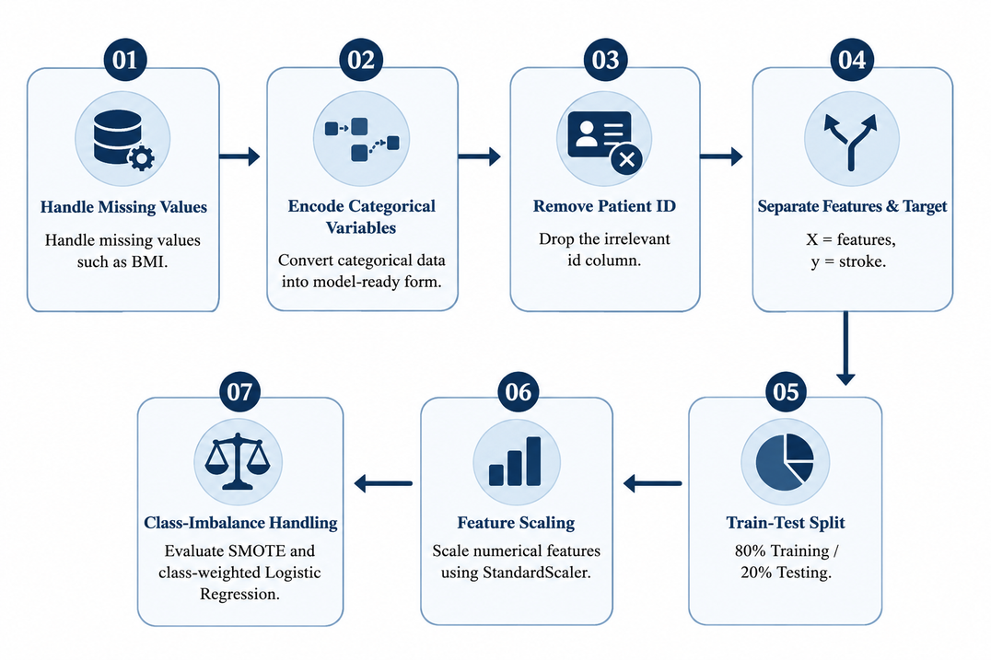
Dataset & Preprocessing
Dataset Overview
Preprocessing
5110
10
4861
249
Patient Records
Input Features
No Stroke
Stroke
Class Distribution - Stroke
No Stroke(0)
95.1%
Stroke (1)
4.9%
Highly imbalanced target class

Slide 7
Machine Learning Methodology
Models Evaluated
Model Evaluation
Logistic Regression
Final Model
K-Nearest Neighbours (KNN)
Accuracy
Precision
Recall
F1
Decision Tree
F1 Score
ROC-AUC
Tuned Balanced Logistic Regression
Comparison & Analysis
Random Forest
Compare all models using evaluation metrics
SMOTE + Logistic Regression
Selected as the Final Model
Hyperparameter Tuning
GridSearchCV - 5-fold CV
Scoring: F1-score
Balanced Logistic Regression

Slide 8
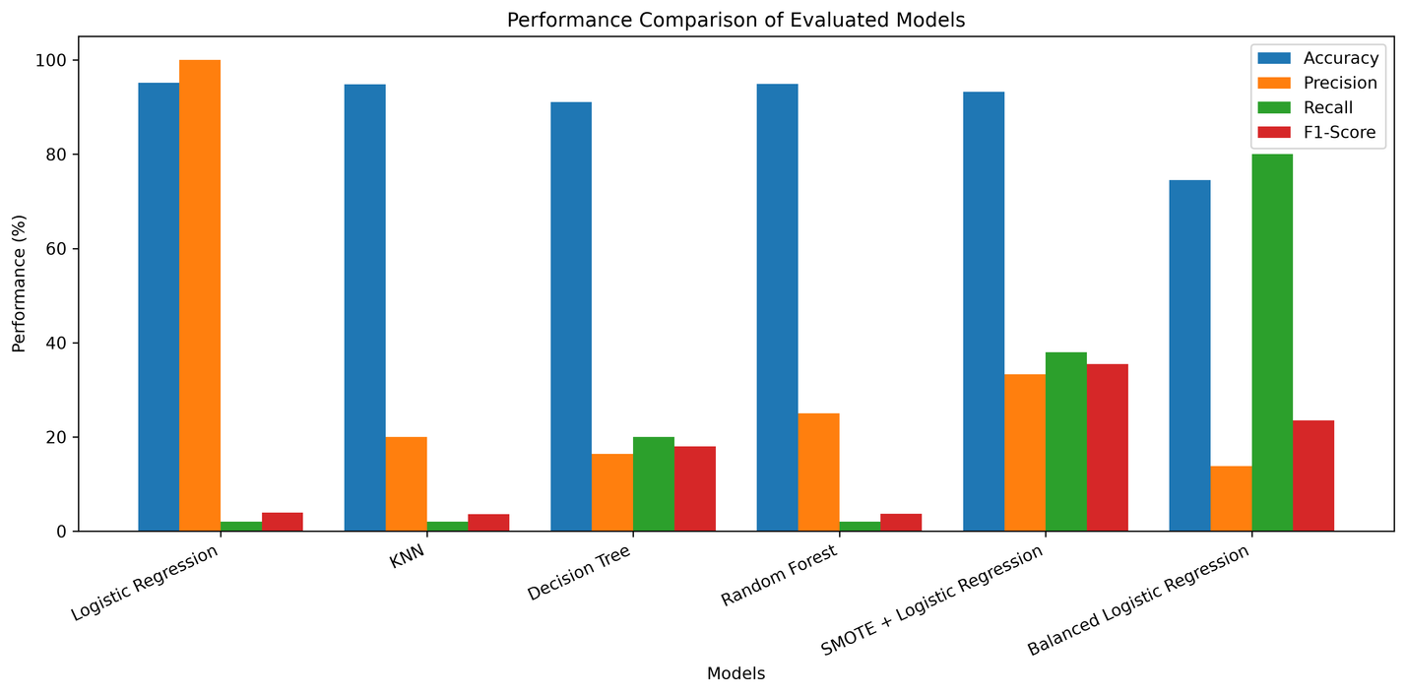
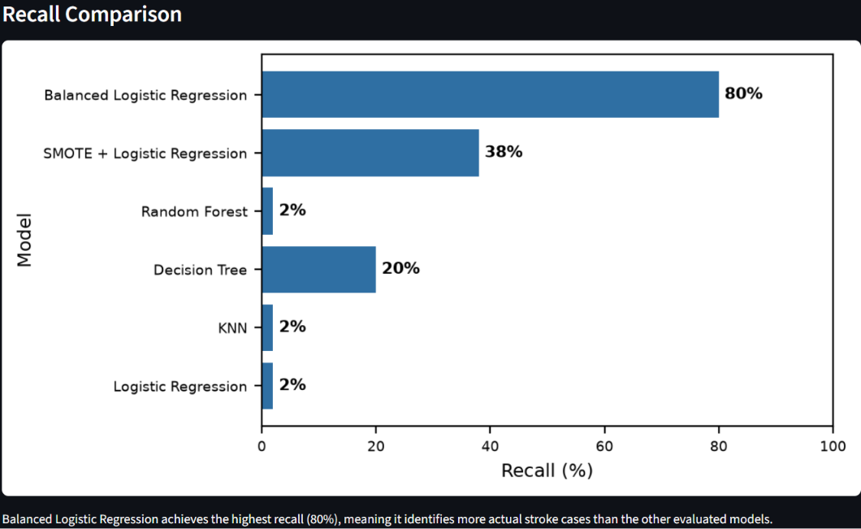
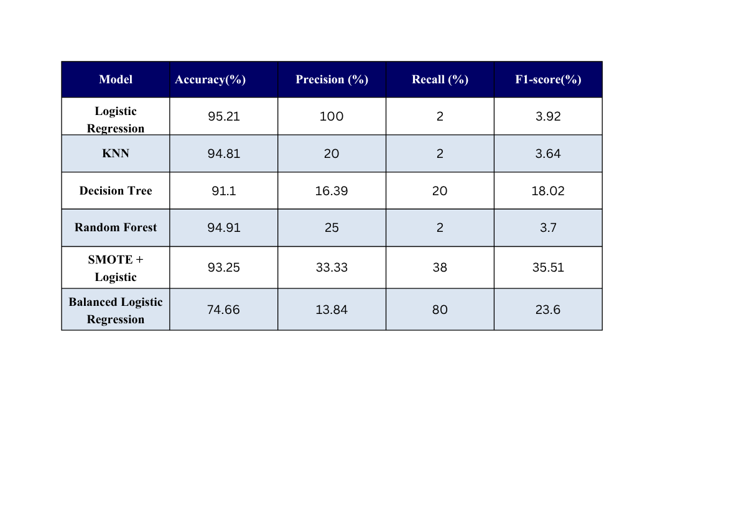
Model Performance Comparison
KEY FINDINGS:
  High accuracy but very low recall in conventional models.
  SMOTE + LR improved recall to 38%.
  Balanced LR achieved the highest recall: 80%.
  Recall is more important than accuracy here.

Slide 9
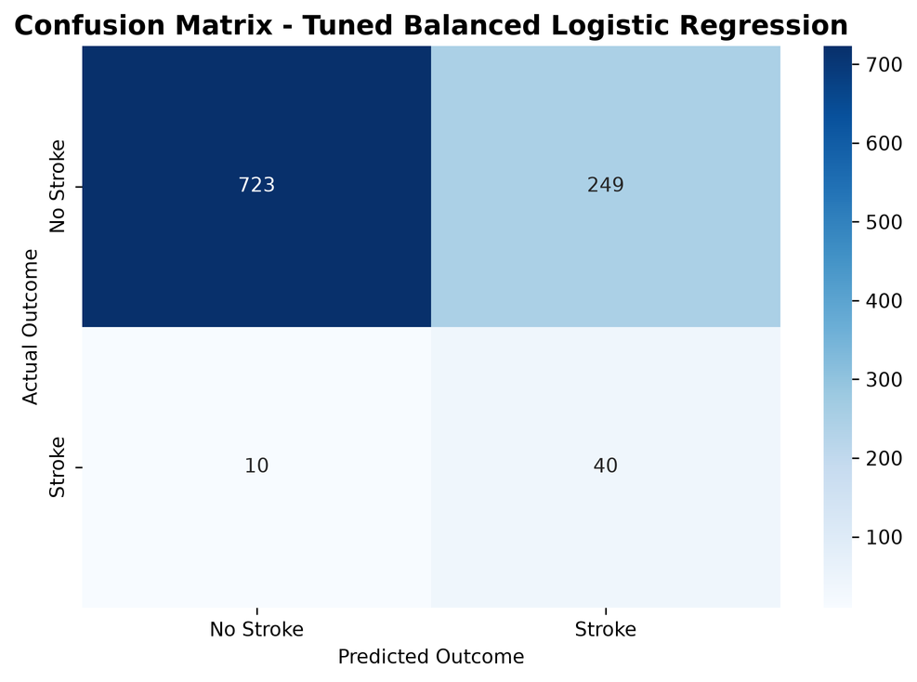
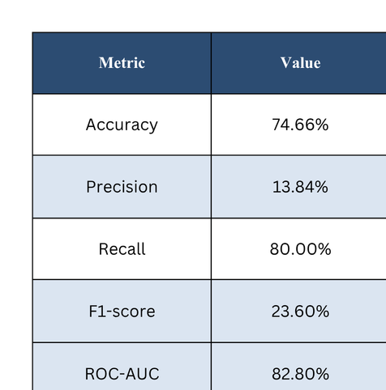
Final Model Performance & Confusion Matrix
Recall = 80% - strong detection of actual stroke cases
TP = 40 | TN = 723
The model prioritizes detection of actual stroke cases
FP = 249 | FN = 10
Only 10 actual stroke cases were missed

Slide 10
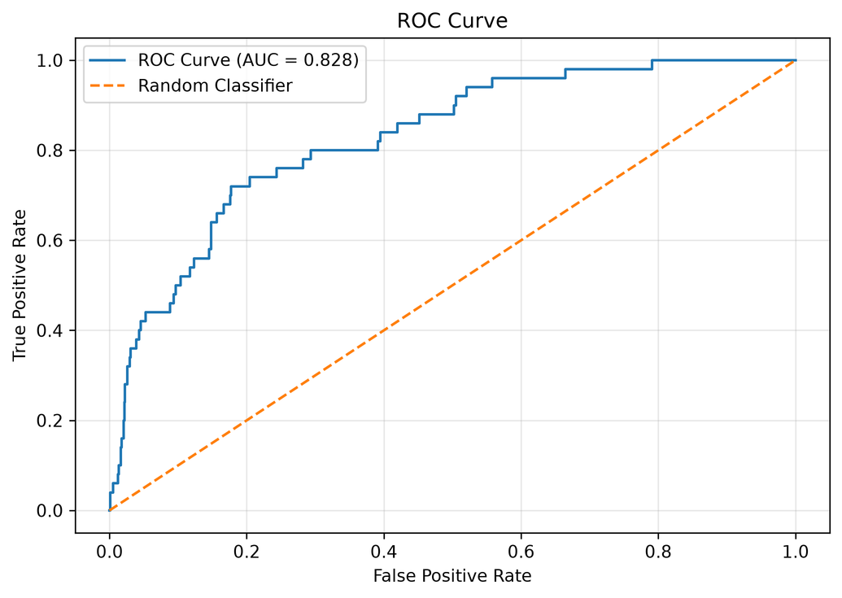
ROC Curve & AUC Analysis
ROC-AUC
82.80%
Good discrimination
What it means:
  The model effectively distinguishes stroke from non stroke cases.

Slide 11
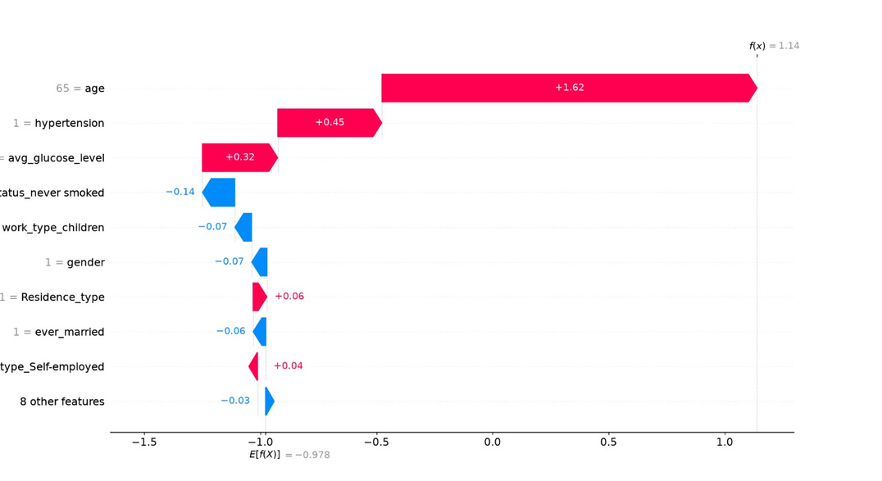
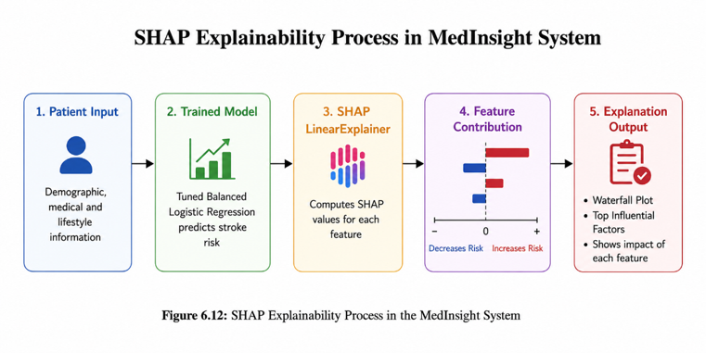
SHAP Explainability & Feature Importance
Why it matters
Provides transparent and interpretable explanations for model predictions.

Slide 12
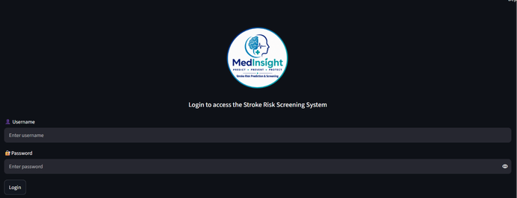
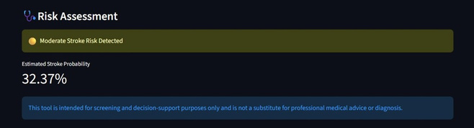
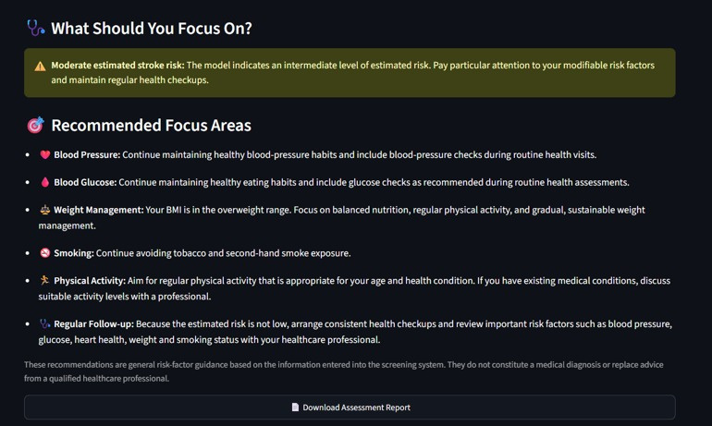
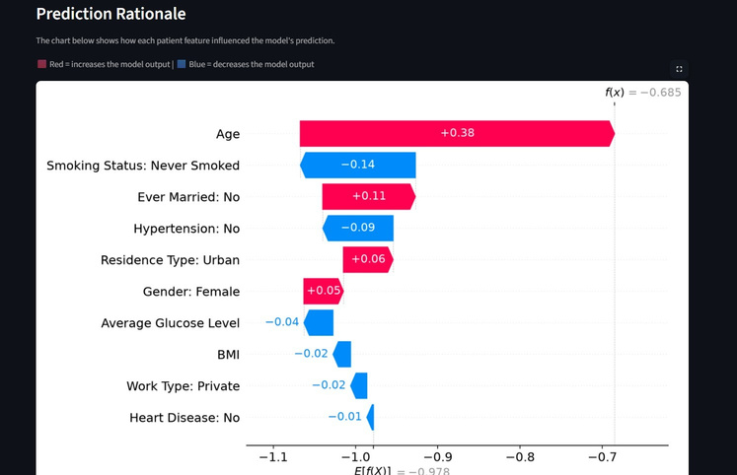
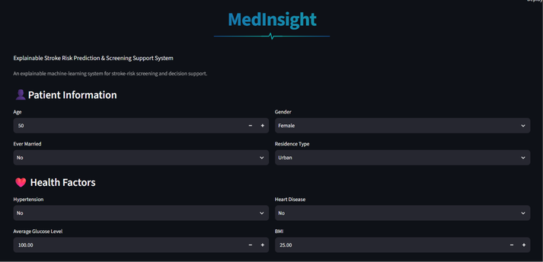
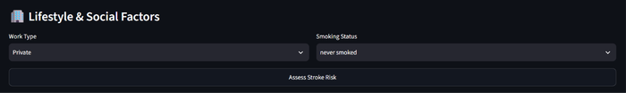
MedInsight Application & Workflow
A. Patient Screening
03. Risk Assessment
01. User Login
05. Report
02. Patient Input
04. Explainable Prediction

Slide 13
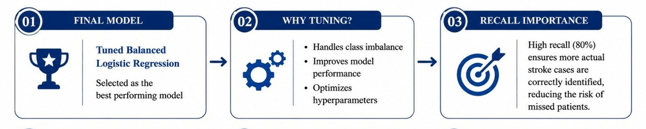
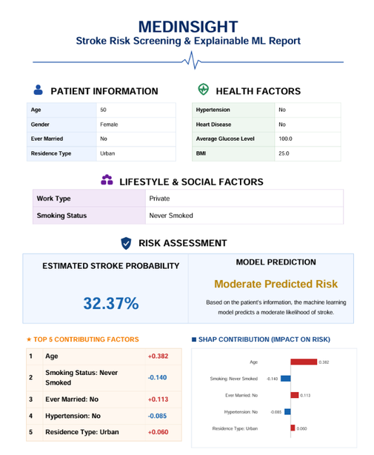
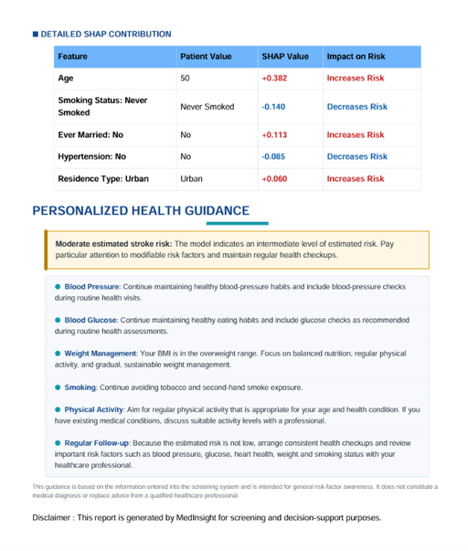
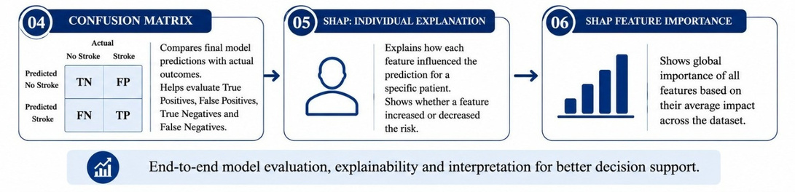
MedInsight Application & Workflow
B. Model Analytics
&
Automated Risk Reporting
Comprehensive evaluation , explainability and interpretation at one place
Transforms model predictions into an actionable patient report

Slide 14
Advantages
Limitations
Future Scope
  High recall (80%)
  Lower precision and F1 score
  Larger and more diverese datasets
  Handles class imbalance
  False positives remain high
  External/clinical validation
  Explainable predictions using SHAP
  Screening tool, not a diagnosis
  Improve precision - recall balance
  Performance depends on dataset quality
  Advanced ML / deep-learning models
  Interactive screening & reporting
  Real world clinical intergration

Slide 15


Key Achievement
01
Developed MedInsight as an explainable ML based stroke risk screening system.
Key Insight
Conclusion
02
Combining model performance with SHAP explainability supports more transparent predictions.
Overall Impact
03
An integrated workflow connects prediction, risk assessment, explanation and reporting.

Slide 16

Thank You
Questions & Discussion

