Slide 1
Welcome to our Presentation
CLASS ROUTINE GENERATOR

Slide 2
Submitted By
Sumaiya Binte Shahid Maleeha Kaikaus Lamis
Roll:180244 Roll:180249
A.K. Din Mohammad Moinul Islam Laskar Roll:180257 Roll:180270
Supervised By
Manan Binth Taj Noor
Lecturer,
Institute of Information Technology,
Jahangirnagar University.

Slide 3
Introduction
“IIT Class Routine Generator” basically generates class routine based on the information given to it.
This system is used to create and manipulate the class routine of an educational institution.
By creating class routine with this system, teachers can save their time and it will reduce their manual activities.

Slide 4
What is one of the major problem we face in IIT?

Slide 5
Classroom Inadequecy
There are only 4 classroom in IIT . But we have currently 5 batch running.
So we have shortage of classrooms and we can not have classes for all at a same time .
And often we see our students are standing and waiting in the corridor as there are no class empty to sit.

Slide 6
Our Goal
To create an efficient programme which ensure that at a time there is at most 4 classes are placed in the routine.
Help Teachers to get an easy and flawless platform where he can choose schedule of his classes without getting collision with others.

Slide 7
Our Approach
We are allocating classes according to “First come First Serve” basis.
That means after assigning the courses to teachers , the teacher who comes first will get the schedule as he wants as their will be more empty slots.
As teachers complete their schedule one by one their will be less class slot to choose.

Slide 8
Collision Scenario
Case 1 :
The teacher has given two classes schedule at a same time.
Case 2 :
Two teachers have given a schedule for a same batch at a same time.
Case 3 :
The teacher selects a schedule when all classes are full.

Slide 9
Replacing
If a collision arise in a particular time slot and a teacher wishes only to take the class at that time then ,
Current teacher can replace the other teacher who is currently occupying that slot.
But a teacher can replace no more than two classes.
Replaced classes will be asked by their assigned teachers to select another time.

Slide 10
Implementation
The programme is written on C++ language .Though we did not follow any algorithm strictly but we adopted the idea form “Activity Selection Problem”. And we have used some technique from following methods and algorithms :
Dynamic Programming
First come first serve
LIFO

Slide 11
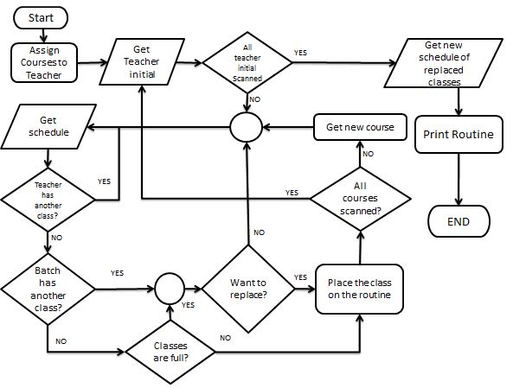
Flowchart

Slide 12
Showing Our Project

Slide 13
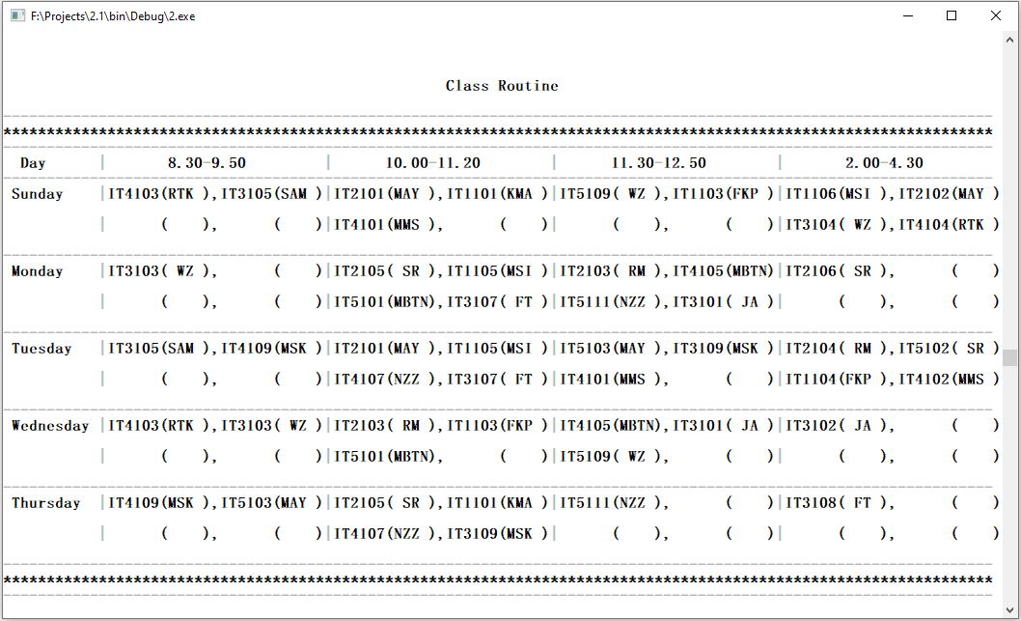
Want big impact?
FINAL CLASS ROUTINE
Use big image.

Slide 14
Future Work
Add GUI(Graphical User Interface) for an attractive view.
Make it more efficient and user friendly.
Create a similar project for universal class routine generator.

Slide 15
Thank You!
Any questions?

