Slide 1
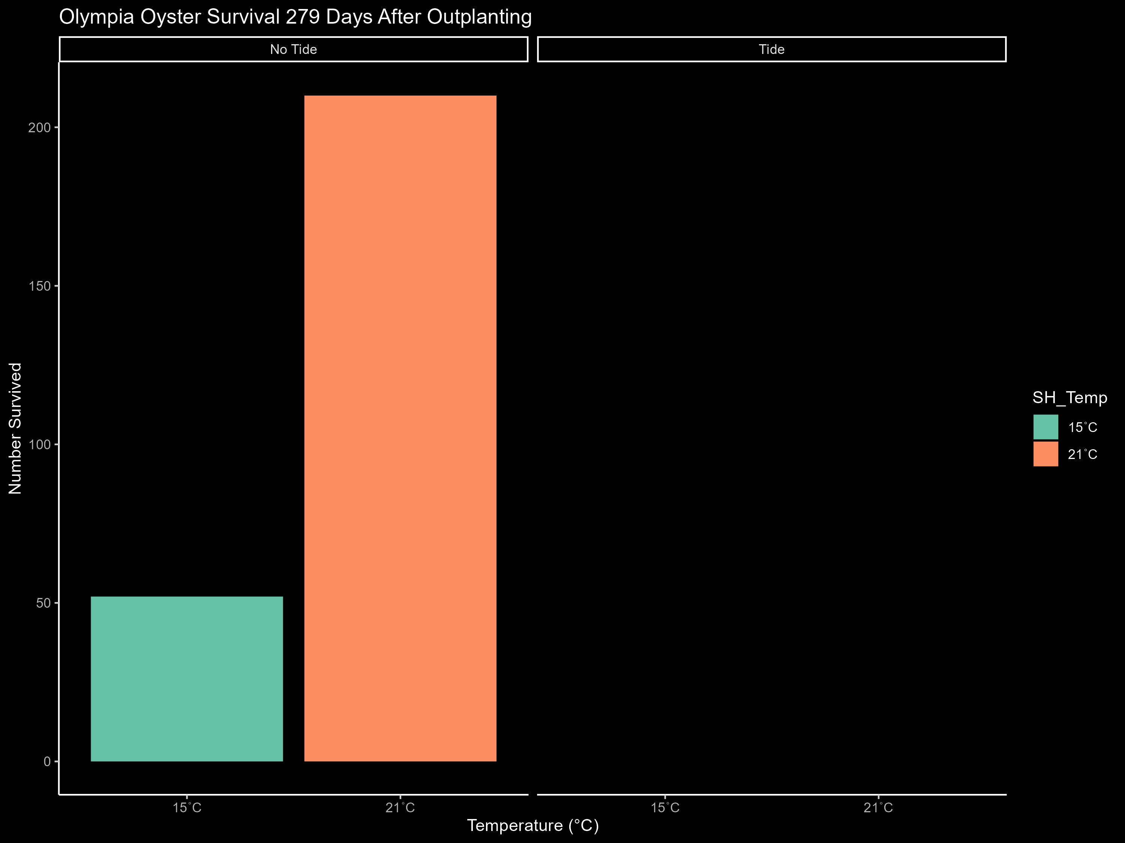
Experiment Mortality

