Slide 1
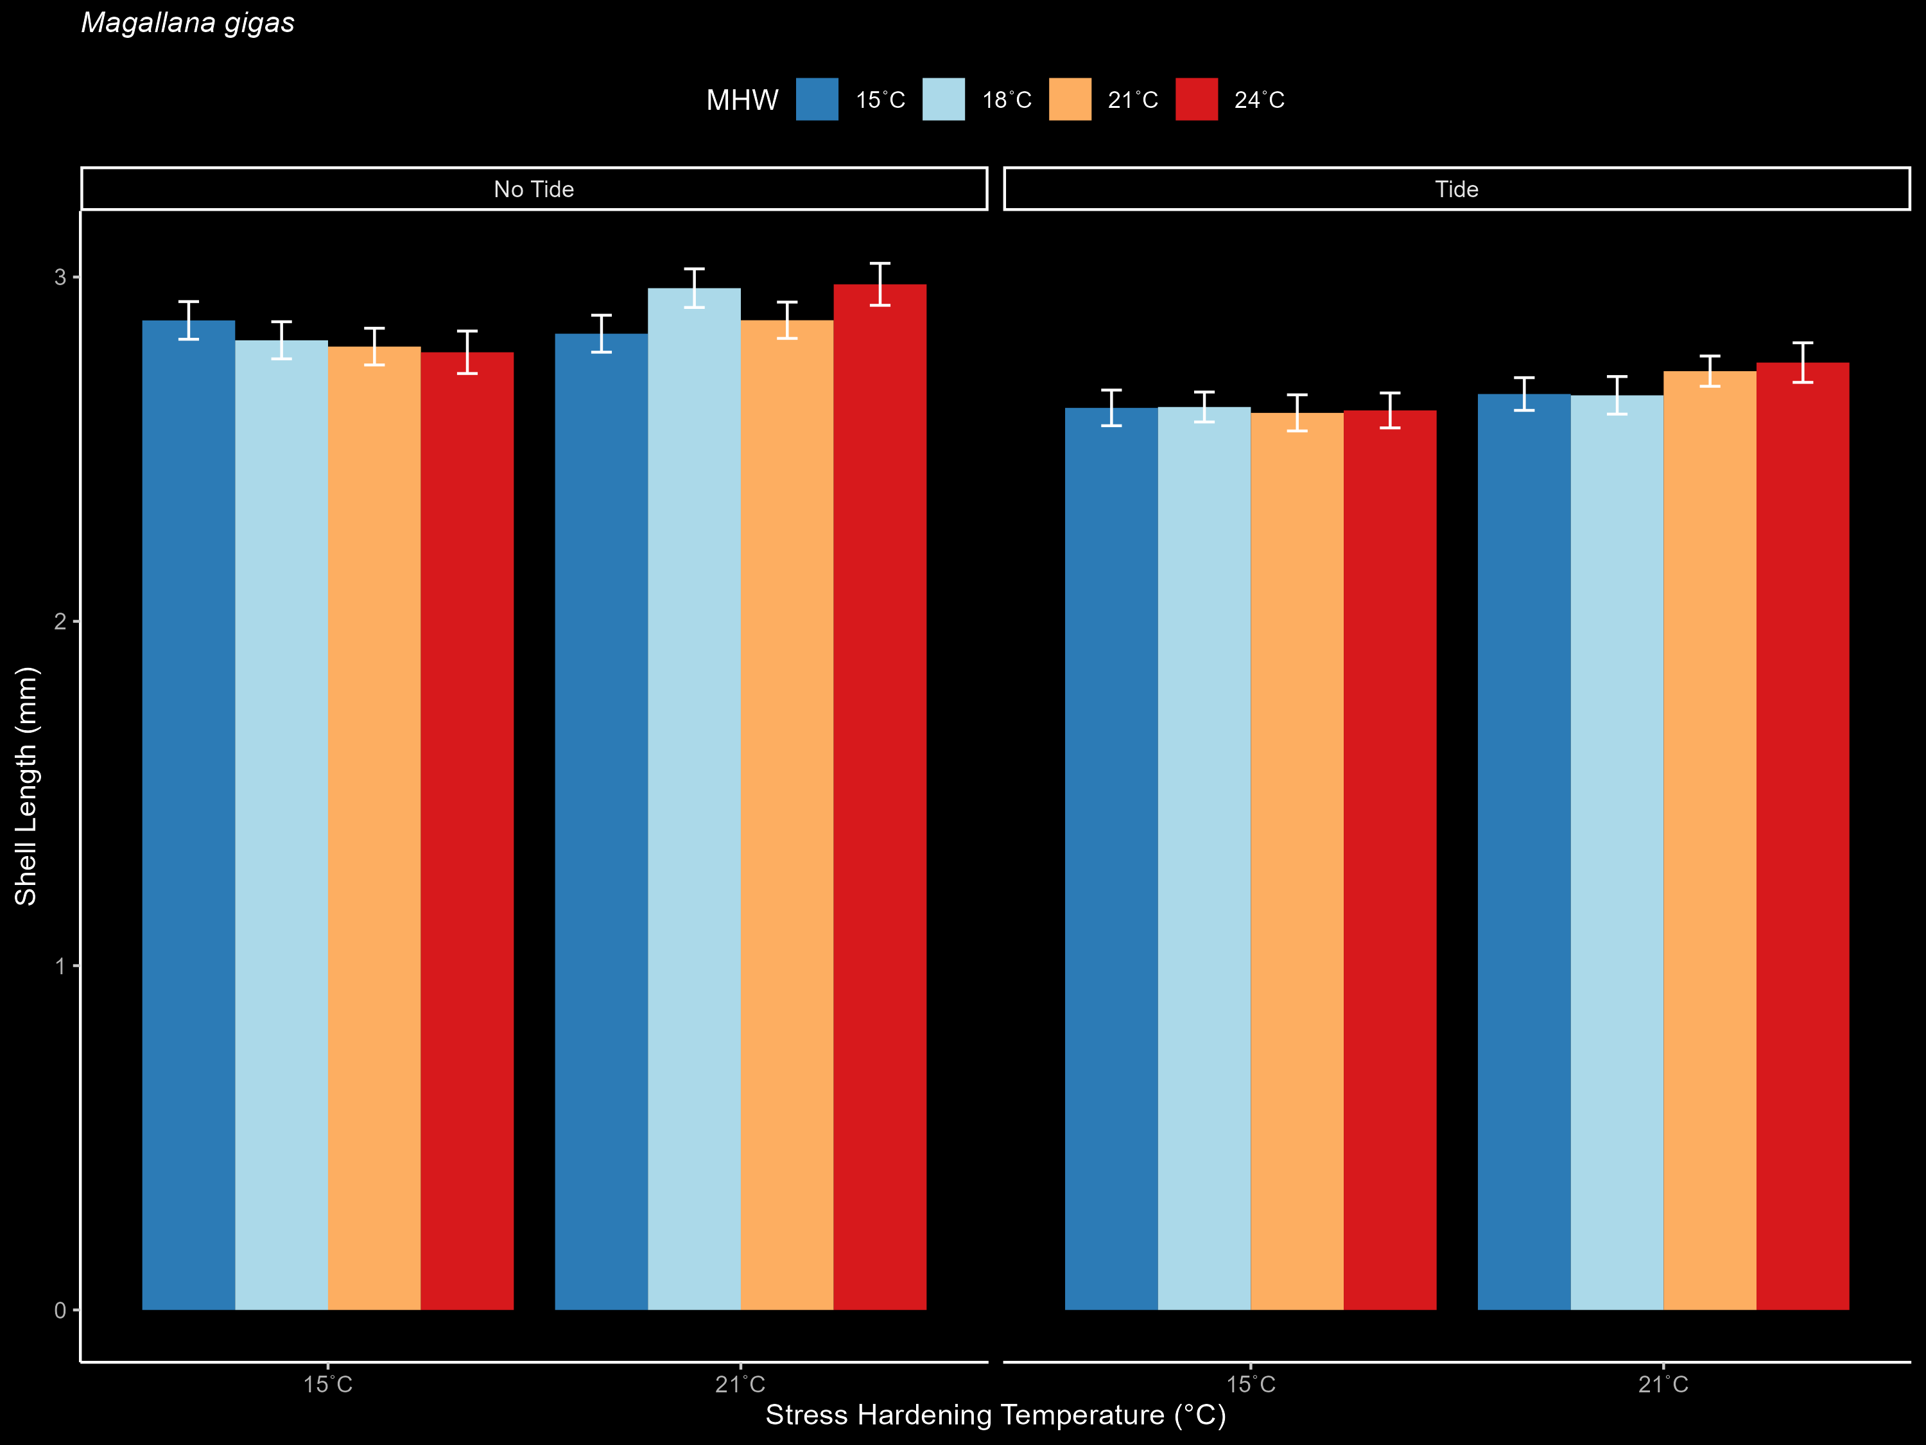
M.gigas_Length

