Slide 1
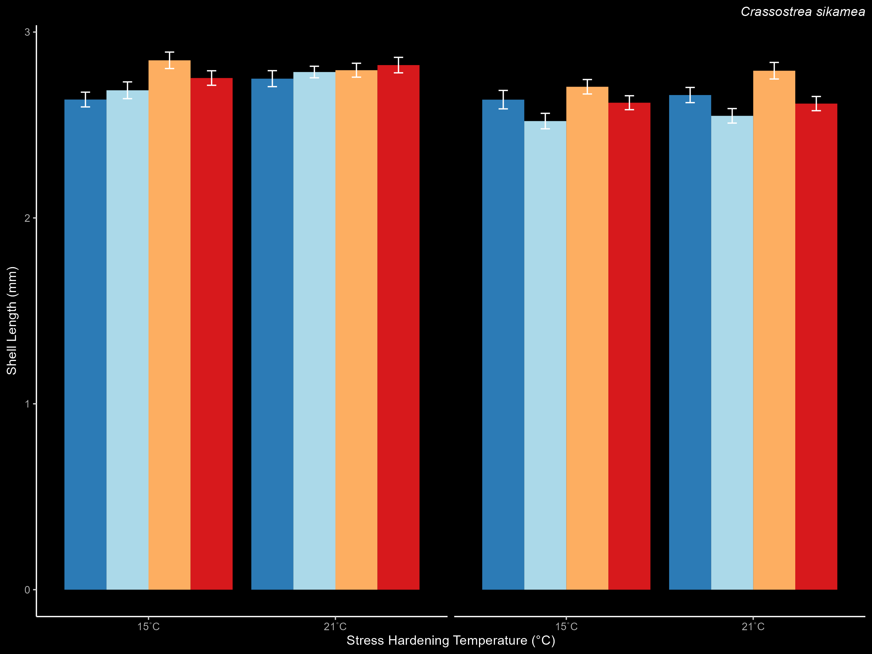
C. sikamea Length

