Slide 1


U & P. U. Patel Department of Computer Engineering
CE452 • MINOR PROJECT FINAL REVIEW
Pothole and Plain Road
Classification Using Deep Learning
Transfer learning • Fine-tuning • Explainability • Robustness
Prepared by
Priya Pedhadiya (23CE115) • Shruti Patel (23CE107)
U & P U. Patel Department of Computer Engineering | CSPIT, CHARUSAT
2026

Slide 2
U & P. U. Patel Department of Computer Engineering
Problem Statement
CONTEXT
Safety risk
Manual inspection
Need for triage
Undetected potholes can contribute to accidents, vehicle damage and traffic disruption.
Physical surveys take time and can be inconsistent across large road networks.
A large volume of road photographs needs a quick, consistent first-pass classification.
Project question
Can a transfer-learning image classifier distinguish road photographs containing a pothole from plain-road photographs?
CE452 • Minor Project Final Review • CHARUSAT
2

Slide 3
U & P. U. Patel Department of Computer Engineering
Objectives and Scope
PROJECT GOALS
01 Prepare data
02 Train models
03 Evaluate fairly
Inspect labeled images; create reproducible train/validation/test splits.
Build a pretrained CNN classifier and compare different backbones.
Use accuracy, precision, recall, F1-score, ROC-AUC and confusion matrix.
04 Explain & stress-test
05 Demonstrate use
Use Grad-CAM and simulate blur, lighting, contrast and noise changes.
Expose single-image prediction through a Gradio web interface.
CE452 • Minor Project Final Review • CHARUSAT
3

Slide 4
U & P. U. Patel Department of Computer Engineering
End-to-End System Workflow
METHODOLOGY
Road images
Split
Preprocess
Train
Evaluate
Explain / demo
Labeled folders
70 / 15 / 15
224×224 + rescale
Transfer learning
Metrics + plots
Grad-CAM + Gradio
Training data is augmented; validation and test generators use rescaling only.
CE452 • Minor Project Final Review • CHARUSAT
4

Slide 5
U & P. U. Patel Department of Computer Engineering
Dataset and Split
DATA
Pothole images
Plain-road images
Input shape
365 images listed in source folders.
375 images listed in source folders.
224 × 224 pixels, RGB.
Subset | Pothole | Plain | Total
Train | 251 | 259 | 510
Validation | 54 | 56 | 110*
Test | 56 | 57 | 113
Notebook generator output:
510 train • 109 validation • 113 test images.
Class mapping: Plain = 0 | Pothole = 1
CE452 • Minor Project Final Review • CHARUSAT
5

Slide 6
U & P. U. Patel Department of Computer Engineering
Preprocessing and Augmentation
IMPLEMENTATION
• Resize each image to 224 × 224.
• Scale pixel values by 1/255.
• Augment training images with small rotations, shifts, zoom and horizontal flips.
• Keep validation/test preprocessing deterministic.
Why it matters: augmentation exposes the model to plausible image variation and may reduce overfitting on a small dataset.
CE452 • Minor Project Final Review • CHARUSAT
6

Slide 7
U & P. U. Patel Department of Computer Engineering
Transfer-Learning Model Architecture
MODEL DESIGN
Pretrained backbone
Classification head
Training objective
MobileNetV2, ResNet50 and EfficientNetB0 use ImageNet weights.
Global Average Pooling → Dense(128) → Dropout(0.3) → Sigmoid.
Adam optimizer + binary cross-entropy; binary output for two classes.
CE452 • Minor Project Final Review • CHARUSAT
7

Slide 8
U & P. U. Patel Department of Computer Engineering
Fine-Tuning MobileNetV2
TRAINING STRATEGY
• Baseline: freeze the full backbone; train the custom head.
• Fine-tuning: unfreeze layers from index 100 onward.
• Keep Batch Normalization layers frozen.
• Use a lower learning rate (1e-5) to make smaller updates.
• Notebook output: 36 / 154 backbone layers trainable.
CE452 • Minor Project Final Review • CHARUSAT
8

Slide 9
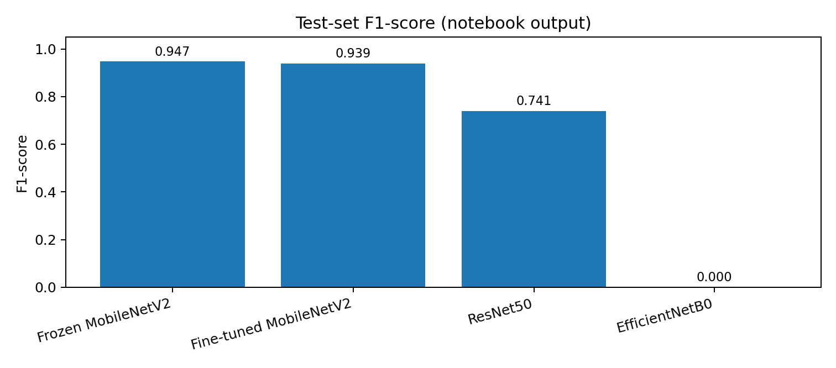
U & P. U. Patel Department of Computer Engineering
Model Comparison — Test Set
RESULTS
Model | Accuracy | Precision | Recall | F1 | ROC-AUC
Frozen MobileNetV2 | 0.947 | 0.931 | 0.964 | 0.947 | 0.977
Fine-tuned MobileNetV2 | 0.938 | 0.915 | 0.964 | 0.939 | 0.988
ResNet50 | 0.690 | 0.633 | 0.893 | 0.741 | 0.813
EfficientNetB0 | 0.504 | 0.000 | 0.000 | 0.000 | 0.546
Best F1 in the displayed table: frozen MobileNetV2 (0.9474).
Important verification: the final-selection cell hardcodes fine-tuned MobileNetV2 (F1 = 0.9391). Resolve/explain this mismatch before presenting.
CE452 • Minor Project Final Review • CHARUSAT
9

Slide 10
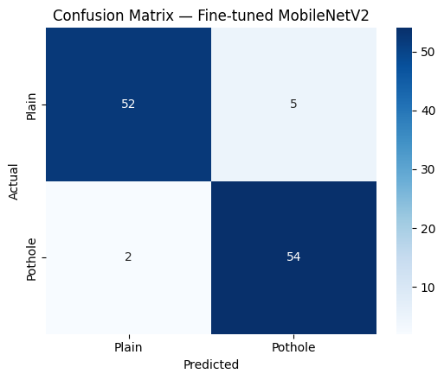
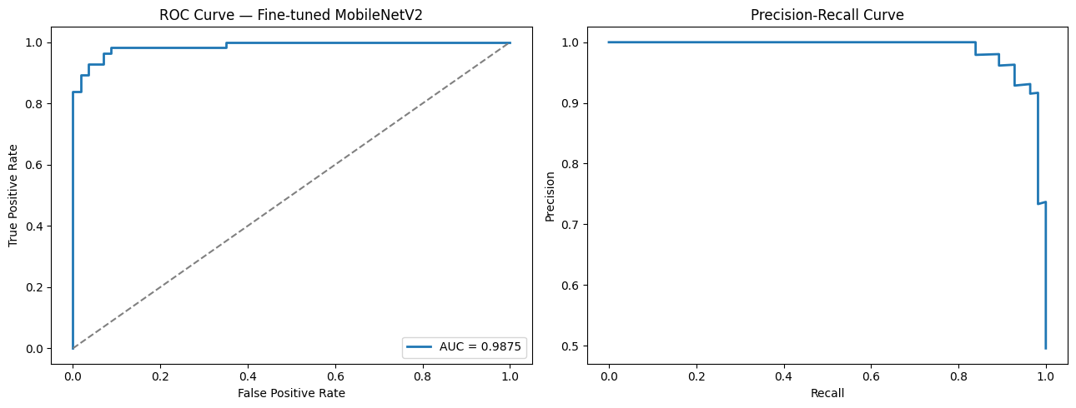
U & P. U. Patel Department of Computer Engineering
Evaluation and Error Analysis
RESULTS
Accuracy
Recall
93.81%
96.43%
CE452 • Minor Project Final Review • CHARUSAT
10

Slide 11
U & P. U. Patel Department of Computer Engineering
Decision Threshold Analysis
EVALUATION
A lower threshold can increase sensitivity, but the actual notebook sweep should guide the decision.
Threshold | Accuracy | Precision | Pothole recall | F1 | Missed potholes
0.3 | 0.938 | 0.915 | 0.964 | 0.939 | 2
0.4 | 0.938 | 0.915 | 0.964 | 0.939 | 2
0.5 | 0.938 | 0.915 | 0.964 | 0.939 | 2
0.6 | 0.938 | 0.915 | 0.964 | 0.939 | 2
0.7 | 0.947 | 0.931 | 0.964 | 0.947 | 2
Observed in this sweep
Safety perspective
Threshold 0.7 had the highest accuracy and F1 among the tested values.
Missed potholes matter; threshold choice is a trade-off, not a universal default.
CE452 • Minor Project Final Review • CHARUSAT
11

Slide 12
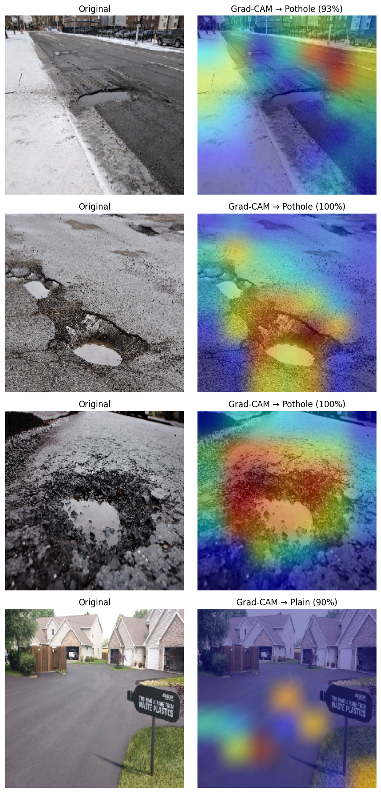
U & P. U. Patel Department of Computer Engineering
Explainability with Grad-CAM
INTERPRETABILITY
What it does
Uses gradients from the predicted class to create a heatmap over convolutional features.
How to read it
Warm/highlighted regions indicate image areas contributing more to the model score.
Caution
A heatmap is a diagnostic aid; it does not prove the model is always reasoning correctly.
CE452 • Minor Project Final Review • CHARUSAT
12

Slide 13
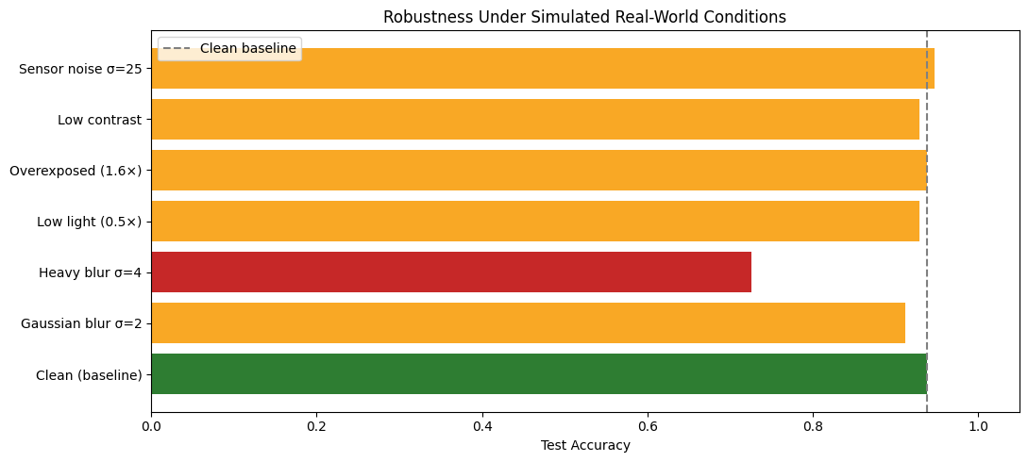
U & P. U. Patel Department of Computer Engineering
Robustness Under Image Degradation
STRESS TESTING
Condition | Accuracy | Pothole recall
Clean baseline | 0.938 | 0.946
Gaussian blur σ=2 | 0.911 | 0.839
Heavy blur σ=4 | 0.726 | 0.464
Low light (0.5×) | 0.929 | 0.893
Overexposed (1.6×) | 0.938 | 0.964
Low contrast | 0.929 | 0.893
Sensor noise σ=25 | 0.947 | 0.929
Weakest tested condition: heavy blur σ=4 (accuracy 72.57%, pothole recall 46.43%). Synthetic corruptions do not replace real dashcam testing.
CE452 • Minor Project Final Review • CHARUSAT
13

Slide 14
U & P. U. Patel Department of Computer Engineering
Demo, Limitations and Future Scope
WRAP-UP
Demo workflow
Current limitation
Future work
Upload road photo → resize/rescale → model predicts class probabilities → display label and confidence.
Image classification only: no bounding box, exact pothole location, severity grade or GPS geotagging.
Test self-captured road images, improve blur robustness, explore object detection and severity grading.
Conclusion
• The notebook demonstrates a complete classification workflow with model comparison, test metrics, Grad-CAM, robustness analysis and a Gradio interface.
• The recorded results favour the frozen MobileNetV2 by F1-score, while the final-selection code chooses the fine-tuned model; explain this discrepancy honestly.
• Performance on clean test images is promising, but heavy blur significantly reduces pothole recall.
CE452 • Minor Project Final Review • CHARUSAT
14

Slide 15
U & P. U. Patel Department of Computer Engineering
References and Technical Stack
REFERENCES
• Dataset used in notebook: Virenbr11, “Pothole and Plain Road Images” (Kaggle dataset path recorded in notebook).
• TensorFlow / Keras: pretrained MobileNetV2, ResNet50 and EfficientNetB0 application models.
• scikit-learn: train_test_split, classification metrics, ROC and precision–recall analysis.
• Matplotlib / Seaborn: evaluation plots and confusion matrix visualization.
• Gradio: image-upload interface for single-image classification.
• Project notebook: Pothole and Plain Road Classification — Fine-Tuning, Architecture Comparison, Explainability, Robustness & Deployment.
Thank you • Questions?
CE452 • Minor Project Final Review • CHARUSAT
15

