Slide 1
Subject Name : DATA ANALYTICS & VISUALIZATION(1IT508)
VIDEO GAME SALES ANALYSIS
Enrollment No: 240840116113
240840116050
240840116029
240840116035
240840116030
Competition: INSIGHTVISTA 2026
INSIGHTVISTA 2026 • VIDEO GAME SALES ANALYSIS
1

Slide 2
01 | Raw Dataset Observation
Dataset profile and initial data-quality checks
TOTAL ROWS
TOTAL COLUMNS
MISSING YEARS
MISSING PUBLISHERS
16,598
11
271
58
Columns in the raw dataset
Initial observations
Rank, Name, Platform, Year
Genre, Publisher
NA_Sales, EU_Sales, JP_Sales, Other_Sales
Global_Sales
Year has 271 blank values.
Publisher has 58 missing values.
No exact duplicate rows were detected.
Sales fields are numeric and suitable for aggregation after type validation.
The dataset covers games released between 1980 and 2020
INSIGHTVISTA 2026 • VIDEO GAME SALES ANALYSIS
2

Slide 3
02 | Data Cleaning Process
Power Query steps and observed results
Step | Action | Result
1 | Checked data types | Rank and Year as Whole Number; sales fields as Decimal Number
2 | Handled missing Publisher | 58 missing values replaced with “Unknown”
3 | Handled missing Year | 271 missing years retained as blank; no invented dates
4 | Trimmed and cleaned text | Whitespace and non-printing characters checked/cleaned
5 | Checked duplicate rows | 0 exact duplicate rows detected
6 | Checked numeric errors | Used Keep Errors to inspect columns; correct any remaining conversion errors before loading
Final profile after cleaning: 16,598 rows • 11 columns • 0 exact duplicate rows • Publisher nulls handled • Year nulls retained
INSIGHTVISTA 2026 • VIDEO GAME SALES ANALYSIS
3

Slide 4
03 | Final Cleaned Dataset
Solution: use vgsales_cleaned.csv as the Power BI source
ROWS RETAINED
COLUMNS RETAINED
PUBLISHER NULLS
EXACT DUPLICATES
16,598
11
0
0
Final dataset structure
Why this dataset is ready for analysis
Game details: Name, Platform, Genre, Publisher, Year
Ranking: Rank
Regional sales: NA, EU, Japan and Other
Overall measure: Global_Sales
Numeric sales columns can be aggregated in visuals.
Missing Publisher values are clearly labeled Unknown.
Missing Year values remain blank to avoid false dates.
Use Year slicers/trends with blank years excluded.
Power BI: Home → Get Data → Text/CSV → vgsales_cleaned.csv → Load
INSIGHTVISTA 2026 • VIDEO GAME SALES ANALYSIS
4

Slide 5
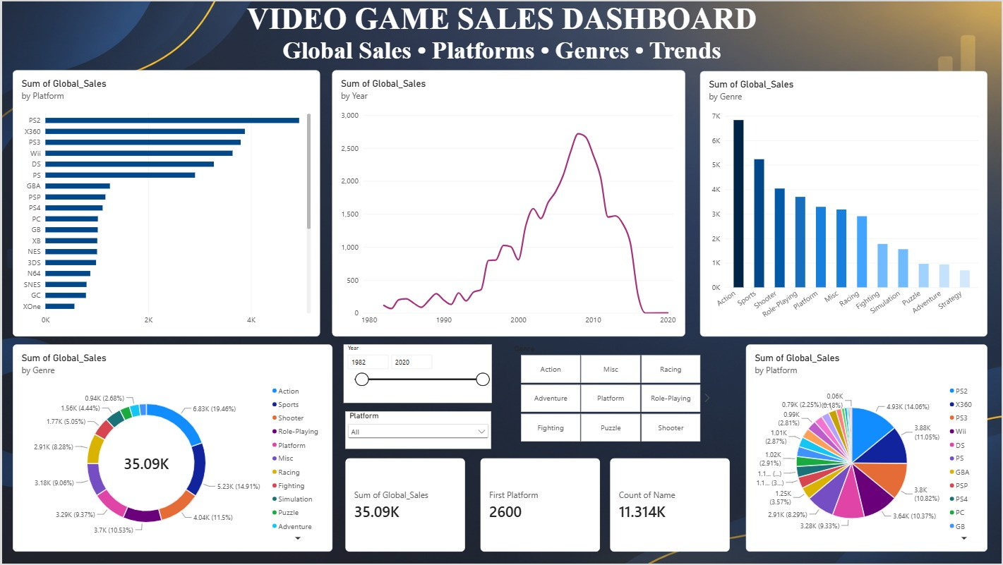
04 | Power BI Dashboard
INSIGHTVISTA 2026 • VIDEO GAME SALES ANALYSIS
4

Slide 6
05 | Observations & Insights
Validate each figure against the Power BI visuals before presenting
What to look for in the dashboard
Top Platform: PS2 has the highest total global sales among platforms.
Top Genre: Action is the leading genre, followed by Sports and Shooter.
Sales Trend: Global sales increased over time, peaked around 2008, and declined afterward.
Genre Contribution: Action contributes the largest share of total genre sales.
Platform Distribution: PS2, X360, PS3 and Wii are among the leading platforms in the dashboard.
Insight statement template
Focus on popular genres such as Action and Sports.
Analyze the sales decline after the peak year.
Compare regional and platform performance before making investment decisions.
INSIGHTVISTA 2026 • VIDEO GAME SALES ANALYSIS
6

Slide 7
06 | Business Recommendations
Actions should follow evidence from the dashboard
01
Focus on Top-Selling Genres
Prioritize Action, Sports, and Shooter games, as they contribute the highest global sales.
02
Target High-Performing Platforms
Focus on PS2, X360, and PS3, which show strong global sales compared with other platforms.
03
Understand Sales Trends
Investigate the sales peak around 2008 and the decline in later years to identify changing market demand.
04
Strengthen Regional Strategies
Compare North America, Europe, Japan, and Other regions to develop targeted marketing and publishing strategies.
05
Improve Future Sales Analysis
Combine sales data with pricing, marketing costs, and profit margins to identify the most profitable games and platforms.
Closing message: Data-driven decisions help identify market opportunities and improve future business performance.
INSIGHTVISTA 2026 • VIDEO GAME SALES ANALYSIS
7

Slide 8
Thank You

