Slide 1
Fine Tuning LLMs with QLORA

Slide 2
Does your use case require Fine tuning ?
Precise output formatting
Consistent response patterns
Adherence to specific guidelines
Improving Domain-specific knowledge : “As a rule of thumb, knowledge is usually absorbed from the pretraining dataset.”(-Sebastian Raschka) Instruction fine tuning is generally more about helping or guiding the LLM towards following instructions.
However, it's worth noting that if memory is a concern, LoRA can also be used for further pretraining existing pretrained LLMs on domain-specific datasets.

Slide 3
Dataset types
A language modeling dataset :A language modeling dataset consists of a column "text" (or "messages" for conversational datasets) containing a full sequence of text.
A prompt-completion dataset includes a "prompt" and a "completion".
A preference dataset is used for tasks where the model is trained to choose between two or more possible completions to the same prompt. This dataset includes a "prompt", a "chosen" completion, and a "rejected" completion.(use with RLHF or DPO)
An unpaired preference dataset is similar to a preference dataset but instead of having "chosen" and "rejected" completions for the same prompt, it includes a single "completion" and a "label" indicating whether the completion is preferred or not.
Stepwise supervision datasets include multiple steps of completions, each with its own label.

Slide 4
Format: Standard Datasets
The standard dataset format typically consists of plain text strings. The columns in the dataset vary depending on the task.
# prompt completion
{"prompt": "The sky is",
"completion": " blue."}
# Stepwise supervision
{"prompt": "Which number is larger, 9.8 or 9.11?",
"completions": ["The fractional part of 9.8 is 0.8.",
"The fractional part of 9.11 is 0.11.",
"0.11 is greater than 0.8.",
"Hence, 9.11 > 9.8."],
"labels": [True, True, False, False]}

Slide 5
Format: Conversational Datasets
Conversational datasets are used for tasks involving dialogues or chat interactions between users and assistants. Unlike standard dataset formats, these contain sequences of messages where each message has a role
messages = [
{"role": "user", "content": "Hello, how are you?"},
{"role": "assistant", "content": "I'm doing great. How can I help you today?"},
{"role": "user", "content": "I'd like to show off how chat templating works!"},
]

Slide 6
Loss calculation during training
For a conversational dataset, we can specify whether to train on the assistant response data alone
For a prompt completion dataset, training will only calculate loss on the completion

Slide 7
Conversational dataset with tool calling
Some chat templates support tool calling, which allows the model to interact with external functions. Such datasets should specify tools in an additional column named ‘tools’ in codified JSON schema format apart from the messages column.
messages = [
{"role": "user", "content": "Turn on the living room lights."},
{"role": "assistant", "tool_calls": [
{"type": "function", "function": {
"name": "control_light",
"arguments": {"room": "living room", "state": "on"}
}}]
},
{"role": "tool", "name": "control_light", "content": "The lights in the living room are now on."},
{"role": "assistant", "content": "Done!"}
] gh

Slide 8
Tool JSON schema
from transformers.utils import get_json_schema
def control_light(room: str, state: str) -> str:
"""
Controls the lights in a room.
Args:
room: The name of the room.
state: The desired state of the light ("on" or "off").
Returns:
str: A message indicating the new state of the lights.
"""
return f"The lights in {room} are now {state}."
# Generate JSON schema
json_schema = get_json_schema(control_light)
{
"type": "function",
"function": {
"name": "control_light",
"description": "Controls the lights in a room.",
"parameters": {
"type": "object",
"properties": {
"room": {"type": "string", "description": "room name."},
"state": {"type": "string", "description": 'state of the light ("on" or "off").'},
},
"required": ["room", "state"],
},
"return": {"type": "string", "description": "str: A message indicating the new state of the lights."},
},
}

Slide 9
Our training dataset ( 50 train, 15 validation)
[
{
"prompt": "Solve using BODMAS: (8 - 3) + 4 * 2",
"completion": "Step 1: Brackets → (8 - 3) = 5\nStep 2: Multiply → 4 * 2 = 8\nStep 3: Addition → 5 + 8 = 13\nFinal Answer: 13"
},
{
"prompt": "Solve using BODMAS: 20 / (2 + 3)",
"completion": "Step 1: Brackets → (2 + 3) = 5\nStep 2: Division → 20 / 5 = 4\nFinal Answer: 4"
},
{
"prompt": "Solve using BODMAS: (6 + 2) * (5 - 3)",
"completion": "Step 1: Brackets → (6 + 2) = 8, (5 - 3) = 2\nStep 2: Multiply → 8 * 2 = 16\nFinal Answer: 16"
}
]

Slide 10
Loading a Dataset
import json
from google.colab import files
uploaded = files.upload()
bodmas_dataset = load_dataset( "json", data_files={ "train": "bodmas.json", "validation": "bodmas_val.json" } )
Result:
DatasetDict({
train: Dataset({
features: ['prompt', 'completion'],
num_rows: 50
})
validation: Dataset({
features: ['prompt', 'completion'],
num_rows: 15
})
})

Slide 11
Training LLMs is memory intensive without LORA
Training involves :
A forward pass to generate an output.
A backward pass where gradients are computed for each weight.
An optimizer that uses the gradients to update the weights. Optimizers have 2 parameters.
 | RAM without QLORA | RAM with QLORA r=16, 8 bit model wt. Training Q/K/V/O - 15 M params, FP16
Weights | 14GB ( 7B x 2 bytes) | 7B(1 byte x 7 B)+2 bytes x .015 GB=7.03 GB+quant. overhead=8.03GB
Gradients | 14GB (7B x 2 bytes) | FP16 x .015 GB = .03GB
Optimizer state | 56GB (7B x 4 bytes x 2 params) | 15M x 4 bytes x 2 =.12 GB

Slide 12
LORA: Basic idea
Suppose we have an LLM with 7B parameters represented in a weight matrix W (mxn dimensional).
During backpropagation, we learn a ΔW matrix, which contains information on how much we want to update the original weights to minimize the loss function during training.
The weight update is then as follows:
W_{updated} = W + ΔW
LORA Approach: Decompose the weight changes, ΔW, into a product of two smaller matrices.
ΔW=AxB , where A =m x r matrix, B=r x n matrix. , and AB will be a higher dimensional mxn matrix

Slide 13
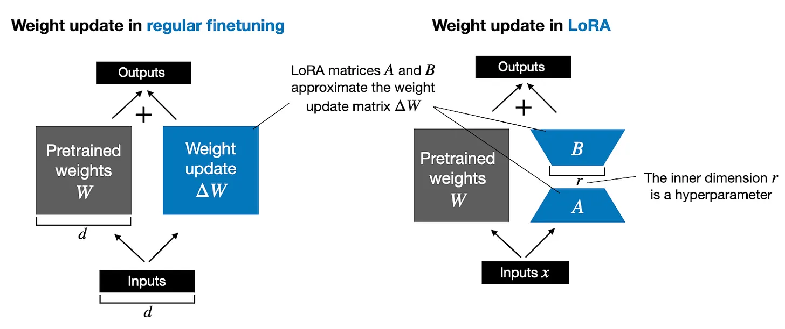
How Lora works

Slide 14
QLORA: add quantization
4-bit Quantization: The base model is loaded in 4-bit precision using bitsandbytes
Frozen Weights: The quantized model weights remain frozen during training
LoRA Adapters: Only the LoRA adapter parameters are trained in higher precision
Memory Efficiency: Enables fine-tuning of models like Llama-70B on a single consumer GPU

Slide 15
QLORA Parameters
LoRA Rank -4 : Dimension of the low‑rank adapters (e.g., 8, 16, 32)
Controls adapter capacity; higher rank = more expressive but heavier
LoRA Alpha (α) : Scaling factor applied to LoRA updates.
Balances adapter contribution vs. base model; stabilizes training
Dropout
Regularizes training, prevents overfitting
Target Modules
Which layers get adapters (e.g., attention projections, feed‑forward layers)
Defines where fine‑tuning happens; common choice is the attention layers
["q_proj", "v_proj", "k_proj", "o_proj"]
Others: Gradient accumulation on/off, learning rates

