Slide 1
Session 2
LLM Inference with Ollama, OpenAI & Langchain basics

Slide 2
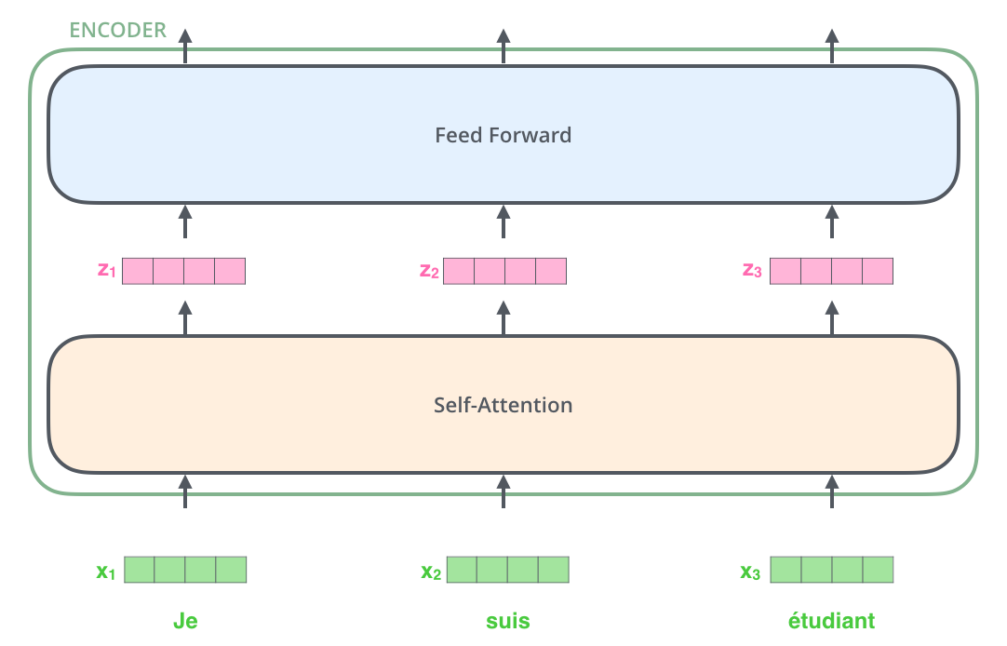
Pending slides: The Transformer architecture

Slide 3
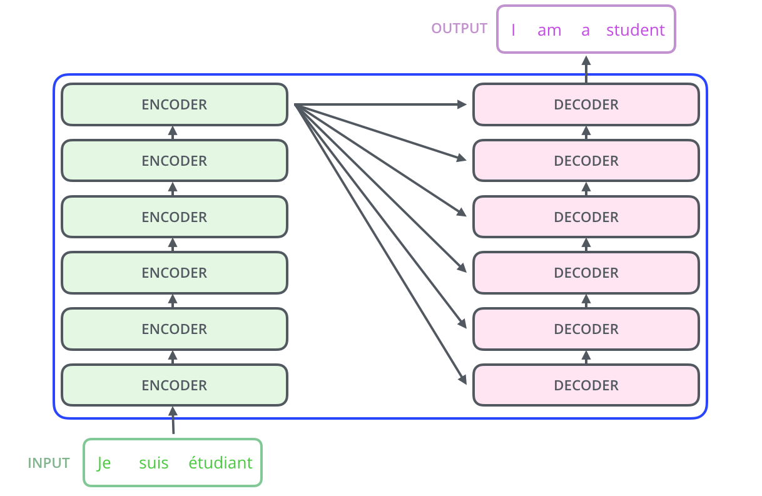
Pending slides: The Transformer architecture

Slide 4
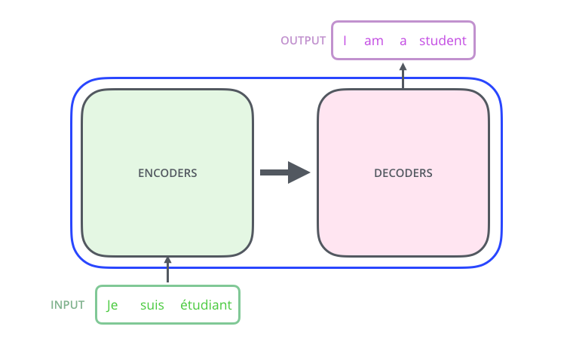
Pending slides: The Transformer architecture

Slide 5
LLM Inference with Ollama, OpenAI & Langchain basics

Slide 6
Options for Local Inference
Ollama: mainly for individual prototyping
vLLM: Better concurrency and performance
LocalAI: Supports audio, vision models as well

Slide 7
Various Model Formats
GGUF: Initially developed for the llama.cpp project. GGUF is primarily used for language models. Offers flexible quantization
Pytorch : .pt/.pth
Safetensors: HuggingFace format that overcomes security limitations with python serialization.JSON parser required to read metadata
ONNX: Open Neural Network Exchange (ONNX) , vendor neutral

Slide 8
Tokens
Tokens are the building blocks of text that models process. They can be as short as a single character or as long as a full word, depending on the language and context. Spaces, punctuation, and partial words all contribute to token counts. This is how the API internally segments your text before generating a response.
Helpful rules of thumb for English:
1 token ≈ 4 characters
1 token ≈ ¾ of a word
100 tokens ≈ 75 words
1–2 sentences ≈ 30 tokens
1 paragraph ≈ 100 tokens
~1,500 words ≈ 2,048 tokens

Slide 9
The need for LLM orchestration Frameworks
An LLM doesn't remember/have access to previous responses it has provided. A common fix for this is to include the conversation so far as part of the prompt sent to the LLM.
Prompts chains can be nested or combined.This lets you build modular systems rather than monolithic scripts (example: a summarization chain feeding into a question‑answering chain)
You don’t have to manually stitch together prompts with past messages.
Consistency across providers. You can swap out the underlying LLM without rewriting the workflow.

Slide 10
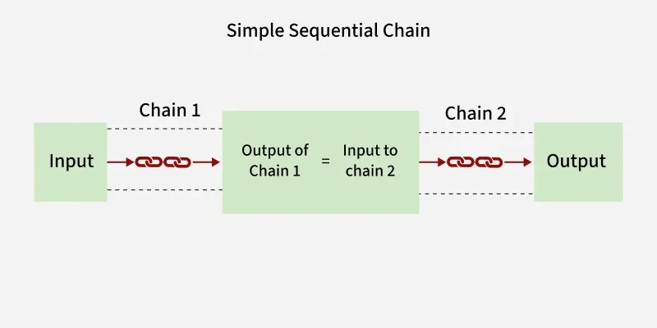
Simple Chain
Each chain in the sequence accepts one input and returns one output. The output of each chain is automatically fed as input to the next chain in the sequence

Slide 11
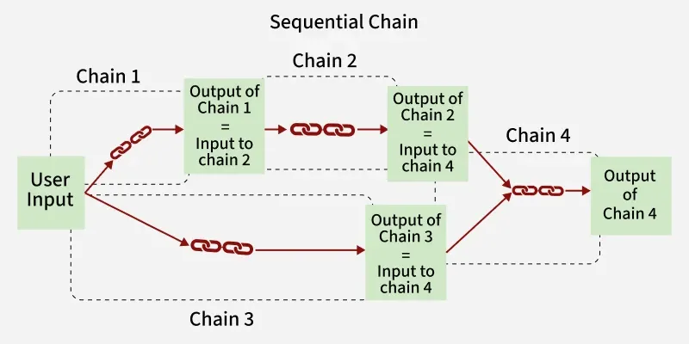
Sequential Chains
complex workflows where chains might depend on several pieces of information.

Slide 12
LangChain framework Core Components
Models: Abstract how to call different model providers
Prompt Templates: Define how user inputs are formatted and structured to guide LLMs effectively
Memory : Store the list of messages sent and received
Chains: Sequence of calls to an LLM
Vector Databases
Agents

Slide 13
ChatOpenAI
ChatOpenAI is the primary class used for chatting with OpenAI models.
LangChain’s interface for interacting with OpenAI’s API.
A subclass of BaseChatModel, which is a generic class that implements subclasses for individual API services

Slide 14
Langchain Memory classes
Automatic history management
ConversationBufferMemory: keeps the full chat history.
ConversationBufferWindowMemory: keeps only the last N turns (avoids token bloat).
ConversationSummaryMemory: summarizes older turns into a compact form.
Plug-and-play with chains
Memory integrates seamlessly with ConversationChain or custom chains.
You don’t have to manually stitch messages into prompts — LangChain does it.
Consistency across models
Whether you use OpenAI, Anthropic, Hugging Face, or Ollama, the memory classes abstract away the differences in message formats.

Slide 15
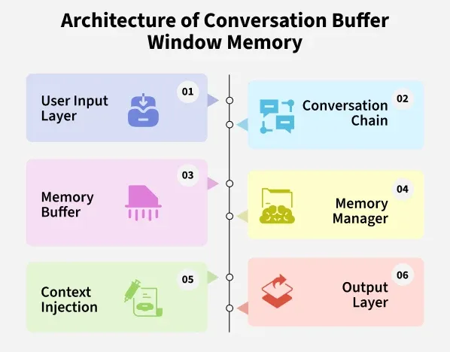
Conversation Buffer Window Memory

Slide 17
Types of Memory
Memory Type | Conversation Buffer Memory | Conversation Buffer Window Memory | Conversation Summary Memory | Vector Store Retriever Memory
What it Stores | Entire conversation history as plain text | Only the most recent k exchanges | Condensed LLM generated summary of past | Embeddings of past conversations in a vector DB
Strengths | Full context preserved, simple to use | Keeps context relevant, avoids token overload | Saves tokens, retains long term context | Semantic recall across long histories
Limitations | Can grow too large and exceed token limits | Loses older parts of the conversation | Summaries may miss important details | Needs external vector DB, higher setup

