Slide 1
Tweet Analysis of TV shows
Group Details:
21) Akash Dhotre (101070041)
26) Priyank Jain (101070048)
40) Prateek Jakate (101070080)
23) Jigar Bhati (101070043)
1

Slide 2
Introduction
Television in India is a huge industry which has thousands of programs in many languages.
As of 2012, the country has a collection of free and subscription services over a variety of distribution media, like the CHERIAN channel, through which there are over 823 channels of which 184 are pay channels.
As the number of people watching television has increased rapidly, it has become a broad market for the various advertising firms.
This firm are now a days more focussed towards broadcasting their ads on television.
For this purpose the concept of TRP has been introduced.

Slide 3
Introduction
Gross rating point
  Gross rating point (GRP) is a term used in advertising to measure the size of an audience reached by a specific media or schedule.
  The purpose of the GRP metric is to measure impressions in relation to the number of people in the audience for an advertising campaign.
  GRPs are the product of the percentage of the audience reached by an advertisement, times the frequency they see it in a given campaign (frequency × % reached).
  GRPs (%) = Reach (%) × Average frequency (#)
  A television advertisement that is aired five times reaching 50% of the audience each time it is aired would have a GRP value of 250 (5 × 50%).

Slide 4
Introduction
Reach (advertising)
  In the application of statistics to advertising and media analysis, reach refers to the total number of different people or households exposed, at least once, to a medium during a given period.
  It is just the number of people who are exposed to the medium and therefore have an opportunity to see or hear the ad or commercial.
  Since reach is a time-dependent summary of aggregate audience behavior, reach figures are meaningless without a period associated with them
  Reach of television channels is often expressed in the form of "x minute weekly reach" - that is, the number (or percentage) of viewers who watched the channel for at least x minutes in a given week.

Slide 5
Introduction
Target Rating Points (TRP)
  Target Rating Points (TRPs) are the gross rating point
delivered by a media vehicle to a specific target audience.
  The purpose of the 'target rating point' metric is to measure impressions in relation to the number of people in a specific target audience for an advertisement.
  Thus, the TRP is a measure of the purchased points representing an estimate of the component of the target audience within the gross audience.
  For example, if an advertisement appears more than once, the entire gross audience also, the TRP figure is the sum of each individual GRP, multiplied by the estimated target audience in the gross audience.

Slide 6
Introduction
The two main organisation which calculate TRP in India are DART and TAM.
DART
  During the days of the single channel Doordarshan monopoly, DART (Doordarshan Audience Research Team) was the only metric available.
  This used the notebook method of recordkeeping across 33 cities across India.
TAM
  TAM (Television Audience Measurement) is the specialised branch of media research, dedicated to quantifying (size) and qualifying (characteristics) this detailed television audience information.

Slide 7
Introduction
  Currently the only electronic rating agency operating in our country is INTAM (Indian Television Audience Management). The two methodologies it adopts for determining TRP’s are
  1. Frequency Monitoring: In this method, meters are installed in the homes which are considered as the sample of the total population.
  2. Picture Matching: It is a relatively new concept to India and in this technique the meters tracks data of the picture that being watched in the household.

Slide 8
Introduction
  Drawback of TRP rating
  The major reason why it can’t be considered foolproof is due to the selection of the sample.
  The ratings derived are measured based on the data collected from top sixteen cities of nine states in India. This sample further does not take into consideration the people from lower middle class and also people from smaller towns.
  Further they have not even considered the elite class on the assumption that these people would prefer to watch high end English channels as compared to the local channels.
  The most crucial part of TRP business is the sample size of the research. Presently, TRP is based upon only a small urban sample of 5500 homes spread all over India.

Slide 9
Fetcher

Slide 10
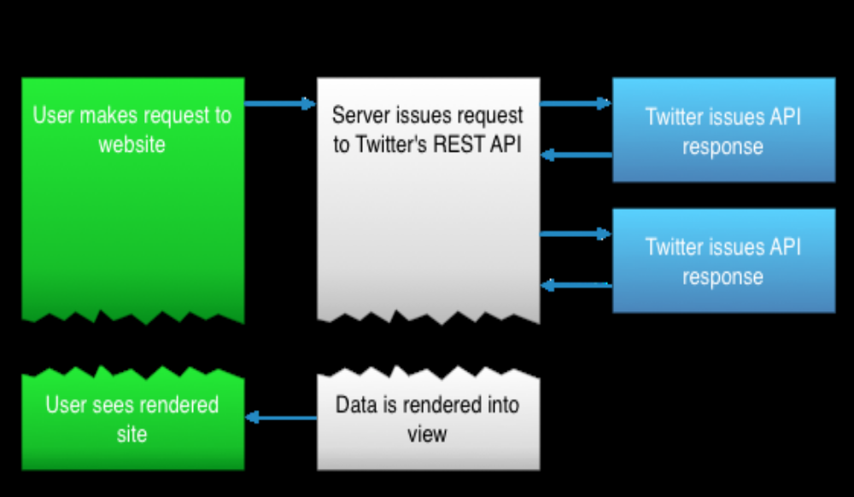
Working of Twitter REST API

Slide 11
About the Twitter Search API
The number of search queries per 15 minutes slot is limited to 180
The number of operators specified in a search query cannot be greater than 10
The search API does not offer tweets older than 7 days
The maximum number of tweets that can be retrieved per page is 100

Slide 12
Gender Analysis
For gender analysis we have used the genderize.io API
All request are sent to the URL: http://api.genderize.io using GET
An example of genderizing a single name could look like this
GET http://api.genderize.io?name=peter
This would render a JSON response like the following. The count represents the number of data entries examined in order to calculate the response.
{"name":"peter","gender":"male","probability":"0.99","count":796}

Slide 13
Sentiment Analysis
For sentiment analysis we have used the LingPipe library, which is based on neural networks.
The training data consists of large number of tweets and their sentiments as prepared by user.
The train() function is used to train the sentiment classifier using the training data and it is saved for later use.
The classifier object is read from a text file and it is used to classify the text of the tweets using the LingPipe library.

Slide 14
Analyzer

Slide 15
Tools Used:
The following tools will be used during the development of the Analyzer:
Platform: Linux (Ubuntu)
Programming language: Java, J2SE
IDE: Eclipse Kepler 4.3
Database: MongoDB, MySQL
Software Framework: Hadoop
Programming Tool (High-Level Platform): Pig Latin
Database Connector: JDBC

Slide 16
MongoDB
Features:
  Cross-platform document-oriented database
  NoSQL database
  JSON-like documents with dynamic schemas
  Is free and open-source
  Replication & High Availability
  Auto-Sharding
  Map/Reduce
Reasons for using MongoDB:
  Schema-less
  Easy to Scale
  No conversion/mapping of application object
  Internal memory working set, faster access speed.
Use:
  Store information about the tweets and the users who have made those tweets.

Slide 17
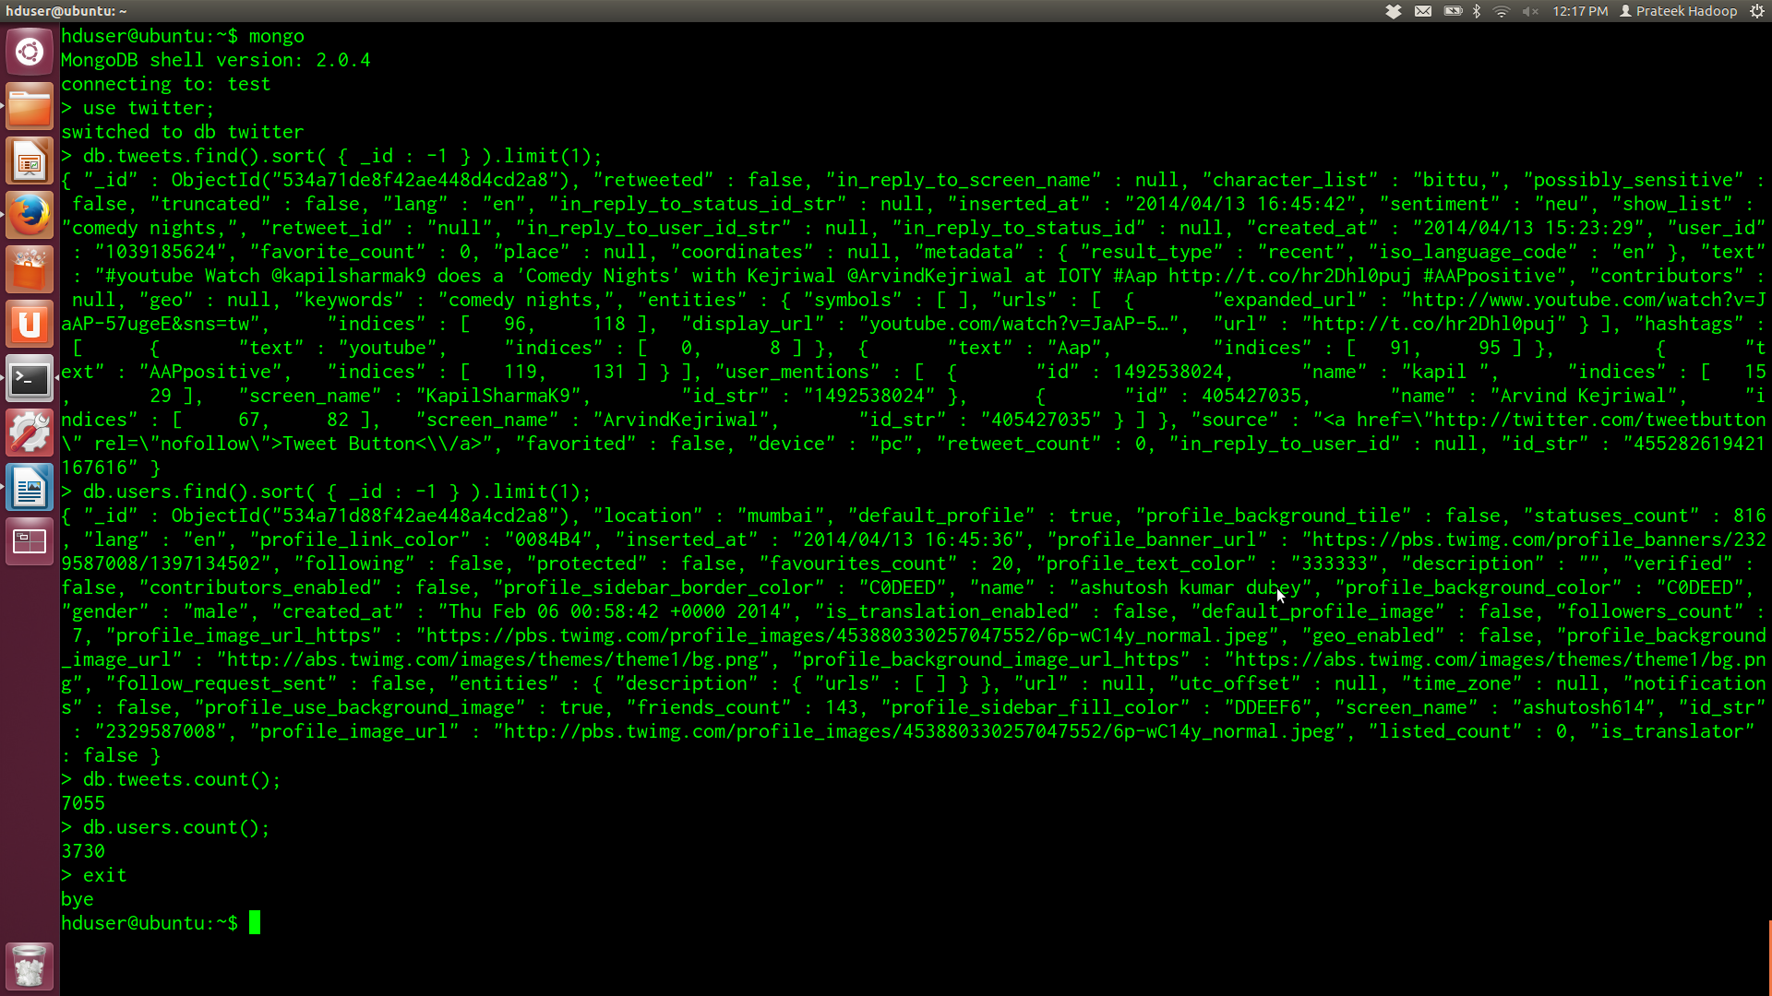
MongoDB (contd)

Slide 18
Software Framework: Hadoop
Framework that allows for the distributed processing of large data sets across clusters of computers using simple programming models.
Highly-available service
HDFS:
  Distributed, scalable, and portable file-system
  Single name node; a cluster of data nodes form the HDFS cluster datanode serves up blocks of data over the network using a block protocol specific to HDFS.
  File system uses the TCP/IP layer for communication.
JobTracker and TaskTracker (MapReduce Engine):
  Client applications submit MapReduce jobs→ JobTracker
  Pushes work to TaskTracker on the node on which data resides or node in the same rack.
  TaskTracker on each node spawns off a separate Java Virtual Machine process

Slide 19
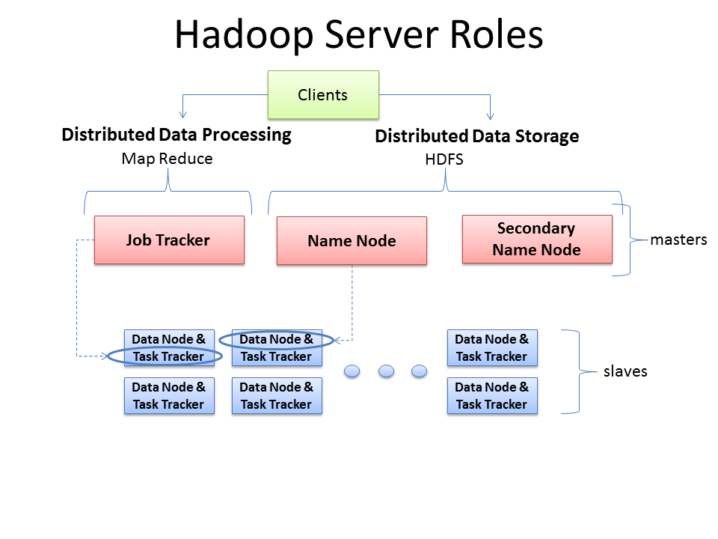
Hadoop Architecture

Slide 20
Software Framework: Hadoop (contd)
Reason for using Hadoop:
  Scalable
  Cost effective
  Flexible
  Fast
  Resilience to failure
Use:
  Works on top of MongoDB.
  Retreives tweets and users from MongoDB and performs distributed parallel execution operations on it.

Slide 21
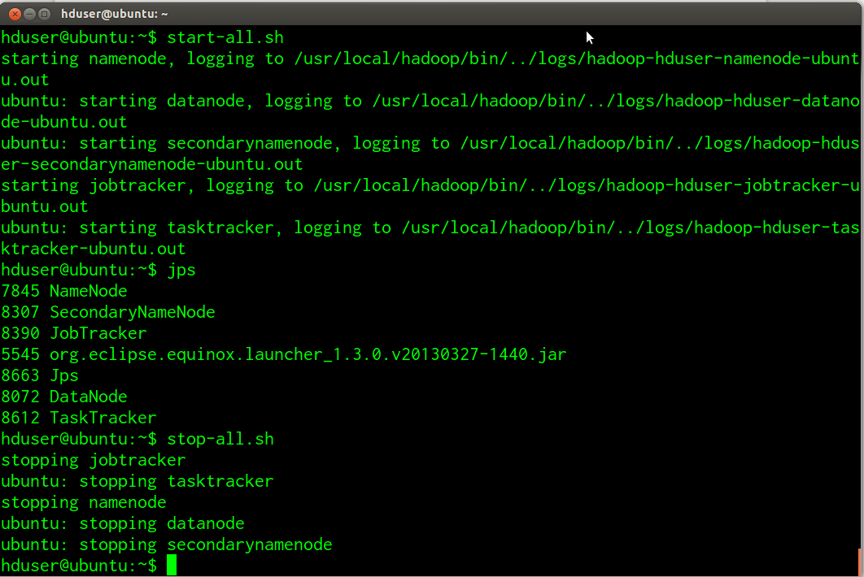
Software Framework: Hadoop (contd)

Slide 22
Programming tool: Pig Latin
Creating MapReduce programs used with Hadoop
Abstracts the programming from the Java MapReduce
Pig Latin can be extended using UDF
In comparison to SQL, Pig
  Uses ETL,
  Is able to store data at any point during a pipeline,
  Declares execution plans,
  Supports pipeline splits.
Reasons for using Pig:
  Multi-query approach
  Supports any type of data
  Common data operations and nested data types
  Easy to use
  It allows User Defined Functions

Slide 23
Programming tool: Pig Latin (contd)
Use:
  Works on top of Hadoop.
  Retrieves tweets and users information from MongoDB and perform FILTER, JOIN and GROUP on them as required.
  Automatically converted to MapReduce code which is executed by Hadoop.
  Pig script is embedded inside Java and the results are manipulated in Java and the first level summary is performed.

Slide 24
Database Connector: JDBC
Features:
  Provides methods for querying and updating data in a database.
  Oriented towards relational databases
  SQL's CREATE, INSERT, UPDATE and DELETE, or they may be query statements such as SELECT
  PreparedStatement
  CallableStatement
Reasons for using JDBC:
  Can read any database if proper drivers are installed.
  Creates XML structure of data from database automatically
  Query and Stored procedure supported.
Use:
  The results of the first level summary are stored inside MySQL database using JDBC drivers.

Slide 25
MySQL Database
Features:
  Open-source relational database management system
  Popular choice for web apps
  Central component of Lampp, Xampp.
Reasons for using MySQL:
  Relational Database System
  Client/Server Architecture
  SQL compatibility
  Foreign key constraints
  Programming languages
  Speed
  Platform independence
Use:
  Used to store the first level summary that is inserted into it by embedded pig in java program using JDBC

Slide 26
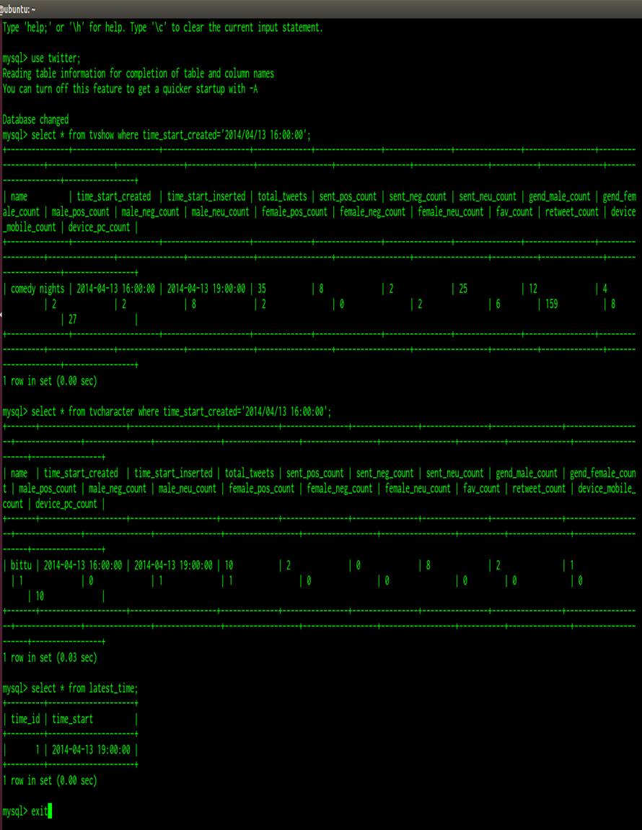
MySQL Database (contd)

Slide 27
Working of the Analyzer
Input from Console:
  Path for pig references, Time for summary
Input from XML files:
  Characters.xml -> Name of all characters
  Shows.xml -> Names of all shows
Prepare PigServer:
  Create properties object and set the values of the properties “fs.default.name” to “hdfs://localhost:9000” and “mapred.job.tracker” to “localhost:9001”.
  Create PigServer object and set the execution type to MAPREDUCE and set the properties using previously created object
Register Pig Jars:
  Use registerJar(“path/file.jar”) function of PigServer to register jars.

Slide 28
Working of the Analyzer (contd)
Execute Pig Script:
  Pig Script is executed by registering the query using registerQuery(“query”) function of PigServer.
  Firstly the pig script retrieves both the tweets and users collections from MongoDB.
  If tweets are present then it performs JOIN on tweets and users collection.
  For every show, it performs FILTER on show_list by using show name and for every character it performs FILTER on character_list using character name.
  Tweets in created in the same hour are grouped.
  Tweets are analyzed on the basis of several parameters.
  Local Map is used to store the results of the analysis with key as created_at coresponding to starting time of the hour.
  It is then inserted into MySQL DB using JDBC.
Once such procedure is completed for all shows and characters, then the latest_time table is updated with latest time of summary.

Slide 29
User Interface

Slide 30
Technologies Used
HTML
CSS
Bootstrap
Javascript
Jquery
Google Charts
amCharts
PHP
MySQL

Slide 31
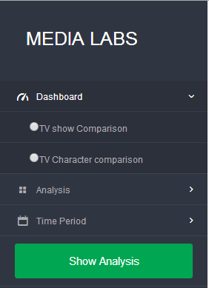
Dimensions of Analysis
  By Subject

Slide 32
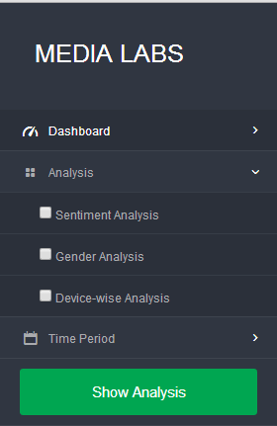
Dimensions of Analysis
  By Gender/Sentiment/Device

Slide 33
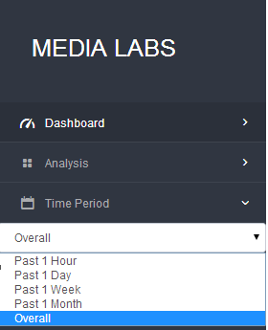
Dimensions of Analysis
  By Time

Slide 34
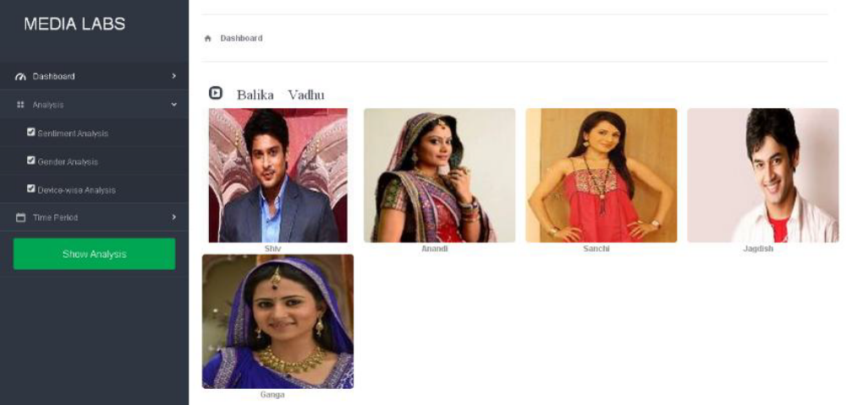
Results of Analysis
  Dashboard

Slide 35
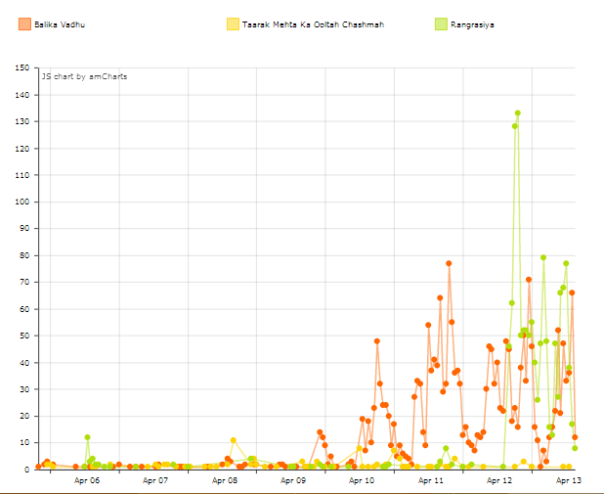
General Analysis

Slide 36
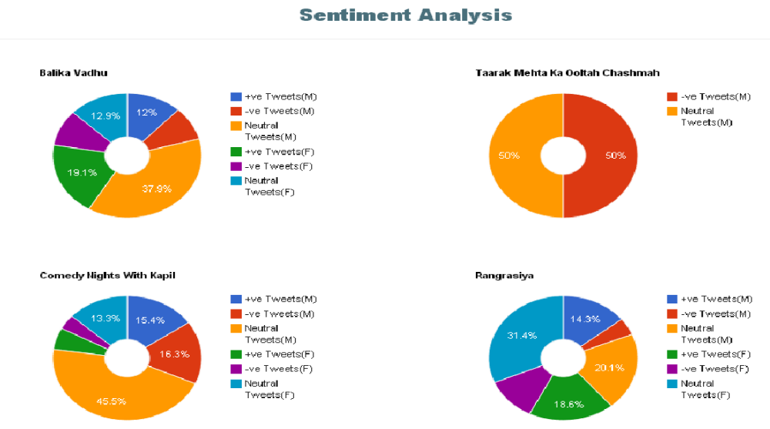
Results of Analysis
  Sentiment Analysis

Slide 37
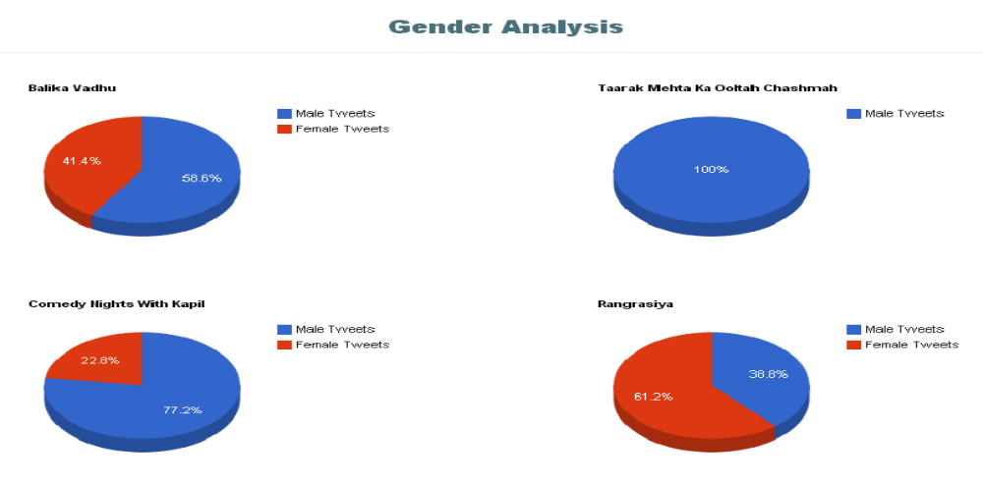
Results of Analysis
  Gender Analysis

Slide 38
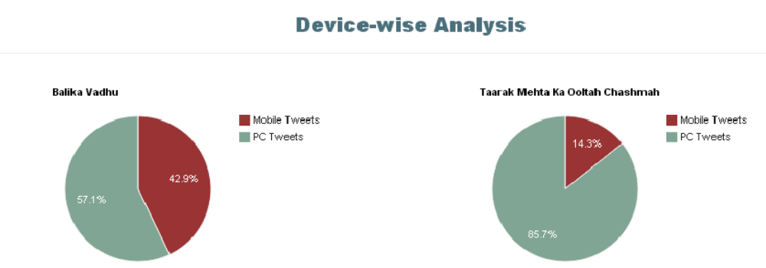
Results of Analysis
  Device Wise Analysis

Slide 39
Thank You

