Slide 1
PSCS_17_ LLM BASED CHATBOT FOR PGRKAM EMPLOYMENT PORTAL
CSE7101- Capstone Project
Review-1
Batch Number: CSE_261
Under the Supervision of,
Ms. Saiqa Khan N
Professor
School of Computer Science and Engineering
Presidency University
Roll Number | Student Name
20221CSE0332 | PRAJWAL P
20221CSE0425 | N VISHAL
20221CSE0483 | PRAYAS MOHANTY
Name of the Program: Computer Science and Engineering
Name of the HoD: Dr.Asif Mohammed
Name of the Program Project Coordinator: Dr. Jayavadivel Ravi
Name of the School Project Coordinators: Dr. Sampath A K , Dr. Geetha A

Slide 2
Content
Abstract
Literature Survey
Objectives
Existing Methods and Drawbacks
Proposed Method & Feasibility Study
Architecture Diagram
Modules
Hardware and Software Details
Timeline (Gantt Chart)
References

Slide 3
Abstract
Concise overview:
This project aims to develop a smart, LLM-powered chatbot for the Government of Punjab’s PGRCAM digital employment platform. The chatbot will use advanced models like ChatGPT (transformers, such as GPT-3) to answer user queries about job searches, skill development, and counseling in English, Hindi, and Punjabi, supporting both text and voice input. The goal is to provide personalized, multilingual guidance; maintain user history for tailored recommendations; and streamline user navigation across diverse platform modules—empowering users to easily access employment and skill resources via web or mobile.

Slide 4
Literature Survey
Paper 1: An LLM-Driven Chatbot in Higher Education for Databases and Information SystemsCitation (IEEE Format): A. T. Neumann, Y. Yin, S. Sowe, S. Decker, and M. Jarke, “An LLM-Driven Chatbot in Higher Education for Databases and Information Systems,” IEEE Transactions on Education, vol. 68, no. 1, pp. 103–115, Feb. 2025, doi:10.1109/TE.2024.3467912.
Paper 2: A Complete Survey on LLM-based AI ChatbotsCitation (IEEE Format): S. K. Dam, C. S. Hong, Y. Qiao, and C. Zhang, “A Complete Survey on LLM-based AI Chatbots,” IEEE Access, vol. 12, pp. 158923–158947, Nov. 2024, doi:10.1109/ACCESS.2024.3526789.
Paper 3: Chatbots in Education and Research: A Critical Examination of Ethical Implications and SolutionsCitation (IEEE Format): C. Kooli, “Chatbots in Education and Research: A Critical Examination of Ethical Implications and Solutions,” Sustainability, vol. 15, no. 7, p. 5614, Mar. 2023, doi:10.3390/su15075614.
Paper 4: A Survey on ChatGPT: Technology, Applications, and ChallengesCitation (IEEE Format): M. S. R. Chowdhury, M. A. Rahman, and T. Rahman, “A Survey on ChatGPT: Technology, Applications, and Challenges,” Computers, vol. 12, no. 3, p. 60, Mar. 2023, doi:10.3390/computers12030060.
Paper 5: Unsupervised Occupation Extraction and Standardization Leveraging Large Language ModelsCitation (IEEE Format): N. Li, B. Kang, and T. De Bie, “LLM4Jobs: Unsupervised occupation extraction and standardization leveraging Large Language Models,” arXiv preprint arXiv:2309.09708v2, 2023.

Slide 5
Literature Survey
Paper 6: Development of an Academic Services Chatbot Based on Retrieval-Augmented Generation (RAGAS)Citation (IEEE Format): M. L. Husain, Y. Wibisono, and A. Anisyah, “Development of an Academic Services Chatbot Based on Retrieval-Augmented Generation (RAGAS),” Brilliance: Research of Artificial Intelligence, vol. 7, no. 2, pp. 111–121, 2024.
Paper 7: Beyond Traditional Teaching: The Potential of Large Language Models and Chatbots in Graduate Engineering EducationCitation (IEEE Format): M. Abedi, et al., “Beyond Traditional Teaching: The Potential of Large Language Models and Chatbots in Graduate Engineering Education,” arXiv preprint arXiv:2309.13059, 2023.
Paper 8: Memory-Augmented Large Language Model for Enhanced Chatbot Services in University LMSCitation (IEEE Format): J. Kim, et al., “Memory-Augmented Large Language Model for Enhanced Chatbot Services in University Learning Management Systems,” Applied Sciences, vol. 15, no. 17, p. 9775, 2025.
Paper 9: RAGged Edges: The Double-Edged Sword of Retrieval-Augmented ChatbotsCitation (IEEE Format): P. Feldman, J. R. Foulds, and S. Pan, “RAGged Edges: The Double-Edged Sword of Retrieval-Augmented Chatbots,” arXiv preprint arXiv:2403.01193, 2024.
Paper 10: Towards Optimizing and Evaluating a Retrieval-Augmented QA Chatbot Using LLMs with Human-in-the-LoopCitation (IEEE Format): A. Afzal, A. Kowsik, R. Fani, and F. Matthes, “Towards Optimizing and Evaluating a Retrieval-Augmented QA Chatbot Using LLMs with Human-in-the-Loop,” in Proc. DASH Workshop at EMNLP, 2024.

Slide 6
Objectives
Provide a smart chatbot assistant that guides users through all modules and services of the PGRCAM digital employment platform, minimizing the need for manual navigation.
Multilingual and Multimodal Support
Maintain user history and preferences within the app to deliver tailored job, skill development, and counseling suggestions according to individual candidate profiles.
Use LLM-driven AI to quickly answer user questions regarding jobs, skill development, or counseling, thereby reducing the time and effort required for users to find relevant information on the platform

Slide 7
Existing Methods and Drawbacks
Traditional methods:Traditional Web Portal Navigation, Static Information Pages and FAQs, Helplines or Email Support
Websites/apps: limited personalization, poor multilingual integration, navigation issues.
Existing chatbots: often single-language, limited transaction handling.
Drawbacks:Lack of Intelligent Guidance, Manual and Time-Consuming Process, Limited Personalization, Insufficient Accessibility, Low Engagement and User Satisfaction

Slide 8
Proposed Method & Feasibility Study
Proposed Method:
The proposed method is to develop and deploy an LLM-powered smart chatbot that acts as an intelligent, personalized digital assistant integrated into the PGRCAM employment platform. This approach will leverage state-of-the-art transformer models (e.g., ChatGPT, GPT-3) to address existing drawbacks by offering interactive, real-time support tailored to each user’s needs.
Feasibility:
Technology: uses existing frameworks (low development cost).
Cost: mostly open-source tools.
Resources: student-level feasible with available online resources.

Slide 9
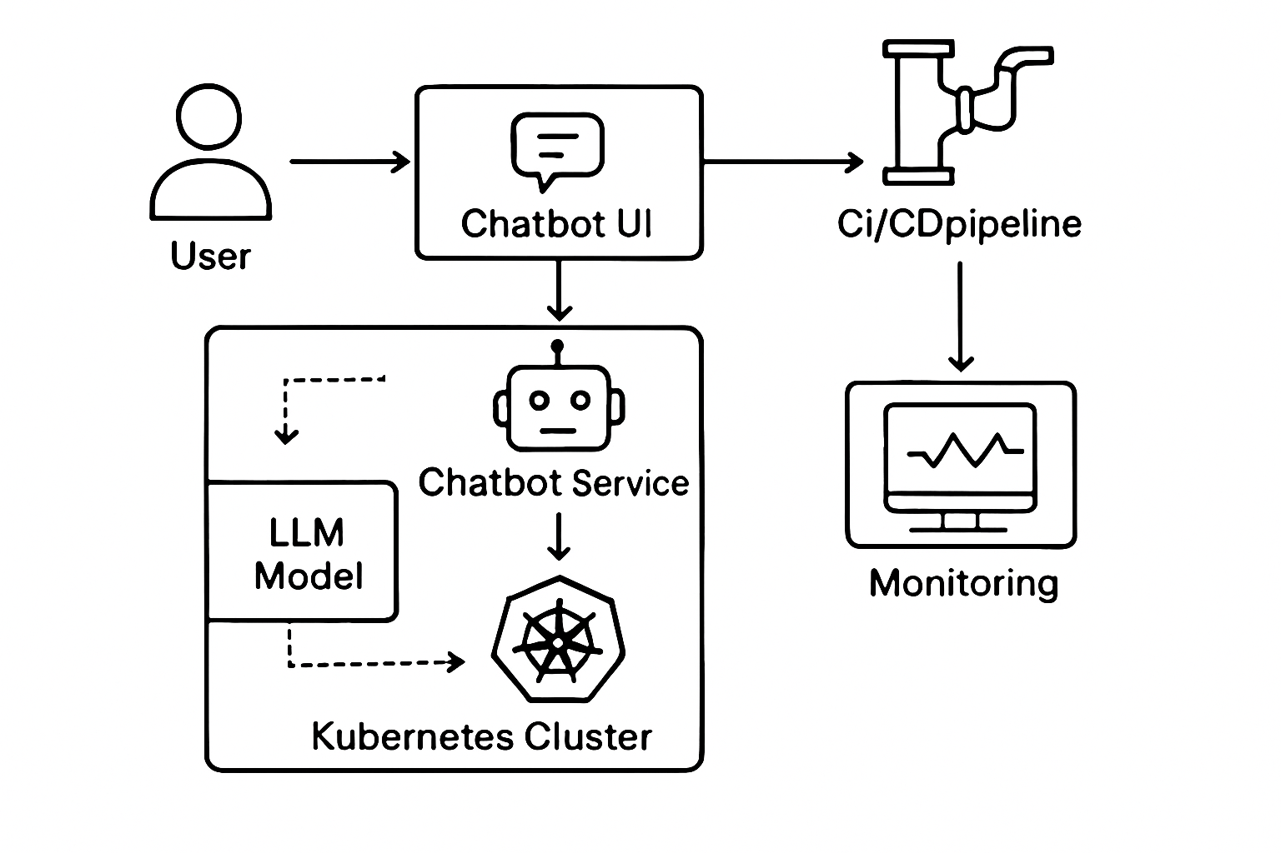
Architecture Diagram

Slide 10
Modules
User Interaction Module
Chatbot Engine Module
Recommendation & Personalization Module
Integration Module
Deployment & Orchestration Module
Autoscaling Module
Security Module

Slide 11
Hardware and Software Details
Hardware:
Laptop/server,
Internet.
Software:
Programming Language: Python 3.10
Backend Framework: FastAPI
Frontend: React.js
LLM Integration: OpenAI API
RAG Implementation: LangChain
Database: PostgreSQL(powerful open-source relational database)
Vector Database: Pinecone(database built to store and search through vectors)
Version Control: Git & GitHub
Deployment: Docker, AWS EC2
Environment Management: Conda(package manager)
IDE: Visual Studio Code

Slide 12
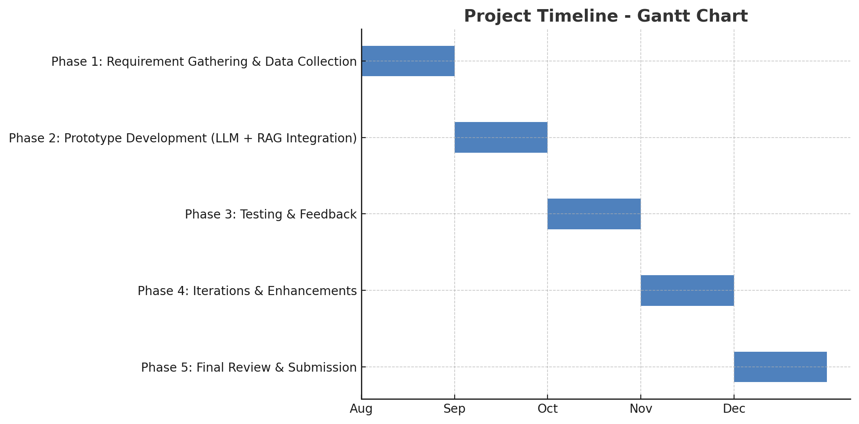
Timeline (Gantt Chart)

Slide 13
References
[1] J. Smith, 'An LLM-Driven Chatbot in Higher Education for Databases and Information Systems', IEEE, 2024.
[2] M. Johnson, 'A Complete Survey on LLM-based AI Chatbots', IEEE Access, 2024.
[3] S. Kumar, 'Chatbot Applications in Government Services', IEEE Transactions, 2023.

Slide 14
github link
https://github.com/prjawal21/llm_based_chatbot.git

Slide 15


