Slide 1

Puppet Configuration Management Tool
DevOps Training
@copyright of www.cloudbearers.com

Slide 2
CONFIGURATION MANAGEMENT
Managing large infrastructures by hand clearly won't scale.
A configuration management system lets us establish a single, authoritative source for system configurations
Abstracted from the OS
Changes can be deployed to 1000 machines just as easily as 1. Policy compliance is enforced.

Slide 3
Infrastructure as code
Resource Abstraction Language (RAL):
Define particular system resources (eg: files, packages, users) independently of the underlying OS
Describe the desired state of the system in your RAL.
It's up to the config management system to bring everything into line.

Slide 4
Infrastructure as code
Resource Abstraction Language (RAL):
Define particular system resources (eg: files, packages, users) independently of the underlying OS
Describe the desired state of the system in your RAL.
It's up to the config management system to bring everything into line.

Slide 5
Options
CFEngine : RAL is based on C fast and light weight
Chef: RAL written in Ruby and used in deployments
Ansible: – Script-based approach with “Playbooks”.
Salt : Agent (minion) runs on each host .”configuration directives”

Slide 6
Puppet
Why Puppet? –
Quite a high level RAL in the form of manifests.
Very active community. (more than 7000 open modules available)
Ability to define environments.
Strong dependency management.
Large surrounding toolset.
Easy language [Puppet DSL : Syntax] & Open Source

Slide 7
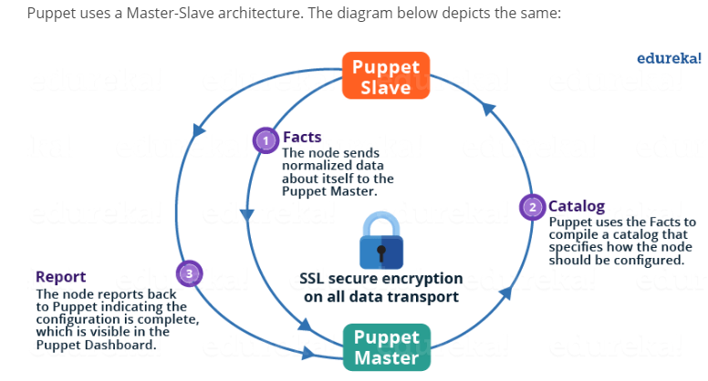

Puppet architecture

Slide 8
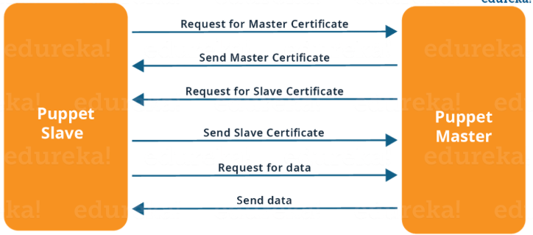
Puppet MASTER/SLAVE COMMUNICATION

Slide 9
Puppet MAIN Components
Puppetmaster: –
- Distributes manifests to agents on demand.
- Environments give the ability to serve out different versions of code to your agents.
Puppet agent: –
- Implements manifests (locally, or from puppetmaster).
Facter: –
- Gathers metadata about the host, which can be used in manifests.

Slide 10
Puppet MAIN Components (cont)
Puppetdb: - Collects data generated by puppet agents, for use in other puppet manifests.
Hiera: – Define hierarchical data for use in puppet manifests.
Puppet ecosystem: –
Foreman – Stats, audits, server lifecycle control. –
MCollective – Parallel job execution framework.
Blueprint – Generate manifests from existing system.
Augeas – Edit legacy config files

Slide 11
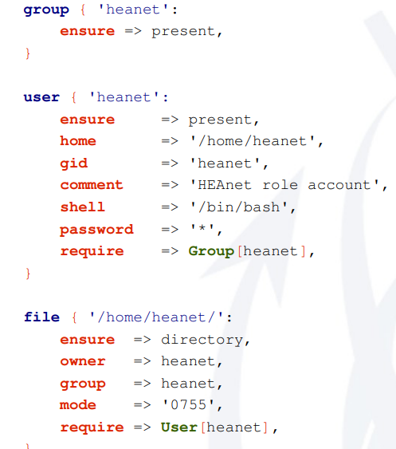
Puppet Manifest EXAMPLE

Slide 12
Puppet modules
Puppet manifests, files and templates can be packaged into a module.
● Modules are intended to be self-contained and reusable: – Ntp server module. – Apache server module.
● The puppet community publishes an extensive collection of modules on the puppet forge: – http://forge.puppetlabs.com

Slide 13
Puppet GOOD PRACTICES
Infrastructure is now code, so.
Put your manifests under version control.
Never allow changes to be made on the live puppetmaster. –
Automate/code deployment procedures.

Slide 14
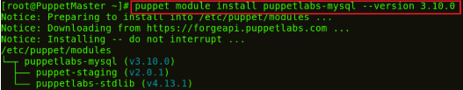
Puppet handson 1
Step 1: In Puppet Master install MySQL and PHP modules.
COMMAND :
puppet module install puppetlabs-mysql –version 3.10.0
This MySQL module installs, configures, and manages the MySQL service. This module manages both the installation and configuration of MySQL, as well as extending Puppet to allow management of MySQL resources, such as databases, users, and grants.

Slide 15

Puppet handson 1 (cont)
2: Command
puppet module install mayflower-php –version 4.0.0-beta1
This module is used for managing PHP, in particular php-fpm. PHP-FPM (FastCGI Process Manager) is an alternative PHP FastCGI implementation with some additional features useful for sites of any size, especially busier sites

Slide 16
Puppet handson 1 (cont)
2: Command
puppet module install mayflower-php –version 4.0.0-beta1
This module is used for managing PHP, in particular php-fpm. PHP-FPM (FastCGI Process Manager) is an alternative PHP FastCGI implementation with some additional features useful for sites of any size, especially busier sites

Slide 17
Puppet handson 1(cont)
Step 2: In Puppet Manifests include MySQL server and PHP.
Execute this: vi /etc/puppet/manifests/site.pp
You can use any other editor as well like vim, gedit etc. In this site.pp file add the following:
1include '::mysql::server'
2 include '::php'
Save and quit.

Slide 18

Puppet handson 1 (cont)
Step 3: Puppet Slaves pulls its configuration from the Master periodically (after every 30 minutes). It will evaluate the main manifest and apply the module that specifies MySQL and PHP setup. If you want to try it out immediately, you need to run the following command on every Slave node:
Execute this: puppet agent –t

Slide 19
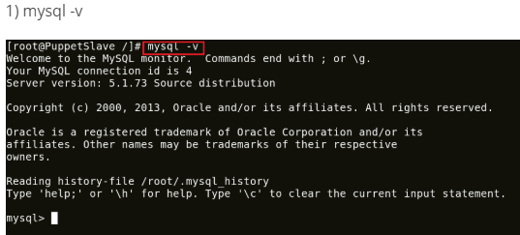
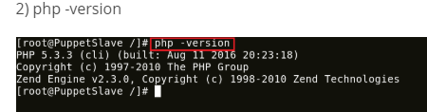
Puppet handson 1(cont)
Step 4: To check the version of MySQL and PHP installed:

Slide 20

THANK YOU!
training@laksans.com
@copyright of www.laksans.com

