Slide 1

Source Control Systems Git & Svn
DevOps Training
@copyright of www.cloudbearers.com

Slide 2
Basic Intro to Git
Discuss how Git differs from Subversion
Discuss the basic Git model
Pull/clone files from a repository on github
Edit files in your own local Git repo
Push files to a repo on github

Slide 3
Version control systems
Version control (or revision control, or source control) is all about managing multiple versions of documents, programs, web sites, etc.
Almost all “real” projects use some kind of version control
Essential for team projects, but also very useful for individual projects
Some well-known version control systems are CVS, Subversion, Mercurial, and Git
CVS and Subversion use a “central” repository; users “check out” files, work on them, and “check them in”
Mercurial and Git treat all repositories as equal
Distributed systems like Mercurial and Git are are gradually replacing centralized systems like CVS and Subversion

Slide 4
Why version control?
For working by yourself:
Gives you a “time machine” for going back to earlier versions
Gives you great support for different versions (standalone, web app, etc.) of the same basic project
For working with others:
Greatly simplifies concurrent work, merging changes

Slide 5
Features of version control
Manages file sharing for Concurrent Development
Keeps track of changes and Copies with Version Control

Slide 6
Concurrent development
Server holds all original files of a project
Gives out copies to participants (clients)
Participants modify their copies & Submit their changes to server
Automatically merges changes into original files. Huge!
Conflicts only occur when modifications are done
by more then one participant
at the same location in their respective copies.
Then participants have to manually resolve such conflicts. Rare!
Powerful edit and merge tools help make this task easy

Slide 7
SVN v/s Git
SVN:
central repository approach – the main repository is the only “true” source, only the main repository has the complete file history
Users check out local copies of the current version
Git:
Distributed repository approach – every checkout of the repository is a full fledged repository, complete with history
Greater redundancy and speed
Branching and merging repositories is more heavily used as a result

Slide 8
Git History
Came out of Linux development community
Linus Torvalds, 2005
Initial goals:
Speed
Support for non-linear development (thousands of parallel branches)
Fully distributed
Able to handle large projects like Linux efficiently

Slide 9
Git Resources
At the command line: (where verb = config, add, commit, etc.)
$ git help <verb>
$ git <verb> --help
$ man git-<verb>
Free on-line book: http://git-scm.com/book
Git tutorial: http://schacon.github.com/git/gittutorial.html
Reference page for Git: http://gitref.org/index.html
Git website: http://git-scm.com/

Slide 10
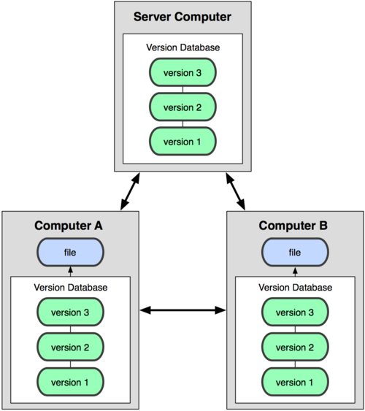

Git uses a distributed model
Distributed Model
Centralized Model

Slide 11
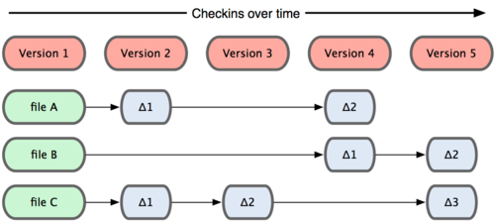
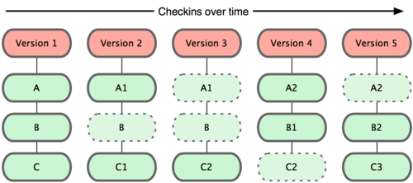
Git takes snapshots
Subversion
Git

Slide 12
Git uses checksums
In Subversion each modification to the central repo incremented the version # of the overall repo.
How will this numbering scheme work when each user has their own copy of the repo, and commits changes to their local copy of the repo before pushing to the central server?????
Instead, Git generates a unique SHA-1 hash – 40 character string of hex digits, for every commit. Refer to commits by this ID rather than a version number. Often we only see the first 7 characters:
1677b2d Edited first line of readme
258efa7 Added line to readme
0e52da7 Initial commit

Slide 13

A Local Git project has three areas

Slide 14
Basic Workflow
Basic Git workflow:
Modify files in your working directory.
Stage files, adding snapshots of them to your staging area.
Do a commit, which takes the files as they are in the staging area and stores that snapshot permanently to your Git directory.

Slide 15
what is github?
GitHub.com is a site for online storage of Git repositories.
Many open source projects use it, such as the Linux kernel.
You can get free space for open source projects or you can pay for private projects.
Question: Do I have to use github to use Git?
Answer: No!
you can use Git completely locally for your own purposes, or
you or someone else could set up a server to share files, or
you could share a repo with users on the same file system

Slide 16
Get ready to use Git!
Set the name and email for Git to use when you commit:
$ git config --global user.name “firstname lastname”
$ git config --global user.email @gmail.com
You can call git config –list to verify these are set.
These will be set globally for all Git projects you work with.
You can also set variables on a project-only basis by not using the --global flag.
You can also set the editor that is used for writing commit messages: $ git config --global core.editor emacs (it is vim by default)

Slide 17
Git commands
command | description
git clone url [dir] | copy a git repository so you can add to it
git add files | adds file contents to the staging area
git commit | records a snapshot of the staging area
git status | view the status of your files in the working directory and staging area
git diff | shows diff of what is staged and what is modified but unstaged
git help [command] | get help info about a particular command
git pull | fetch from a remote repo and try to merge into the current branch
git push | push your new branches and data to a remote repository
others: init, reset, branch, checkout, merge, log, tag

Slide 18
Committing files
The first time we ask a file to be tracked, and every time before we commit a file we must add it to the staging area:
$ git add README.txt hello.java
This takes a snapshot of these files at this point in time and adds it to the staging area.
To move staged changes into the repo we commit:
$ git commit –m “Fixing bug #22”
Note: To unstage a change on a file before you have committed it:
$ git reset HEAD -- filename
Note: To unmodify a modified file:
$ git checkout -- filename
Note: These commands are just acting on your local version of repo.

Slide 19
Status and Diff
To view the status of your files in the working directory and staging area:
$ git status or
$ git status –s
(-s shows a short one line version similar to svn)
To see what is modified but unstaged:
$ git diff
To see staged changes:
$ git diff --cached

Slide 20
Viewing logs
To see a log of all changes in your local repo:
$ git log or
$ git log --oneline (to show a shorter version)
1677b2d Edited first line of readme
258efa7 Added line to readme
0e52da7 Initial commit
git log -5 (to show only the 5 most recent updates, etc.)
Note: changes will be listed by commitID #, (SHA-1 hash)
Note: changes made to the remote repo before the last time you cloned/pulled from it will also be included here

Slide 21
Pulling and Pushing
Good practice:
Add and Commit your changes to your local repo
Pull from remote repo to get most recent changes (fix conflicts if necessary, add and commit them to your local repo)
Push your changes to the remote repo
To fetch the most recent updates from the remote repo into your local repo, and put them into your working directory:
$ git pull origin master
To push your changes from your local repo to the remote repo:

Slide 22
Pulling and Pushing [continue]
git push origin master
Notes: origin = an alias for the URL you cloned from
master = the remote branch you are pulling from/pushing to, (the local branch you are pulling to/pushing from is your current branch)
Note: On attu you will get a Gtk-warning, you can ignore this

Slide 23
BRANCHING
To create a branch called experimental:
$ git branch experimental
To list all branches: (* shows which one you are currently on)
$ git branch
To switch to the experimental branch:
$ git checkout experimental
Later on, changes between the two branches differ, to merge changes from experimental into the master:
$ git checkout master
$ git merge experimental
Note: git log --graph can be useful for showing branches.
Note: These branches are in your local repo!

Slide 24
Hands on 1
$ git config --global user.name “Your Name”
$ git config --global user.email youremail@whatever.com
$ git clone https://github.com/PROJ/REPO.git
Then try:
$ git log, $ git log --oneline
Create a file named userID.txt (e.g. rea.txt)
$ git status, $ git status –s
Add the file: $ git add userID.txt

Slide 25
Hands on 2
$ git status, $ git status –s
Commit the file to your local repo: $ git commit –m “added rea.txt file”
$ git status, $ git status –s, $ git log --oneline
*WAIT, DO NOT GO ON TO THE NEXT STEPS UNTIL YOU ARE TOLD TO!!
Pull from remote repo: $git pull <GITHUB> master
Push to remote repo: $git push <GITHUB> master

Slide 26

THANK YOU!
training@laksans.com
@copyright of www.cloudbearers.com

