Slide 1

DevOps Engineer Training
Introduction

Slide 2
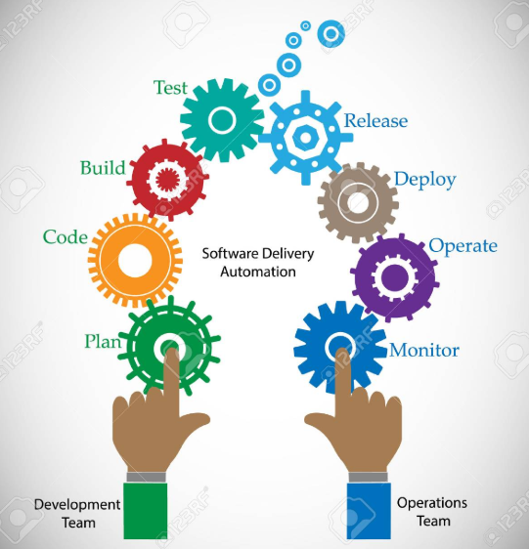
What Is DevOps?
DevOps is a set of processes and practices to bridge the gap between Agile Software Development and Operations

Slide 3
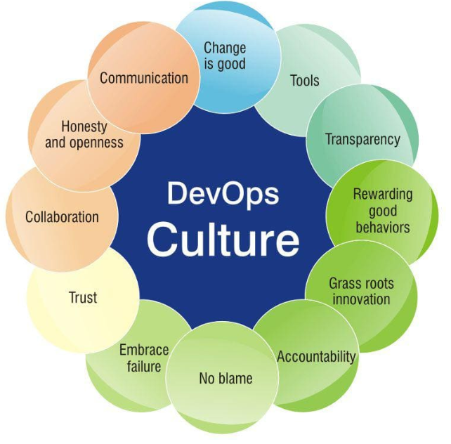
Why DevOps?
Shorter Development Cycles
Faster Innovation
Reduce Implementation Failure
Faster Recovery
Better Communication and Cooperation
Reduce Costs

Slide 4
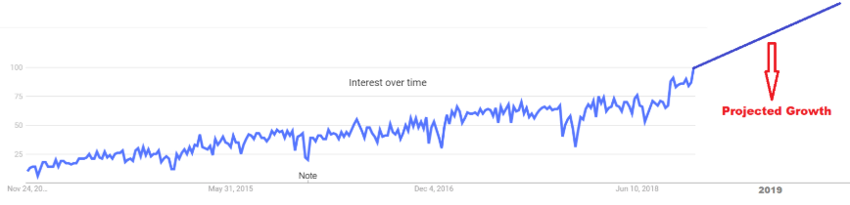
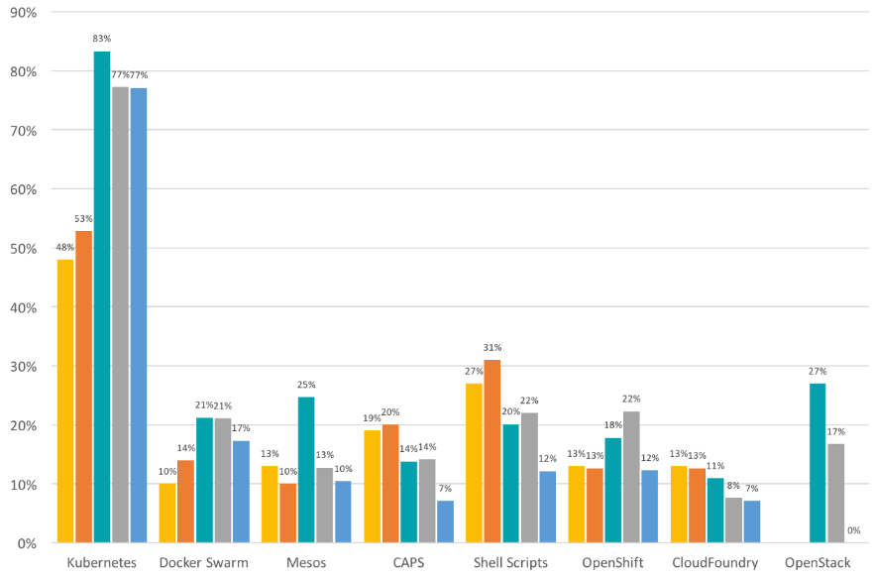
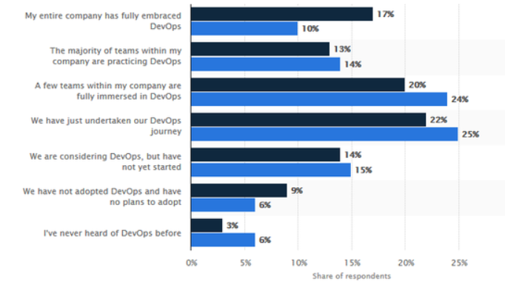
Why To Adopt to DevOps?
The Shift of Focus From CI Pipelines to DevOps Assembly Lines
Automation Will Become the Primary Focus
Testers Are Expected to Learn to Code
Increase in the Adoption of Microservices Architecture (FaaS)
Container orchestration with Kubernetes Is Going to Evolve Significantly
Infrastructure as a Service (IaaS) push
Automated DB Deployments
Security across the process chain

Slide 5
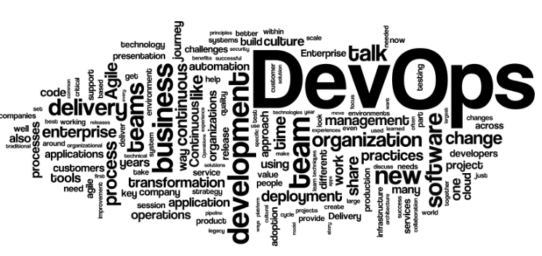
Benefits Of Being DevOps Engineer
Why Should I Take This Course?
Niche Technology Skills
High Market Demand
Long Term Projects
Higher Billing Rate
Low Resource Pool
Continue to learn Cutting Edge Technologies
According to one of the leading sourcing company “RHT”, the market for DevOps Engineers is extremely strong.
For professionals to succeed in DevOps environments, they need strong communication and collaboration skills, as well as critical-thinking and problem-solving skills, to keep projects running smoothly. They need to be Jack of All Trades!
According to job sites, DevOps engineer is the #1 hardest job to fill
More than 65% of engineers are changing jobs and many of them going into roles related to DevOps.

Slide 6

Your Trainers
3 Trainers
More than 45 years of collective experience
Career DevOps Technologists
Developed World Class Products
Practicing Cutting Edge Technologies
Automotive & Finance companies background
6

Slide 7

Who Can Take This Course?
Software Engineers
QA Engineers
Any one with Technology Background
Build & Release Engineers

Slide 8
Course Outline
Where?
> Instructor Led
> Online
> Home practice
1
When?
> 11/9/2019 – 1/11/2020 [10 weeks]
> Saturday [9 am – 1 pm]
> Tuesday & Thursday [8 pm – 9 pm]
2
What?
>https://github.com/prkatta/dotraining/blob/master/Session-00/DevOpsEngineerTraining_Modules.pdf
3

Slide 9

THANK YOU!
training@laksans.com

