Slide 1

DevOps Principles
DevOps Training

Slide 2
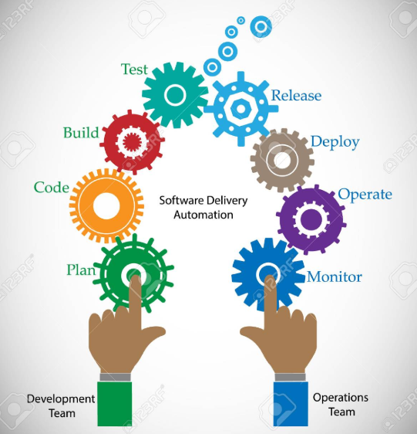
What Is DevOps?
DevOps is a set of processes and practices to bridge the gap between Agile Software Development and Operations

Slide 3
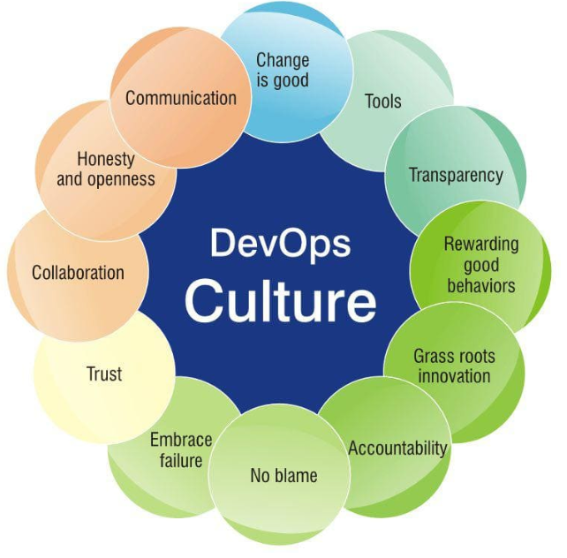
Why DevOps?
Shorter Development Cycles
Faster Innovation
Reduce Implementation Failure
Faster Recovery
Better Communication and Cooperation
Reduce Costs

Slide 4
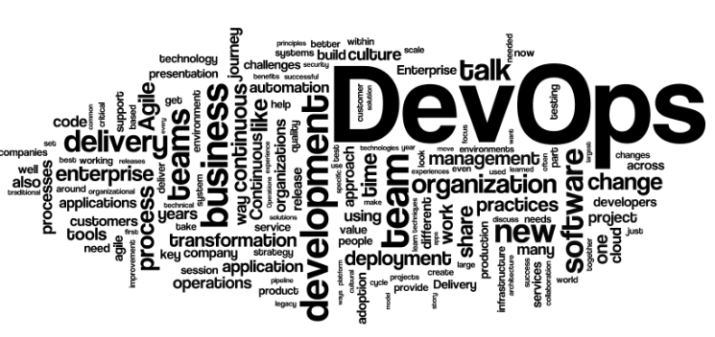
Benefits Of Being DevOps Engineer
Why To Adopt to DevOps?
The Shift of Focus From CI Pipelines to DevOps Assembly Lines
Automation is the Primary Focus
Testers Are Expected to Learn to Code
Increase in Microservices (FaaS)
Container orchestration with Kubernetes
Infrastructure as a Service (IaaS) push
Automated DB Deployments
Security across the process chain
Niche Technology Skills
High Market Demand
Long Term Projects
Higher Billing Rate
Low Resource Pool
Continue to learn Cutting Edge Technologies

Slide 9

THANK YOU!
training@laksans.com

