Slide 1
Create/Restful controller
CRUD | HTTP Verbs | Actions Involved (rails) |  | For views, add at end
Create | Get → Post | New (get) | Create (post) | Need view for the new
Read | Get | Index (many) | Show (1 mins) | Need view for index and show
Update | Get → Put | Edit (get) | Update (put) | Edit needs a view
Delete | Delete | Destroy
The controller is the main communicator with the routes file. It has a set of actions that facilitate CRUD/restful structure.
Notes:
bookazon
Creating home: rails generate controller static_pages home
Create controller/views: rails generate controller books new index show edit
User should be able to view all books - READ (R)
User should be able to view just one book - READ (R)
User should be able to create a new book - CREATE (C)
Step 1: Create a controller for books
rails generate controller books view view view ← where it says view, you add in names of the views for everything that needs one (see last column in table)
#books has to be plural!
#everything you enter after books will create a view, we don’t need a view for everything. Only for get request
Step 2
Step 3: Add all of CRUD to the controller
Step 4: Create a book class so we can make books
rails generate model book title:string year_published:integer author:string available:boolean genre:string image_url:string
It returns stuff including “db/migrate/20150903034645_create_books.rb” ← that creates a table for us to create instances
Then run rake db:migrate to actually create it. Woo!
Should see “createbooks”
Run “annotate” gem ← makes a list of what’s available in the book.rb file
Step 5: rails console ← access the console
***Model HAS to be singular
Embedding ruby code <%= ruby_code_that_is_visible %>
<% ruby_code_that_is_invisible %>

Slide 2
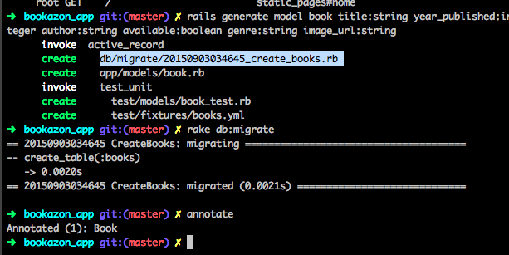

Slide 3
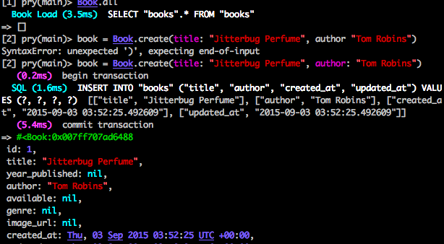
Create an instance of book (it’s a hash) and created in the database
Notes:
Book.all retrieves all books from the database
Need to create a method in our index method for the user to see all books
Within the controller, instance variable is also available in the view

Slide 4
Notes:
Working in index.html – if you don’t want to show something in the view, no = , if you do want to show it use an =

Slide 5
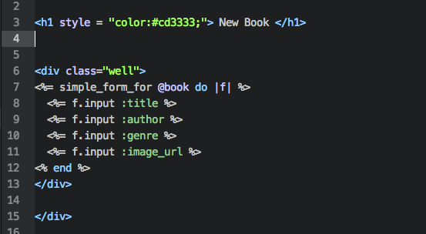
Notes:
Creating a form with an empty instance of book
For each of the params, it’s associating specified items in the form

