Slide 1

Fashion retail
Findings
(Dummy)

Slide 2
Overview of the brand's sales performance

Slide 4
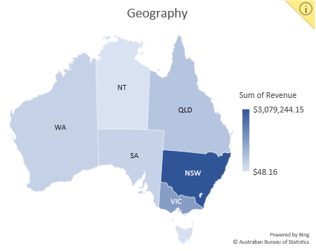
Attributes

Slide 5
Frequency

Slide 6
Product Affinity
Products seen bought together:
2 Pack Cami Top Black 2 Pack Cami Top White
2 Pack Cami Top Black Danah
2 Pack Cami Top Black Suki Dot Dress
2 Pack Cami Top Nude Alexa Jeans
2 Pack Cami Top Nude Anime Wrap Dress
2 Pack Cami Top Nude Original SWS
2 Pack Cami Top White 2 Pack Tank Top Black
2 Pack Cami Top White Daisy Chain Top
2 Pack Cami Top White Elody Mules
2 Pack Cami Top White Tash Off-Shoulder Frill Sleeve Top
Not enough product combinations without expanding purchases with multiple product.(see Product Affinity.py for comments)

Slide 7
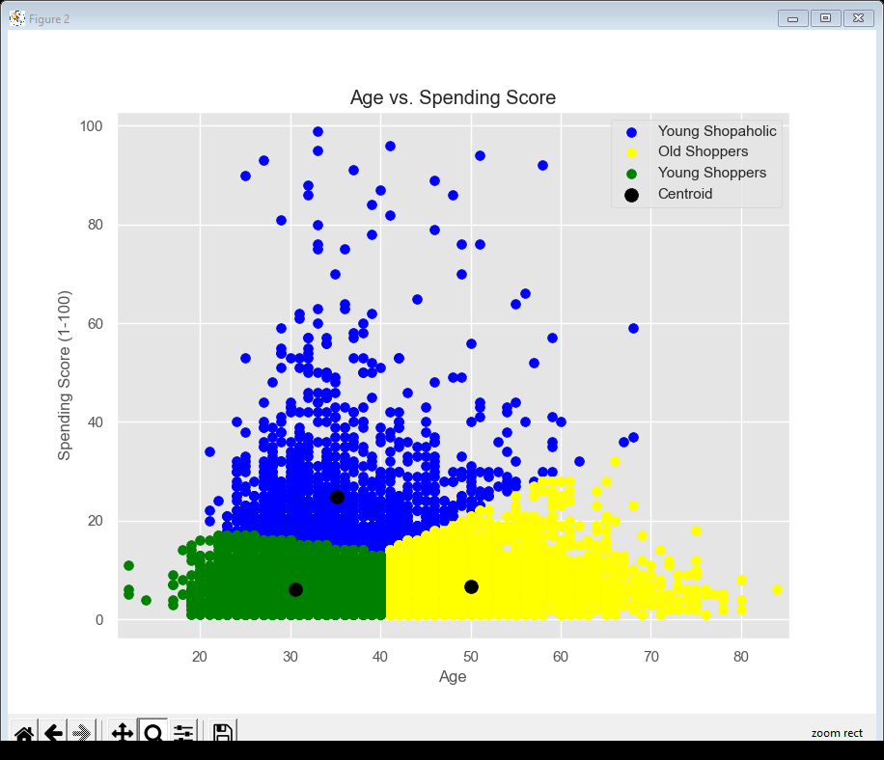
User Segmentation
Spending score is calculated on groups of revenue per timestamp
Age is calculated from Birthday
Please refer MIQ-user-segmentation.py for procedure.

Slide 8
Targeting more users
Individual Targeting
Custom Affinity (Interests and Habits)
Intent (What they are actively researching/planning )
Remarketing (Interaction with business)
Collaborative Users (Users w\ Similar Interests )
Past Activity (Products on their Wishlist and Cart)
Product Recommendations
Product base filtering (Similar Products)
Collaborative filtering (Similar Users)
Model based (clustering users based on demographics etc)
Memory based (associating users based on observed interaction)

