Slide 1
YLOOKUP X ENCODE AI HACKATHON | PRODUCT TRACK
The Problem: Manual Reconciliation
100+ quarterly hours lost manually checking spreadsheets against PDFs
01 • NO PROVENANCE
Disconnected Formulas Formulas like C4 + D5 = C6 have zero link to source PDFs.
ORIGIN: FUND MANAGER INTERVIEWS
“Auditors spend 70% of their time manually cross-checking spreadsheets against PDFs.”
• 70% — MANUAL WORK
• 2-4 WKS — AUDIT DELAY
• 100% — PROOF NEEDED
02 • HIGH RISK
Manual Data Entry Re-typing balances across funds causes delays and mistakes.
03 • HIDDEN ISSUES
Buried Discrepancies Unallocated wires stay buried until year-end audits.

Slide 2
GEMINI 2.5 MULTIMODAL AI | PRODUCT SOLUTION
The Solution: X-Ray Audit Copilot
Instant lineage, verified math, and click-to-source evidence
01 • Multimodal AI Gemini 2.5 Extraction
Reads statements into structured data with exact quote citations. • Verbatim quote citations • Multi-fund classification
02 • Math Engine Deterministic Verification
Python AST recalculates all formulas with zero hallucinations. • Zero math guessing • Real-time reconciliation
03 • Source Evidence Click-to-Source PDF BBox
PyMuPDF highlights exact character coordinates on source PDFs. • Sub-millimeter bounding boxes • Instant cell-to-PDF jump

Slide 3
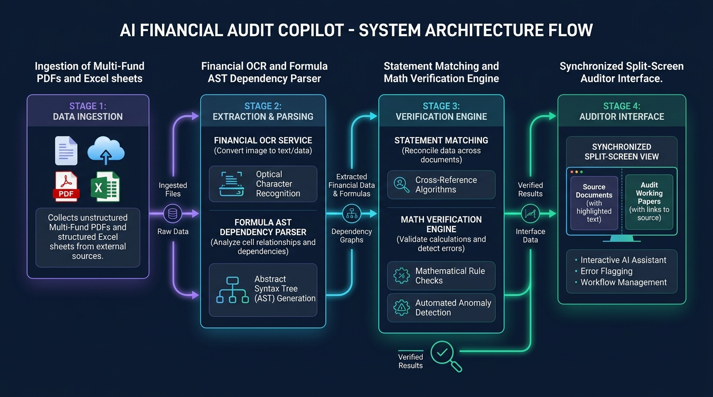
SYSTEM PIPELINE | ZERO-HALLUCINATION
High-Level System Architecture
4-stage pipeline connecting PDF statements to verified spreadsheets
CORE PIPELINE
• Gemini 2.5 Flash & Pro
Fast PDF classification & deep financial extraction.
• PDF Bounding Boxes
Exact visual coordinates on source documents.
• Deterministic Math
Python AST evaluates formulas with zero error.
• Exception Quarantine
Auto-flags unallocated items for review.

Slide 4
TECH STACK | READY TO RUN
Technology & Deployment
Modern, decoupled architecture built for production
GOOGLE GEMINI 2.5
Gemini Flash & Pro for fast classification and structured extraction.
FASTAPI & PYTHON 3.11
Async API and formula AST solver with sub-50ms execution.
NEXT.JS 14 & FORTUNESHEET
Canvas spreadsheet synced with interactive PDF.js viewer.
DOCKER & COMPOSE
Single-command launch via ./run_docker.sh.

