Slide 1
Chemical fingerprinting
Goal: Develop a solution for chemical fingerprinting used to represent molecules for property prediction in downstream applications. Algorithm to use: ChemBERTa
Project deliverables:
Phase 1: Have algorithm available for downstream systems so there is immediate business value and build the foundation for automated pipeline. Use a smaller dataset to evaluate model predictability and usage (use it to get more idea of how to tune hyperparameters).
Phase 2: Full scale automated ingestion and model training. Feedback loop from downstream systems to provide additional training data to improve model accuracy.
Phase 3: Build canary release so we can test different algorithms to further improve model and support different downstream systems.

Slide 2
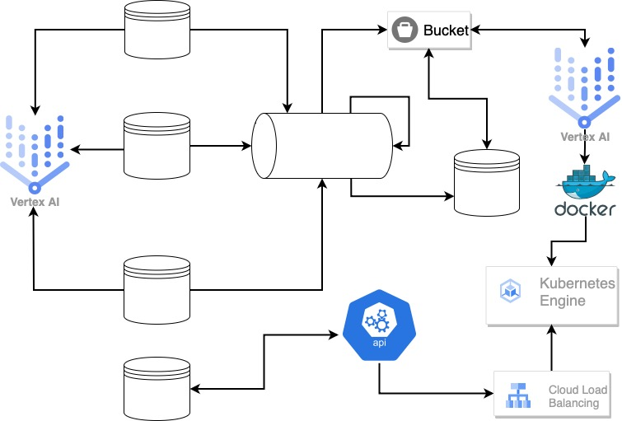
Solution design
Manual - Phase 1
Upstream Source
Google Colab/ Vertex AI
Batch/Streaming
Manual - Phase 1
Upstream Source
Upstream Source
Datastore
Manual - Phase 1
Downstream Datastore

Slide 3
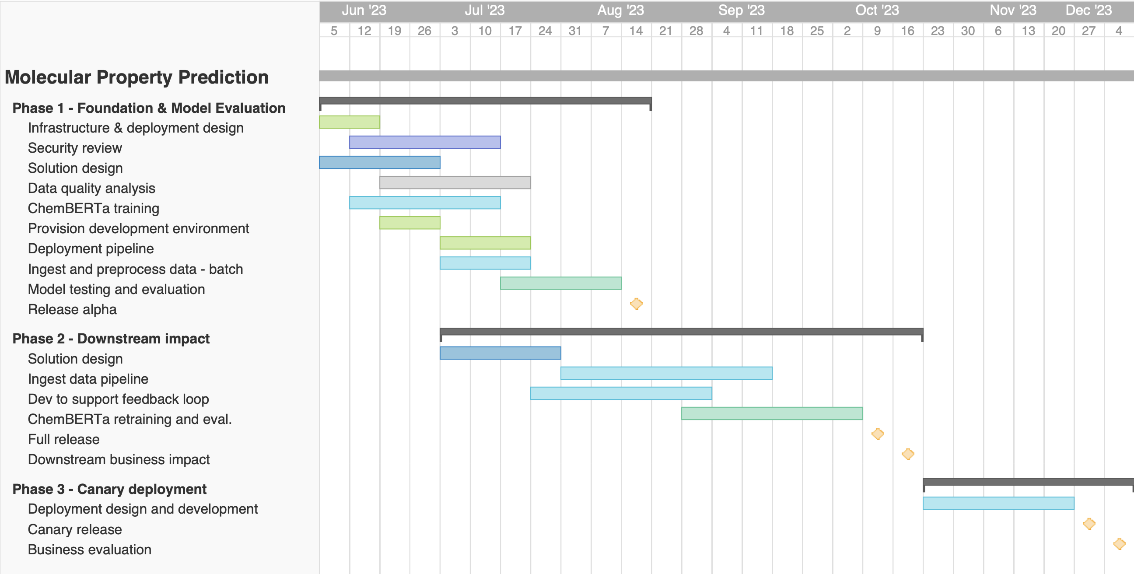
Project Timeline

Slide 4
Cost Table
Domain | Project Role | Location | FTE count | Post-COLA Rate ($) | Hours | Fees
Data | Data Engineer | Onshore | 1 | $189 | 600 | $113,400
Data | Data Engineer | Offshore | 2 | $44 | 700 | $61,600
Data | Sr. Data Engineer | Offshore | 1 | $62 | 900 | $55,800
Data | Sr. ML Engineer | Onshore | 1 | $330 | 800 | $264,000
Data | Lead ML & Data Engineer | Onshore | 1 | $482 | 900 | $433,800
Data | Sr. Data Scientist | Onshore | 1 | $482 | 800 | $385,600
Data | Data Architect | Onshore | 1 | $482 | 100 | $48,200
Data | Data Quality Engineer | Offshore | 2 | $44 | 320 | $28,160
Data | Data Scientist | Onshore | 1 | $330 | 800 | $264,000
Infrastructure | Sr. Cloud Engineer | Onshore | 2 | $267 | 900 | $480,600
Infrastructure | Sr. Cloud Engineer | Offshore | 1 | $62 | 700 | $43,400
Product | Product Analyst | Onshore | 1 | $167 | 900 | $150,300
Project | Project Manager | Onshore | 1 | $330 | 900 | $297,000
Project | Project Analyst | Offshore | 1 | $32 | 900 | $28,800
Security | Sr. Security Engineer | Onshore | 1 | $482 | 400 | $192,800
Project | Manging Director/Partner | Onshore | 1 | $562 | 100 | $56,200
Infrastructure | Hardware and Software | Cloud |  | $65 |  | $46,800
 |  | Total | 19 |  | 10720 | $2,790,260
Role | Skillset (preferable with Pharma industry experience)
Data Scientist | NLP, Transformer, HuggingFace, MLM, RoBERTa
Data Engineer | Python, SQL, RDKit
ML Engineer | ML Pipeline, Deployment, Canary release, Python, Terraform
Cloud Engineer | Terraform, Ansible, CI/CD
Security Engineer | Data and Information Security, Cloud Security

