Slide 1
Deep Learning Tutorial
Xudong Cao

Slide 2
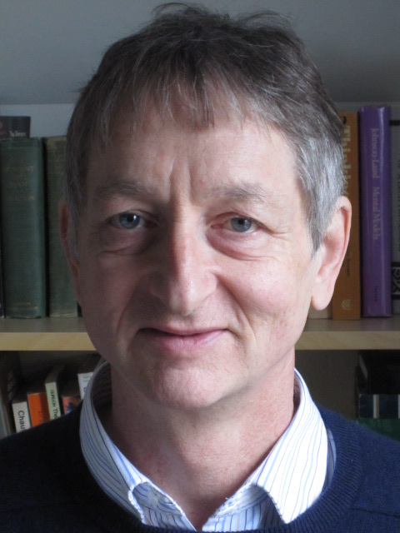
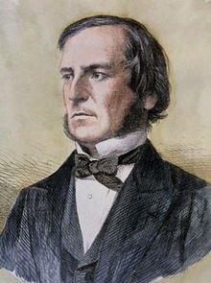
Figures

Slide 3
Historical Line
1960s
Perceptron
1980s MLP
BP algorithm
2006 RBM
unsupervised learning
2012 AlexNet
ImageNet Comp.
2014 GoogleNet VGGNet
ImageNet Comp.
Rule based AI algorithm
Game Tree & Search Algorithm
Support vector machine
Wrong direction
Big booming:
DNNResearch 6M, DeepMind 400M
Google, Microsoft, Baidu, FB, Apple
Hundreds of Startups

Slide 4
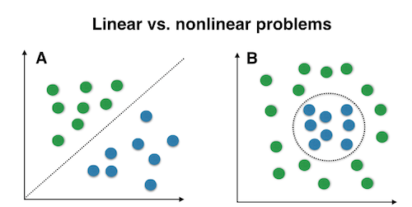

Linear inseparable problem & fitting power

Slide 5
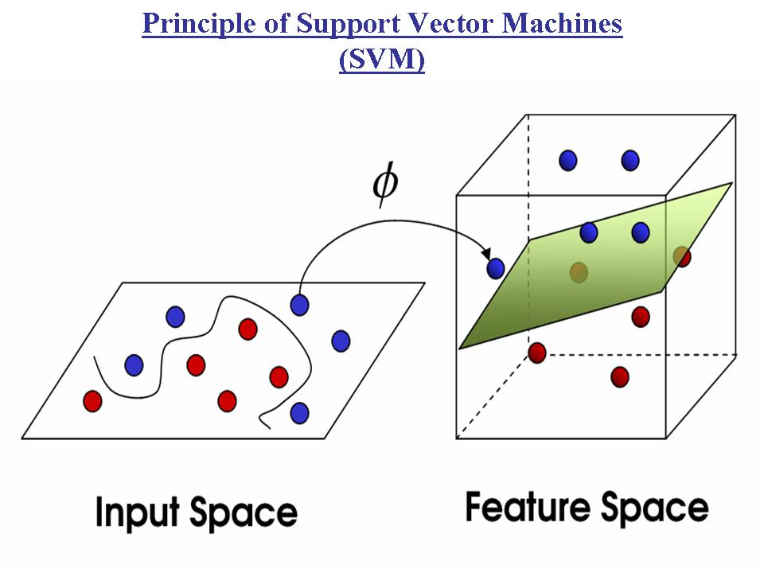
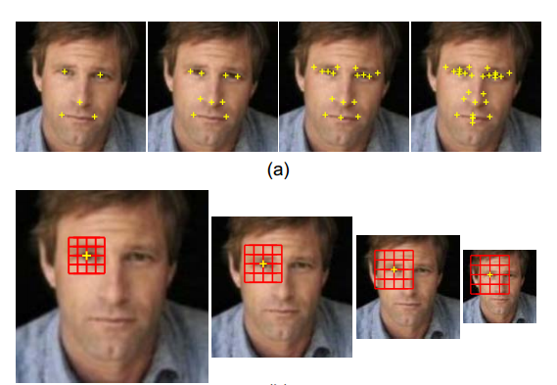
Solution 1: Going High dimension
Explicitly design high-dim. features
e.g. high-dim LBP and fisher vector
Implicitly project to high dim.

Slide 6
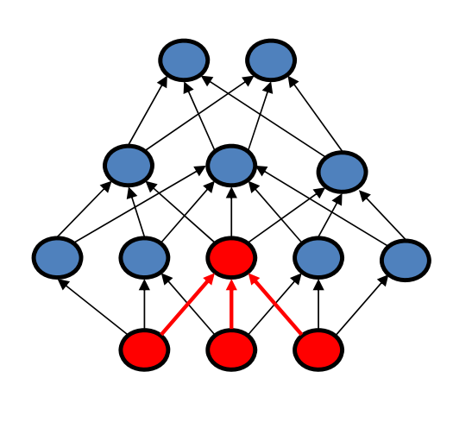
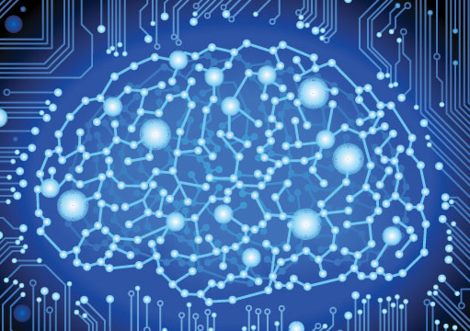
Solution 2: Going Deep

Slide 7
High-Dim VS. Deep
High-Dim
Deep
Easy to train, convex in general
Solid mathematic foundation
Generalized well
Low computational cost
Fitting power scales linearly
Hard to train, non-convex
Black magic & unknown territory
Prone to over-fitting
High computational cost
Fitting power scales exponentially

Slide 8
Explains why people hated neural networks in the past, BUT time changes …

Slide 9
New Era: Big Data & Moore’s Rule

Slide 10
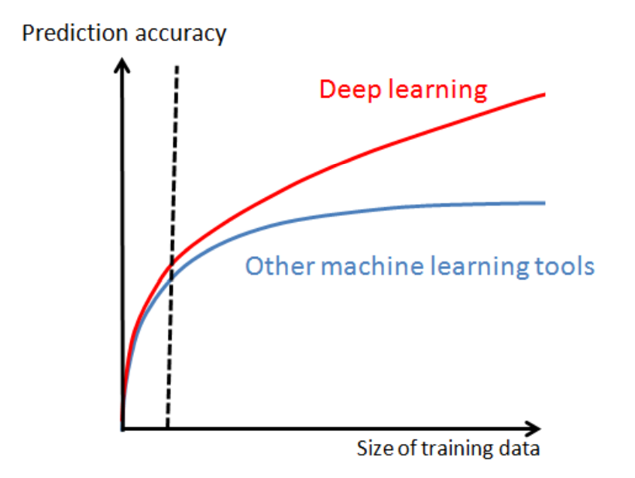
Practical application
Xiaogang Wang, Introduction to Deep Learning

Slide 11
End-to-end learning, less domain knowledge
Training
Training
Model Design
Networks Design
No or very small amount of domain knowledge
Conventional Approach
Feature Design
Small amount of domain knowledge
Deep Learning
Pre-processing
Large amount of domain knowledge
Collect Data
Collect Data

Slide 12
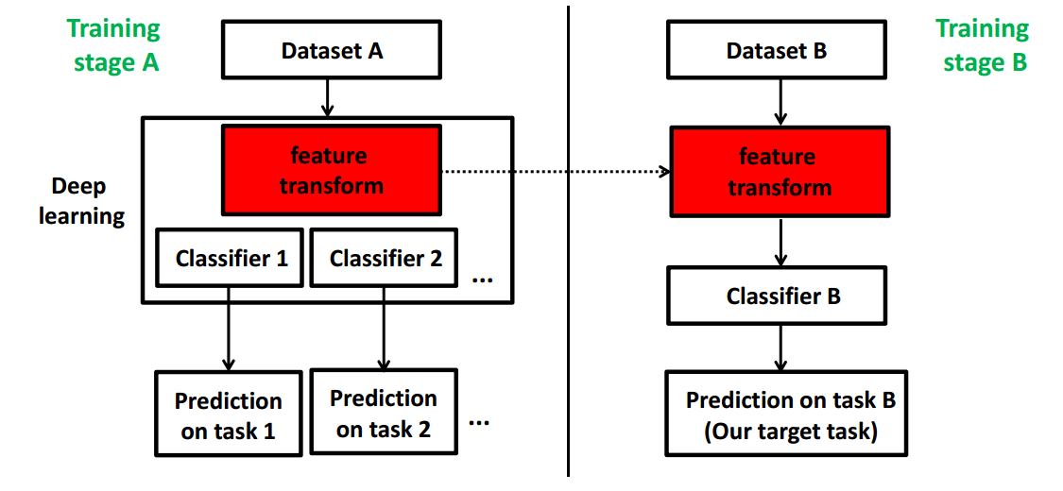
Good features
Xiaogang Wang, Introduction to Deep Learning

Slide 13
Good features cont.
Transfer the face identification features to age estimation & gender classification
Transfer ImageNet features to other tasks
Dataset | Conv. Best (acc) | Tran. Best (acc)
Oxford 102 Flowers | 91.3% | 98.7%
Oxford-IIIT Pets | 88.1% | 93.1%
FGVC-Aircraft | 81.5% | 85.2%
MIT-67 indoor 49 | 68.9% | 82.4%
Human Age Estimation
Dataset | Pre. Best (MAE) | Ours(MAE)
Morph | 3.6 | 2.4
FGNet | 3.2 | 2.7
Geneder Classification
Dataset | Pre. Best (acc) | Ours(acc)
Morph | 98.7% | 99.4%

Slide 14
Directions of DL Research
Feature engineering to architecture engineering
ImageNet Classification with Deep Convolutional Neural Networks (Alex Net)
Going Deeper with Convolutions (Google Net)
Very Deep Convolutional Networks for Large-Scale Visual Recognition (VGG Net)
Faster and smaller
How to train very deep neural network
Batch Normalization: Accelerating Deep Network Training by Reducing Internal Covariate Shift (Speedup CNN training)
Delving Deep into Rectifiers: Surpassing Human-Level Performance on ImageNet Classification (Good initialization)

Slide 15
Directions of DL Research cont.
Existing Applications
Face: DeepFace, Deep ID serials & FaceNet
Detection: R-CNN, fast R-CNN, faster R-CNN
Segmentation: F-CNN serials
New applications
Image captioning [Google & Berkeley]
Synthesize real world images [Facebook AI Lab]
A Neural Algorithm of Artistic Style [Gatys et al.]

Slide 16
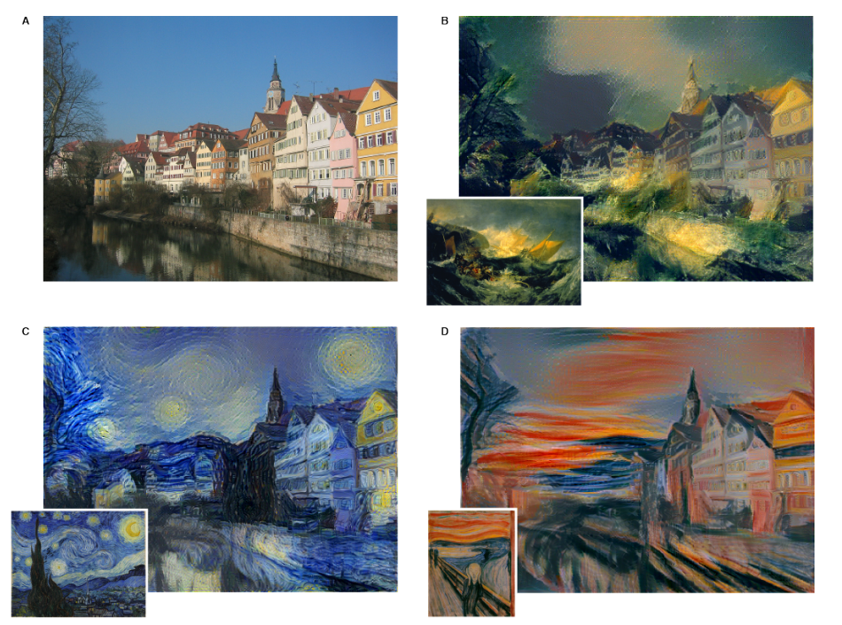
A Neural Algorithm of Artistic Style

Slide 17


