Slide 1
St. Timothy presents

Slide 2

A Fractured Fred Production

Slide 3
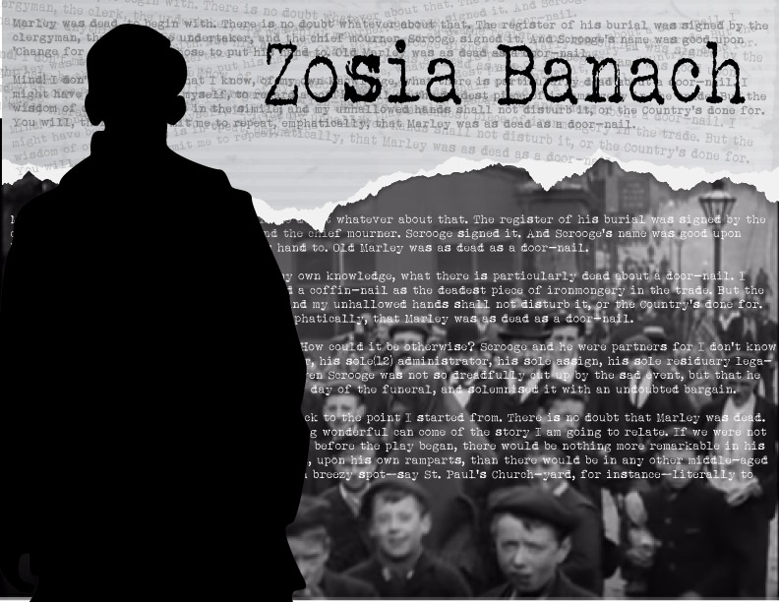

Slide 4


Slide 5
A Christmas Carol

