Slide 1
MaPro DMS
(Document Management System)
Priyanka Mudgal(pmudgal@pdx.edu)

Slide 2
MaPro DMS
What the Project is?
This project is a document Management System where the the user can navigate through system with proper authentication/authorization in place, and can leverage facilities like uploading/retrieving and downloading documents.
This project scope covers following scope :
a) Upload documents.
b) Retrieve Meta-Data List of documents
c) Download documents.

Slide 3
MaPro DMS
LICENSE INFORMATION:
The project has the standard MIT License which is in Github:
https://github.com/prmudgal/documentManagement/blob/master/LICENSE

Slide 4
MaPro DMS
Software's/Installations required:
  Mongo DB 3.2https://www.mongodb.com/download-center#community
  Java (JRE 7)
  http://www.oracle.com/technetwork/java/javase/downloads/jre8-downloads-2133155.html
  Tomcat Server(7)
  https://tomcat.apache.org/download-70.cgi
  Development Tool required:
  Eclipse(Eclipse Kepler): http://www.eclipse.org/downloads/packages/eclipse-ide-java-ee-developers/keplerr

Slide 5
MaPro DMS
Mongo DB Data Path Local Directory creation:
- 1) Create a folder "mongodb/data" in any of the drive.
- For example : "D"/mongodb/data".

Slide 6
MaPro DMS
Start the server(DB and Application servers)
To start Mongo DB server:
a) Goto the folder/directory path where mongodb is installed e.g. "D:\Mongo\MongoDB\Server\3.2\bin" and type below command.
b) mongod --dbpath "D:/mongodb/data"
To start Tomcat Server:
1) Go to the path where tomcat is installed : "C:\Program Files\apache-tomcat-7.0.70\apache-tomcat-7.0.70\bin"
2) Type tomcat7.exe start to start the server.

Slide 7
MaPro DMS
To start the welcome page:
- 1) Type url "localhost:8080/MaProDMS/cmslogin".

Slide 8
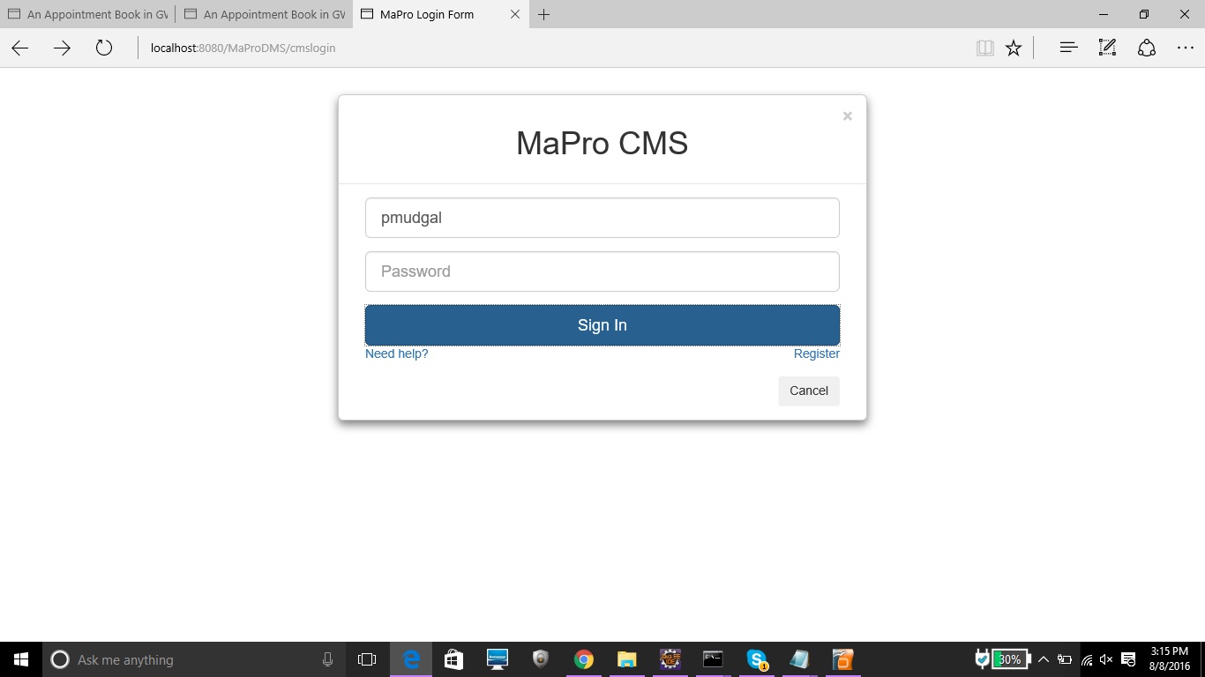
Welcome Page/Login Screen

Slide 9
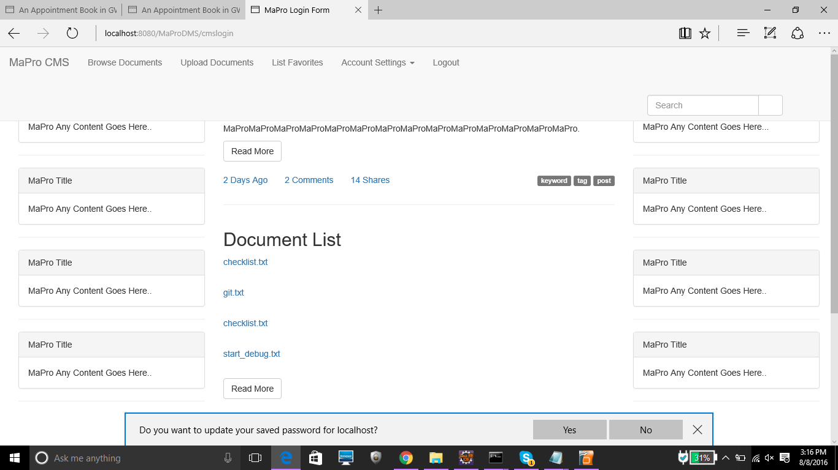
HomePage

Slide 10
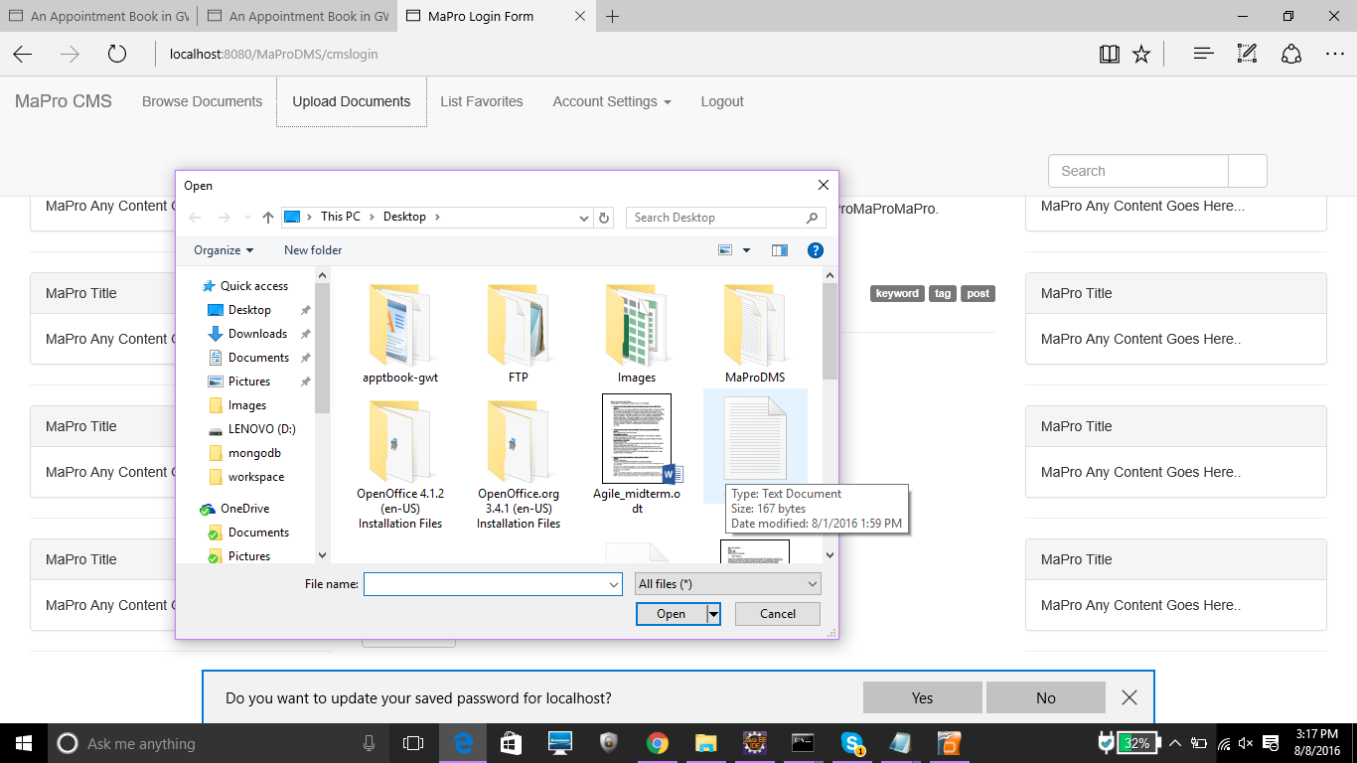
Upload Document

Slide 11
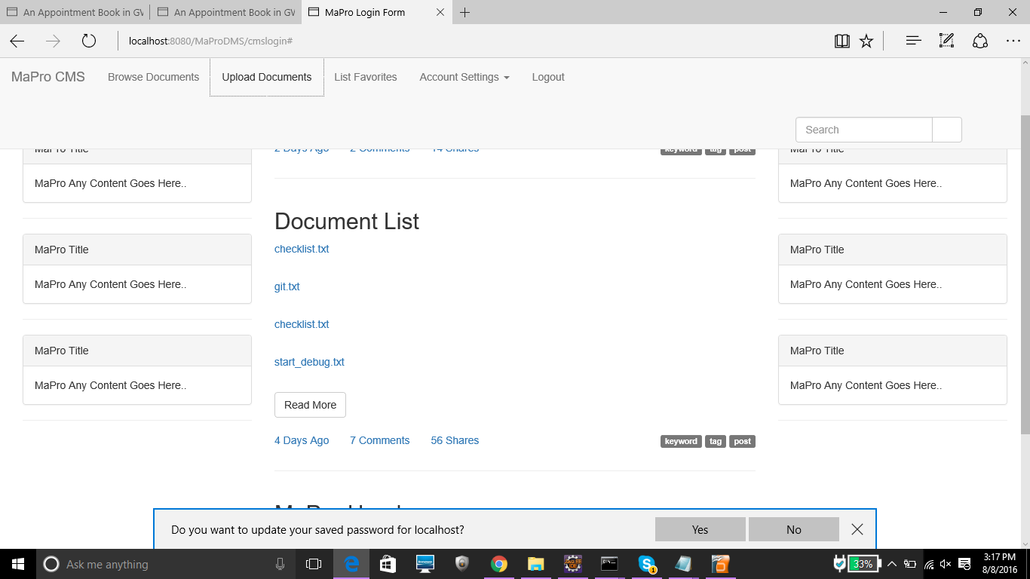
List Document

Slide 12
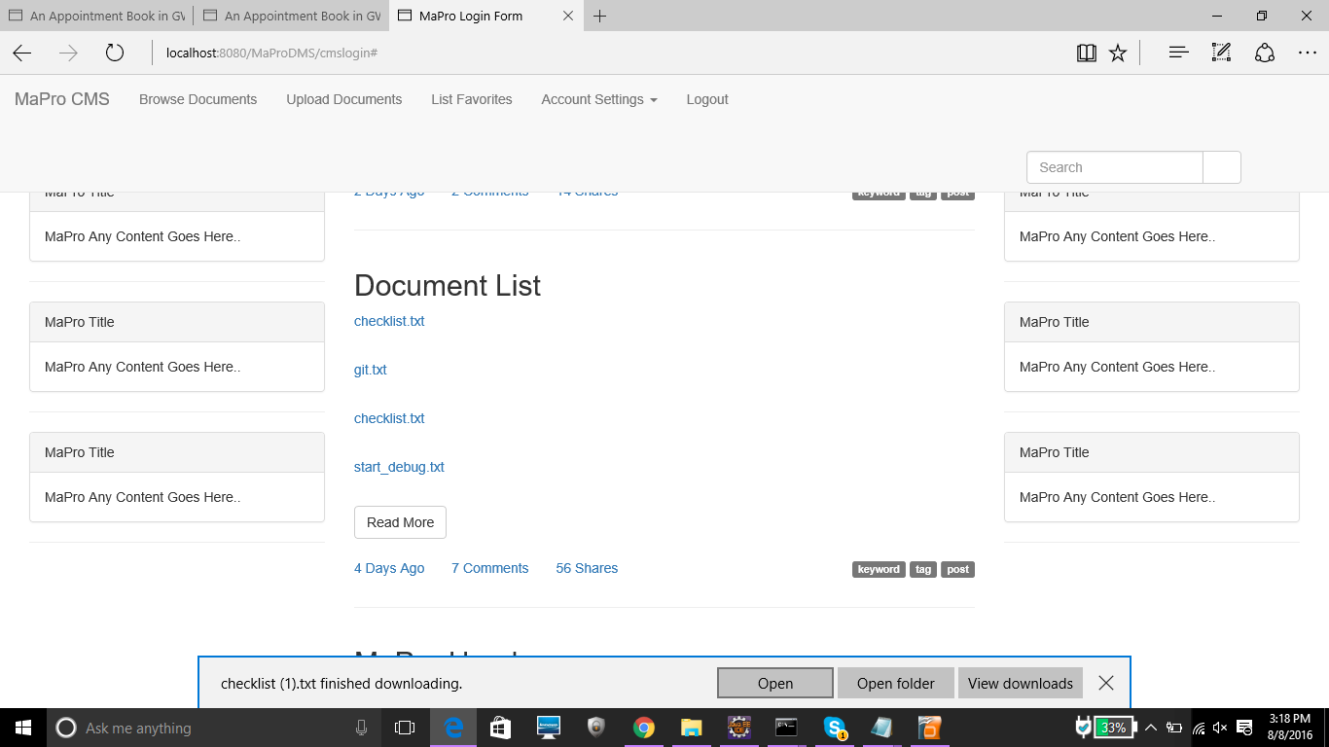
Download Document

Slide 13
Functionalities on Target & Not Completed
Validations for user login(Major Target)
Fancy UI(To catch User attention)
Organize the uploaded documents
Facility to make folders and upload the document in the desired folder.

Slide 14
Things Learnt
Mongo DB(Gained confidence working on Hot technology)
UI(jQuery, bootStrap css, JavaScript and JSP)

Slide 15
Thank you !!

