Slide 1

Text2text generation using GAN
Presented by- Group 06
Mukund Kumar 2006200
Prince Raj 2006185
Ayush Gautam 2006155
Under Supervision of
Dr. Jyoti Prakash Singh
Department of Computer Science & Engineering
National Institute of Technology, Patna

Slide 2
Content
Vision
GAN model introduction
cGAN
Why cGAN?
Initial dataset
Workflow Diagram
Preprocessing
Why GloVe?
Final dataset
Accuracy
Future scope
Reference

Slide 3
Vision
To remove the biases of a dataset by generating extra dataset.
To generate similar text.
Improvement of GAN model in the field of text generation.
Balancing of the dataset.

Slide 4
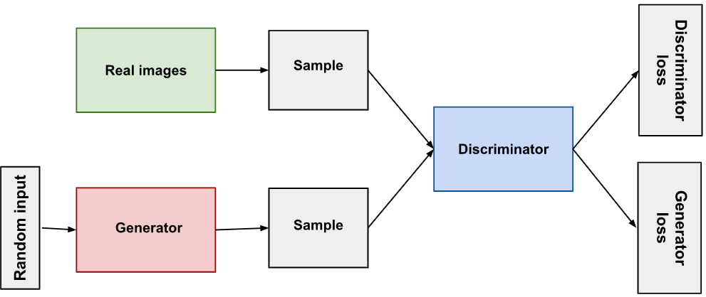
Generative Adversarial Network Model
The two neural networks(i.e Generator and Discriminator) that make up a GAN compete with each other to become more accurate in their predictions.

Slide 5
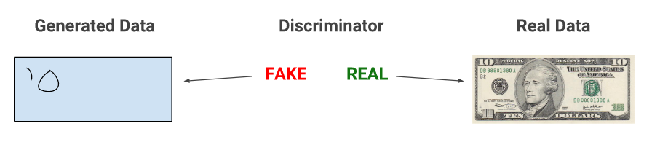
How does the GANs work ?
When training begins, the generator produces obviously fake data, and the discriminator quickly learns to tell that it's fake.

Slide 6
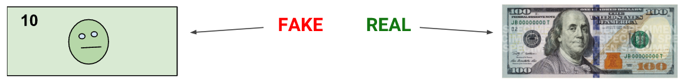
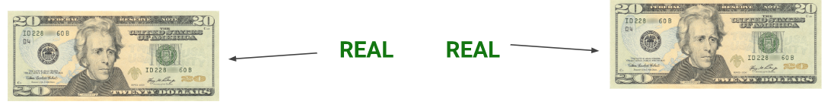
continue
As training progresses, the generator gets closer to producing output that can fool the discriminator.
Finally, generator generates realistic example so that discriminator can’t discriminate.

Slide 7
Types of GAN
Some of the most popular type of GAN models:
Vanilla GAN
Conditional GAN (cGAN)
CycleGAN
Generative Adversarial text to image synthesis.
Style GAN
Super resolution GAN

Slide 8
cGAN
The Generator and Discriminator of the cGAN both receive some additional conditioning input information. This could be the class of the current image or some other property.
Adding a vector of features controls the output of the Generator

Slide 9
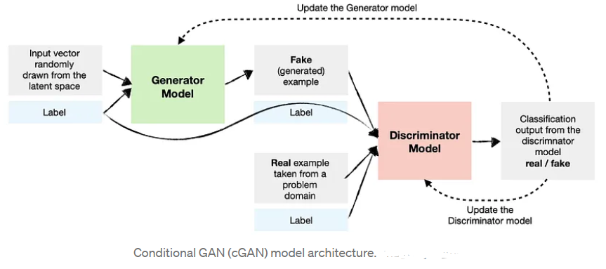
Architecture Diagram of the cGAN

Slide 10
Why Conditional Generative Adversarial Networks ?
As per our requirement, we need to generate dataset of some particular label, to decrease biasness in datasets that's why we require cGAN so that we can feed label as the condition input in cGAN.

Slide 11
Initial dataset
Dataset have the 5 Columns.
The ‘label’ attribute have three values male, female and neutral. Here mention in term of 0,1 and n.
Dataset have initially total 3000 samples and are not balanced.
No of dataset of 0, 1, n is about 400, 900 and 1700 respectively.

Slide 12
Technical Aspect
Google colaboratory for the run time environment of the project.
Nltk library to process the text data into the vector form.
cGAN model to generate the text data according to the condition.

Slide 13
contd.
Glove Embedding vector to find the embedding of the text data.
Cosine similarity to find similarity between the the glove vector embedding and the vectors generated by the model.
CNN model as accuracy improvement checker .

Slide 14
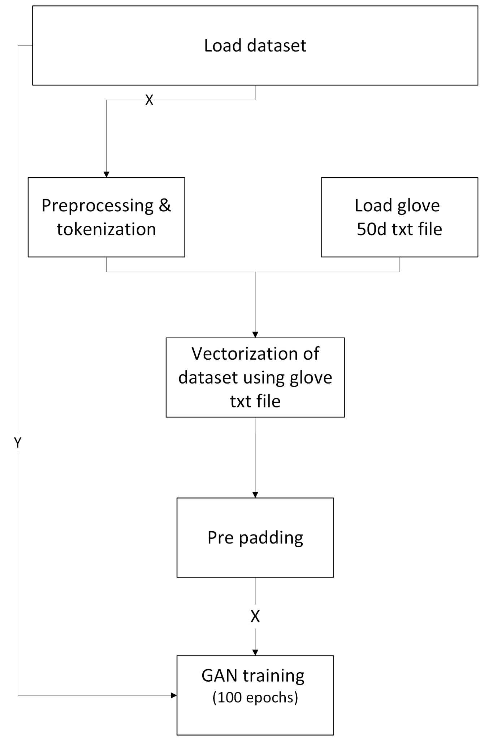
Workflow diagram

Slide 15
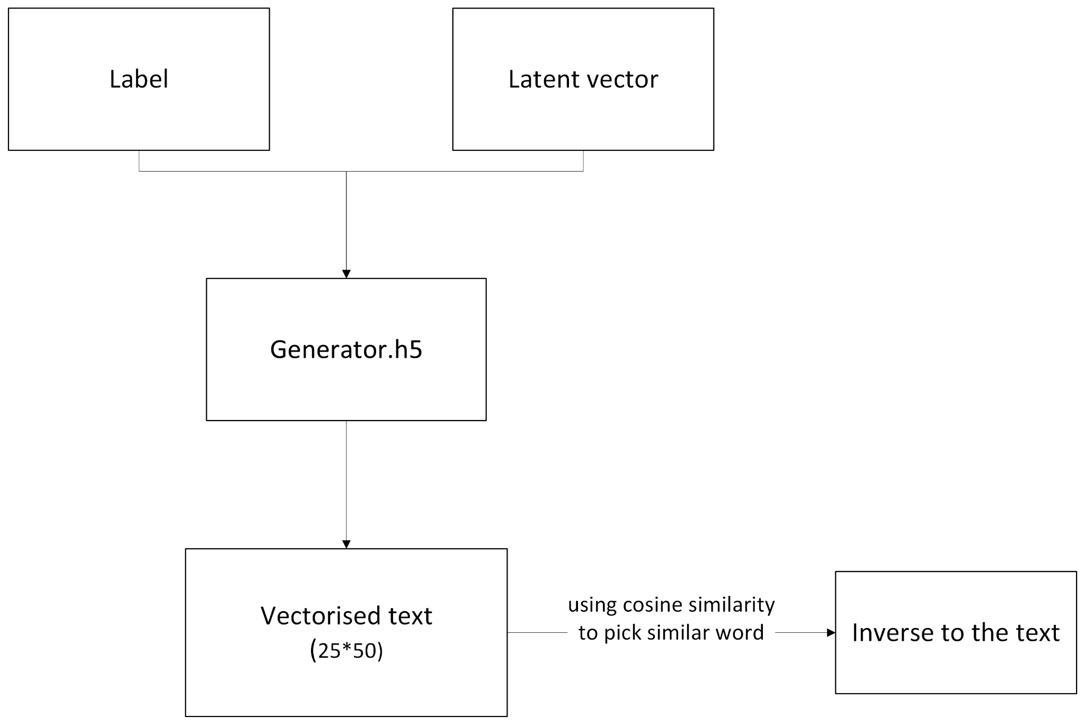
contd.

Slide 16
Preprocessing
Removal of usernames, links and unwanted texts and symbols.
Tokenizations
Lowering the tokens.
Lemmatization
Conversion of words into vectors using GloVe.

Slide 17
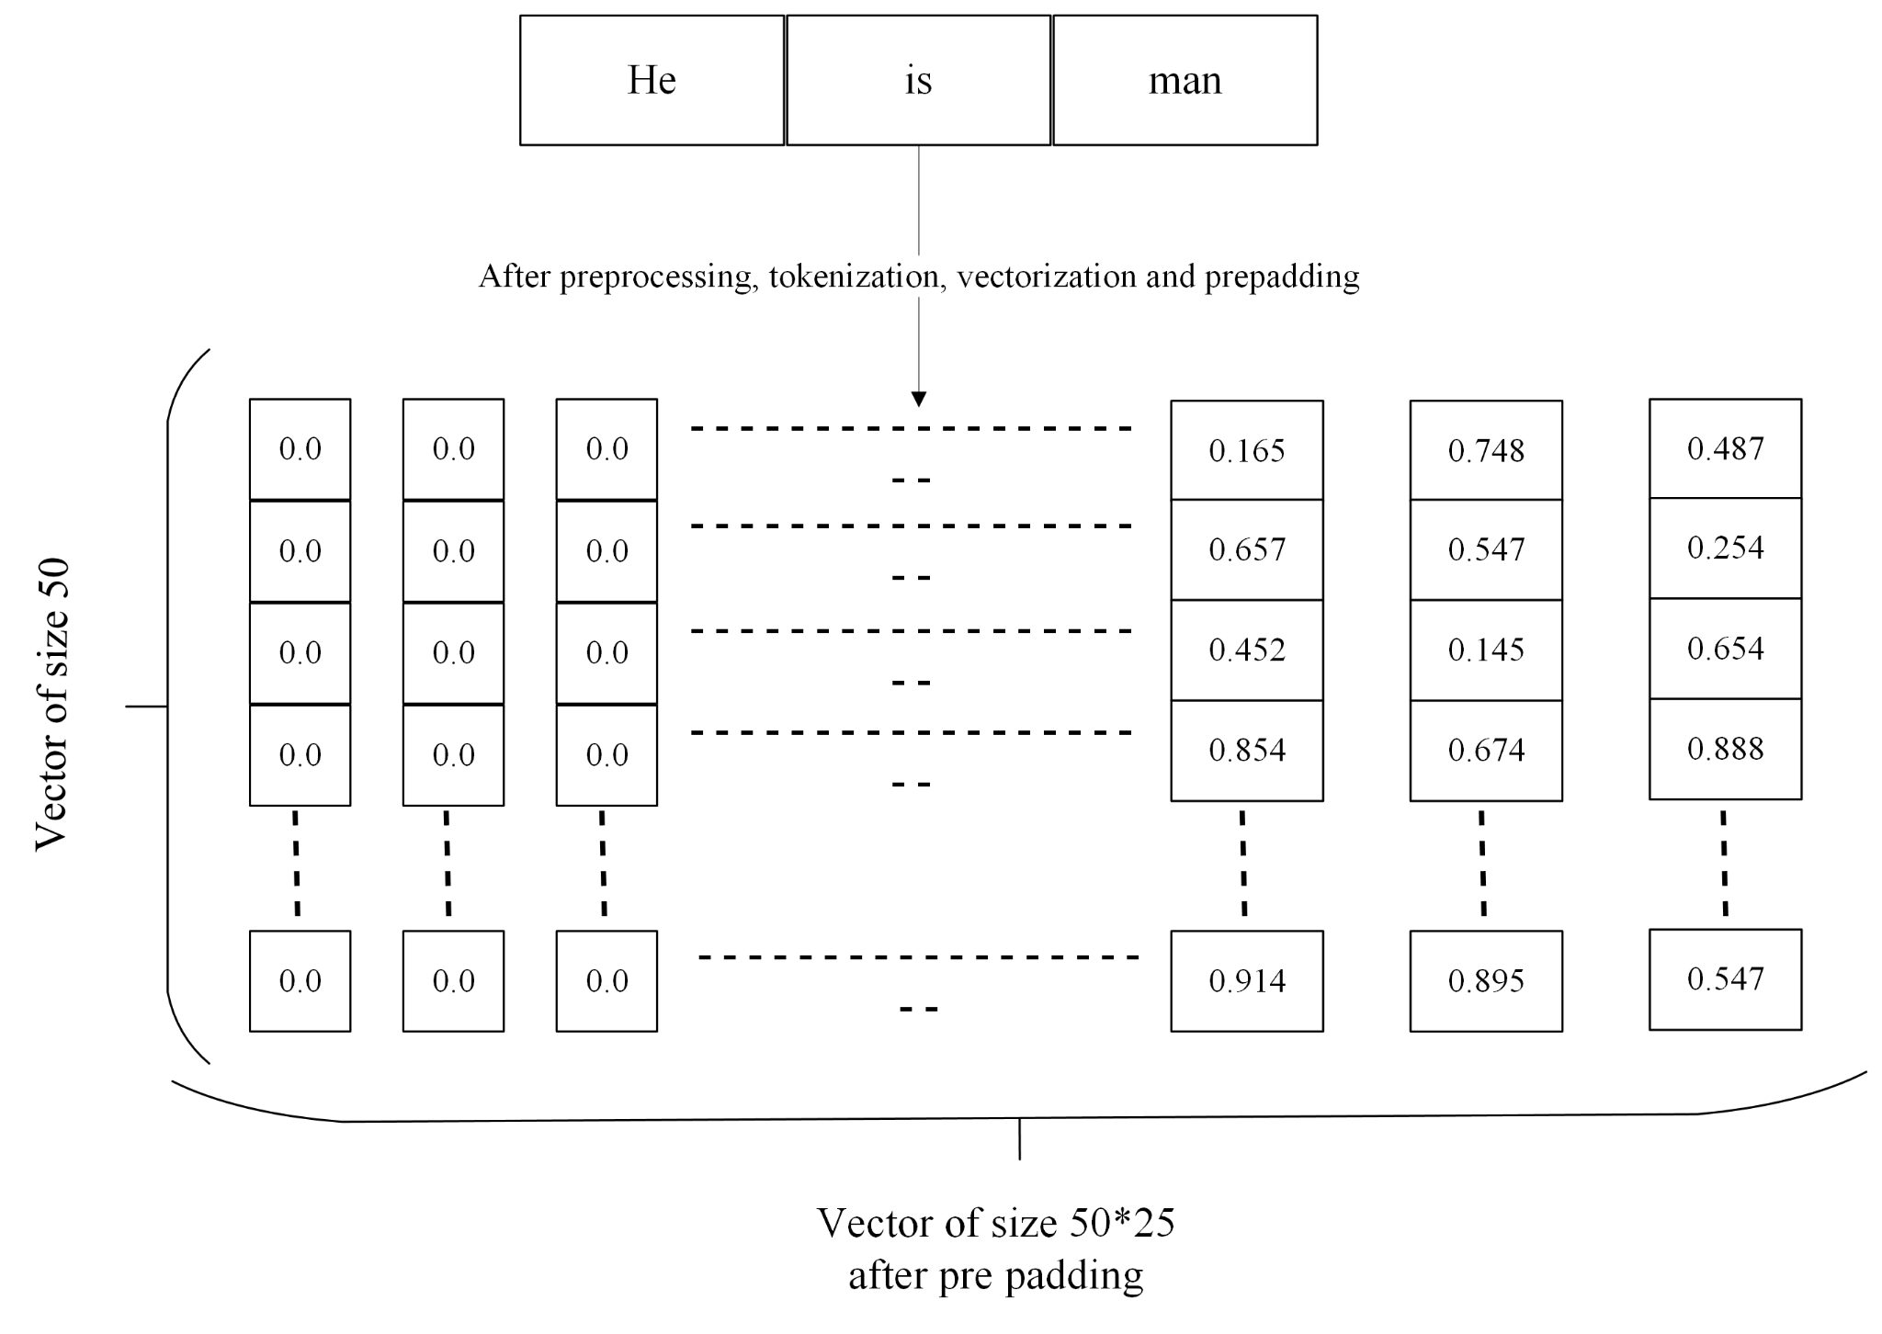
contd.

Slide 18
Why only GloVe?
GloVe perform better than Word2vec in the word analogy tasks.
GloVe gives lower weight for highly frequent word.
Stop the dominance of the stopword like ‘is’,’the’ , etc.

Slide 19
Final dataset
Balance dataset using the developed cGAN model.
Equal no of dataset corresponding to each class of the data.

Slide 20
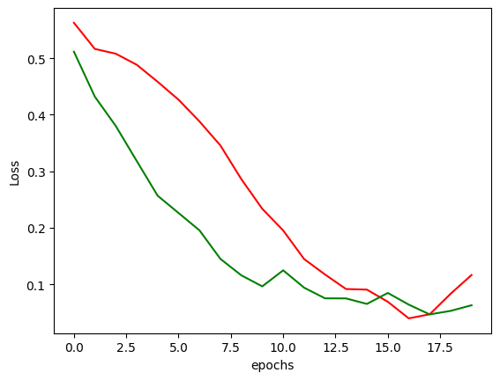
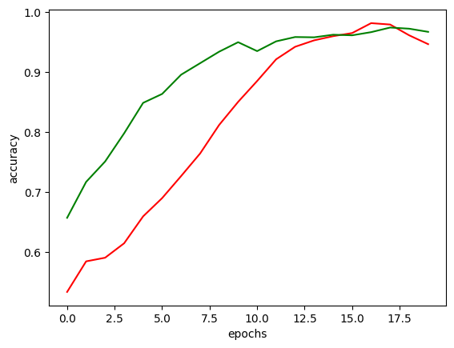
Accuracy improvement

Slide 21
Future Scope
Improvement of accuracy of the Discriminator model.
Decrement of loss of Generator model.
More accurate sentence prediction using Generator.
Grammatically correct sentence prediction.
Notes:
The new dataset will become the balance by using the model developed. The balance dataset will good for the further training of any model . In future

Slide 22
References
Review of deep learning: concepts, CNN architectures, challenges, applications, future directions
Laith Alzubaidi, Jinglan Zhang, Amjad J. Humaidi, Ayad Al-Dujaili, Ye Duan, Omran Al-Shamma, J. Santamaría, Mohammed A. Fadhel, Muthana Al-Amidie & Laith Farhan
Generative Adversarial Networks: An Overview
Antonia Creswell; Tom White; Vincent Dumoulin; Kai Arulkumaran; Biswa Sengupta
Generative adversarial networks: introduction and outlook
Kunfeng Wang; Chao Gou; Yanjie Duan; Yilun Lin; Xinhu Zheng; Fei-Yue Wang

Slide 23
Contd..
GloVe: Global Vectors for Word Representation
Jeffrey Pennington, Richard Socher, Christopher
A Survey of Glove-Based Systems and Their Applications
Laura Dipietro; Angelo M. Sabatini; Paolo Dario
Image-To-Image Translation With Conditional Adversarial Networks
Phillip Isola, Jun-Yan Zhu, Tinghui Zhou, Alexei A. Efros;

