Slide 1


Scala for
Machine Learning
Patrick Nicolas
December 2014
patricknicolas.blogspot.com
www.slideshare.net/pnicolas
Notes:
Context of the presentation:
The transition from Java and Python to Scala is not that easy: It goes beyond selecting Scala for its obvious benefits.
- support functional concepts
- leverage open source libraries and framework if needed
- fast, distributed enough to handle large data sets
Scala was the most logical choice.
In order to ease the pain, we tend to to learn/adopt Scala incrementally within a development team.. The problem is that you end up with an inconsistent code base with different levels of quality and the team developed a somewhat negative attitude toward the language.
The solution is to select a list of problems or roadblocks (in our case Machine learning) and compare the solution in Scala with Java, Python ... (You sell the outcome not the process).
Presentation
A set of diverse Scala features or constructs the entire team agreed that Scala is a far better solution than Python or Java.

Slide 2
What challenges?
What makes Scala particularly suitable to solve machine learning and optimization problems?
Building scientific and machine learning applications requires ….
Clearly defined abstractions
Flexible, dynamic workflows
Scalable execution
Notes:
There are really 3 dimensions to building machine learning apps.
Abstraction is critical to encode or translate mathematical concepts
Ability to create workflow is needed for chaining data transformation and reduction
Scalable execution comes into play when deploying application in production

Slide 3
Scala tool box
Which elements in the Scala tool box are useful to meet these challenges?
Guards
Dependency injection
Bifunctor
Typeclass
Memoization
Tail recursion
Higher Kind projection
Monads
Streams
Cake pattern
Reactive
Implicits
F-bound
Hotswap
Back-pressure
Partial function
Supervision
ADT
Composed futures
Parallel collections
Magnet pattern
Lazyness
View bounds
Currying
Mixins
Futures
ETA expansion
Macros
DSL
Weak references
Contra-variant functors
Delimited continuation
Actors
Notes:
Being an object oriented and functional language, Scala has a lot of features and powerful constructs to choose from….
Here is a list of some of the features of Scala that are particularly valuable for writing machine learning algorithms or building applications that use these algorithms.

Slide 4
Abstraction
Monadic kernels
Tensor functoriality
Extending types
Flexibility
Scalability
Notes:
Let’s start with ability in Scala to represent or implement abstractions such as
Mathematical concepts, equations
Programming concepts already defined in the Scala standard library.

Slide 5


Abstraction: Monadic kernels
Kernel functions are commonly used in training to separate classes of observations with a linear decision boundary (hyperplane).
Problem: Building a model entails creating, composing and evaluating numerous kernels.
Solution: Define kernels as a 1st class programming concept with monadic operations.
Notes:
The first category of abstraction is the representation, encoding or transcription of mathematical formula and concept:
I assume you are familiar with Monads are used for collection, error handling in Scala standard library.
There is no need to know kernel to understand the benefits of using Monads in this particular case.
A kernel function is used in a lot of supervised learning such as support vector machine and neural networks as well as dimension reduction, kernel principal components analysis as an example.
The challenge is to create and reuse kernel functions during multiple training runs in an attempt to extract the fittest model from the data set.
By 1st class programming element, I mean
Kernel functions have to be defined as a class
Kernel functions can be categorized by sharing basic group functions (or monadic operations)

Slide 6
Abstraction: Monadic kernels
A kernel function K can be regarded as a generalization of the product “dot” of two observations or vector of features values (x, y) of observations.
x={x_{j}}
y={y_{j}}
Observations are assigned to a specific class by computing their similarity as x.y converted into K(x,y) in a space of higher dimension.
Notes:
The purpose of the kernel function is to transform data into higher dimension so boundary (hyperplane) between classes is linear or pseudo linear.
For those not familiar with kernel function, it can be thought as a “dot” product of two observations. The vector represent an observation with multiple features. For instance, a disease can be observed with age, ethnicity, location of the patient, body temperature or other symptoms.
As a side note, the number of features (or dimension of the model) can be infinite (Hilbert space).

Slide 7
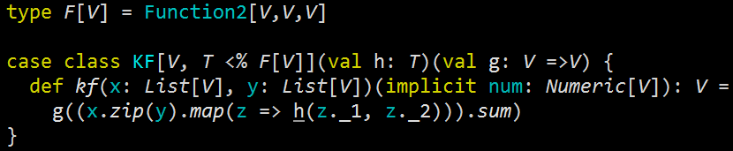
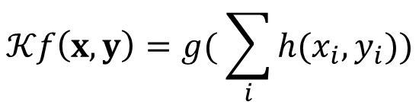
Abstraction: Monadic kernels
Define an explicit kernel function in a Euclidean space as the composition of 2 functions Kf = g o h
$$𝒦f\left(x,y\right)=g( \sum_{i}{h(x_{i},y_{i}))}$$
Notes:
The purpose here is to generate and experiment with any kind of explicit kernels by defining and composing two g and h functions
A function h operates on each feature or component of the vector
A function g is the transformation of the dot product of the two vectors. The dot product is computed by applying the function to all the elements and compute the sum (which requires Numeric to be defined).
The class, KF, parameters list is curried because the function h is used in the computation g.
The “dot” product K is computed by traversing the two observations (vector of features implemented as lists), computing the sum and finally applying the g transform.
The summation requires that an instance of the Numeric class has to be implicitly defined.
Notes: Implicit kernels such as Laplace-Beltrami operator or Heat kernel used in manifold are modeled as ordinary differential equations and cannot use this decomposition.

Slide 8
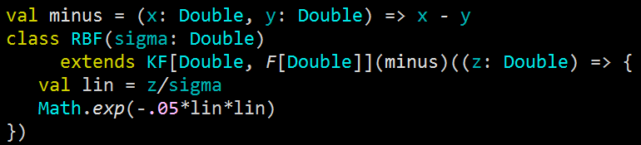
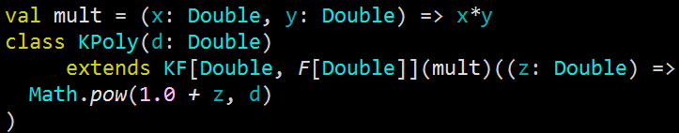


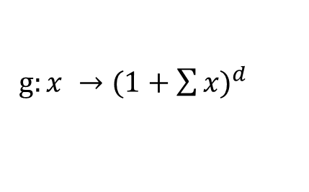



Abstraction: Monadic kernels
Radius basis function kernel
$$𝒦\left(x,y\right)= e^{−\frac{1}{2}{\left(\frac{x−y}{σ}\right)}^{2}}$$
g$:x →e^{−\frac{1}{2σ^{2}}{(\sum{x})}^{2}}$
h$:\left(x,y\right) →x−y$
Polynomial kernel
$${𝒦\left(x,y\right)=(1+x.y)}^{d}$$
h$:\left(x,y\right) →x.y$
g$:x →{(1+\sum{x})}^{d}$
Notes:
Polynomial kernels are another example of kernel function.
Note: The source code is shown here to illustrate the fact that the implementation in any other language would be a lot more messy and won’t be able to fit in any of those slides.

Slide 9
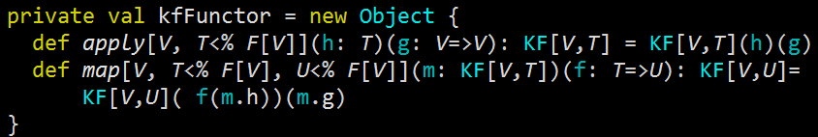
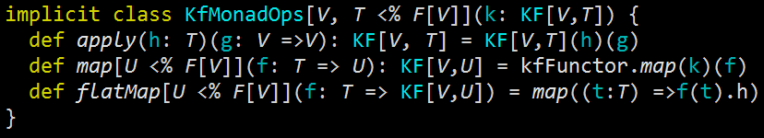
Abstraction: Monadic kernels
Let’s define the applicative functor …
… and the implicit for the monad
Notes:
Once the functor is defined, the monad is created by adding the flatMap method. The monad, KFMonad which take a kernel function as argument is defined as an implicit class so kernel functions “inherits” the monadic methods.
The flatMap method is implemented by creating a new Kernel and applying the transformation to only one of the component of the Kernel function: function h (in red). This “partial” monadic operation is good enough for building Kernel functions on the fly.

Slide 10
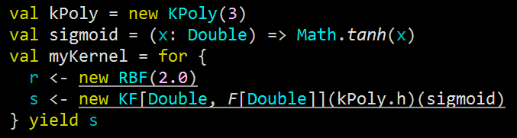
Abstraction: Monadic kernels
Our monad is ready for composing any kind of kernels on demand, using for-comprehension (syntactic sugar)
Notes:
In this example, the kernel is created composing a Radius basis function with a standard deviation 2.0 and a Kernel function derived from the polynomial kernel of degree 3, kPoly, and using a sigmoid (hyperbolic tangent) as transformation on the dot product.
Once defined, the new kernel is used to compare observations (xs1, xs2)

Slide 11
Abstraction: Monadic kernels
Notes
The monad applies only to explicit kernel functions in Euclidean space. Kernel functions such as Heat kernel defined on manifolds require more elaborate functors (~> next section).
Quite often monads defines filtering capabilities (i.e. Scala collections).
Accidently, the for-comprehension closure can be also used to create dynamic workflow
Notes:
Implicit kernels that are defined iteratively or as a solution of equation or ODE such as Laplace-Beltrami operator on Manifold require a different class and monadic implementation
The two filter functions in Scala standard library are filter and filterWith.
For-comprehension is a “sugar” syntax that wraps a stack of flatMap and map invocation. It can be used to create any complex container or programming entity including dynamic workflows. You will be introduced to a different approach to create workflows by weaving transformation/reduction on datasets.

Slide 12
Abstraction: Tensors functoriality
Machine learning consists of identifying a low dimension manifold within an Euclidean observations space.
Problem: How to represent tensors and metrics?
Solution: Functorial representation of tensors, tensor products and differential forms.

Slide 13
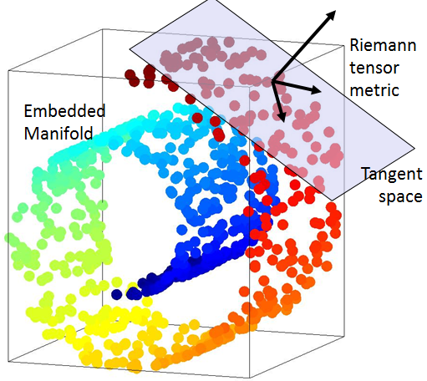
Abstraction: Tensor functoriality
Machine learning consists of extracting a low dimension features space (manifold) from an observation space (Euclidean)
Tensors
Vector V on field F
Co-vector/ map V => F
Bi-linear forms V x V => V
Inner product V x V => F
Tensor product
Notes:
Geometric entities on a differential (Riemann) manifold are defined as tensors. Tensor can be
Covariant
Contra variant
A bilinear form such as Tensor product
Inner product
n-differential forms
…

Slide 14

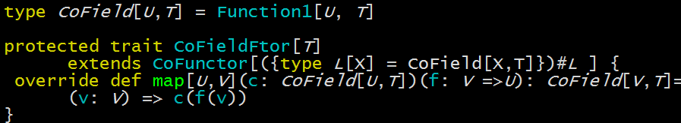
Abstraction: Tensor functoriality
Contravariant functions are used for morphisms or transformation on Covariant tensors (type CoField)
Higher kind type projection for the type U of the argument of a covariant tensor for a predefined field type T.
Notes:
Functors are used to define the morphisms or transformations on covariant vectors (or linear maps) with type CoField[U,T] = U => T where U is a (Contravariant). A U is an type argument in a higher Kind CoFunctor, this functor has to be contravariant:
F[U => V] := F[V] => F[V]
Functors as defined in Scala are actually covariant functor as defined in algebraic topology.

Slide 15
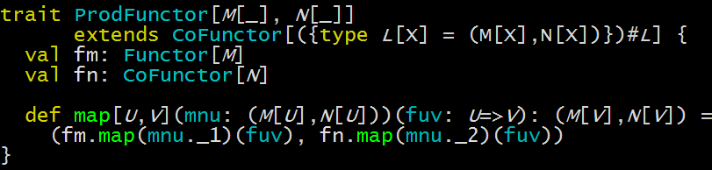

Abstraction: Tensor functoriality
Tensor metrics and products requires other type of functors … Higher
Product Functor
BiFunctor
(*) Paul Phillips’ cats framework https://github.com/non/cats
Notes:
Morphisms applied to each type of tensor which require a specific functors (ProductFunctor, Bifunctor, HOM functor….).
As example the definition of the functors for morphisms on the inner product, ProdFunctor CoField dot VField => Set and the bi-functor BiFunctor.

Slide 16
Abstraction: Extending types
The purpose of reusability goes beyond refactoring code. It includes leveraging existing well understood concepts and semantic.
Scala libraries classes cannot always be sub-classed. Wrapping library component in a helper class clutters the design.
Implicit classes extends classes functionality without cluttering name spaces.
Notes:
We looked at the abstraction of mathematical concepts. What about abstraction of programming concepts?
Let’s consider the problem of handling a computation error and recovery the workflow to its previous known stable state (transactional computation). There are two outcomes
If the current step in the computation succeeds, the next computation stage is started
If the step fails, the workflow rolls back to the previous known stable state.
Can we leverage existing Scala constructs without the need to introduce a new pattern?
Standard library classes are either final or implemented a sealed trait or abstract class. Creating a helper or utility class (reuse by composition) adds a new indirection and clutter the design.

Slide 17
Abstraction: Extending types
Data flow micro-router for successful and failed computation by transforming Try to Either with recovery and processing functions
scala.util.Try[T]
recover[U >: T](f: PartialFunction[Throwable, U]): Try[U]
getOrElse[U >: T](f: () => U): U
orElse[U :> T](f: () => Try[U]): Try[U]
toEither[U](rec: () => U)(f: T => T): Either[U, T]
Notes:
Here is the dilemma:
On one hand, the concept of transactional computation (all or nothing) is better expressed with the Either class
On the other hand, exceptions are implemented through the Try class (as in C++ and Java)
We need to combine these two concepts (Try and Either) by extending “transparently” the Try class with Either. This is accomplished by wrapping Try with an implicit class containing toEither (Try -> Either) method.

Slide 18
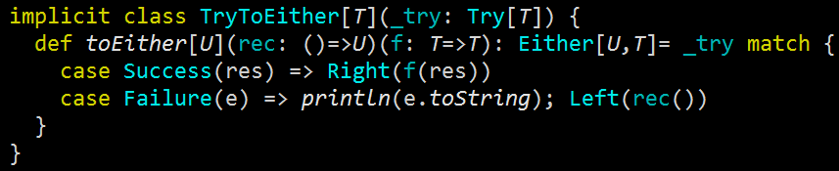
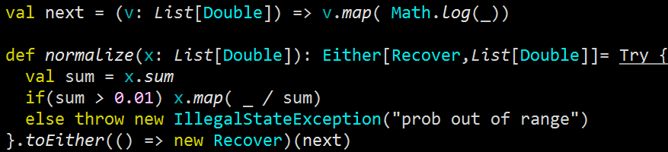
Abstraction: Extending types
4 lines of Scala code to extend Try with Either concept.
.. as applied to a normalization problem.
Notes:
Let’s apply the implicit class Try2Either to a simple data transformation: normalization.
If the denominator “sum” were too small, downstream computation would incur significant rounding errors. In this case, the normalization aborts and a recovery mechanism (instance of class Recover) is invoke. If the normalization proceeds without rounding errors, the next computation step (creating a log of the vector x) is triggered.

Slide 19
Abstraction: Extending types
Notes
Type conversion such as toDouble, toFloat can be extended to deal rounding error or rendering precision
This design is used to define checkpoint in a “transactional” workflow. The workflow rolls back to the previous checkpoint in case of errors.
Alternative to the state monad
Notes:
As I mentioned previously, such a pattern can be used as a micro-router. I used the Try.toEither to roll back to the previous known stable state of the computation which is stored in file.
Note: Delimited continuation seems would be an interesting alternative to investigate for transactional computation.

Slide 20
Abstraction
Monadic kernels
Tensor functoriality
Extending types
Flexibility
Dependency injection
Scalability
Notes:
The second requirement for a programming language (to be a good fit for implementing machine learning) is the ability to create dynamic and configurable data flows/workflows as a sequence of transformation/reduction on data.

Slide 21
Flexibility: dependency injection
Factory design patterns have been used to create dynamic systems (GoF). Dependency injection has gain popularity for creating configurable systems (i.e. Spring framework).
Building machine learning apps requires configurable, dynamic workflows
Leverage mixins, inheritance and abstract values to weave data transformations/reductions.
Notes:
The first thing to come to mind in creating complex system from existing objects (or classes) is a factory design pattern.
Design patterns have been introduced by the “Gang of four” in the eponymous “Design Patterns: Elements of Reusable Object-Oriented software” some 20 years ago… The list of factory design patterns includes Builder, Prototype, Factory method, Composite, Bridge and obviously Singleton.
Those patterns are not very convenient for weaving data transformation (these transformation being defined as class or interface). This is where dependency injection popularized by the Spring framework comes into play.
Beyond composition and inheritance, Scala enables us to implement and chain data transformations/reductions by stacking the traits that declare these transformations or reductions.

Slide 22
Flexibility: dependency injection
Multiple models and algorithms are typically evaluated by weaving computation tasks.
A learning platform is a framework that
Define computational tasks
Wires the tasks (data flow)
Deploys the tasks
Notes:
We briefly mentioned that the for comprehension can be used to chain/stack data transformation. Dependency injection provides a very flexible approach to create workflows dynamically, sometimes referred as the Cake pattern.
Note: As far the 3rd point, deployment of tasks, it usually involves a actor-based (non blocking) distributed architecture such as Akka and Spark. We will mention it briefly later in this presentation is introducing mailbox back-pressure mechanism.

Slide 23
Flexibility: dependency injection
Even the simplest workflow requires flexibility …..
Loading
Preprocessing
d
Preprocessor
DFTFilter
Kalman
Validating
d
Reducing
Training
Reducer
Supervisor
PCA
SVM
EM
MLP
Notes:
Let’s look at the Training module/task as an example. The task of training a model is executed by a Supervisor instance that can be either a support vector machine or a multi-layer perceptron, in this simplistic case. Each of these two “supervisors” can have several implementations (single host, distributed through a low-latency network,…)
Once defined, the modules are to be weaved/chained by making sure that output of a module/tasks matches the input of the subsequent task.
Notes:
The training module can be broken down further into generative and discriminative models.
Real-world applications are significantly more complex and would include REST service, DAO to access relational database, caches….
The terms “module”, “tasks” or “computational tasks” are used interchangeably in this section.

Slide 24
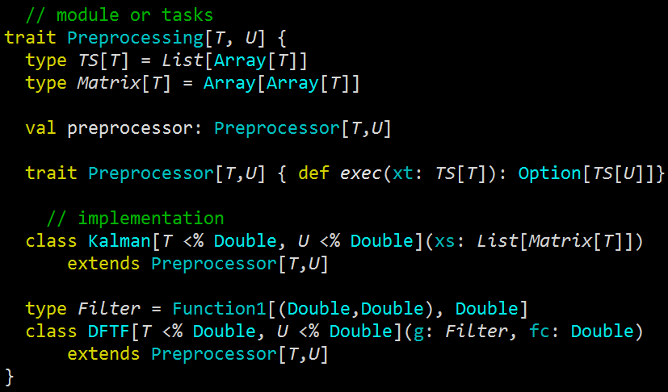
Flexibility: dependency injection
Implementation of Preprocessing module
Notes:
Let’s consider the Preprocessing module (or task) implemented as trait
Preprocessing of a data set is performed by a processor of type Preprocessor that is defined at run time. Therefore the preprocessor has to be declared as an abstract value.
The three preprocessors defined in the preprocessing modules are Kalman filter, Moving Average (MovAv) and Discrete Fourier filter (DFTF). Those 2 inner classes act as adapter or stub to the actual implementation of those algorithm.

Slide 25
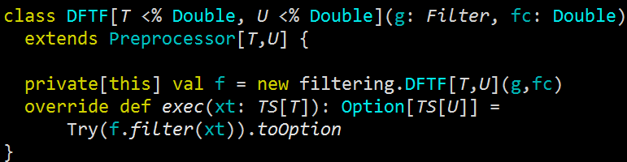
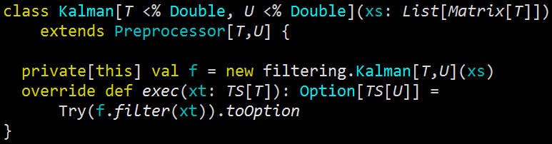
Flexibility: dependency injection
Implementation of Preprocessing module using discrete Fourier
… and discrete Kalman filter
Notes:
Here is an implementation of the Kalman and Discrete Fourier transform band-pass filter.
The2 inner classes, Kalman and DFTF act as adapter or stub to the actual implementation of those algorithm. It allows the implementation may consist of multiple version. For instance filtering.Kalman is a trait with several implementation of the algorithm (single host, distributed, using Spark…)
Such design allows to
Select the type of preprocessing algorithm within the Preprocessing module or namespace
Select the implementation of this particular type of algorithm/preprocessor in the filtering package

Slide 26
Flexibility: dependency injection
Clustering workflow = preprocessing task -> Reducing task
Modeling workflow = preprocessing task -> model training task -> model validation
Loading
d
Preprocessing
Modeling
Preprocessor
DFTFilter
Clustering
Validating
Kalman
d
Reducing
Training
Reducer
Supervisor
PCA
SVM
EM
MLP
Notes:
Clustering workflow is created by weaving (or stacking) a preprocessor and a reducer.
Modeling workflow is generated by stacking a preprocessor, a supervisor and a validator.

Slide 27
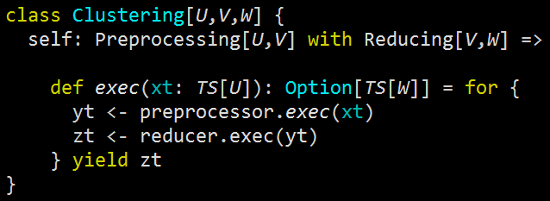
Flexibility: dependency injection
A simple clustering workflow requires a preprocessor & reducer. The computation sequence exec transform a time series of element of type U and return a time series of type W as option
Notes:
From the data management perspective, Clustering implements two consecutive data transformations: preprocessing and dimension reduction.

Slide 28
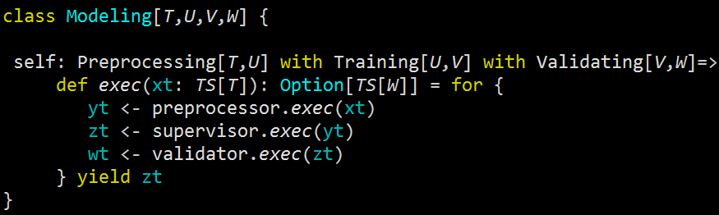
Flexibility: dependency injection
A model is created by processing the original time series of type TS[T] through a preprocessor, a training supervisor and a validator
Notes:
Modeling workflow is created by chaining an implementation of the filter, training and validator, all selected at run-time.
Modeling is therefore implemented as a stack of 3 traits, each representing a transformation or reduction on data sets.

Slide 29
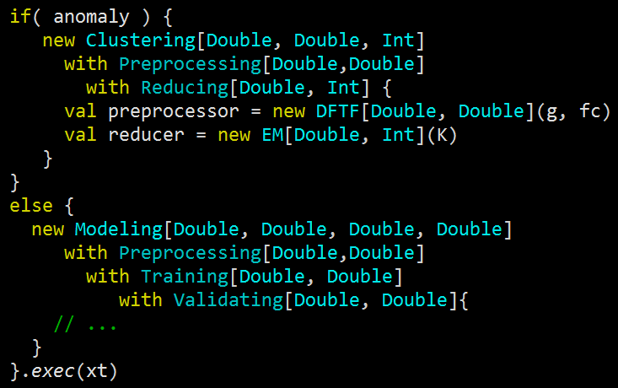
Flexibility: dependency injection
Putting all together for a conditional path execution …
Notes:
Computational tasks related to machine learning can be complex and lengthy. The process should be able to select the appropriate date flow (or sequence of data transformation or reduction) at run time, according to the state of the computation.
In this simple case, a clustering task is triggered if anomalyDetection is needed, training a model is launched otherwise.
These conditional path execution are important for complex analysis or lengthy computation that require unattended execution (i.e. overnight or over the week-end).
Note: The overriding of the abstract value for the Modeling workflow are omitted here for the sake of clarity

Slide 30
Abstraction
Monadic kernels
Tensor functoriality
Extending types
Flexibility
Dependency injection
Scalability
Tail recursion
Streaming
Flow control
Notes:
At last, Scala has to be performant and scalable to execute some lengthy computations.

Slide 31
Scalability: tail recursion
Choosing between iterative and recursive implementation of algorithms is a well-documented dilemma.
Many machine learning algorithms (HMM,RL, EM, MLP, …) relies on dynamic programming techniques
Tail recursion is very efficient solution because it avoids the creation of new stack frames
Notes:
Let’s start with the ubiquitous tail recursion. Although tail recursion is widely known and used, I have to include in this presentation because it is essential to the implementation of dynamic programming techniques in Scala.
Quite a few machine learning algorithm does not rely on a close, explicit, global minimization of the loss function (or maximization of the log likelihood). Dynamic programming techniques are therefore required for such classifier as Q-learning, hidden Markov model or back propagation neural network.
For better or worse, recursion has the reputation of being an elegant but inefficient option for implement dynamic programming algorithm. Scala provides us with a viable alternative with tail recursion.

Slide 32
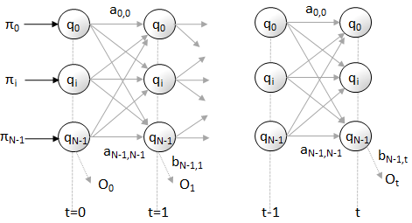
Scalability: tail recursion
Viterbi algorithm for hidden Markov Models
The objective is to find the most likely sequence of states {q_{t}} given a set of observations {O_{t}} and a λ-model
Notes:
The Viterbi algorithm is an excellent candidate for tail recursion because the number recursions (equal to the length of the sequence of states) is finite and reasonable and the number of parameters to be passed is small.

Slide 33
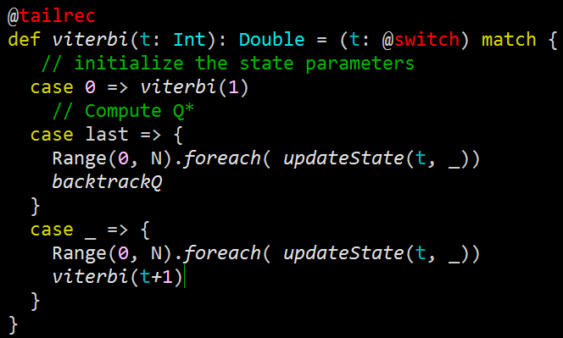
Scalability: tail recursion
The algorithm recurses along the observations with N different states.
Notes:
Here is the skeleton of the implementation of the Viterbi algorithm that traverses a sequence of observations.
This implementation is representative of implementation of dynamic programming algorithms in Scala:
First invocation (on observation of index 0) initializes the context of the tail recursion (hidden states in our case)
Subsequent invocations update the states parameters and recurse to the next observation (index t+1)
Finally the last invocation on the last observation (index obs.size -1) updates the last state’ parameter, performs some cleaning activities if needed and exits.
As a side note, using a closure for which the recursive call update a global values or class attribute will degrade the performance of the recursion.

Slide 34
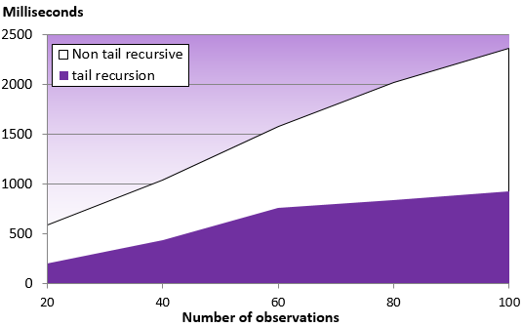
Scalability: tail recursion
Relative performance of the recursion w/o tail elimination for the Viterbi algorithm given the number of observations
Notes:
Simple performance test using Fibonacci sequence shows a 3 fold improvement.
This “back of the envelop” performance test consists of Viterbi to compare the tail recursion and the recursion without tail elimination using 5 samples with increasing number of observations.
Although it is not a rigorous and scientific finding, the tail recursion becomes very effective for test with more than 60 observations
It would be interesting to compare the performance of those two recursions with the performance of an iterative function.

Slide 35
Scalability: streaming
An increasing number of algorithms such as reinforcement training relies on online (or on-demand) training.
Traversing & processing ‘infinite’ data sets for which computation can be aborted or re-applied
Streams reduce memory consumption by allocating and releasing chunk of data (or slice or time series) while allowing reuse of intermediate results.
Notes:
Real-time streaming is becoming popular (i.e. Apache Spark streaming library, Akka reactive streams….). Short of using one of these frameworks, you can create a simple streaming mechanism for large data sets that require.
Streams vs. Iterator: Iterator does not allow to dynamically select the chunk of memory or preserve it if necessary for future computation.
It is not uncommon to have to train a model as labeled data becomes available (online training). In this case, the size of the data set can be very large and unknown. The processing of the data would result in high memory consumption and heavy load on the Garbage collector.
Finally, the traversing the entire data sets (~ allocating large memory chunk) may not even needed as some computation may abort if some condition is met.
Scala’s streams can help!

Slide 36
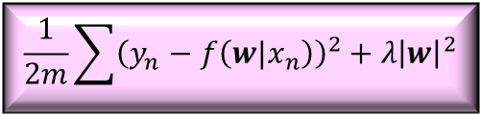
Scalability: streaming
Slices of the data stream are instantiated at the time, processed by the operator (i.e. loss function) and released back to the garbage collector.
Traversal loss function
Heap
$$\frac{1}{2m}\sum{{\left(y_{n}−f\left({w|x}_{n}\right)\right)}^{2}+λ{\left|w\right|}^{2}}$$
Allocate
slice .take
Data stream
X₀ X₁ ….... X_{n} ………. X_{m}
Release slice .drop
Garbage collector
Notes:
Most of machine learning algorithms consists of minimizing a loss function or maximizing a likelihood. For each iteration (or recursion) the cumulative loss is computed and passed to the optimizer (i.e. Gradient descent or variant) to update the model parameters.
In order to minimize the memory footprint, two actions have to take place
Allocate slice of the data set (memory chunk) from the heap using take method.
Release the memory chunk back to the Garbage collection through a drop method.
Each slice of n observations is allocated, processed by the loss function then released back to the Garbage collector.

Slide 37
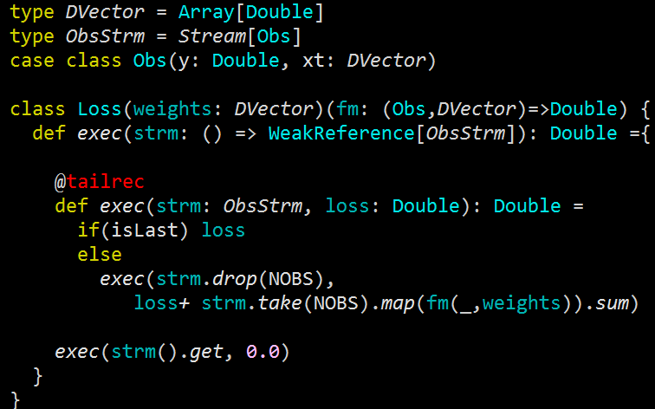
Scalability: streaming
Slices of NOBS observations are allocated one at the time, (.take) processed, then released (.drop) at the time.
Notes:
The Loss class has a single method, exec, that traverses the stream. Once again, the loss is computed using a tail recursion.
An observation is defined as y = f(x) where x the feature set containing for instance, age, ethnicity of patient, body temperature and y is the label value such as the diagnosed disease.. The tail recursion allocates the next slice of STEP observations through the take method, computes the lost, nextLoss, then drop the slice. The reference is recursively redefined as the reference to the remaining stream.
The problem is that the garbage collector cannot reclaim the memory because the first reference to the stream is created outside the recursion. The solution is to declare the reference to the stream as weak so it chunks of memory associated to the slices/batches of observations already processed can be reclaimed.

Slide 38
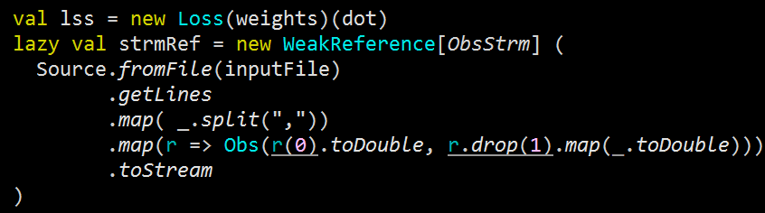
Scalability: streaming
The reference streamRef has to be weak, in order to have the slices garbage collected. Otherwise the memory consumption increases with each new batch of data.
(*) Alternatives: define strmRef as a def or use StreamIterator
Notes:
The reference of the stream is created as a Weak java reference to an instance created by the stream constructor, Stream.iterate.
In this case, the weak reference has been used to show Java concepts are still relevant.

Slide 39
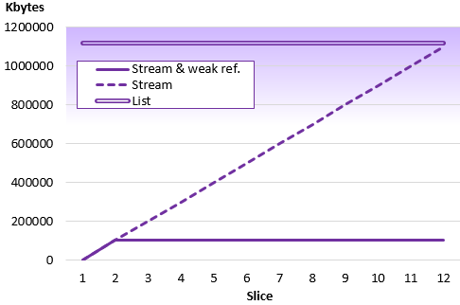
Scalability: streaming
Comparing list, stream and stream with weak references.
Notes:
Let’s compare the memory consumption of three strategies to compute the loss function on a very large dataset.
A list
A stream with standard reference
A stream with weak reference
In the first scenario, and as expected, the memory for the entire data set is allocated before processing. The memory requirement for the stream with a strong reference increases each time a new slice is instantiated, because the memory block is held by the reference to the original stream. Only the stream with a weak reference guarantees that only the memory for a slice of STEP observations is needed through the entire execution.

Slide 40
Scalability: streaming
Notes:
Iterators:
computation cannot not memoized. (“Iterators are the imperative version of streams”)
One element at a time
Non-recursive (tail elimination)
Views:
No intermediate results preserved
One element at a time
Stream iterators:
Lazy tails
Notes:
Let’s compare the memory consumption of three strategies to compute the loss function on a very large dataset.
A list
A stream with standard reference
A stream with weak reference
In the first scenario, and as expected, the memory for the entire data set is allocated before processing. The memory requirement for the stream with a strong reference increases each time a new slice is instantiated, because the memory block is held by the reference to the original stream. Only the stream with a weak reference guarantees that only the memory for a slice of STEP observations is needed through the entire execution.

Slide 41
Scalability: flow control
Actor-based workflow has to consider
Cascading failures => supervision strategy
Cascading bottleneck => Mailbox back-pressure strategy
Router, Dispatcher, …
Workers
Notes:
We mentioned earlier that a learning platform requires implementing, wiring and deploying tasks. Akka or framework derived from Akka, are commonly used to deploy workflow for large datasets because of the immutability, non-blocking and supervision characteristic for actors.
Scala/Akka actors are resilient because that are defined with hierarchical context for which an actor because a supervisor to other actors. In this slide, a router is a supervising actor to the workers and, depending on the selected strategy, is responsible of restarting a worker in case of failure.
But, what about the case for which the load (number of messages in the mail box) for each actor increases indefinitely?

Slide 42
Scalability: flow control
Actors provides a very efficient and reliable way to deploy workflows and tasks over a large number of cores and hosts.
The execution of workflow may create a stream bottleneck, for slow tasks and overflow local buffers.
A flow control mechanism handling back pressure on bounded mail boxes of upstream actors.
Notes:
The objective is to avoid bottleneck in the computation data flow which would result in overflowing actors’ mail box/local buffers.
A strategy to control the flow (or back-pressure flow) is needed to regulate the data flow across all modules.
This example use a back-pressure handling mechanism that consists of monitoring bounded mail boxes. This is a simplistic approach to flow control described for the sake of illustrating the concept. As we will see later, there is a far more effective mechanism to deal with back-pressure.

Slide 43
Scalability: flow control
Messages passing scheme to process various data streams with transformations.
Dataset
Load->
Status ->
Controller
<- GetStatus
Completed->
Compute->
Watcher
Bounded mailboxes
Workers
Notes:
In this example, an actor, Controller loads chunk of data, partitions and distributed across multiple Worker actors, along with a data transformation.
Upon receiving the message ‘Compute’ the workers process data given a transformation function. The workers returns the processed data through a Completed message.
The purpose of the watch dog actor, ‘Watcher’ is to monitor the utilization of mailbox and report it to the Controller
This is a simple feedback control:
1- Watcher monitors the utilization of the mailbox (average length)
2- The controller adjust the size of each batch in the load message handler (throttling)
3- The workers process the next batch

Slide 44
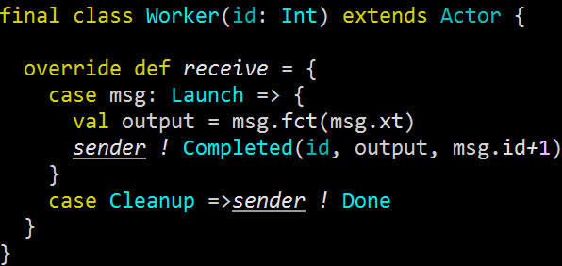

Scalability: flow control
Worker actors processes data chunk msg.xt sent by the Controller with the transformation msg.fct
Message sent by collector to trigger computation
Notes:
Let’s start with the Worker actor.
The load on a worker depends on three variables
1- The amount of data to process
2- The complexity of the data transformation
3- The underlying system (cores, memory..)
The controller provides the slice of data to be processed by the workers msg.xt as well as the data transformation msg.fct.

Slide 45
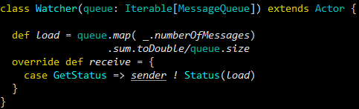
Scalability: flow control
Watcher actor monitors messages queues report to collector with Status message.
GetStatus message sent by the collector has no payload
Notes:
Let’s look at our watch dog actor, Watcher: It computes the load as the average mailbox utilization and send it back to the controller through a Status message.

Slide 46
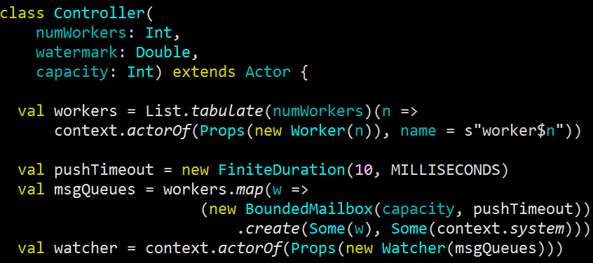
Scalability: flow control
Controller creates the workers, bounded mailbox for each worker actor (msgQueues) and the watcher actor.
Notes:
As its name implies, the controller configure and manage the dynamic workflow and control the back pressure from the worker actors.
As far as the configuration is concerned, the Controller generates a list of workers, the bounded mailboxes, msgQueues, for the workers and ultimately the watcher actor.
The worker and watcher are created within the Controller context using the Akka actorOf constructor.

Slide 47
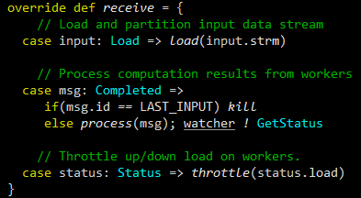
Scalability: flow control
The Controller loads the data sets per chunk upon receiving the message Load from the main program. It processes the results of the computation from the worker (Completed) and throttle the input to workers for each Status message.
Notes:
As far as the management of data flow and feedback control loop, the Controller
loads partition and distribute batch of data points to the worker actors (message: Load)
processes the results of the computation in workers (message: Completed)
- Throttle up or down the flow upon receiving the status on utilization of mail boxes from the watcher (message: Status)

Slide 48
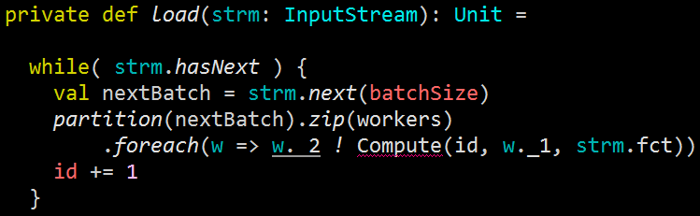
Scalability: flow control
The Load message is implemented as a loop that create data chunk which size is adjusted according to the load computed by the watcher and forwarded to the controller, Status
Notes:
The composition of the messages processed by the controller are self-explanatory. It
Adjusts the size of the next batch if required (throttle method)
Extracts the next batch of data from the input stream
Partition and distribute the batch across the worker actors
Send the partition along with the data transformation to the workers.

Slide 49
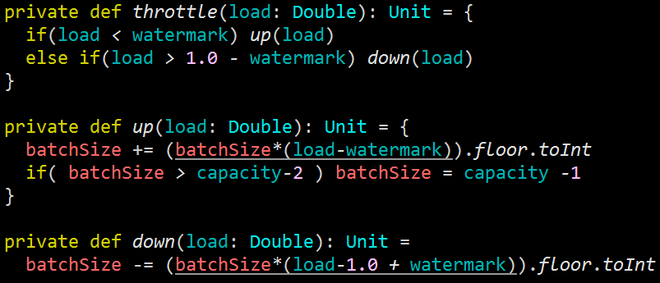
Scalability: flow control
Simple throttle increases/decreases size of the batch of observations given the current load and specified watermark.
Notes:
The implementation of the throttle method is rather simple. It takes the load computed by the watcher actor and the current batch size (number of data points to be processed) as input. It update the batch size using a simple ratio relative to the watermark. For instance if load is below the watermark, the batch size is increased.

Slide 50
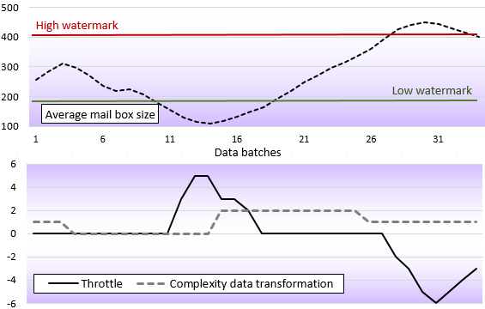
Scalability: flow control
Feedback control loop adjusts the size of the batches given the load in mail boxes and complexity of the computation
Notes:
The bottom graph describes the throttle action and the complexity of data transformation.
The complexity of the data transformation and has an impact on the load on workers. It varies from 0 (simple map operation) to 2 (complex data processing involving recursion or iterations).
The throttle intensity ranges between -6 (rapid decrease of size of batches) and +6 (rapid increase of size of batches of data)
The top graph displays the actual utilization of the mail boxes with capacity of 512 messages as regulated by the feedback control loop (executed by the controller).

Slide 51
Scalability: flow control
Notes
Feedback control loop should be smoothed (moving average, Kalman…)
A larger variety of data flow control actions such as adding more workers, increasing queue capacity, …
The watch dog should handle dead letters, in case of a failure of the feedback control or the workers.
Reactive streams introduced in Akka 2.2+ has a sophisticated TCP-based propagation and back pressure control flows
Notes:
The deployment of a reactive data flow in production would require significant improvement on our Naïve model.
The feedback control loop could be smoothed with a moving average technique or Kalman filter to avoid erratic behavior
We would need to provide a larger range of options for control actions beside adjusting the size of data batches: increase of number of workers, mail box capacity, caching strategy, .. A fine grained set of actions reduces also the risk of instable systems.
The watch dog should be able to handle dead letters in case of failure (mailbox overflowing)
Reactive streams control the flow back pressure at the TCP connection level. It is far more accurate and responsive that mailbox utilization.

Slide 52
… and there is more
There are many other Scala programming language constructs I found particularly intriguing as far as for machine learning is concerned …
Domain Specific Language
Emulate ‘R’ language for scientists to use the application.
Reactive streams (TCP)
Effective fault-tolerance & flow control mechanism
Delimited continuation
Save, restore, reuse computation states
Notes:
The implementation of machine learning algorithm would benefit from few other interesting features of the Scala language, I have not used yet.
DSL are used to introduce domain specific semantic in the library. It is also intensively used in reactive programming.
As stated earlier, Akka reactive streams are an efficient approach to managing data flows. It would be particularly valuable to combine the flexibility of dependency injection with the efficiency of Akka streams and reactors.

Slide 53
References
Monads are Elephants J. Ivy –
james-iry.blogspot.com/2007/10/monads-are-elephans-part2.html
Cats functional library P. Phillips – https://github.com/non/cats
Extending the Cake pattern: Dependency injection in Scala A. Warski –
www.warski.org/blog/2010/12/di-in-scala-cake-pattern
Programming in Scala $12.5 Traits as stackable modification M. Odersky,
M. Spoon, L. Venners - Artima 2008
Introducing Akka J. Boner - Typesafe 2012
www.slideshare.net/jboner/introducing-akka
Scala in Machine Learning: $1 Getting started P. Nicolas –
Packt publishing 2014
Exploring Akka Stream’s TCP Back Pressure: U. Peter – Xebia 2015
blog.xebia.com/2015/01/14/exploring-akka-streams-tcp-back-pressure/
Donate to Apache software and Eclipse foundations
Notes:
I hope you will find some of these references, useful

