Slide 1

Implementing the PRN Role
Pediatric Pain PRN Curriculum

Slide 2
Table of Contents
Objectives
Engage patients, families, leaders, and the interdisciplinary healthcare teams to identify opportunities and develop an action plan to improve sensitivity to children’s pain and clinical care provided.
Assess your unit, specialty, organization, and community for opportunities to successfully educate patients/families and/or the interdisciplinary health care team, conduct evidence-based practice, research, and/or quality improvement projects that will facilitate optimal pain management and systemize optimal pain care.
Analyze your potential for success in the PRN role based on your qualifications and your evaluation of your institution’s leadership commitment, interdisciplinary teamwork, and resources to address staff/organization related challenges and barriers to optimal pain care.
Evaluate how your goals for the PRN role align with the outlined PRN responsibilities and the institutions care priorities.
page
page
page
page
page
3
11
20
24
33
What is a Pain Resource Nurse?
PRN Responsibilities
Clinical Standards
Implementing the PRN Role
Identify Opportunities
page
page
page
page
page
39
58
64
75
79
Your Role as a Change Agent
Leveraging Informatics
Advocating for Patients and Families
In Summary
Appendix

Slide 3
What is a Pain Resource Nurse?

Slide 4

Type your answer here.
Take a minute to reflect…
Is your leadership committed to your active involvement in this effort? Are you?
Who are key members of your collaborative interdisciplinary team who effectively communicate vertically and horizontally?
Where can you focus your first effort for the quickest win and biggest reward?
Do you have the resources you need to secure success?

Slide 5
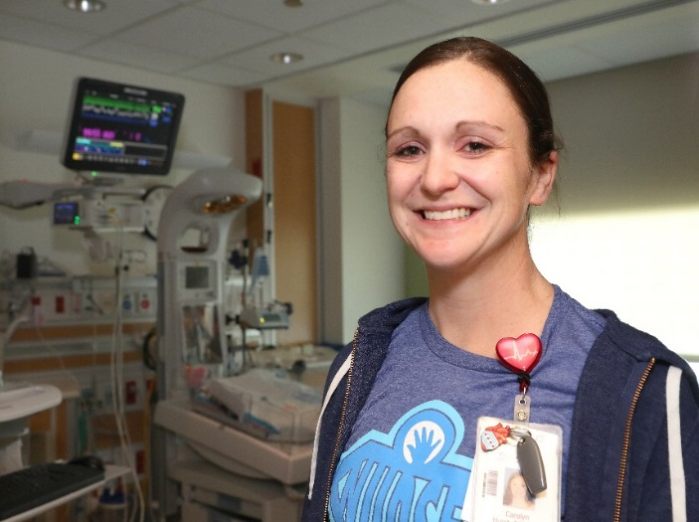
The Pain Resource Nurse (PRN) Role
A Pain Resource Nurse (PRN) is a registered nurse who interfaces with healthcare team members, patients, and families as a resource, change agent, and leader to disseminate information, facilitate optimal pain management, and systemize quality pain care.
A systematic review of PRN programs identified four key elements for a successful program:
Committed leadership and active PRN involvement to embed a culture of effective pain management throughout an organization.
Collaborative interdisciplinary teamwork and communication.
Focused effort to address staff-related and organization-related challenges and barriers to pain management.
Uses a combination of strategies and resources to overcome barriers to optimal pain management.
PRNs influence care at the unit, specialty, organization, and community level

Slide 6

PRN Qualifications
Qualifications may vary by institutional commitment, culture, structure, and employee policies
Confident professional Registered Nurse, bachelors’ degree preferred
Defined clinical experience and demonstrated competence as a nurse and leader on current unit, clinical practice or specialty
Able to articulate beliefs, knowledge, and attitudes about pain in a complex healthcare system
Demonstrates knowledge and expertise in providing nursing care, problem solving, critical thinking, and implementing standards
Demonstrates effective interpersonal skills, and flexible thinking. Able to collaborate with the interdisciplinary team
Open to diverse strategies for pain care and pain care improvement
Expresses interest and a commitment to providing the best pain management available
Shares knowledge with staff through role modeling and teaching
Demonstrates effective written and verbal communication skills
Able to prioritize and independently manage time

Slide 7
Characteristics of a Successful PRN
Personal Characteristics: | Clinical Leadership Skills:
Committed | Advocate
Confident | Coach
Contagious enthusiasm | Collaborator
Flexible | Change Champion
Open-minded | Provides effective feedback
Passionate | Risk manager
Patient | Role Model
Professionally Credible | Skilled in Conflict resolution
Resilient | Teambuilder
Yours? | Others?
Nursing Virtuosity is the performance of the professional discipline with great knowledge, skill, and intuitiveness by an expert in caring.
The PRN demonstrates technical proficiency, sustainable talent, innovation, and connectiveness in care. The PRN reacts to the subtleties of patients’ conditions and the dynamics of interpersonal relations based on knowledge and experience, modulated by workload, and evaluated by the patient, family, leadership, and interdisciplinary health team.
(Manworren, 2010).

Slide 8

Measures of Successful PRN Program Outcomes
Strategies for successful implementation of the PRN role:
Identify opportunities to improve pain care and promote an organizational culture of sensitivity to children’s pain
Align work with organizational priorities
Promote PRN role; make it visible and accessible
Document and communicate PRN activities and outcomes
Increased documentation of pain assessments and interventions
Greater awareness of the problem of undertreated pain; improved knowledge and attitudes
Implementation of multimodal pain treatment protocols, including pharmacologic and biobehavioral (non-pharmacologic) strategies
Improved pain relief
Improved patient knowledge and satisfaction with pain care
Enhanced nurse empowerment, job satisfaction, and retention
Seek feedback from patients, families, nurses, healthcare team members, leadership
Benefits
Specialized ongoing continuing education
Leadership and career development opportunities
Recognition of clinical expertise and leadership role
Support for identified educational, evidence-based practice, performance improvement, and/or research projects related to pain management
Opportunities to present and publish project findings internally and externally in local, regional, national and international forums
Challenges
Time, resources, role conflict and ambiguity

Slide 9
Type your answers here.
Take a minute to reflect…
What are your organizational priorities?
How will you successfully brand the PRN role?
Who can help you overcome these challenges?
Who can help you access the resources you need?

Slide 10
Leadership Commitment to PRN and PRN Role
Leadership should commit to provide:
Time for initial training and ongoing continuing education
Commitment to a culture of effective pain management throughout an organization
Program facilitation by a leader with expertise in pain management and education
Ongoing role development
Communication and provide support for PRN role and project
Help with way finding, identification of resources, and effective methods of addressing staff and organizational challenges and barriers.
Facilitate interdisciplinary communication, cooperation, and teamwork to advance PRN role
Collaboration with PRN to evaluate role
Evaluation of effectiveness of PRN
Management is doing things right; leadership is doing the right things. ~ Peter Drucker

Slide 11
PRN Responsibilities

Slide 12
What PRNs Do
Personal Professional Development
Care Provider
Educator
Scientist
Change Agent
Leader
Responsibilities vary by institutional commitment, culture, structure, needs, opportunities, and expectations

Slide 13
Responsibilities
Personal Professional Development
Assess personal knowledge and attitudes about pain and pain care
Regular active attendance at PRN meetings and other committee meetings as defined
Negotiate with leadership for time to complete the responsibilities of the PRN role
Care Provider
Act as a role model for others in the care of patients by performing thorough pain assessments, providing pharmacologic and biobehavioral interventions, evaluating outcomes, teaching patients and families about pain care, and communicating pain care through documentation and verbally during patient care rounds and reports
Advocates for patients experiencing pain as a resource for staff and by escalating concerns to healthcare team members, leadership, and committees
Educator
Educates patients and families in pain care through developmentally appropriate strategies
Improves health literacy related to children’s pain through consistent use of words with discrete and powerful meaning
Disseminates information about pain care and clinical practice guidelines to the interdisciplinary healthcare team through a variety of creative strategies
Coordinates unit education related to pain

Slide 14
Responsibilities
Change Agent
Performs informal needs assessment of clinical unit, specialty, or clinic practice setting including a review of staff knowledge and attitudes about pain, general pain management practices, and documentation to target areas for improvement
Supports institution-wide efforts to improve pain care
Facilitates ongoing quality improvement projects related to pain
Leads projects to facilitate optimal pain management and systemize quality pain care
Scientist
Identifies gaps in evidence-based guidance for pediatric pain care
Explores opportunities to pursue new knowledge and innovation
Leader
Provides feedback to healthcare team members regarding pain management practices
Recognizes and addresses ethical issues related to pain care

Slide 15

PRN Projects: Patient/Family Educator
PRNs should lead projects that facilitate optimal pain management and systemize quality pain care
Projects of importance should be developed based on needs assessment and reflect the PRNs strengths and interests. Projects should be outcome focused and time limited.
Examples of recommended project responsibilities.
Health Literacy and/or Patient/Family Education
Identifies patient/family education needs
Assembles a team or joins or consults with a developed team to address identified education need
Collaborates to develop and implement an action plan
Assists in the development and dissemination of education materials for patients and families
Acts as a resource for patient/family education related to pain care.
Collaborates with the leadership, Educators and other resources to evaluate progress
Author: *
PRN Project Leadership
Potential projects
Health Literacy and/or Patient/Family Education
Nursing or Interdisciplinary Healthcare Team Education
Evidence-based Practice
Quality Improvement
Research
* Author: Videoplasty.com
Books with Apple Flat Icon Vector.svg from Wikimedia Commons
License: Creative Commons Attribution-ShareAlike 4.0

Slide 16

PRN Projects: Staff Educator
More examples of recommended project responsibilities and potential projects:
Nursing or Interdisciplinary Healthcare Team Education Role
Identifies interdisciplinary teams’ education needs
Assembles a team or joins or consults with a developed team to address identified education need
Collaborates to develop and implement an action plan
Assists in the development and dissemination of education materials
Employs effective education strategies, for example
Conducts pain rounds
Provides journal articles relevant to pain care provided on unit or clinical area
Coordinates in-services related to pain
Promotes pain-related educational opportunities
Acts as a resource for healthcare provider and student education related to pain care.
Collaborates with the leadership, educators, and other resources to evaluate progress toward advancing healthcare team knowledge and attitudes related to pain and pain care
Potential Staff Education Projects
Conducts an accreditation readiness campaign for ChildKind or The Joint Commission survey
Assists in the coordination of Pain Awareness month activities & other pain education opportunities
Attends national scientific conferences related to pain and shares newly gained knowledge
PRN Project Leadership
Potential projects
Health Literacy and/or Patient/Family Education
Nursing or Interdisciplinary Healthcare Team Education
Evidence-based Practice
Quality Improvement
Research
https://creativecommons.org/licenses/by-sa/4.0/deed.de#

Slide 17

PRN Projects
More examples:
Evidence-Based Practice Projects
Develops an algorithm for evidence-based prevention of IV insertion pain
Selects and implements use of an opioid risk assessment tool
Designs a system to ensure equipment needed to provide developmentally appropriate biobehavioral treatments is available around the clock
Develops and implements an evidence-based order set to treat the most common reason for pain on a clinical unit
Quality Improvement Project Responsibilities
Plan
Do
Check
Act
Research Projects
Conducts a comparative effectiveness trial of PCA and PCA with continuous infusion
Develops a pain assessment tool for patients with spina bifida
Conducts a focus group with physical therapists to describe how they interact with nurses to manage children's pain before and during therapy
Retrospectively reviews EHR to compare outcomes of two treatment protocols
PRN Project Leadership
Potential projects
Health Literacy and/or Patient/Family Education
Nursing or Interdisciplinary Healthcare Team Education
Evidence-based Practice
Quality Improvement
Research

Slide 18

PRN networks
PRNs need to network to stay current!
Seek a mentor for PRN role.
Network internally and externally (locally, nationally, and internationally).
Societies
American Pain Society, especially the Pediatric Special Interest Group and Nursing Issues Special Interest Group
americanpainsociety.org
Regional Pain Societies
American Society for Pain Management Nursing
www.aspmn.org
International Association for the Study of Pain (IASP), especially the Pediatric Special Interest Group
https://www.iasp-pain.org
Society of Pediatric Nurses
www.pedsnurses.org
National Association of Pediatric Nurse Practitioners (NAPNAP)
https://www.napnap.org
Association of Pediatric Hematology/Oncology Nurses (APHON)
aphon.org
Others?

Slide 19
Type your answer here.
Take a minute to reflect…
What are some potential projects you could take on in your PRN role?
Which PRN characteristic do you need to develop to carry out the project responsibilities suggested?
How can you better develop your personal and professional PRN networks?

Slide 20
Clinical Standards

Slide 21
Accreditation Standards
The Joint Commission
The Joint Commission accredits healthcare organizations by their Standards Related to Pain Assessment and Management. Conduct a gap analysis and recommendations to meet these standards. Leadership (LD)
Standard LD.04.03.13
Pain assessment and pain management, including safe opioid prescribing, is identified as an organizational priority for the hospital.
Medical Staff (MS)
Standard MS.03.01.03
The management and coordination of each patient’s care, treatment, and services is the responsibility of a practitioner with appropriate privileges.
Standard MS.05.01.01
The organized medical staff has a leadership role in organization performance improvement activities to improve quality of care, treatment, and services and patient safety.
Provision of Care, Treatment, and Services (PC)
Standard PC.01.02.07
The hospital assesses and manages the patient’s pain and minimizes the risks associated with treatment.
Performance Improvement (PI)
Standard PI.01.01.01
The hospital collects data to monitor its performance..
Standard PI02.01.01
The hospital compiles and analyzes data.
See the Appendix for the draft language that goes live January 2018.
Applicable to Hospitals
Effective January 1, 2018

Slide 22

ChildKind Principles
ChildKind is a global initiative aimed at reducing pain and unnecessary suffering in children by offering a special designation to those facilities that have demonstrated an institutional commitment to pain relief and by providing the technical support to achieve that goal.
5 Key Principles:
Presence of a facility-wide written policy on pain prevention, assessment, and management endorsed by hospital administration
Comprehensive and on-going education for staff, patients, and caregivers
Documentation that pain is assessed using a developmentally appropriate process
Creation of and access to specific evidence-informed protocols for pain management including pharmacologic, psychologic, and physical methods
Use of a regular institutional self-monitoring quality program

Slide 23

Ethical Principles
Definitions
Beneficence
Taking positive action to help others and the desire to do good; it is a core principle of patient advocacy
Nonmaleficence
The duty to do no harm
Autonomy
The rights of self-determination
Justice
The fair treatment of individuals and equitable allocation of healthcare resources.

Slide 24
Implementing the PRN Role

Slide 25
How to Begin
Prepare yourself
Seek knowledge.
Survey present practice in selected areas – compare to benchmarks.
Identify impediments to change.
Get buy-in from appropriate stakeholders empowered to make change.
Establish Interdisciplinary team.
Develop and implement strategic action plan. Include active education, intuitive system changes, care audits, structured reinforcement, and timely feedback.
Make efforts and outcomes visible- promote and reward change.
Form a team
Identify qualified individual and invite them to participate.
Select team leader/project leader.
Set meeting times and location.
Keep key stakeholders outside team informed.
Decide on the focus and boundaries of the project.
Establish an interdisciplinary team to explore opportunities for improvement, identify barriers, develop an action plan, champion change, and monitor outcomes.

Slide 26
Engage Healthcare Professionals in Change
PRNs engage the interdisciplinary healthcare team to improve pain care
Rapid advances in care, changes in healthcare financing, and competing priorities make change in complex organizations, like hospitals , challenging. Clinical practice changes require a synthesized approach by interdisciplinary teams. The pain resource nurse is an ideal candidate to lead these team efforts.
Identify team members
Pitch the project
Brand the project
Three keys to engaging other healthcare professionals in change projects
1. Identify team members as early as possible while developing the change project
2. Pitch the project
3. Brand the project, but communicate in person

Slide 27
Steps for Engaging Healthcare Professionals
Identify team members as early as possible while developing the change project
Team members need to feel and believe in the urgency of making the change. No matter how good you think the idea is, you have to convince them that there is an urgent reason to incorporate “one more change” in their already challenging world.
Choose team members you respect and know you can work with to achieve outcomes.
Choose team members with both positional and informal leadership roles who can successfully champion changes in practice to improve pain management both in their profession and among the inter-professional healthcare team.
Include no more than 20% nay-sayers
Pitch the Project
Go where there is buy-in and likelihood of success to create an internal success story . Ignore the “nay-sayers” until you have 80% buy-in. Then, engage them to identify the most difficult barriers.
Frame the project as much as personally and as positively as you can. Highlight ways the project will personally benefit the organization and/or team members. “This will help you be more successful (or produce better outcomes)” Instead of: “You have to do this because it’s required (or policy).”
Use success stories of other units or divisions or peer organizations (other top tier Pediatric hospitals) BUT, let the change/process be customized for your culture. Let them get their fingerprints on it and make it personal. A “B+” approach with buy-in will always be better than your pure “best practice” or “A+” approach that is rejected.
Identify team members
Pitch the project
Brand the project

Slide 28
Steps for Engaging Healthcare Professionals.
Brand the Project, but communicate to the person
Clear, compelling, accurate – and short
Use “people-speak,” not “brand-speak”
Sometimes 5 words are better than 1
Think 1, 2, 3, - never 8, 9, or 10.
Show, don’t tell
Engage and challenge with questions
Identify team members
Pitch the project
Brand the project

Slide 29

Communicate, Communicate, Communicate!
Talk to team members in-person or at least, phone conversations. Both are far more effective than email.
Be flexible and prepared to let go of your agenda. If the PRN is not sensitive to the work demands and pressures of other members of the healthcare team, the likelihood of success is greatly diminished .
If you need to use written material, it should be as concise and to the point as possible.
Bottom line on top.
More detail is seldom better; less is more.
Make an emotional connection
Explain facts
Explain successes
Be Concise
Persuade
Repeat memorable phrases
Share your optimism and resolve!
Keep team members informed and seek feedback to ensure communication has been successful.
Tell your story
Send a message for healthcare improvement:
Make it memorable
Make it resonate
Make it inspire action
Check to see if the message was heard:
Problem
Solution
Ask
Urgency
Hope

Slide 30
Build Trust and Rapport
Build trust and rapport if you want others to follow your lead. It is essential to successfully getting buy-in.
Once you have established trust, the speed in which you can make change takes a quantum leap.
Trust is developed through:
Credibility
Be dependable; always keep your commitments
Deliver on promises and never promise something you can’t deliver
Respect
Value people as a whole person and treat everyone with respect
Convey that you understand their world and want to help them succeed
Be humble; no one trusts someone who seems to think they are the smartest person in the room and that their needs always take precedence of the needs of others.
Fairness
Avoid anything that could be perceived as a different or “special relationship” with another team member
Communication
Abundant, open, communication, preferably in person as much as possible
Be a great listener
Trust
Credibility
Respect
Fairness
Communication

Slide 31

Listen for Meaning
Great Listening is the key to getting people to open up to your perspective. It is the foundation of effective communication, positive relationships and building trust.
Being a great listener is simple…but doing it is hard. It means overcoming the greatest barrier to effective listening: Resisting the urge to “rush in and fix things” or “express your view.” Doing this is particularly hard for smart, high performing, and successful people.
Most of us listen passively; we are not “present” and are thinking of other things:
What we are going to say next, formulating our “brilliant” next statement.
Our next meeting, a deadline, errands we have to run after work, or what’s on our Phone.
Really great listeners are focused exclusively on the person we are interacting with:
The words they are saying
Their nonverbal cues
The feeling behind the message
Understanding the other person’s point of view and the assumptions they are making.
Great listeners respond on any commitments and follow-up agreed to in the discussion.
Great listeners confirm understanding with someone before speaking.
“Seek first to understand, then to Be understood.” ~Stephen Covey, 7 Habits of Highly Effective People
Great listeners speak less than half the time
“We have two ears and one mouth so that we can listen twice as much as we speak.” ~Epictetus

Slide 32

Type your response here.
Who’s on the team?
List key team members for developing your role as a PRN and for the success of your project.
List naysayers you think would work with you on the project to identify barriers (list only 1 for every 5 key team members).

Slide 33
Identify Opportunities

Slide 34
Identify Opportunities
Use this model to identify opportunities to optimize patient care and advance clinical pain management
Question
PICOT question
Evidence
Search for evidence
Critically appraise evidence
Teamwork
Engage interdisciplinary team
Pilot
Disseminate
Develop action plan to integrate change into practice
Obtain pre-data
Pilot practice change
Evaluate outcomes
Disseminate change internally
Disseminate change externally, if appropriate

Slide 35
Question
PICOT question
Question
Use a PICOT question format to define keywords and concepts
Example:
In pediatric oncology patients who can provide self-report (P), how does use of nitrous oxide (I) compare to use of topical anesthetics (C) for preventing (T) the needle pain with port access(O)?
Key PICOT Concepts
Population | Pediatric oncology patients
Intervention | Nitrous oxide
Comparison | Topical anesthetics
Outcome | Pain with port access
* Time (T) | May not be appropriate for all PICOT questions

Slide 36
Evidence
After identifying a PICOT question, review the literature to identify the best evidence before implementing a practice change.
Evidence
Search for evidence
Critically appraise evidence
Search the literature for relevant related research
Critique of evidence-based practice guidelines.
Critique of systematic reviews.
Critique of primary research articles.
Contact experts (if needed) for information.
Synthesize the literature
Write summary recommendations/ evidence-based practice guideline
Consult a medical librarian
Librarians are experts in searching and obtaining literature.
Search relevant databases and professional subscription resources
Each database covers a different focus and can contain literature from different date ranges and different publications.
Search more than one database
Google Scholar can be a helpful tool, but remember that it is not peer-reviewed or human curated.
Database | Focus
CINAHL | Nursing &allied health
Cochrane Library | Database of Systematic Reviews
ERIC | Education
Ovid MEDLINE | Biomedical/ multi-specialty
PsycINFO | Psychology
PubMed MEDLINE | Biomedical/ multi-specialty
After identifying a PICOT question, review the literature to identify the best evidence before implementing a practice change.
See the Appendix for more information.

Slide 37

What’s your next step? Type your answer here.
Decision point: is there enough evidence?
Discuss strength of evidence.
Contact additional experts as necessary.
Use other sources of evidence as necessary.
Decide if more research is necessary and feasible.
If you have enough evidence to proceed, draft/revise policy, procedure, standards.

Slide 38
Teamwork
Teamwork
The previous section on Implementing the PRN Role provides you with a good foundation for how to engage the interdisciplinary team.
The next section on Your Role as a Change Agent explores how to develop your action plan and integrate change.
Pilot
Select and collect outcome and/or process indicator data.
Implement changes in one unit/small number of patients - PILOT
Opinion leader
Change champion
Educate staff
Revise systems (documentation forms) to support practice change
Develop practice prompts
Decide on length of “trial” before collecting post implementation data
Collect and analyze outcome and process data
Disseminate
This step is about spreading the news. The next section on Your Role as a Change Agent gets into the details about how to do this.
Engage interdisciplinary team
Develop action plan to integrate change into practice
Teamwork
Pilot
Pilot
Obtain pre-date
Pilot practice change
Evaluate outcomes
Disseminate
Disseminate change internally
Disseminate change externally, if appropriate
Disseminate

Slide 39
Your Role as a Change Agent

Slide 40
Some factors can be leveraged to increase the rate of diffusion
Your job as a pediatric PRN is to be an innovator or early adopter of new pain management practices.
Attributes of the Innovation
Relative advantage
Communication Channels
Mass media
Nature of the Social Systems
Norms
Types of Innovation Decision
Optional
Compatibility
Observability
Trialability
Complexity
Interpersonal
Interconnectedness
Consequences
Collective
Authority
Multiple factors determine the rate of adoption
You can begin to see where you might impact the rate of change and the sustainability of the innovation over time.
Here’s an example of an innovation decision related to pain assessment: the timeline of pain assessment was done at judgement of nurse, and then recommendations for pain scales came out in papers. Then The Joint Commission made it a mandate…
And of course, TIME can be a serious factor affecting adoption of any change project.

Slide 41
Phased Implementation
I. Creating Awareness & Interest
II. Building Knowledge & Commitment
III. Promoting Action & Adoption
IV. Pursuing Integration & Sustained Use
A phased implementation plan uses diffusion theory to achieve sustainability.
Using Roger’s phases for diffusion of innovations, Cullen and Adams identified four phases of implementation.
The phases progress from passive to active and interactive.
I. Creating Awareness & Interest | Getting the attention of busy clinicians
II. Building Knowledge & Commitment | Preparing the clinical team for forthcoming change
III. Promoting Action & Adoption | Implementing the change; go-live; requiring a behavior change
IV. Pursuing Integration & Sustained Use | Pursuing integration and sustaining use of the evidence-based practice which is to hardwire process into routine workflow
Cullen, L. & Adams, S. (2012). Planning for Implementation of Evidence-Based Practice. Journal of Nursing Administration, 42(4), 222-230

Slide 42
Phase I. Create Awareness & Interest
This stage is about getting attention.
Highlight the advantage – strong evidence; likely to be helpful across all phases; can easily be shared within project purpose in reminders, unit posters, etc.
Highlight compatibility – strong evidence; helpful to link the evidence-based practice change with existing unit values (reducing patient risk of infection).
Create sound bites
Draft three brief and easy-to-remember pieces of information about the evidence-based practice. Include one statement of each:
Why it is important?,
How it relates to our patients?, and
What actions they need to do (essential!)?.
I. Creating Awareness & Interest
Goals | Strategies
What are the positives about the evidence-based practice? Think of this as marketing the evidence-based practice. Make it fun and eye-catching | Highlight advantage Highlight compatibility Sound bites

Slide 43
Phase II. Build Knowledge & Commitment
This stage is about preparing the team for change.
Education – the “go to” strategy that does little to change clinician behavior; none-the-less is an essential foundation before expecting a change in practice (live, virtual or computer-based).
Change agents – there are a variety of change agent roles, but in all, the focus is on helping your team members understand how to use their role.
Educational outreach or academic detailing – most effective approach to support application of learning; particularly useful when provided by a peer opinion leader
Gap assessment/gap analysis – demonstrates a clear opportunity for improvement; particularly effective for clinicians and leaders accustomed to interpreting data.
Local adaptation and simplify – creates commitment, while making the evidence-based practice easier to complete; the procedure for adaptation is important to keep the key steps essential to achieving the desired practice improvement.
Action plan – keeps the team organized and moving forward with clear delineation of responsibilities and a timeline for commitment.
II. Building Knowledge & Commitment
Goals | Strategies
How do clinicians within a discipline like to learn? Build upon the natural tendency for clinicians to learn from each other. Keep an eye toward building the evidence-based practice into the system to make it easy to do right. | Education Change agents Educational outreach or academic detailing Gap assessment/gap analysis Local adaptation and simplify Action plan

Slide 44
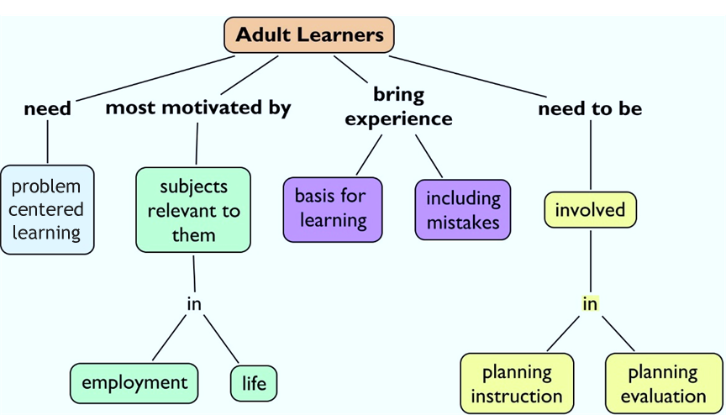
The PRN as a Teacher
Incorporate adult learning principles
Adults learn from their own experiences. Provide a foundation or context for the learning that’s based on what they need or want to know. They are motivated by content that is relevant, builds their confidence, captures their attention, or provides satisfaction. Adult learners want to be actively involved in learning rather than being lectured.

Slide 45
The PRN as a Teacher
Use effective teaching strategies, formats, resources
Source: National Training Laboratories. Bethel, Maine.

Slide 46
The PRN as a Coach
The PRN will serve as a coach to others
A coach is a content expert who demonstrates competency in teaching skill development. Coaching is a short-term relationship that is task-oriented and performance-driven .
Whereas:
A preceptor is assigned, based on knowledge, skills, and experience, to orient an individual and provide short-term formal training to produce competence.
A mentor is a close, trusted, experienced counselor who provides long-term, relationship-oriented, development-driven guidance.
A coach must:
Have enthusiasm for the work
Serve as a model for professional behavior and attitudes
Understand adult learning principles
Provide support
Suggest sources of information to acquire knowledge
Ask for feedback
An effective coach:
Actively listens
Provides and asks for constructive feedback
Asks questions
Builds trust

Slide 47
Phase III. Promote Action & Adoption
The purpose of this stage is to implement the behavioral change
Educational outreach/academic detailing – very strong evidence of effectiveness; highly useful for sharing information to promote learning and adoption.
Try the practice change – allows for incremental success in adopting the new practice; works well in combination with troubleshooting, recognition at point-of-care, and evaluation.
Change agents – there are a variety of change agent roles, with focuses varying from the local clinical setting, the system, and networking from outside the system. A key to success is helping clinician understand how to use their role.
Audit key indicators – used to assess current structure, processes, and outcomes of care to establish progress and need for improvement; consistently used and essential.
Actionable and timely data feedback – clinicians must know their current performance; feedback must be both – actionable so next steps are clear and timely so the data is relevant.
Report into quality improvement program – links the EBP with the quality improvement infrastructure; promotes adoption through the quality improvement cycle and access to resources.
III. Promoting Action & Adoption
Goals | Strategies
Use highly interactive and personal approaches. Show and use return demonstration and reinforcement. Expand upon context focused strategies. | Educational outreach/academic detailing Try the practice change Change agents Audit key indicators Actionable and timely data feedback Report into quality improvement program

Slide 48
Measures
Outcomes
Example: Decreased procedural pain in children
Start at the end and work back
What is the expected outcome of this change? (Decreased procedural pain)
What are indicators of that outcome? (Pain ratings)
How can they be measured? (Documentation review)
Look at the literature
What are you currently measuring?
How hard would it be to collect new data?
Enlist clinical experts when needed
Processes
Example: Decreased procedural pain in children
Start at the end and work back
What is the expected change in practice? (Pain assessment, comfort plan, evidence-based interventions
What are indicators of that change? (Documentation of pain assessments, comfort plan, intervention)
How can they be measured?
Look at the literature
What are you currently measuring?
How hard would new data be to collect?
Get clinical experts when needed
Start at the end and work back
Look at the literature
Get clinical experts

Slide 49
Evaluation Framework
Knowledge
Attitude
Behavior
Outcome
Staff knowledge
Practice
Technique
Staff perception
Importance
Priority
Staff behavior
Technique
Compliance checks
Outcomes
Patient
Staff
Cost
Pre and post implementation data is useful for evaluating a change in practice. This evaluation framework is useful for identifying where problems exist, so that implementation strategies can be targeted to the right processes.
For example, if nurses were not using distraction as an adjuvant therapy for pain management due to a knowledge deficit versus not thinking it was effective, vs not knowing how to use the therapy, the implementation strategies you chosen would be very different.
PROCESS
OUTCOME
Post implementation data can be collected using the same tools to monitor effectiveness of the implementation strategies and impact on outcomes.
Knowledge- How knowledgeable were staff about the practice?
Attitude- How supported and educated did the nurses feel they were to carry out the new practice? What barriers were there to carrying out the new practice?
Behaviors- Was the new practice carried out as intended? If clinicians are not completing key steps in the process (low intervention fidelity), consider the feasibility and the need to potentially revise the practice protocol and/or implementation plan.
Outcomes- Did the practice change improve patient care? Were the outcomes consistent with the outcomes found in the research? Did the practice change result in cost savings?
Bick & Graham (2010). Evaluating the Impact of Implementing EBP

Slide 50

Measuring and Improving Outcomes
If the intervention fails to achieve the expected outcome, it may be a function of implementation failure, rather than failure of the intervention itself (Panzano et al., 2012).
If the practice change is not carried out as intended (low fidelity), outcomes may fail to improve (if steps are skipped in a pain management protocol, pain scores or satisfaction rates may not improve and could even increase). Balancing measures are used to determine if there is risk associated with the practice change.
Deciding if the outcome met the intended goal for improvement and understanding risks is key to making a decision about next steps.
Although outcomes can be measured, they can only be managed through improvements in care processes.
Processes are the steps for improvement (auditing pain assessment documentation)
Outcomes are the goals for improvement (medications given in response to pain)
Balancing measures monitor for systemic effects and unintended consequences from the practice change (respiratory depression after pain meds).
In order to change outcomes, you need to change processes.

Slide 51



Identify Data Sources
What are your outcomes and where can you get that data now – before you implement your project and after - to demonstrate a difference?
Are the outcomes of interest sensitive to change over time?
How will the outcome(s) of interest be measured (e.g. subjective through self-report or objective by observation)?
Are there existing valid and reliable instruments to measure the outcomes of interest?
Who will measure the outcomes and will training be necessary?
What is the cost of measuring the outcomes?
Quantify medical outcomes
iatrogenic effects of treatment
health behaviors
the economic impact of therapy and
illness management
Quality care improvement: symptom management
sleep disturbances
appetite changes
anxiety or depression caused by
many acute and chronic pains
“If you don't know where you are going, any road will get you there.”
~ Lewis Carroll
“If you don't know where you are going, you will probably end up somewhere else”. ~Laurence Peter
health status
morbidity
mortality
Nausea and vomiting
fatigue
pain

Slide 52
Identify Data Sources
Patient-Centered Quality Care
Patient-centered quality care measures are defined as the value patients and families place on the healthcare received. Patient-centered quality care requires a philosophy of care that views the patient as an equal partner rather than a passive recipient of care in which patient preferences must be part of the evidence-based practice decision making.
Measures include:
effective communication with healthcare personnel;
open, non-hurried interactions;
presentation of all options for care;
open discussion of pain;
sensitivity to pain and emotional distress;
considerations of the cultural and religious beliefs of the patient and family;
being respectful and considerate;
non-avoidance of the specific issues; empathy;
patience;
a caring attitude and environment.
Quality Management
Incident reports
Sentinel events
Medication errors
Hospital acquired infection
Patient Satisfaction
“The reason most people never reach their goals is that they don’t define them, or ever seriously consider them as believable or achievable. Winners can tell you where they are going, what they plan to do along the way, and who will be sharing the adventure with them.” -Denis Watley

Slide 53
Identify Data Sources.
Efficiency of processes
As healthcare organizations become more sophisticated in evaluation strategies, it becomes essential to evaluate the efficiency of healthcare delivery processes.
Efficiency in providing EBP care and evaluating the best possible process for implementing these practices leads to excellence in care and cost containment. These indicators are directly associated with outcomes.
Environmental changes – evaluation of
Policy and procedure adherence,
Availability of unit resources, and
Healthcare professional access to supplies and materials essential to implement best practices.
Human Resources
Knowledge and expertise of healthcare professionals
Training costs
Over time
Employee Satisfaction
Examples:
Pharmacy utilization
Appropriate timing of interventions,
Effective discharge planning,
Referral sources
Finance
Cost of care
Patient LOS
Readmission rates
Patient demographics

Slide 54

Why did you choose that answer? Type your response here.
Process your thinking!
Define your measure and identify how to get it.

Slide 55

Return on Investment
Simple framework for quality initiatives
STEP 1: Identify your improvement goal
Benchmark when possible
Set a goal
Consider priority adverse events
STEP 2: Estimate improvement costs
Calculate baseline costs of events
STEP 3: Calculate revenue improvement through cost avoidance
Use this formula:
Number of HAC avoided
x Cost of average HAC
_________________________
Total cost avoided
Structure costs | Process costs
Space Office supplies Personnel Equipment | Team work / meetings Develop experts Implementation resources Evaluation Reporting

Slide 56

Return on Investment.
Simple framework for quality initiatives
STEP 4: Calculate the Return on Investment (ROI)
Compare cost to benefit
Use this formula: Estimated cost avoided
- Implementation costs
Estimated ROI
Consider initial start-up expenses and estimate on-going expenses for sustaining improvement.
STEP 5: Embed into organization
Sustaining practice change requires:
Leadership commitment
Investment in champions & periodic reinfusion
Training new hires
Monitoring data
Recognition for high standards and creating a culture of excellence
Other potential benefits:
Reputation or market share
Improve work processes and flow

Slide 57
Phase IV. Pursue Integration & Sustained Use
Purpose – hardwire the changed process into routine workflow.
Peer influence – matches clinicians preferred learning approach (from peers); sets expectations for acceptable behaviors/practices.
Audit and feedback – used to establish progress or need for improvement; consistently used and essential; feedback must be actionable so next steps are clear (and timely so the data is relevant).
Report into quality improvement program – links the EBP with the quality improvement infrastructure; promotes adoption through the quality improvement cycle and access to resources.
IV. Pursuing Integration & Sustained Use
Pilot the change
Decide on continuing with project/adopt evidence-based practice.
Refine/revise policy and procedure standards
Goals | Strategies
Think about booster shots or periodic reinforcement. Build toward EBP becoming the norm or standard way to practice. Building EBP into the system is critical to help clinicians. | Peer influence Audit and feedback Report into quality improvement program

Slide 58
Leveraging Informatics

Slide 59
What is Nursing Informatics?
Nurse informatics specialists review clinical needs and documentation input, work flows & utilization. The goal is to use technology to gain wisdom.
Current nursing informatics standards are published in the Nursing Informatics: Scope and Standards of Practice, 2nd ed (2015).
Data, information, knowledge, and wisdom model
Nursing Informatics is a specialty that integrates nursing science with multiple information and analytical sciences to identify, define, manage, and communicate data, information, knowledge, and wisdom in nursing practice
Data | Discrete entities that are described objectively without interpretation
Information | Data that has been interpreted, organized, or structured
Knowledge | Information that is synthesized so that relationships are identified and formalized
Wisdom | Appropriate use of knowledge. For pain resource nurses, wisdom involves judgment about knowing what options are most appropriate for managing children’s pain. The PRN must be able to place measures of pain in context of a particular patient’s and families situation and be able to interpret the meaning of pain assessment and treatments.

Slide 60

Implications of Informatics for the Pediatric PRN
Tools are available which enable the PRN to incorporate appropriate resources into patient electronic health records and document nursing care to meet unique cultural, ethnic, and religious values and beliefs.
As technology advances, the electronic health record will evolve to:
advance the patient story in the documentation of health care across the continuum of care.
focus on health
incorporate or download patient centric information to personalize the electronic health record.
Ideally, patients pain experiences, including all pain histories, assessments, treatments, and evaluations of treatment efficacy, will flow into patients’ personalized plans of care. These plans of care should focus on patient-generated goals.

Slide 61

Pain Screening Tools
Most health care institutions include pain screening tools and pain history questions within the electronic health record to obtain information about patients’ previous experiences with pain and pain management interventions.
Pain screening and history information should ideally be obtained electronically pre-visit through a patient EHR portal or by phone call. This data can then be made available in a consistent manner across the continuum of care (ambulatory and inpatient setting and procedural setting(s)). This data is typically validated with the patient and family on their arrival for their health care encounter.
For example prior to surgery, are nurses screening for comfort measures the patient and family have used prior to a procedure?
Screening questions formatted in a choice selection can include :
Distraction techniques assist children in coping with painful procedures: (i.e. bubbles, holding, music, etc.).
What pain management techniques have worked in the past (e.g. Buffered lidocaine, oral sucrose, etc.) to relieve the child’s pain or facilitate their coping with pain.

Slide 62

Implications for Informatics on the Documentation of Pain Response
Informatic tools facilitate documentation of pain. The PRN should contact nursing informatics and/or information management or other organizational resources to ensure tools populate based on age and the workflow if the patient does not fit standard criteria.
Pain assessments and responses to treatments are usually documented in a flow sheet section of the EHR. A priority for the pain resource nurse is to ensure that this documentation is visible, so it can be acted upon by all relevant healthcare providers, and portrays the patient’s pain experience story, so healthcare providers can use this knowledge to continue or modify the patient’s treatment plan.
Questions to consider:
Where are pain assessments documented in the EHR? Does this location stand out (like vital signs)? Do these fields need to populate areas where other providers view patient information?
How are data extracted from healthcare provider notes to track patient care and/or is a note required to fully document patient experiences of pain?
Does the documentation distinguish types of pain assessment tools to account for differences in measures of pain by type and patients’ developmental levels? Does the EHR use conditional logic to facilitate the selection of appropriate pain assessment tools for individual patients?
Are all necessary elements of pain assessment readily accessible in the EHR, for example, pain location, intensity, and quality? Can multiple sites of pain be monitored easily in the documentation?

Slide 63
Documenting & Reviewing the Impact of the Patient Story
More questions
Where are pain treatments, including pharmacologic and biobehavioral treatments (Transcutaneous Nerve Stimulation, hypnosis, sucrose , etc.) or the refusal of a pain treatment by a patient or parent documented?
Is the pain assessment, intervention, evaluation of treatment efficacy and documentation workflow logical, efficient, and reflective of pain experiences and care provided? Can the documentation easily be audited to determine the type, frequency, and intensity of both pain and interventions to manage pain? Can pain care quality on each unit, as well as the organization as a whole be assessed by EHR documentation?
Are EHR alerts for evaluation of treatment efficacy and continued surveillance of pain available? Would alerts be helpful? Can patients and families be engaged in assessing pain and intervention efficacy? (i.e. having questions answered by the patient populate their pain assessments).
Alerts
If alerts are desired or used, determine the measurable goal for the alert and plan on reviewing the effectiveness of any alert.
For example, when does it fire, and is the alert helpful? There are two parts to reviewing effectiveness of any alert: 1) working with a reporting team to see when it fires and how clinical nurses are responding to the alert (taking a pain intervention action or ignoring alert) and 2) obtaining qualitative information on alerts. Form a focus group of impacted clinicians and inquire how these alerts impact their practice in a meaningful or useless manner.
Not everything can be documented in a standard EHR flow sheet field.
The benefit of flow sheet fields is that they are easy to document on, they follow a specific workflow, and specific reports can easily be generated from this data.

Slide 64
Advocating for Patients and Families

Slide 65
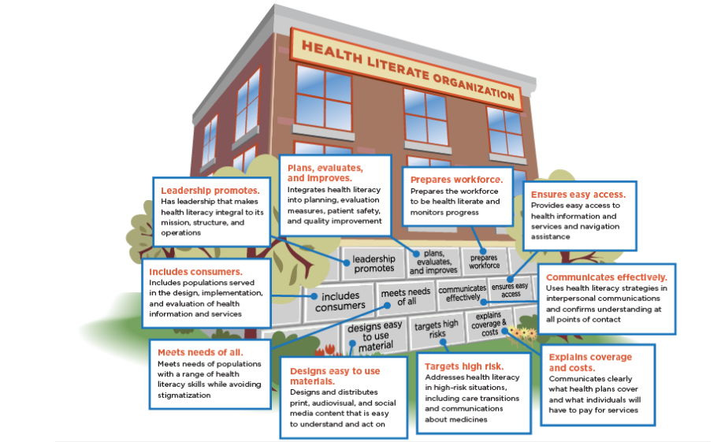
Health Literacy and Patient/Family Education

Slide 66
Health Literacy
Definition
“The degree to which individuals have the capacity, to obtain, (communicate), process, and understand basic health information and services needed to make appropriate health decisions.”
Healthy People 2010, 2020 (Patient Protection and Affordable Care Act)
Functional Health Literacy
Functional health care literacy
How well do people use the health care system?
Functional self-care literacy
How well do people maintain personal and child health at home?
Scale of the problem
Over 21 million parents with basic, or below basic Health Literacy
From National Assessment of Adult Literacy (NAAL) 2003, Yin 2009

Slide 67
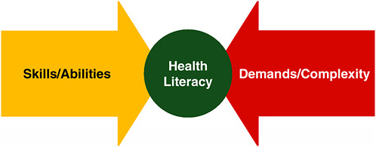
How does Health Literacy affect Patients/Families?
Children of parents with low HL tend to have poorer outcomes
70% of preventable outpatient adverse drug events (ADEs) in children occur due to caregiver medication error
Between 1995-2005: 585,922 pediatric outpatient ADEs annually resulted in physician visits
Bourgeois 2009, Kaushal R et al 2007, Zandieh SO et al 2008

Slide 68

Health Literacy Universal Precautions Toolkit
Guidelines from the AHRQ Toolkit
As a PRN, you can use these guidelines when talking with patients and families.
Use plain language (and interpreters, if needed)
Conduct brown bag Medication Reviews
Use the “Teach Back” method
Encourage questions
Make action plans
Use health education material effectively
2nd Edition, Agency for Healthcare Research and Quality,2015
The “Teach Back” Method
Ask a patient or family to demonstrate to you how they would carry out your instructions.
Ask a patient or their family to repeat your information using their own words. For example, “I want to be sure I explained everything clearly, so can you please tell me what you are going to do so I can be sure I was clear.”
Ask: | “What questions do you have?”
Instead of: | “Do you understand?”

Slide 69
PRN as a Champion for Pain-Related Health Literacy
Readability
Suggested 6th grade reading level Fleisch-Kincaid- in word
Create a standardized set of language that conveys your commitment to partnering with families in their child’s pain care. Using this in your communications with families will help reiterate this important message with them through different media.
Use this same standardized language to communicate with your colleagues; find others who can help champion this approach; make it visible in your areas of work – similar to a multi-faceted marketing campaign.

Slide 70
?
Explore how word choice communicates meaning
What is the difference between a “pain score” and a “pain rating”? A score or rating of 4 and 5?
What is the difference between a “narcotic” and an “opioid”?
What is the difference between a “non-pharmacologic intervention” and a “biobehavioral intervention”?
Type your answers here.

Slide 71
Tips and Resources to Better Advocate for your Patients/Families
Tailor the information to the patient/family
Consider the age and developmental level of the child when selecting appropriate materials and methods of communication.
Identify how to work and communicate with both the parent/caregiver and child whenever appropriate
Ask about the family members’ learning preferences – ideally, a combination of teaching methods should be used (verbal, written, visual demonstration, simulation), culminating in a return demonstration or “teach back” to confirm understanding.
Potential internal resources to promote health literacy and patient/family education:
Written materials | print, website, EHR integration, patient portal
Video materials | internally produced, vendor purchased, disseminated through a centralized video system
Interactive tools | promote the partnership with families and involve them in the learning that needs to take place
Resource Center/Library | used to look up information

Slide 72
Tips and Resources to Better Advocate for your Patients/ Families
Identify patient/family educational needs for your clinical unit and explain how the recommended format addresses health literacy.
Examples of pain management subjects and formats to improve patient/family pain management health literacy:
Distraction/coping methods
particularly important when working with young children
video or web-based formats provide models of distraction and coaching; but interactive formats that are able to evaluate return demonstration would be best
see Chambers videos.
Medications and opioid storage, monitoring, and disposal
Use written and downloadable web-based brochures available from CDC, EPA, FDA, and other advocate groups. The instructions vary and therefore may be confusing.
Used to help patients and their family members understand the importance of this information, in addition to providing the printed brochure and verbal instructions, make sure to frame the conversation around safety of their family, friends and home. For example, emphasize opioids are a frequently reported cause of death from accidental ingestion by young children and pets, or in a family with adolescents, emphasize 1 in 4 adolescents reports using an opioid that was prescribed to an acquaintance, friend, or family member.

Slide 73
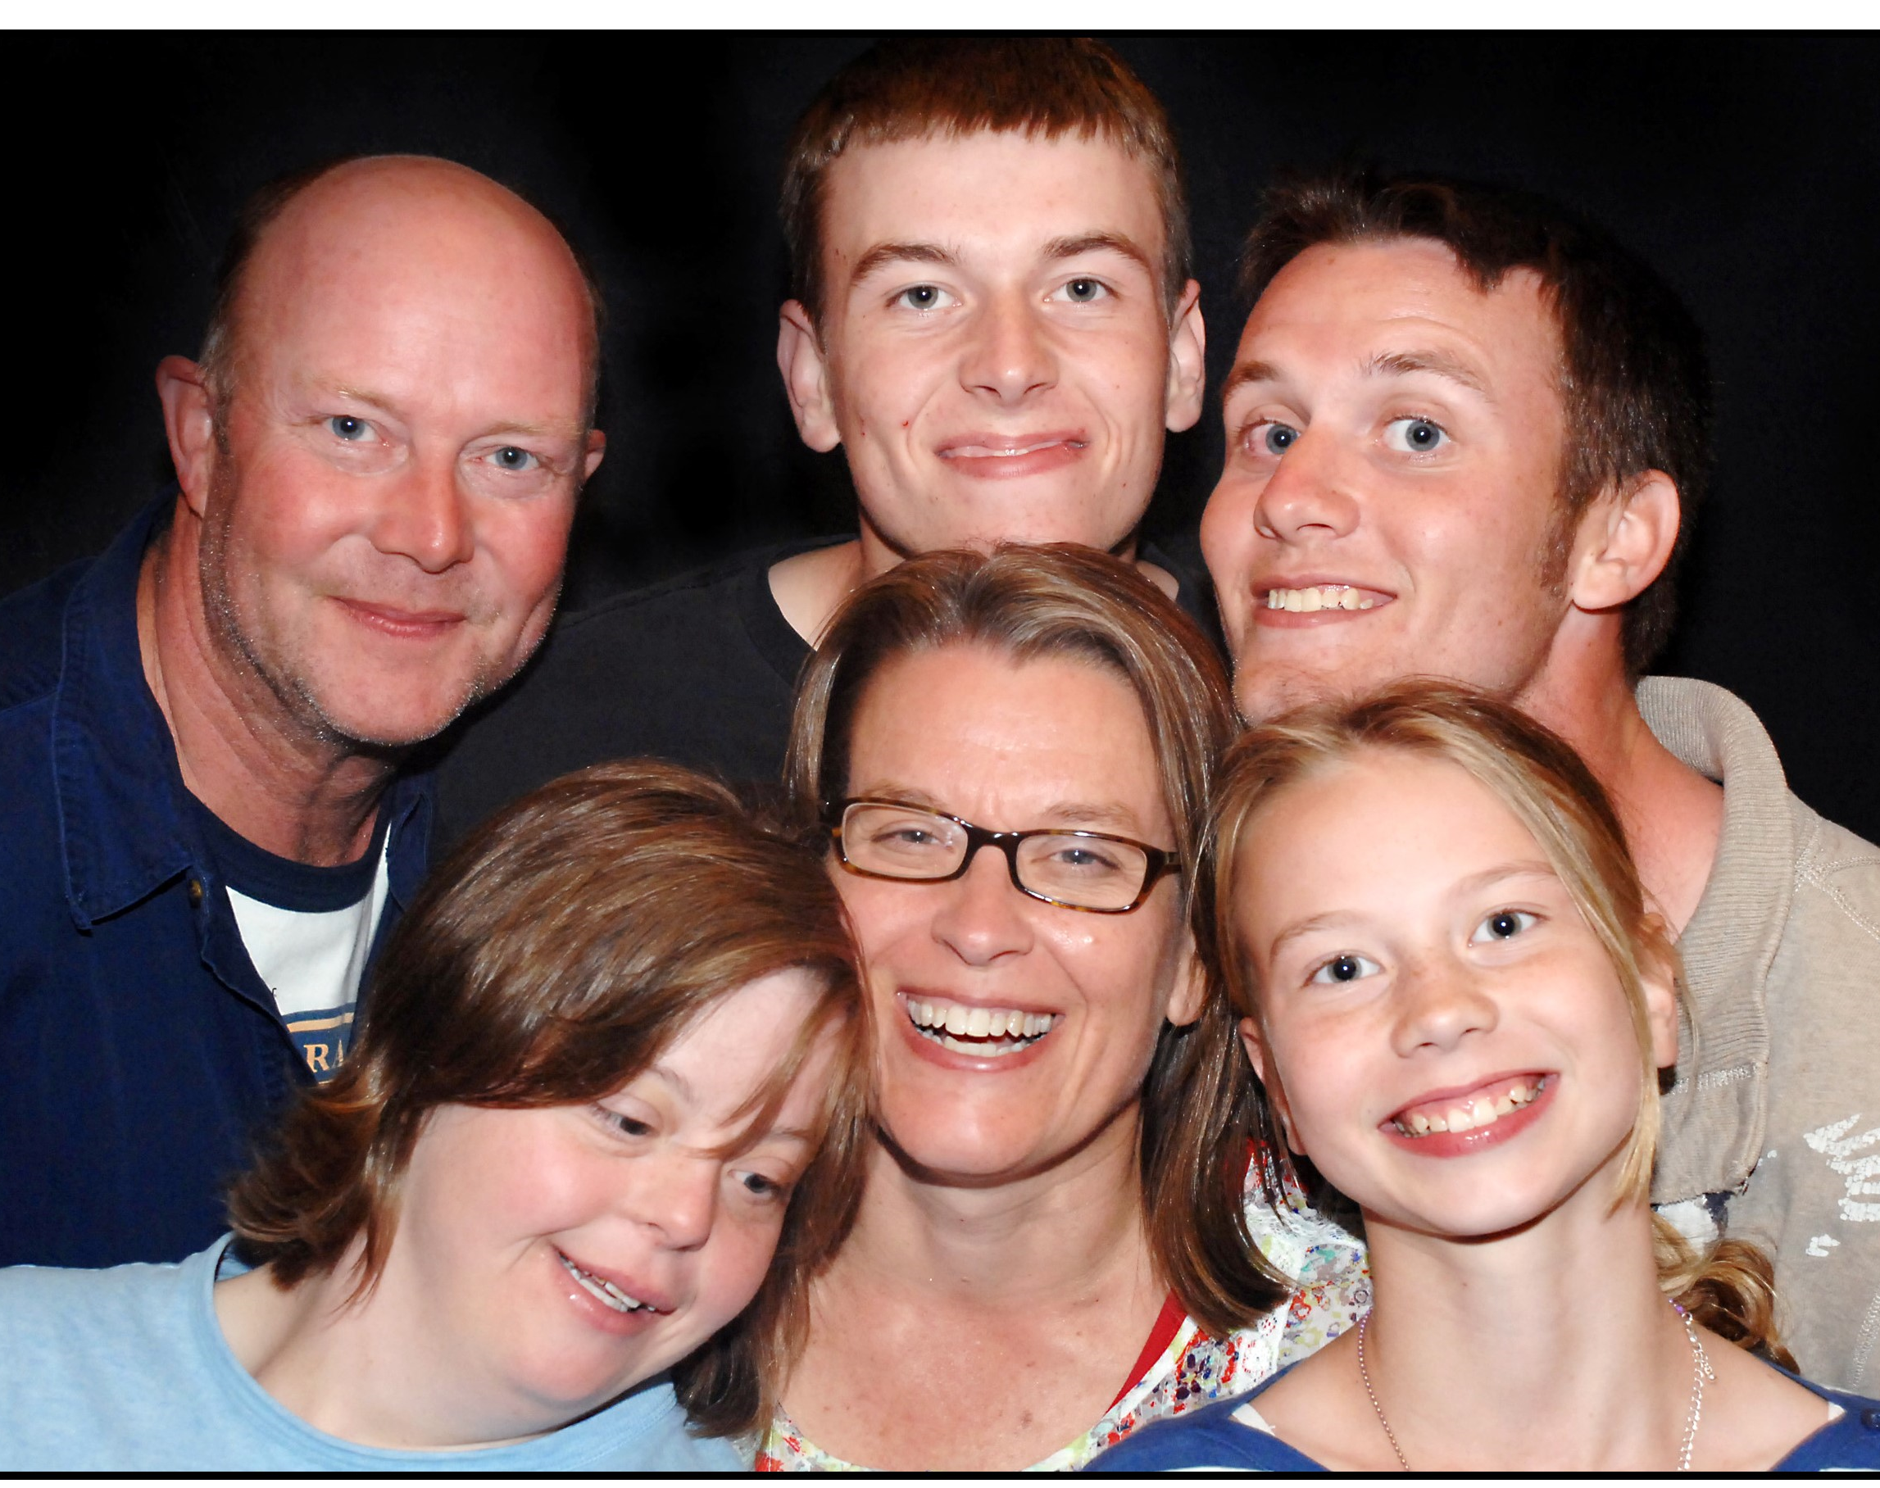
Tips and Resources to Better Advocate for your Patients/Families
Potential people and departments with expertise in health literacy and patient/family education
These are resources that you may be able to access at your institution to address and advance knowledge in this area:
Family Learning Center/Resource Center
Research Library and/or Librarian
Patient Education experts/coordinators/ managers/consultants
Health Educators (specific topics, or general)
Child Life Specialists
Possible next steps to becoming a better advocate as a PRN
Identify at least three resources at your institution that will help you teach patients/families how to manage pain.
Find examples of developmentally and linguistically-appropriate support materials or resources for each developmental level for which you provide pain care, to guide patients and families in implementing pain care plans, including individualized pain coping plans for their children.
Outline the process to obtain translators/interpreters who can work with you to ensure appropriate communication with a variety of families with different linguistic capabilities.

Slide 74
Write your next steps here.
Take a minute to reflect…
Can you identify three resources at your institution that will help you in teaching patients/families how to manage pain?
Do you have a variety of age-appropriate/linguistically appropriate support materials or resources to guide a family through developing an individualized coping plan for their child?
Do you have a team of translators and/or interpreters that can work with you to ensure appropriate communication with a variety of families with different linguistic capabilities?

Slide 75
In Summary…

Slide 76

Key Points
A Pain Resource Nurse (PRN) is a registered nurse who interfaces with healthcare team members, patients, and families as a resource, change agent, and leader to disseminate information, facilitate optimal pain management, and systemize quality pain care.
Leadership commitment to PRN and PRN role is critical for success.
PRN responsibilities include:
Personal Professional Development
Clinical
Educator
Researcher
Change agent
Leader
Clinical standards
PRNs champion and facilitate quality, leadership, pain management, and ethical standards
When implementing the PRN role:
Establish an interdisciplinary team to explore opportunities for improvement, identify barriers, develop an action plan, champion change, and monitor outcomes.
Use communication, trust-building and listening skills.
Identify high-impact opportunities
Identify and implement change: Question, Evidence, Teamwork, Pilot, and Disseminate
Your role as a Change Agent
Phase project implementation to create awareness and interest, build knowledge and commitment, promote action and change, and plan integration and sustained use.
Identify specific data sources and outcome measures.
Leverage Informatics
Advocate for patients & families
Tailor the pain-related information to the patient and family.
PRNs influence care at the unit, specialty, organization, and community level
PRNs should lead projects that facilitate optimal pain management and systemize quality pain care

Slide 77

Checklist: Instituting Evidence-Based Practice
Define units, patient populations to extend evidence-based practice
Select opinion leaders
Select change champions
Select core group members
Outline responsibilities
Establish timelines
Keep them involved
Decide on initial education
Who?
Opinion leader
Change champion
Core group
Staff
Methods
When
Plan for education of new staff
Plan for annual competency review
Decide on written resources needed for implementation
Quick reference guides.
Patient/education forms.
Decision tree.
Plan for and make system changes as needed (documentation forms, etc.)
Plan baseline data collection
Process indicators
Outcome indicators
Frequency
Initial feedback to staff
Graphs
Who
When
Posting
Audit and feedback of data
Frequency
Where to post
Celebrate progress and success

Slide 78

Write your next steps here.
What’s your plan?
Review the characteristics for implementing the PRN role successfully. What do you still need?
Review the types of projects PRNs can take responsibility for. Which can immediately benefit your clinical unit or specialty?
Review the checklist for instituting evidence-based practice. Who needs to be on your interdisciplinary team?
Think about your own professional development. Who can be your mentor?

Slide 79
Appendix

Slide 80
References
Health Literacy & Best Evidence for Patient/Family Education
American Academy of Pediatrics
Considered a ‘go-to’ for patient education information on a variety of topics www.aap.org
KidsHealth
For general patient education information on a variety of topics addressing kids, teens and parents www.kidshealth.org
Agency for Healthcare Research and Quality (AHRQ)
Good resource for toolkits, examples of how to approach education and engaging patients on a variety of topics. Can be used as framework. https://www.ahrq.gov/professionals/education/curriculum-tools/index.html
Centers for Disease Control (CDC)
Good resource for toolkits, examples of how to approach health literacy https://www.cdc.gov/healthliteracy/
Change Management
Rogers, E.M. (2003). Diffusion of Innovations (5th Ed.). New York, NY: The Free Press.
Cullen, L. & Adams, S. (2012). Planning for Implementation of Evidence-Based Practice. Journal of Nursing Administration, 42(4), 222-230.
Implementation
Cullen, L., Hanrahan, K., Tucker, S., Rempel, G., & Jordan, K. (2012). Evidence-Based Practice Building Blocks: Comprehensive Strategies, Tools, and Tips. Iowa City, IA, University of Iowa Hospitals and Clinics, Nursing Research and Evidence-Based Practice.
Bick & Graham (2010). Evaluating the Impact of Implementing Evidence-Based Practice. Wiley-Blackwell.
Coaching
Jakubik LD, Eliades AB, Weese MM (2016). Part 1: An Overview of Mentoring Practices and Mentoring Benefits. Pediatric Nursing 42 (1): 37-38.
Coaching (online course). Accessed from webchex.org
Nursing Informatics
American Nurses Association (2015). Nursing Informatics: Scope and Standards of Practice (2nd ed.). Silver Springs, Maryland: Nursebooks.org
Ball, M. Douglas, J. & Hinton Walker, P. (2011). Nursing Informatics: where technology and caring meet. (4th ed.). New York: Springer.

Slide 81
The Joint Commission Standards Related to Pain
Revisions
Effective January 1, 2018

Slide 82
New Accreditation standards for 2018
The Joint Commission
Applicable to Hospitals Effective January 1, 2018
Leadership (LD) Standard LD.04.03.13
Pain assessment and pain management, including safe opioid prescribing, is identified as an organizational priority for the hospital.
Elements of Performance for LD.04.03.13
The hospital has a leader or leadership team that is responsible for pain management and safe opioid prescribing and develops and monitors performance improvement activities. (See also PI.02.01.01, EP 19)
The hospital provides nonpharmacologic pain treatment modalities.
The hospital provides staff and licensed independent practitioners with educational resources and programs to improve pain assessment, pain management, and the safe use of opioid medications based on the identified needs of its patient population. (See also RI.01.01.01,EP8)
The hospital provides information to staff and licensed independent practitioners on available services for consultation and referral of patients with complex pain management needs.
The hospital identifies opioid treatment programs that can be used for patient referrals.
The hospital facilitates practitioner and pharmacist access to the Prescription Drug Monitoring Program databases. Note: This element of performance is applicable in any state that has a Prescription Drug Monitoring Program database, whether querying is voluntary or is mandated by state regulations for all patients prescribed opioids.
Hospital leadership works with its clinical staff to identify and acquire the equipment needed to monitor patients who are at high risk for adverse outcomes from opioid treatment. (See also PC.01.02.07, EP 6)

Slide 83
New Accreditation standards for 2018.
Medical Staff (MS)
Standard MS.03.01.03
The management and coordination of each patient’s care, treatment, and services is the responsibility of a practitioner with appropriate privileges.
Element of Performance for MS.03.01.03
The hospital educates all licensed independent practitioners on assessing and managing pain. (See also RI.01.01.01, EP 8).
Standard MS.05.01.01
The organized medical staff has a leadership role in organization performance improvement activities to improve quality of care, treatment, and services and patient safety.
Element of Performance for MS.05.01.01
The medical staff is actively involved in pain assessment, pain management, and safe opioid prescribing through the following:
- Participating in the establishment of protocols and quality metrics - Reviewing performance improvement data
Provision of Care, Treatment, and Services (PC)
Standard PC.01.02.07
The hospital assesses and manages the patient’s pain and minimizes the risks associated with treatment.
Elements of Performance for PC.01.02.07
The hospital conducts a comprehensive pain assessment that is consistent with its scope of care, treatment, and services and the patient’s condition. (See also PC.01.02.01, EP 2; RI.01.01.01, EP 8)
2. 1. The hospital uses methods has defined criteria to screen, assess, and reassess pain that are consistent with the patient’s age, condition, and ability to understand.
3. 2. The hospital reassesses and responds to the patient’s pain, based on its
reassessment criteria. The hospital screens patients for pain during emergency department visits and at the time of admission.

Slide 84
New Accreditation standards for 2018.
Elements of Performance for PC.01.02.07
3. The hospital treats the patient’s pain or refers the patient for treatment.
Note: Treatment strategies for pain may include nonpharmacologic,
pharmacologic, or a combination of approaches.
4. The hospital either treats the patient’s pain or refers the patient for
treatment. The hospital develops a pain treatment plan based on evidence-
based practices and the patient’s clinical condition, past medical history, and
pain management goals.
Note: Treatment strategies for pain may include pharmacologic and
nonpharmacologic approaches. Strategies should reflect a patient-centered
approach and consider the patient’s current presentation, the health care
providers’ clinical judgment, and the risk and benefits associated with the
strategies, including potential risk of dependency, addiction, and abuse.
5. The hospital involves patients in the pain management treatment planning process through the following:
Developing realistic expectations and measurable goals that are understood by the patient for the degree, duration, and reduction of pain
Discussing the objectives used to evaluate treatment progress (for example, relief of pain and improved physical and psychosocial function)
Providing education on pain management, treatment options, and safe use of opioid and non-opioid medications when prescribed (See also RI.01.02.01, EPs 6–8; RI.01.03.01, EP 6)
The hospital monitors patients identified as being high risk for adverse outcomes related to opioid treatment. (See also LD.04.03.13, EP 7)
The hospital reassesses and responds to the patient’s pain through the following:
- Evaluation and documentation of response(s) to pain intervention(s) (See also RC.01.01.01, EP 7)
- Progress toward pain management goals including functional ability (for example, ability to take a deep breath, turn in bed, walk with improved pain control)
- Side effects of treatment
- Risk factors for adverse events caused by the treatment

Slide 85
New Accreditation standards for 2018.
Elements of Performance for PC.01.02.07 (continued)
The hospital educates the patient and family on discharge plans related to pain management including the following:
Pain management plan of care
Side effects of pain management treatment
Activities of daily living, including the home environment, that might exacerbate pain or reduce effectiveness of the pain management plan of care, as well as strategies to address these issues
Safe use, storage, and disposal of opioids when prescribed
Performance Improvement (PI)
Standard PI.01.01.01
The hospital collects data to monitor its performance.
Elements of Performance for PI.01.01.01
The hospital collects data on pain assessment and pain management including types of interventions and effectiveness.
Standard PI02.01.01
The hospital compiles and analyzes data.
Elements of Performance for PI.02.01.01
The hospital analyzes data collected on pain assessment and pain management to identify areas that need change to increase safety and quality for patients.
The hospital monitors the use of opioids to determine if they are being used safely (for example, the tracking of adverse events such as respiratory depression, naloxone use, and the duration and dose of opioid prescriptions). (See also LD.04.03.13, EP 1)

Slide 86
Gathering evidence: Boolean operators
Boolean operators can help broaden or narrow your search by stating a relationship between your search terms. Boolean operators are AND, OR, NOT.
AND retrieves results with BOTH terms
ALL search terms must be present in the resulting records
OR retrieves results with ANY/EITHER term
TIP: OR is helpful when searching with synonyms
NOT retrieves just ONE term
Helpful when you need to exclude items (use sparingly)

Slide 87
Identify your keywords & combine with Boolean operators
Search | Add to builder | Query | Items found
#6 | Add | (((((oncology) OR cancer)) AND ((port) OR nitrous)) AND ((pediatric OR child))) AND pain | 83
#5 | Add | (((((oncology) OR cancer)) AND pain relief) AND ((port) OR nitrous)) AND ((pediatric OR child)) | 6
#5 | Add | (pediatric OR child) | 2270057
#5 | Add | port OR nitrous | 11777
#5 | Add | “pain relief” | 41475
#1 | Add | (oncology OR cancer) | 3567263

Slide 88
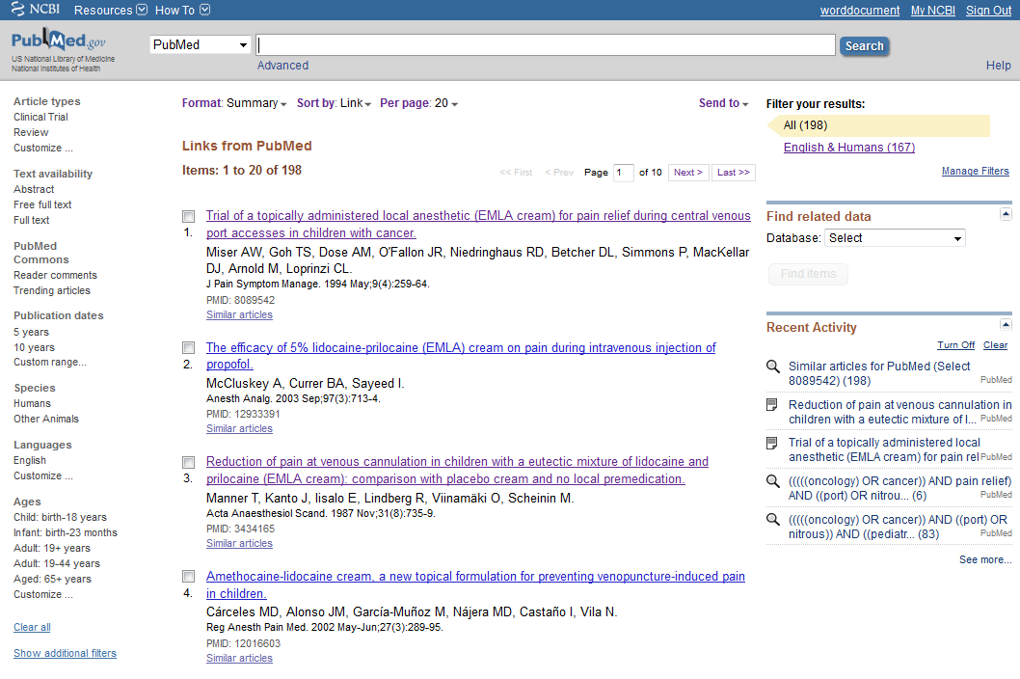
Review abstracts to determine an article’s relevance to your topic
Analyze your search results. Use search limiters to narrow your search (by publication date, age, language, etc.)

