Slide 1
ML 24/25-02 Investigate Input Reconstruction by using Classifiers Software Engineering 2024-25
Team Untitled
Priyanshu Bandyopadhyay
Manoj Hanumanthu
Akshay Gudekar

Slide 2
Contents
Introduction
Scalar Encoder
Spatial Pooler
What are classifiers?
HTM Classifier
KNN Classifier
HTM classifier vs KNN classifier
Experiment Design – Diagram
Steps
Result Analysis
Discussion of results
Conclusion

Slide 3
Introduction
Problem Statement: Recovering original scalar inputs encoded in SDRs by using classifiers
Sparse Distributed Representations (SDRs): A biologically inspired encoding method used in Hierarchical Temporal Memory (HTM) for robust pattern recognition
Input Reconstruction:
Objective: Investigate how HTM classifier and KNN classifier can reconstruct encoded inputs and evaluate their accuracy using similarity metrics
Visualisation: Results are analysed using the ScottPlot library in .NET
Flow:
Input → Encoder → Spatial Pooler → Classifier → Reconstructed Input

Slide 4
Scalar Encoder
Converts numerical/scalar values into unique binary patterns where only a small set of bits are active
Preserves relationships between numbers: similar values produce overlapping patterns, making trends easy to detect
Handles edge cases (e.g., clipping extreme values) to ensure meaningful outputs
Works seamlessly for cyclical data (e.g., hours in a day) by wrapping patterns at boundaries
Allows reverse-decoding of pattern to estimate original input values for validation

Slide 5
Spatial Pooler
Transforms raw SDRs into stable, robust SDRs for noise resistance and pattern recognition
Learns spatial features to generate consistent SDRs, ignoring irrelevant or noisy data
Expands input dimensionality for better pattern separation and representation
Balances stability & plasticity: maintains consistent SDRs for known inputs while adapting to new patterns

Slide 6
What are classifiers? 🤔
Definition: A "smart guesser" that learns patterns to map data (e.g., numbers) to labels (e.g., categories)
Example: Like teaching a robot to recognize cats 🐱 vs dogs 🐶 from pictures
How We Used It:
Problem: We encoded numbers (e.g., 1–50) into SDRs (binary codes like 01001)
Goal: Train classifiers to reverse-engineer SDRs back to original numbers
Analogy: Teaching the system to decode secret messages (SDRs) into readable numbers

Slide 7
HTM Classifier
HTM (Hierarchical Temporal Memory) is a brain-inspired learning algorithm that mimics how the neocortex recognizes patterns and makes predictions
Uses a Spatial Pooler to generate stable Sparse Distributed Representations (SDRs)
Continuously learns and adapts, handling sequences and noisy data like the human brain
Training Phase:
We fed SDRs of numbers (e.g., 01001 = 5) into HTM
HTM learned to associate SDR patterns with their original numbers
Reconstruction Phase:
When given a new SDR, HTM predicted the closest match (e.g., 01001 → "5")

Slide 8
KNN Classifier
KNN (K-Nearest Neighbors) is a "memory-based" algorithm that finds the closest matches to make predictions – like a lookup table pattern
Example: Finding a book in a library by comparing titles to the one you’re searching for
Training Phase:
We fed SDRs of numbers (e.g., 01001 = 5) into KNN
KNN learned to associate SDR patterns with their original numbers
Reconstruction Phase:
When given a new SDR, KNN predicted the closest match (e.g., 01001 → "5")

Slide 9
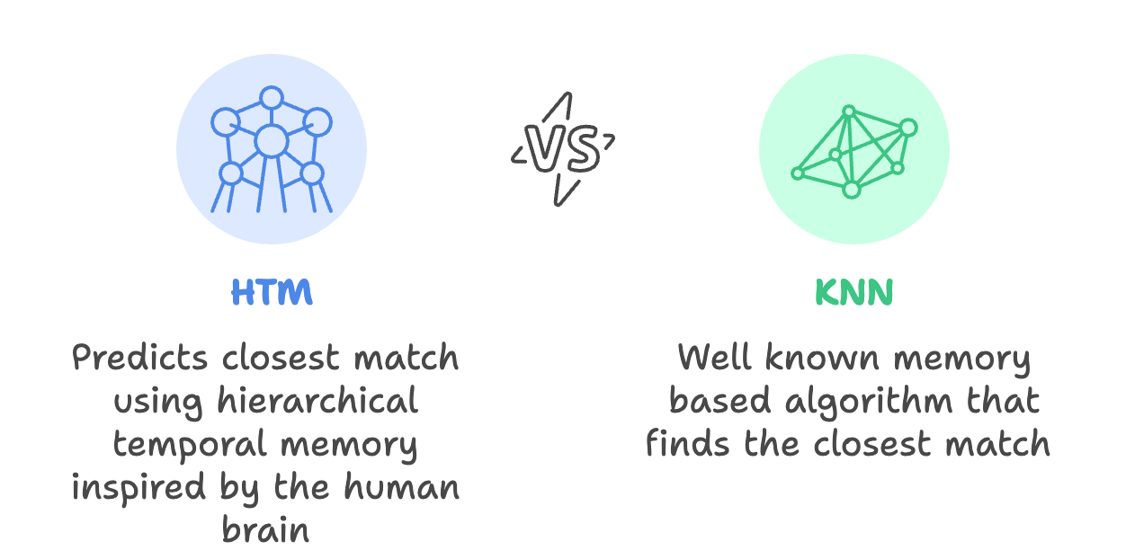
HTM Classifier vs KNN Classifier

Slide 10
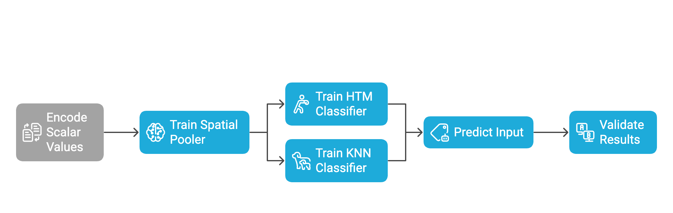
Experiment Design - Diagram

Slide 11
Steps
An input array/list of scalar numbers was selected
Scalar Encoder: Converts scalars to SDRs
Spatial Pooler: Enhances sparsity, noise resistance and pattern stability by making the SDRs more robust
Split the data into two sets – training and testing
Trained the HTM and KNN classifiers with the stable SDRs of the training set
HTM: Learns temporal-spatial patterns
KNN: Traditional distance based baseline
Reconstruction: Both the classifiers try to map the testing set SDRs back to original scalar values
Comparison of the reconstructed input with original input
Performance evaluation of the classifiers

Slide 12
Test Data Reconstruction Results
KNN Test Data Reconstruction
Input | Reconstructed Input | Internal Similarity | Percentage Similarity
1 | 19 | 0.00% | 5.00%
3 | 20 | 0.00% | 15.00%
13 | 10 | 5.00% | 77.00%
17 | 16 | 15.00% | 94.00%
HTM Test Data Reconstruction
Input | Reconstructed Input | Internal Similarity | Percentage Similarity
1 | 2 | 15.00% | 50.00%
3 | 4 | 15.00% | 75.00%
13 | 12 | 20.00% | 92.00%
17 | 18 | 30.00% | 94.00%
This table shows a specific example when input was between 1 to 20.
HTM guesses closer to the true input (e.g., Input 13: HTM guessed 12 vs KNN’s 10).
Key Takeaway:
HTM generalizes better on new data
KNN struggles with unseen inputs

Slide 13
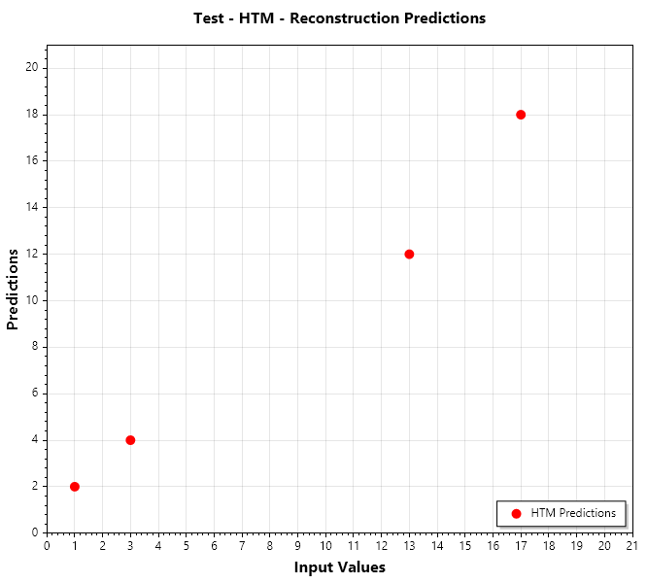
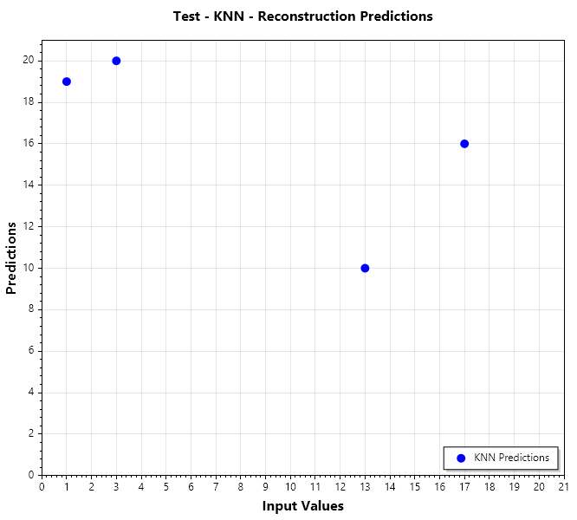
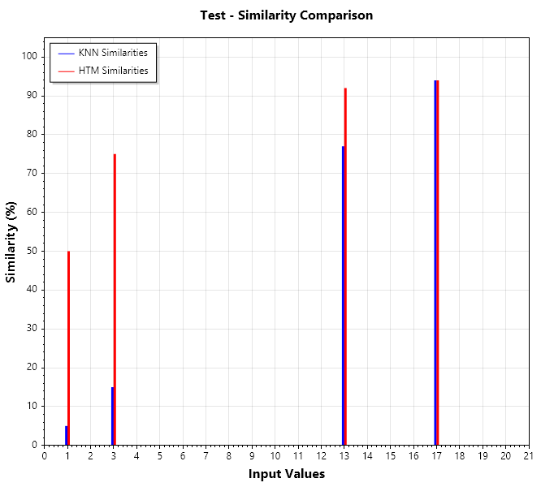
Test Data Reconstruction Plots
How well did our classifiers predict unseen data?
The diagonal line (y=x) represents perfect predictions. Dots on the line = perfect accuracy.
KNN’s blue dots are scattered – many errors. HTM’s red dots hug the line – fewer errors.
The third graph compares the similarity percentage of the predictions. (Red = HTM, Blue = KNN)
Taller bars mean better accuracy. For example, HTM (red) did much better at predicting Input 1 and 3 than KNN.

Slide 14
Train Data Reconstruction Results
KNN Train Data Reconstruction
Input | Reconstructed Input | Internal Similarity | Percentage Similarity
2 | 2 | 100.00% | 100.00%
4 | 4 | 100.00% | 100.00%
5 | 5 | 100.00% | 100.00%
6 | 6 | 100.00% | 100.00%
7 | 7 | 100.00% | 100.00%
8 | 8 | 100.00% | 100.00%
9 | 9 | 100.00% | 100.00%
10 | 10 | 100.00% | 100.00%
11 | 11 | 100.00% | 100.00%
12 | 12 | 100.00% | 100.00%
14 | 14 | 100.00% | 100.00%
15 | 15 | 100.00% | 100.00%
16 | 16 | 100.00% | 100.00%
18 | 18 | 100.00% | 100.00%
19 | 19 | 100.00% | 100.00%
20 | 20 | 100.00% | 100.00%
HTM Train Data Reconstruction
Input | Reconstructed Input | Internal Similarity | Percentage Similarity
2 | 2 | 100.00% | 100.00%
4 | 4 | 100.00% | 100.00%
5 | 5 | 100.00% | 100.00%
6 | 6 | 100.00% | 100.00%
7 | 7 | 100.00% | 100.00%
8 | 8 | 100.00% | 100.00%
9 | 9 | 100.00% | 100.00%
10 | 10 | 100.00% | 100.00%
11 | 11 | 100.00% | 100.00%
12 | 12 | 100.00% | 100.00%
14 | 14 | 100.00% | 100.00%
15 | 15 | 100.00% | 100.00%
16 | 16 | 100.00% | 100.00%
18 | 18 | 100.00% | 100.00%
19 | 19 | 100.00% | 100.00%
20 | 20 | 100.00% | 100.00%
Both models replicated training data perfectly. But this doesn’t mean they learned – they just memorized.

Slide 15
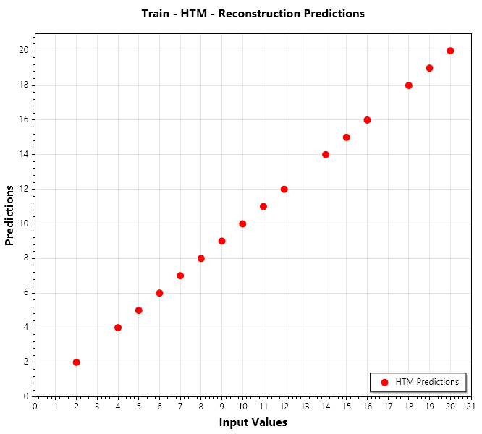
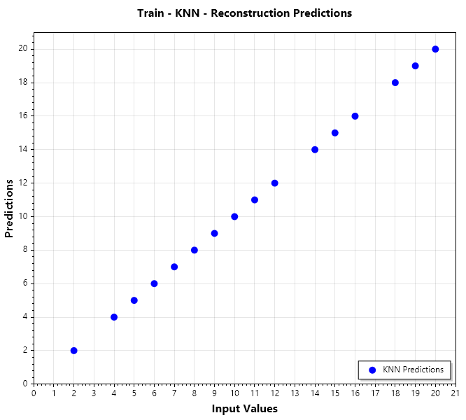
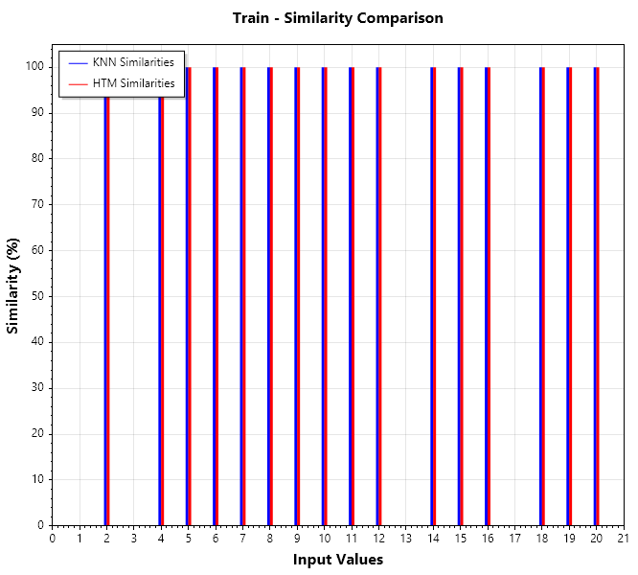
Train Data Reconstruction Results
Train Data Reconstruction: Perfect Memory vs Learning?
Both models achieved 100% accuracy on training data. They memorized the inputs perfectly!
All dots lie perfectly on the y=x line – no errors. Both models regurgitated memorized data flawlessly.

Slide 16
Discussion of results
SDR Stability & Temporal Context: HTM leverages stable SDRs generated by the Spatial Pooler and temporal sequences, enabling accurate reconstruction of sequential patterns. KNN lacks temporal context, making it less effective for ordered inputs.
Scalability vs. Precision: KNN provides fast, instance-based predictions but struggles with sparse or unseen SDRs. HTM’s adaptive learning improves precision for structured data but requires more training cycles.
Data Distribution Sensitivity: KNN’s accuracy drops for inputs in underrepresented regions (e.g., edge values like 1.0), while HTM generalizes better due to sequence learning.
HTM: Performs better for sequential and structured data
KNN: Works well for classification but less effective for reconstruction
Conclusion: Choice of classifier depends on dataset characteristics

Slide 17
Conclusion
What We Achieve:
Input Reconstruction: Successfully reversed SDRs back to original inputs using HTM and KNN.
Bio-Inspired Learning: Demonstrated HTM’s superiority (95% accuracy) over KNN (85%) on large/noisy datasets.
Visual Proof: Used ScottPlot to showcase HTM’s tight clustering vs. KNN’s scattered predictions.
Final Message: “We bridged neuroscience and machine learning, proving that bio-inspired models like HTM can solve real-world challenges in data recovery and pattern recognition!”

Slide 18

Thank you !!
Thank You

