Slide 1
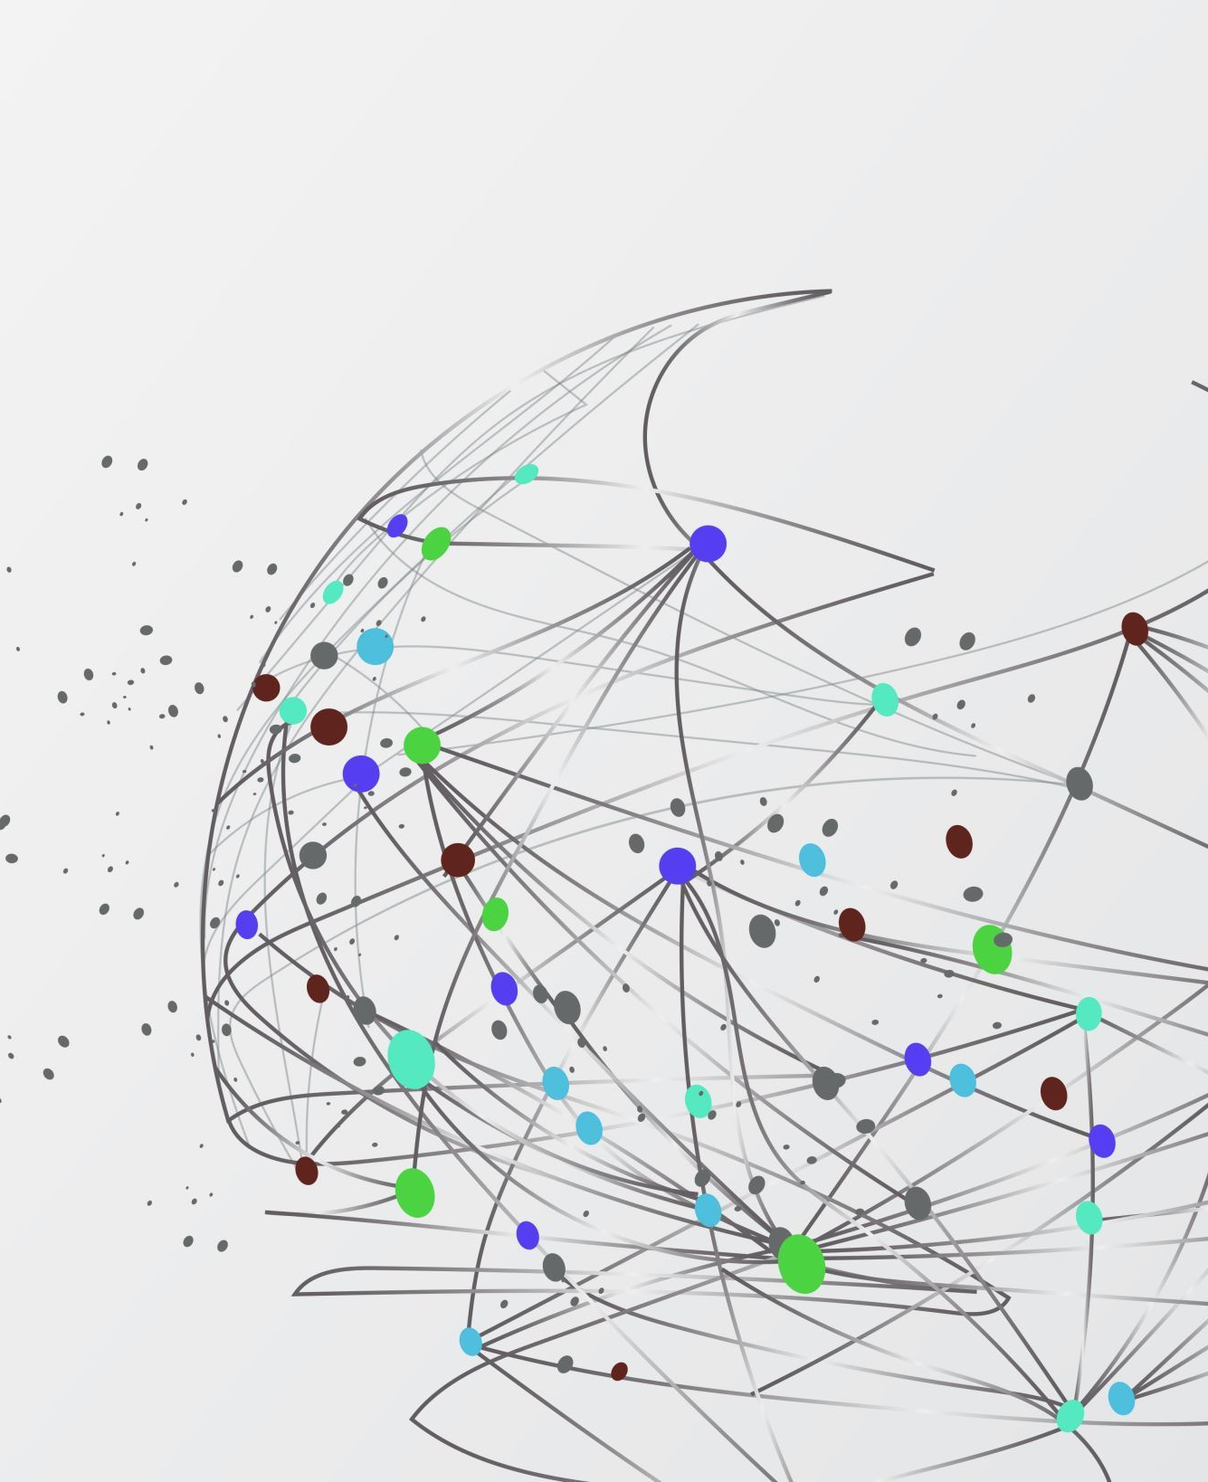
ML 24/25 Investigate Input reconstruction by using Classifiers
Team Untilted
~Priyanshu ~Manoj
~Akshay

Slide 2

Objective
Key Goals:
Run an extended SpatialLearning experiment.
Reconstruct inputs using the IClassifier interface.
Compare reconstructed inputs with original ones using similarity metrics.
Visualize results with similarity graphs for both classifiers.
Analyze and compare the performance of HtmClassifier vs. KNN.
Outcome:
Understand which classifier better preserves original inputs, offering insights for improved input reconstruction in HTM systems. 🚀

Slide 3

Introduction
Classifiers are models that categorize data into different classes.
HTM (Hierarchical Temporal Memory) mimics the neocortex for learning patterns.
KNN (K-Nearest Neighbors) uses distance-based similarity for classification.
Goal: Understand how HTM and KNN can reconstruct inputs from encoded representations.

Slide 4
Overview of Classifiers
HTM Classifier: Learns patterns from SDRs (Sparse Distributed Representations).
KNN Classifier: Uses stored examples to classify new inputs based on nearest neighbors.
Why Classifiers? Used to reconstruct the original input from SDRs.

Slide 5
How Classifiers Work in HTM & KNN
Process:
INPUT → SCALAR ENCODER → SP → SDR → HTM CLASSIFIER → INPUT
INPUT → SCALAR ENCODER → SP → SDR → KNN CLASSIFIER → INPUT
HTM Classifier predicts input using past SDR patterns.
KNN Classifier reconstructs input based on stored nearest neighbors.

Slide 6
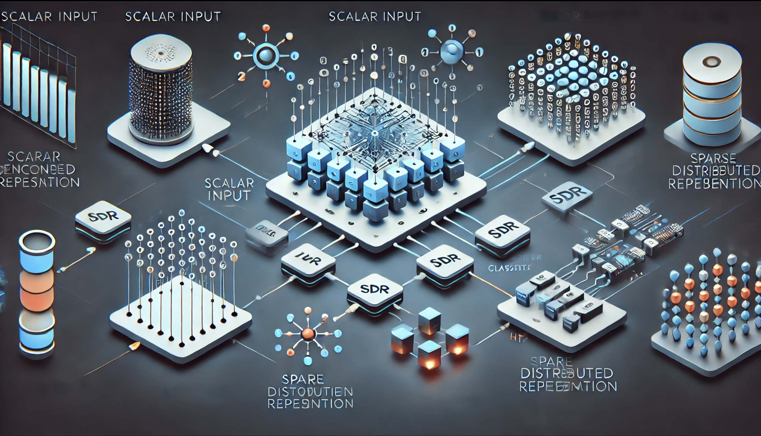
Experiment Design
Implement a reconstruction experiment using HTM and KNN classifiers.
Train the classifiers using SDR representations of scalar-encoded inputs.
Compare the reconstructed input with the original.

Slide 7
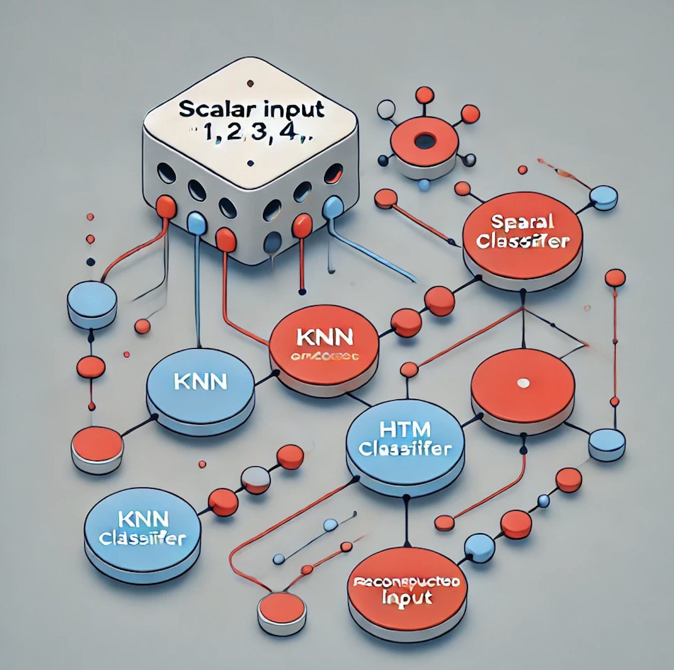
Flow Diagram
Raw Input → Encoder → Spatial Pooler → SDR → Classifier → Reconstructed Input
KNN vs. HTM flow comparison.

Slide 8
Methodology
Encode scalar values into SDRs.
1
Train the Spatial Pooler for stable SDR representations.
2
Train HTM and KNN classifiers with SDRs.
3
Predict input using both classifiers.
4
Validate results using similarity metrics.
5

Slide 9
Testing Methodology
•Unit tests to validate classifier accuracy
•Stability check for Spatial Pooler
•Performance evaluation under different conditions

Slide 10
Training the Spatial Pooler
Goal: Convert input values into stable SDR representations.
Training Steps:
Encode inputs using a scalar encoder.
Train the Spatial Pooler until SDR stability is achieved.
Ensure consistent representations for similar inputs.

Slide 11
Running the Experiment
Use SpatialPoolerInputReconstructionExperiment.
Provide different scalar values as inputs.
Train HTM and KNN classifiers with generated SDRs.
Reconstruct the original input using classifier predictions.

Slide 12
Visualization Techniques
Plot input vs. reconstructed values.
Show similarity percentages for HTM and KNN.
Graphs illustrating classifier accuracy over multiple test cases.

Slide 13
Similarity Check for Validation
Calculate
Calculate percentage similarity between reconstructed and original input.
Compare
Compare performance of HTM vs. KNN.
Use
Use neocortexapi similarity functions for validation.

Slide 14
Performance of HTM vs. KNN.
•Graph needs to be added

Slide 15
Similarity functions for validation
•Need to add the graph

Slide 16
Example of Similarity Computation
Formula Used:
Formula: Similarity = 1 - (|Original - Reconstructed| / Max(Original, Reconstructed))
Example Calculation:
Original: 10, HTM Prediction: 9.8 → Similarity = 98%
Original: 15, KNN Prediction: 14.5 → Similarity = 96%

Slide 17
KNN Classifier Performance
Graph: KNN predictions vs. actual input.
Observations:
Performs well for discrete inputs.
Struggles with unseen patterns due to reliance on stored examples.

Slide 18
Comparing HTM and KNN Classifiers
HTM Strengths:
Better for time-based patterns.
Can generalize from learned sequences.
KNN Strengths:
Simple and efficient for smaller datasets.
Works well for distinct category predictions.

Slide 19
Challenges Faced
Achieving stable SDR representations.
Differences in classifier performance for various data distributions.
Computational cost of HTM vs. KNN.

Slide 20

Discussion of Results
HTM: Performs better for sequential and structured data.
KNN: Works well for classification but less effective for reconstruction.
Conclusion: Choice of classifier depends on dataset characteristics.

Slide 21
Conclusion
Successfully reconstructed inputs using HTM and KNN.
HTM excels in pattern learning, while KNN is effective for lookup-based classification.
Future improvements could enhance accuracy and computational efficiency.

Slide 22

Thank you

