Slide 1
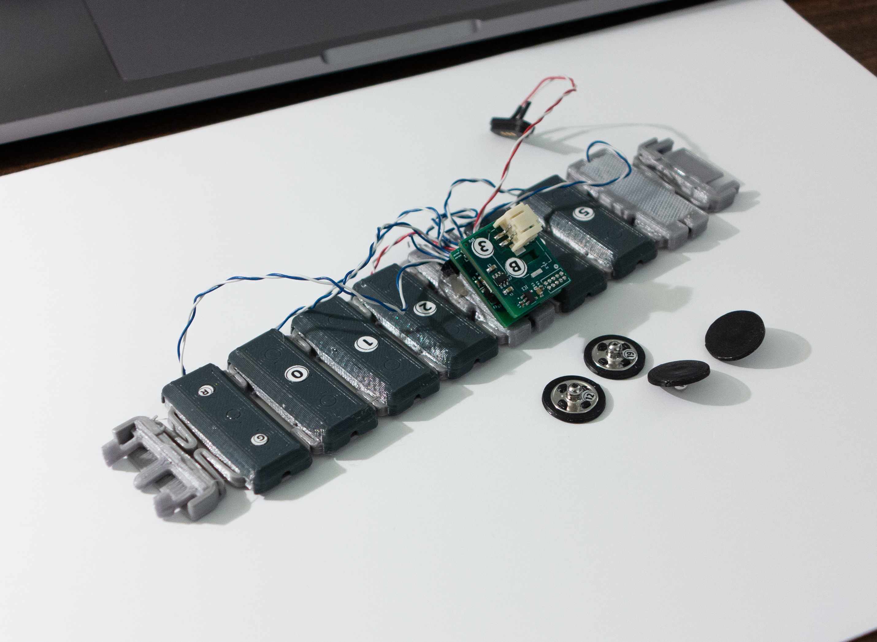
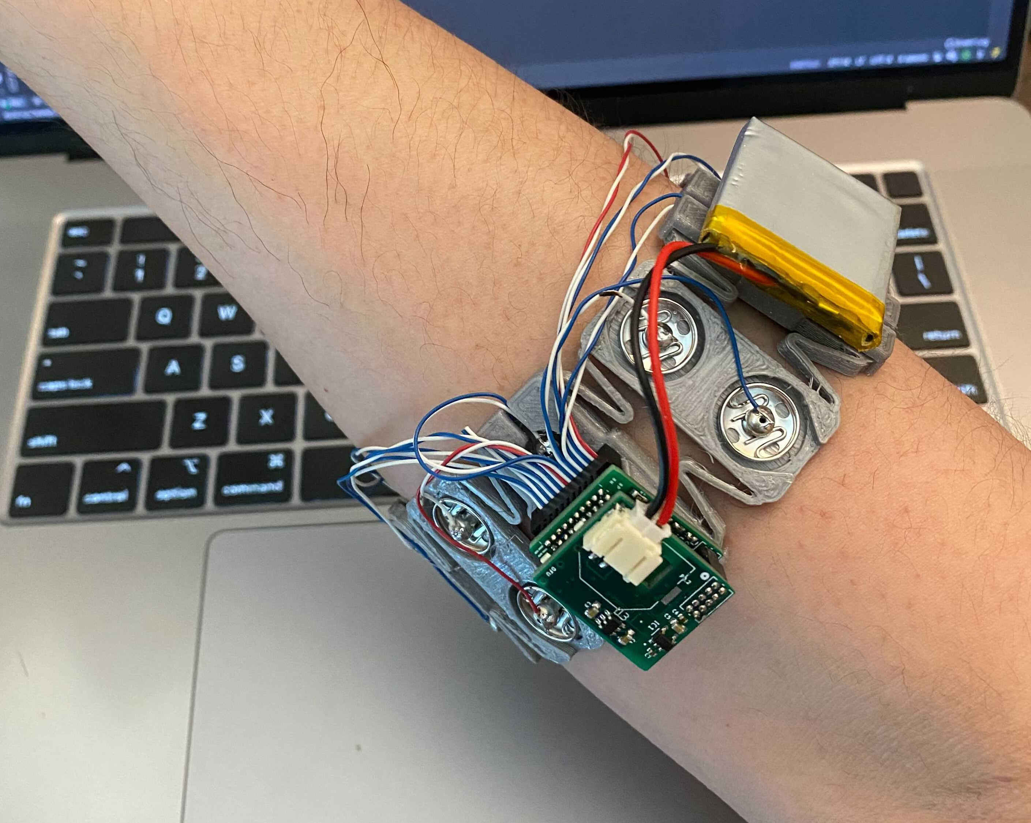
nRF52832 SoC
ADS1299 AFE
3D printed electrodes
3D printed band

