Slide 1
MINING AND ANALYSIS OF INSURANCE POLICIES CUSTOMER DATABASE

Slide 2

DATA
Data are any facts, numbers, or text that can be processed by a computer.

Slide 3

DATABASE
A database is an organized collection of data in the form of schemas, tables, queries, reports, views, and other objects.

Slide 4

DATA MINING

Slide 5
Data mining is the process of discovering meaningful new correlations, patterns and trends by sifting through large amounts of data stored in repositories, using pattern recognition technologies as well as statistical and mathematical techniques.

Slide 6
-> Who is my target customer?
-> What products are the most popular?
-> What trends have been the most successful for my business?
-> What is the ideal location for my business?
-> How can I identify new sales prospects for my business?

Slide 7

DATA ANALYTICS

Slide 8
Data analysis is the science of examining raw data with the purpose of drawing conclusions about that information. Data analytics is used in many industries to allow companies and organizations to make better business decisions and in the sciences to verify or disprove existing models or theories..

Slide 9
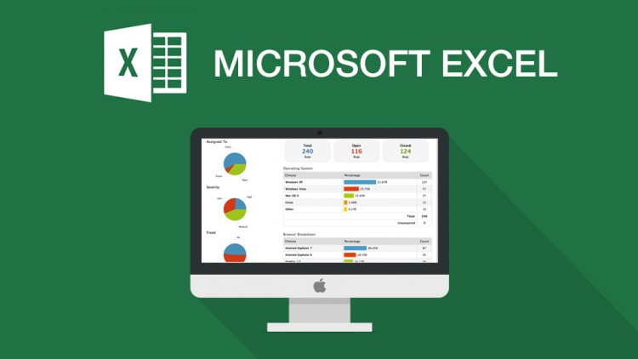
MICROSOFT EXCEL

Slide 10
Microsoft Excel is a spreadsheet developed by Microsoft for Windows, Mac OS X, Android and iOS. It features calculation, graphing tools, pivot tables, and a macro programming language called Visual Basic for Applications.

Slide 11
Microsoft Excel has the basic features of all spreadsheets, using a grid of cells arranged in numbered rows and letter-named columns to store data and perform mathematical operations. In addition, it can display data as line graphs, histograms and charts.

Slide 12
PIVOT TABLE
A pivot table is a data summarization tool. Among other functions, it can automatically sort, count, sum or give the average of the data stored in one table or spreadsheet.

Slide 13
Each field can be dragged to one of the following 4 options:
Report filter- used to apply a filter to an entire table.
Column labels- used to apply a filter to one or more columns.
Row labels- used to apply a filter to one or more rows.
Summation Values- has numerical values that can be used for different types of calculations.

Slide 14
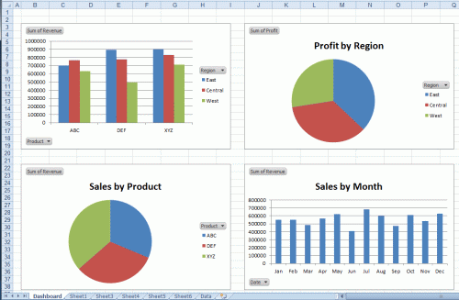
PIVOT CHART

Slide 15
A pivot chart is a data analysis tool that enables one to visualize a pivot table.

Slide 16

INSURANCE

Slide 17
Insurance helps us protect ourselves and the things we value, such as our homes, our cars and our valuables, from the financial impact of risks, big and small – from fire, flood, storm and earthquake, to theft, car accidents, travel mishaps It works by spreading the cost of unexpected risks among a large number of people in the same region who share similar risks.

Slide 18
WHO IS AN INSURANCE BROKER ?
Brokers use their professional knowledge and experience to help you properly assess your insurance needs, shop for the best value in insurance coverage and help you in the event of a claim.

Slide 19
DESCRIPTION OF CUSTOMER DATABASE
Data set containing information regarding renewals of insurance policies.
Data is of the first quarter (April, May, June).
There are two types of customers: Company and Individual.
Customers are based in various regions (cities) in India.
There are various Insurance companies and Policy categories.
The data contains information of a total of 19,760 customers.

Slide 20
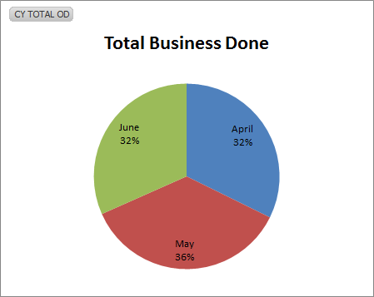
Business done
#Total Policies= 19760
#2016 Quarter 1 Renewals
Attribute
Month: April, May and June
Inference
Maximum percentage of business was done in the month of May, followed by equal amounts of business in April and June.

Slide 21
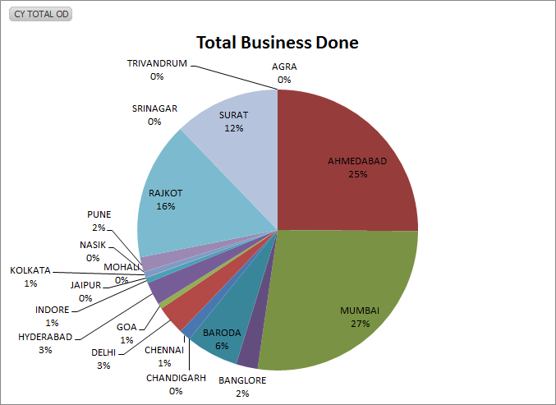
Business done
#Total Policies= 19760
#2016 Quarter 1 Renewals
Attribute
Region: various cities
Inference
Maximum percentage of business was done in Mumbai, followed by Ahmedabad, which together constitute more than 50% of the total business.

Slide 22
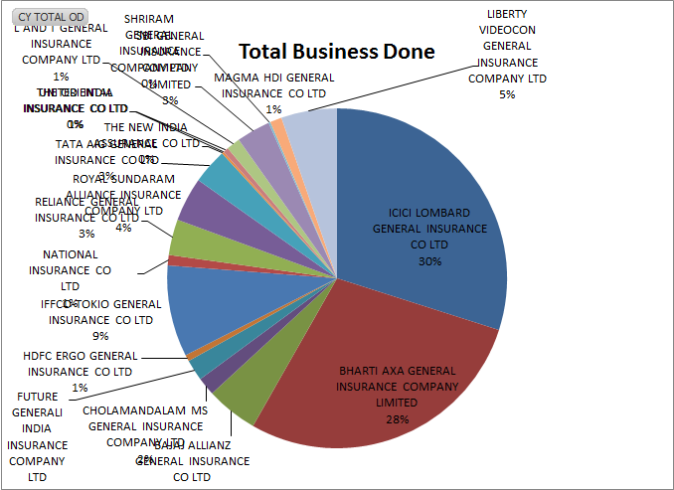
Business done
#Total Policies= 19760
#2016 Quarter 1 Renewals
Attribute
InsCompany: various insurance companies
Inference
Maximum percentage of business was done with ICICI Lombard, followed by Bharti Axa, which together constitute more than 50% of the total business.

Slide 23
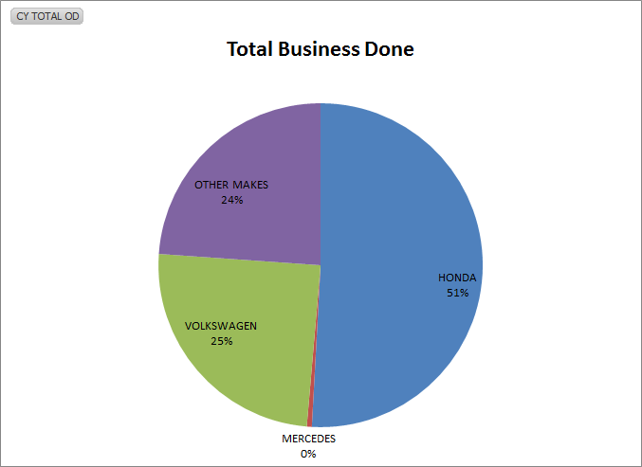
Business done
#Total Policies= 19760
#2016 Quarter 1 Renewals
Attribute
Vehicle Company: Honda, Mercedes, Volkswagen and Others
Inference
More than 50% of the business was done with vehicles made by Honda, followed by Volkwagen vehicles.

Slide 24
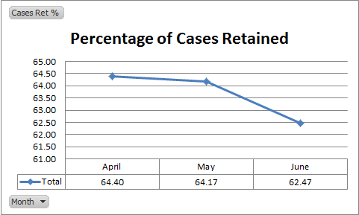
Cases Retention Percentage
#Total Policies= 19760
#2016 Quarter 1 Renewals
Attribute
Month: April, May and June
Inference
Percentage of retained cases is consistently decreasing with each month.

Slide 25
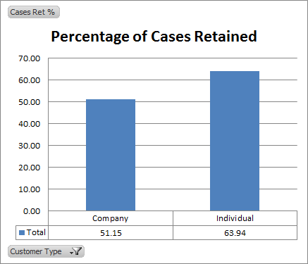
Cases Retention Percentage
#Total Policies= 19760
#2016 Quarter 1 Renewals
Attribute
Customer Type: Company and Individual
Inference
Percentage of retained cases is higher for ‘Individual’ customers than ‘Company’ customers.

Slide 26
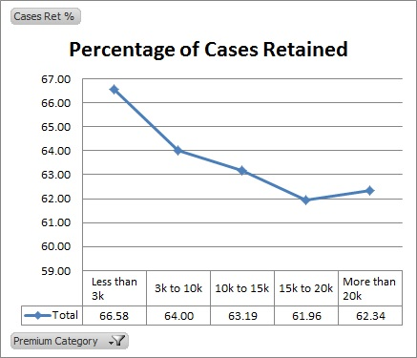
Cases Retention Percentage
#Total Policies= 19760
#2016 Quarter 1 Renewals
Attribute
Premium Category: <3k, 3k-10k, 10k-15k, 15k-20k and >20k
Inference
Percentage of retained cases decreases with increase in Premium amount, except for the last 2 categories.

Slide 27
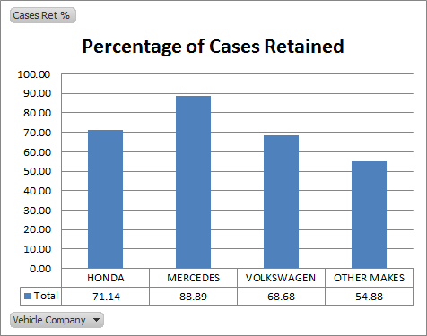
Cases Retention Percentage
#Total Policies= 19760
#2016 Quarter 1 Renewals
Attribute
Vehicle Company: Honda, Mercedes, Volkswagen and Others
Inference
Percentage of retained cases is the highest for Mercedes vehicles.

Slide 28
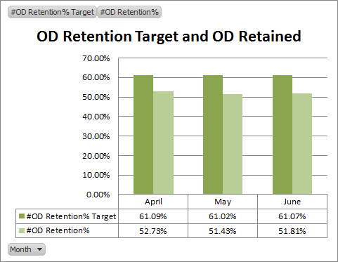
OD Target and Retained
#Total Policies= 19760
#2016 Quarter 1 Renewals
Attribute
Month: April, May and June
Inference
OD retention target and retained percentage is almost consistent over the three months.

Slide 29
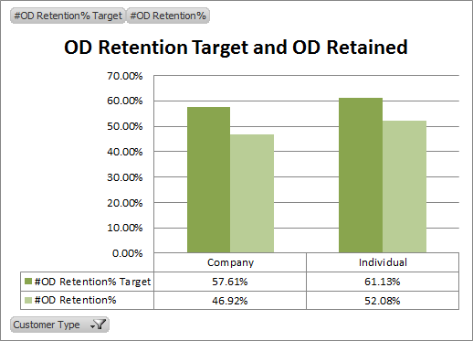
OD Target and Retained
#Total Policies= 19760
#2016 Quarter 1 Renewals
Attribute
Customer Type: Company and Individual
Inference
OD retention target and Retained percentage is slightly higher for ‘Individual’ customers.

Slide 30
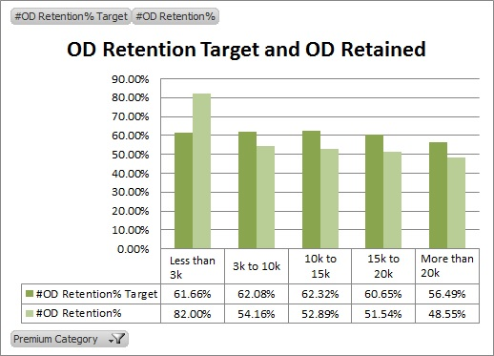
OD Target and Retained
#Total Policies= 19760
#2016 Quarter 1 Renewals
Attribute
Premium Category: <3k, 3k-10k, 10k-15k, 15k-20k and >20k
Inference
OD retention target is achieved in the ‘less than 3k’ category only.

Slide 31
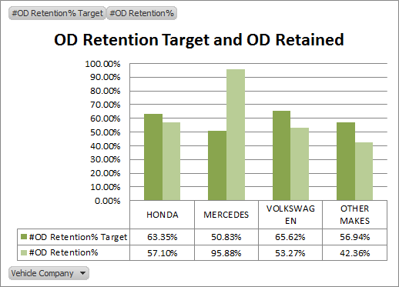
OD Target and Retained
#Total Policies= 19760
#2016 Quarter 1 Renewals
Attribute
Vehicle Company: Honda, Mercedes, Volkswagen and Others
Inference
OD retention target is achieved only in the case of Mercedes vehicles.

Slide 32
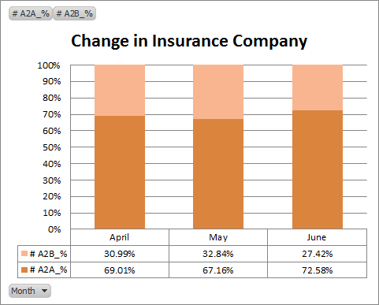
Percentage of Ins Comp Shifts
#Total Policies= 19760
#2016 Quarter 1 Renewals
Attribute
Month: April, May and June
Inference
Maximum percentage of shifts was observed in the month of May.

Slide 33
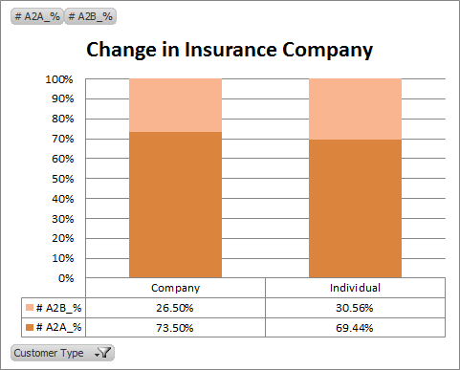
Percentage of Ins Comp Shifts
#Total Policies= 19760
#2016 Quarter 1 Renewals
Attribute
Customer Type: Company and Individual
Inference
Percentage of Company shifts is higher for ‘Individual’ customers than that for ‘Company’ customers.

Slide 34
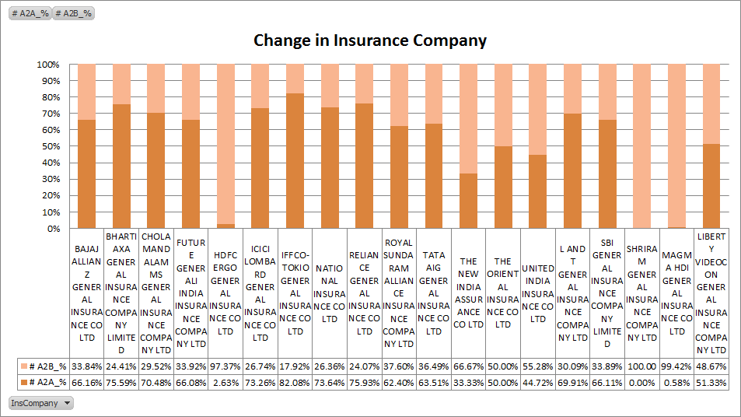
Percentage of Ins Comp Shifts
#Total Policies= 19760
#2016 Quarter 1 Renewals
Attribute
Insurance Company: various companies
Inference
Almost all the customers having policies of ‘Shriram Gen Ins’ and ‘Magma HDI Gen Ins’ shifted to other companies.
Minimum percentage of shift was observed for ‘Iffco-Tokio Gen Ins’.

Slide 35
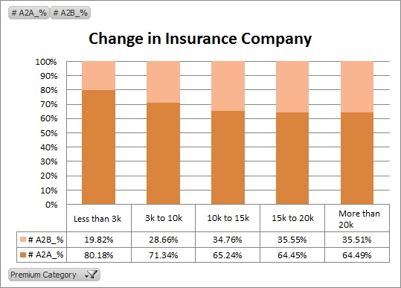
Percentage of Ins Comp Shifts
#Total Policies= 19760
#2016 Quarter 1 Renewals
Attribute
Premium Category: <3k, 3k-10k, 10k-15k, 15k-20k and >20k
Inference
Percentage of shift increases consistently with increase in the Premium amount, except for the last two categories where it is almost same.

Slide 36
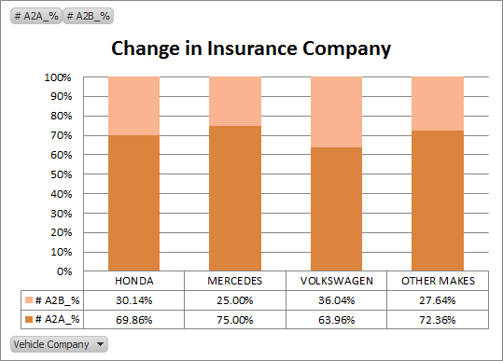
Percentage of Ins Comp Shifts
#Total Policies= 19760
#2016 Quarter 1 Renewals
Attribute
Vehicle Company: Honda, Mercedes, Volkswagen and Others
Inference
Highest shift in the Insurance company is observed for Volkswagen vehicles, and minimum for Mercedes vehicles.

