Slide 1
EMPLOYMENT STATISTICS DASH
Team 13
Jackson Shelton, Justin Varela, Pranav Prathap, Yixuan Tan

Slide 2
TABLE OF CONTENTS
Introduction and Goal
Building Line Plots
Building Choropleth
Use Cases and Demo

Slide 3
THE GOAL
Design a dashboard using FRED data to provide an overview of employment statistics by industry.
Use to identify potential events and to provide statistical background to identified events.
Three Components:
Employee headcounts by industry over time (Line)
Employment by industry by state over time (Choropleth)
Wage by industry over time (Line)

Slide 4
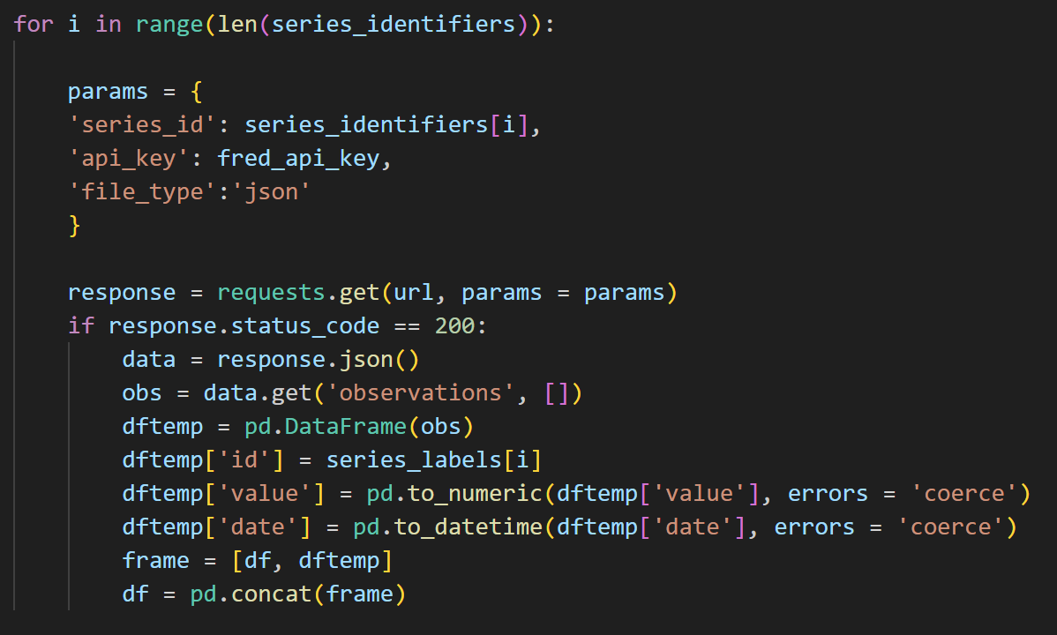
BUILDING LINE PLOTS (BASIC INPUTS)
The headcount and wage graphs operate on the same code
Build data frame outside of callback using FRED datasets for each industry
Incorporate a dcc checkbox to take user input
Within callback, filter data frame by selected industries and plot.

Slide 5
BUILDING LINE PLOTS (DATE)
A user may want to see a specific range with more clarity
Incorporate a dcc date range
Within callback, use the start date and end date to filter the data frame and plot

Slide 6
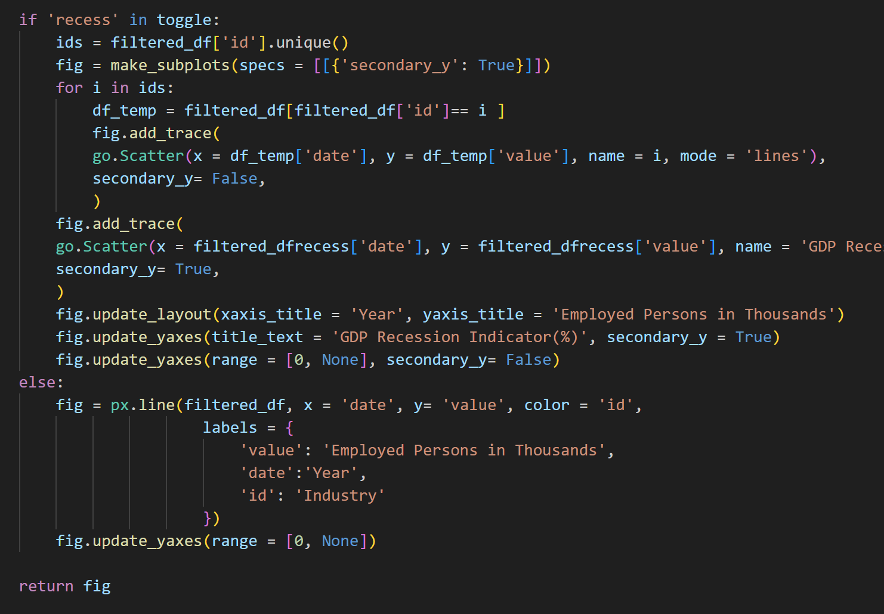
BUILDING LINE PLOTS (TWO Y-AXES)
Plotly does not natively support two y-axes
Required plotly subplots and plotly graph objects
Include a separate checklist element to act as a toggle
Toggle determines how you build graph

Slide 7
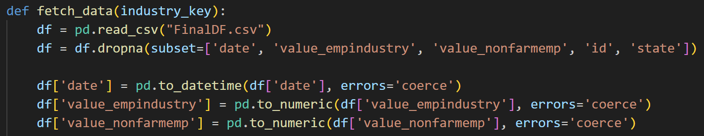
BUILDING CHOROPLETH
Required industry headcounts by both state and industry.
Massive dataset, requires external saving
Year and month selector included to be able to see every release
Some states are missing data depending on the industry
Some industries are so concentrated in some states that it makes the choropleth hard to read

Slide 8
BUILDING CHOROPLETH (ADJUSTMENT)
Adjusted Choropleth to show industry presence as a percentage of total non-farm jobs.
Ensures that more populous states are not overrepresented on Choropleth

Slide 9
USE CASES
Finding the statistical impact of an event on employment and wages in a given industry:
How large were the COVID-19 employment dips for each industry?
How have wages in industries responded to inflation post-COVID?
Identifying trends and concentrations for further research:
Why are education and health services resistant to recessions?
Why does Texas have a high concentration of mining and logging industries?

Slide 10
DEMO

Slide 11
Questions?

