Slide 1
SOFTWERE ENGINEERING
JOB AND COURSE PROPOSAL

Slide 2
GROUP MEMBERS
EHSANUL HAQUE
ANIKA TAHSIN MEEM
NAYMA ISLAM
SHAMMI AKTER
JOB AND COURSE PROPOSAL

Slide 3
PANEL DISCUSION
01
ENTITY RELATION DIAGRAM
02
CLASS DIAGRAM
03
STAKEHOLDERS AND REQUIREMENTS
04
FEATURES

Slide 4
Welcome!!

Slide 5
INTRODUCTION
Software engineering is all about the benefit and developments about the society and the society will be self-dependent only the economical developments of a country. Today most of the undergraduate students is seen not to find eligible job according to their qualification. Our software can help the undergraduate students to find the eligible jobs according to their qualification and expectation salary. And also any undergraduate students if interested he can do courses according to their pre requisite.

Slide 6

Our Services
EXPECTED
JOBS
KNOWLEDGEMENT
ONLINE COURSES
HIGHER EDUCATION
JOB AND COURSES
PROPOSAL

Slide 7

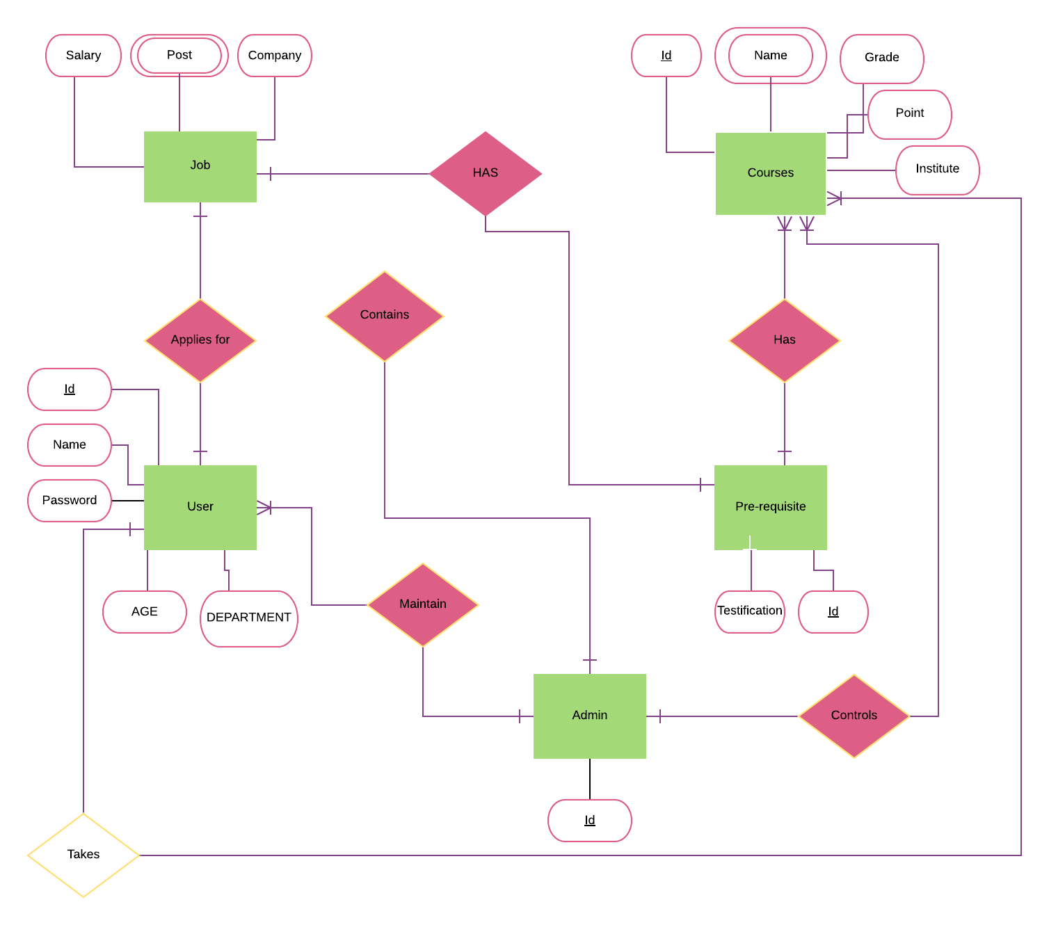
ENTITY RELATION DIAGRAM

Slide 8
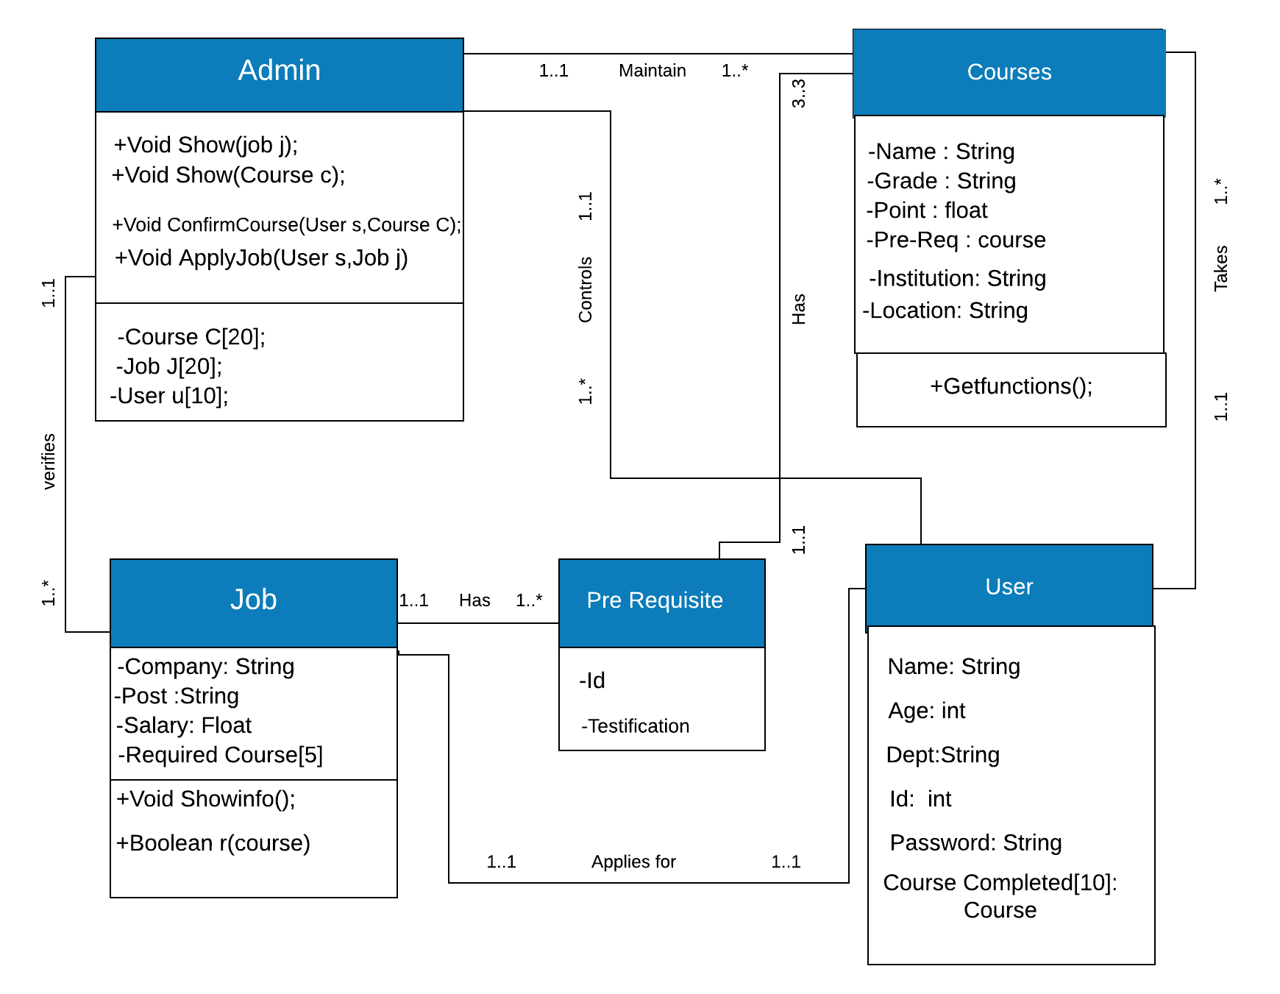
CLASS DIAGRAM
JOB AND COURSE PRPOSAL

Slide 9
OVERVIEW
OVERVIEW
This Requirements Document will provide the requirements for a Job and Course Proposer website. Both functional and non-functional requirements will be documented.

Slide 10

STAKEHOLDERS
Stakeholder Name | Organization | Role
Osama Bin | JCP | President
Ayman Zawahiri | JCP | Treasurer
Abu Zarqawi | JCP | Secretary
Hamza Bin | JCP | Member
Abu Masri | JCP | Vice President

Slide 11
Job and Course Proposer Processes Affected
The following Job and Course Proposer processes are “in scope:
• New member registration
• Sign in and Sign out
• Set Constraints
•Results will be scanned of completed credits of a student match
•Users can edit their profile
Assumptions/Constraints
Applications
- n/a
The following applications are in scope:
• Job and Course Proposer Website
Risks
- n/a
Related Documents
- n/a

Slide 12
FUNCTIONAL REQUIREMENTS
Requirement ID | Requirement Statement | Must/Want | Comments | Requirement ID
FR001 | The Home page shall have a list of the purpose of the organization | Must |  | FR001
FR002 | The Home page shall list categories from where user may select their desired options. |  |  | FR002
FR003 | The Home page may show categories like job, course outline, online institution, set location etc. |  | We have a spreadsheet that contains the students name, institution names, email, location etc. | FR003

Slide 13
FUNCTIONAL REQUIREMENTS
REQUIREMENT ID | REQUIREMENT STATEMENT | MUST / WANT | COMMENTS
FR004 | Students will be able pay for online courses and there will be list of courses which students can avail for free. | Must | Credit cards/ Paypal
FR005 | If students select any courses they’ll be provided suggestions of courses available in those particular institutions. | Must
FR006 | Links of some part and full time job will be provided from where students can avail this job according to their interest and qualities job can be paid or unpaid depending on experience | Must | Salary will be provided via online or Paypal

Slide 14
NON-FUNCTIONAL REQUIREMENTS
Requirement ID | Requirement Statement | Must/Want | Comments
NF001 | This App shall cost less than $1,000 to build. | Must
NF002 | The App shall be secure from hackers. | Must
NF003 | This App is user friendly for students they’ll have a clear view on what courses they shall focus more. | Must
NF004 | The website shall be backed up nightly and be able to be restored on one hour’s notice. | Must
NF005 | Student’s information will be secured within the application. | Must

Slide 15
FEATURES
1) Registration : Every student must have to sign up an create an account to that application in order to get access to all the facilities to our software.
2) Log in : After completion of their registration they can log in to their respective accounts and check all the updates of newly arrived jobs and courses.
3) Set constraints : After selecting any options from the list provided in our system we can also set additional conditions as per need. For example while selecting a courses we can also set location and range of money we want to pay for that course.
4) Auto checker: The software will filter before showing results all the eligible jobs and courses for that students. It will check students profile and match will all requirements to the particular jobs/courses and show results.

Slide 16




Thank you
SHAMMI AKTER
NAYMA ISLAM
ANIKA TAHSIN MEEM
EHSANUL HAQUE ANTIK
18-36445-1
18-36607-1
18-37662-1
18-36572-1

