Slide 1
Scaling eCGA Model Building via Data-Intensive Computing
Abhishek Verma, Xavier Llora, Shivaram Venkataram, David E. Goldberg, Roy H. Campbell
Presenter:

Slide 2
Motivation
Genetic Algorithms (GAs)
applied to very large scale data-intensive problems
Current approach: MPI
Complicated to program, debug, checkpoint
Does not scale on commodity clusters
MapReduce: simple and scalable abstraction
Model building for estimation of distribution algorithms is expensive : O(l³), where l is the number of genes
Scale extended Compact Genetic Algorithm (eCGA) using MapReduce
Notes:
Used MapReduce to scale simple GAs [ISDA 09]

Slide 3
Outline
Motivation
MapReduce
MapReduce Simple Genetic Algorithm
Extended Compact Genetic Algorithm
Approaches
Experimental Results
Conclusion

Slide 4
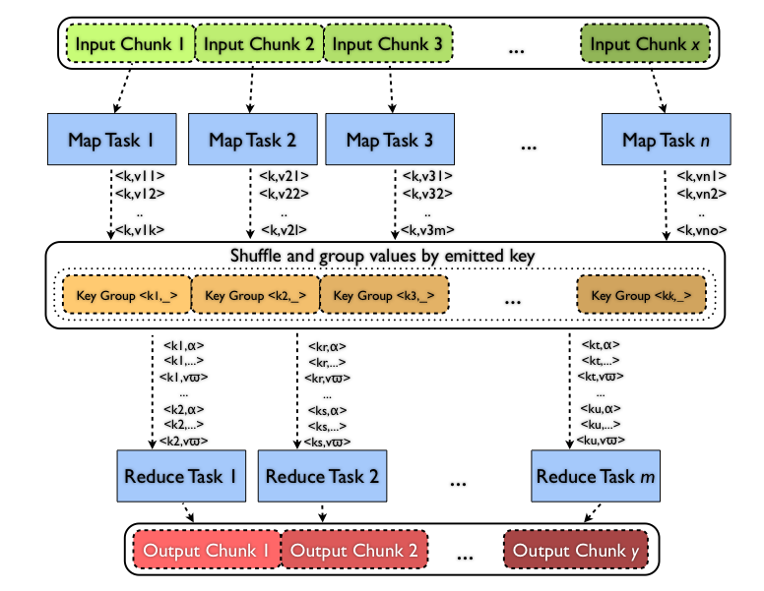
Data-intensive computing: MapReduce

Slide 5
Simple Genetic Algorithm
Initialize population with random individuals.
Evaluate fitness value of individuals.
Repeat steps 4-5 to 2 until some finalization criteria are met.
Select good solutions by using tournament selection without replacement.
Create new individuals by recombining the selected population using uniform crossover.
Map
Reduce

Slide 6
Trap Function

Slide 7
Extended Compact Genetic Algorithm
Initialize population with random individuals.
Evaluate fitness value of individuals.
Repeat steps 4-5 to 2 until some convergence criteria are met.
Build the probabilistic model using greedy search
Create new individuals by sampling the probabilistic model

Slide 8
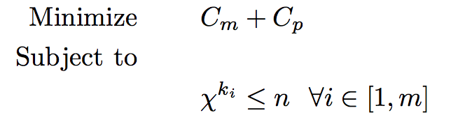
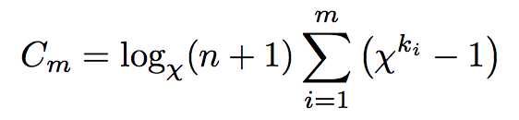
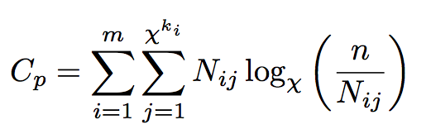
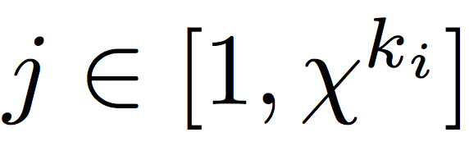
Model building in eCGA
X : the alphabet cardinality, 2 for binary strings
C_{m} : Model complexity
C_{p} : Compressed population complexity
m: number of building blocks
k_{i} : length of the ith building block
N_{ij}: number of chromosomes possessing bit sequence
for building block i

Slide 9
Map Phase
ComputeMarginalProbabilities( ):
// Compute marginal probability of all building blocks
for all possible schemas in a partition b
do
for all individuals i
do
value ← decimal value of b in i
P(b)[value] ← P(b)[value]+1
end for
end for

Slide 10
Reduce phase : PickAndMerge()
// Find the best merge of building blocks
Initialize b_{comp} ← 1, b_{i} ←−1, b_{j} ←−1 for all i and j
while b_{comp} > 0 :
b_{comp} ←−1
for i ← 0 to number of building blocks:
for j ← i +1 to number of building blocks:
c_{i} ← Combined complexity (CC) of block b_{i}
c_{j} ← CC of block b_{j}
c_{ij} ← CC of blocks b_{i} and b_{j} merged together
δ_{ij} ← c_{i} +c_{j} −c_{ij}
if δ_{ij} ≥ b_{comp} :
b_{i} ←i, b_{j} ←j, b_{comp} ←δ_{ij}
if b_{comp} ≠ −1 :
Merge building blocks i and j and recompute the marginal probabilities
Notes:
Compare every building block with every other building block and merge them if their combined complexities decrease. Recompute the marginal probabilities

Slide 11
Motivation of Caching
Abhishek

Slide 12
Experimental Results
Experimental setup
62 nodes: each has 16GB RAM, 2TB hard drives, and 8 cores
Each node runs 6 mappers + 2 reducers
MK deceptive trap function, k =4, d=0.25

Slide 13
Scaling Model building

Slide 14
Other Experimentation
Exploring other MapReduce implementation

Slide 15
CGA using MongoDB

Slide 16
CGA running on MongoDB

Slide 17
Conclusion
Scalable estimation of distribution algorithms
Using Hadoop and MongoDB
Caching greatly speeds up iterative parallel model building
Catch: Caching mechanics also need to scale
Future Work
Demonstrate scalability for practical applications
Comparison with MPI implementation

Slide 18
Questions?

Slide 19
Thank You

