Slide 1
MITHRA: Multiple data Independent Tasks on a Heterogeneous Resource Architecture
Reza Farivar, Abhishek Verma, Ellick Chan, Roy H Campbell
University of Illinois at Urbana-Champaign
Systems Research Group
farivar2@illinois.edu
Wednesday, September 2, 2009

Slide 2
Motivation for MITHRA
Scaling GPGPU is a problem
Orders of magnitude performance improvement
But only on a single node and up to 3~4 GPU cards
A cluster of GPU enabled computers
Concerns: node reliability, redundant storage, networked file systems, synchronization, …
MITHRA aims to scale GPUs beyond one node
Scalable performance with multiple nodes
Notes:
GPGPU is …..

Slide 3
Presentation Outline
Opportunity for Scaling GPU Parallelism
Monte Carlo Simulation
Massive Unordered Distributed (MUD)
Parallelism Potentials of MUD
MITHRA Architecture
How MITHRA Works, Practical Implications
Evaluation

Slide 4
Opportunity for Scaling GPU Parallelism
Similar underlying hardware model for MapReduce and CUDA
Both have spatial independence
Both prefer data independent problems
A large class of matching scientific problems: Monte Carlo Simulation
In a sequential implementation, there is temporal independence

Slide 5
Monte Carlo Simulation
Create a parametric model
y = f (x₁ , x₂ , ..., x_{q} )
For i = 1 to n
Generate a set of random input
x_{i1} , x_{i2} , ..., x_{iq}
Evaluate the model - and store the results as y_{i}
Analyze the results
Histograms, summary statistics, etc.

Slide 6
Black Scholes Option Pricing
A Monte Carlo simulation method to estimate the fair market value of an asset option
Simulates many possible asset prices
Input parameters
S: Asset Value Function
r: Continuously compounded interest rate
σ: Volatility of the asset
G: Gaussian Random number
T: Expiry date
y = f (S, r, σ, T, G )

Slide 7
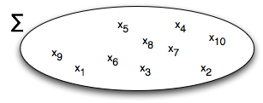
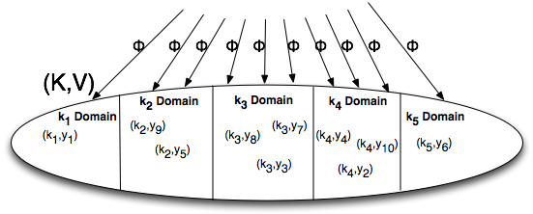




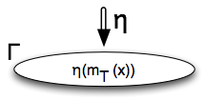
Massive Unordered Distributed (MUD)
Map
Reduce

Slide 8
Parallelism Potential of MUD
Input data set creation
Data independent execution of Φ
Intra-key parallelism of ⊕
If ⊕ is associative and commutative, it can be evaluated via a binary tree reduction
Inter-key parallelism of ⊕
When ⊕ is not associate or commutative
Φ creates multiple key domains
Example: Median computation
Notes:
Φ may use a single key domain if there is no need for multiple key domains

Slide 9
Role of the η Function
If possible, decompose non-associative or non-commutative ⊕ into two functions
f₁ : associative and commutative
f₂ : non-associative or non-commutative
Ex. Mean aggregator ⊕ is (a ⊕ b) = (a+b)/2
division operator distributive
f₁ (a,b) = a + b
f₂ (a) = a / const

Slide 10
MITHRA Architecture
The key important factor in MITHRA
The “best” computing resource for each parallelism potential in MUD is different
Leverage heterogeneous resources in MITHRA design
MITHRA takes MUD, and adapts it to run on a commodity cluster
Each node contains a mid range CPU and the best GPU (within budget)
Majority of computation involves evaluating Φ, which now is performed in GPU
Connected with Gigabit Ethernet

Slide 11
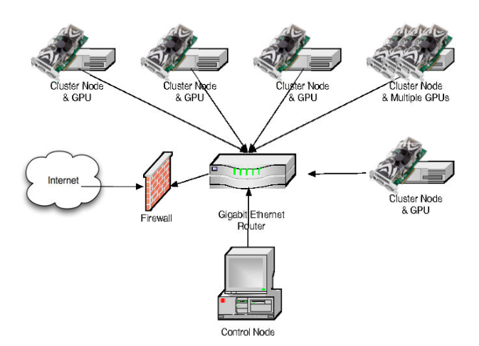
MITHRA Architecture (ctd.)
Based on Hadoop Framework
Scalability
Up to 10,000s
Reliable and Fault Tolerant
Nodes fail frequently
Software fault tolerance
Speculation on slow nodes
Periodic heartbeats
Re-execution
Redundant Distributed File System
HDFS

Slide 12
How MITHRA Works
Map function of MITHRA is a 2 phase process
Hadoop Map merely distributes Φ workload across nodes
Data chunk size typically 64 MB to 256 MB
The Φ function (in CUDA) is evaluated on GPUs
Key Domain Partitioning
Application of ⊕ in each Key Domain
If Intra Key Parallelism possible, reduction is 2 Phase
Subtree reduction happens in GPUs
Highest level trees in CPUs
But typically performed serially on node 0
Better in practice, since data size is O(nodes)

Slide 13
Random Number Generation
Generated locally in GPUs
Different seeds used across the cluster
Use of Niederreiter Quasirandom Generator
Less random than a psuedo random generator
More useful for some analyses
Samples space more uniformly
Superior Convergence
Monte Carlo Simulation requires normally distributed random numbers
Also applied on GPU
Implementations available in CUDA SDK

Slide 14
Evaluation
Multiple Implementations
Multi-core
Pthread
Phoenix (MapReduce on Multi-cores)
Hadoop
Single Node CUDA
MITHRA

Slide 15
Multi-core

Slide 16
Hadoop
Hadoop 0.19, 496 cores (62 nodes)
248 nodes allocated to mappers

Slide 17
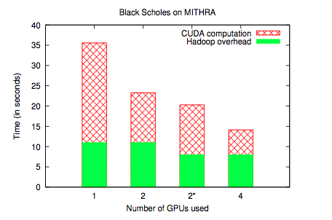
MITHRA
Overhead determined using Identity Mapper and Reducer
Mostly startup and finishing time, more or less constant
CUDA speedup seems to scale linearly
Speculation: The speedup will eventually flatten, probably on a large number

Slide 18
Per Node Speedup
The 62 quad-core node Hadoop cluster (248 mappers) takes 59 seconds for 4 billion iterations
The 4 node (4 GPUs) MITHRA cluster takes 14.4 seconds

Slide 19
Future Work
Experiment on larger GPU clusters
Key Domain partitioning and allocation
Evaluate other Monte Carlo algorithms
Financial risk analysis
Extend beyond Monte Carlo to other motifs
Data mining (K-Means, Apriori)
Image Processing / Data Mining
Other Middleware Paradigms
Meandre
Dryad

Slide 20

Questions?

