Slide 1


Play It Again, SimMR!
Abhishek Verma^{1,2}, Lucy Cherkasova², Roy H. Campbell¹
¹University of Illinois at Urbana-Champaign, ²HP Labs

Slide 2

Casablanca [1942]
“Play it again, Sam!”

Slide 3
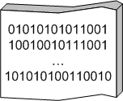
Large-scale Distributed Computing
…
. . .
How to program this monster?
…
…
…
DATA
. . .
…
Age of Big Data
Industries, sensors, Internet producing enormous amounts of data
Need to process very large datasets
Using 1000s of machines

Slide 4
Processing data using MapReduce
MapReduce and Hadoop (open source) come to rescue
Key technology for search (Google, Yahoo, Bing, …)
Web data analysis, user log analysis, relevance studies,
Data may not have strict schema
Unstructured or semi-structured
Nodes fail every day
Failure is the norm, rather than exception
Expensive and inefficient to build reliability in each application

Slide 5

Hadoop operation
Job
Scheduler
Task
Task
Task
MapReduce Layer
Location Information
JobTracker
TaskTracker
TaskTracker
File system Layer
NameNode
DataNode
DataNode
...
Disk
Disk
Master
Worker Node
Worker Node

Slide 6
Motivation
MapReduce clusters shared
Multiple users and applications
Controlling resource allocations difficult
FIFO, Fair share, Capacity scheduler
Currently done by administrators using rules of thumb in an ad-hoc way
Key challenge: Evaluating and comparing different schedulers and workload management strategies
Goal: Build a simulator
Accurate, Fast and Useful
To replay collected real application traces
To play synthetic workloads

Slide 7

Outline
Motivation
Feasibility
SimMR Design
Simulator Engine
Evaluation
Case Study

Slide 8
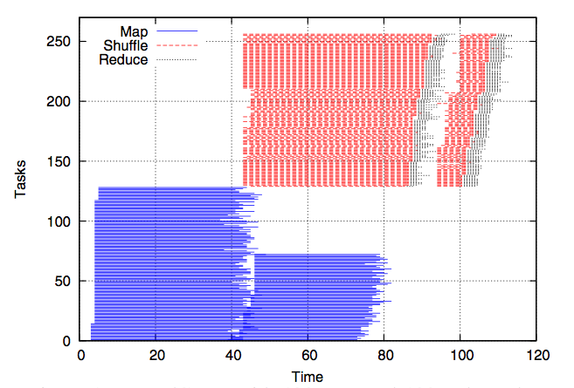
Why is this problem difficult?
WordCount with 128 map/128 reduce slots
Overlap of map and shuffle phases

Slide 9
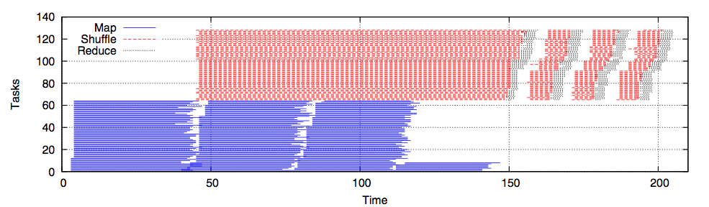
Why is this problem difficult? (2)
WordCount with 64 map/64 reduce slots
Different resource allocations change completion time

Slide 10
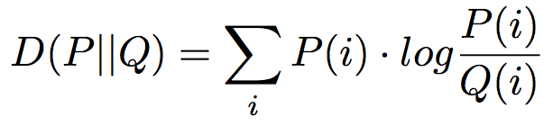
Feasibility
Kullback-Liebler Measure
Different resource allocations lead to similar task duration distributions

Slide 11
SimMR Design
Extracts number of map/reduce tasks, durations
Generates synthetic trace from task duration distribution
Different policies
MRProfiler
Synthetic
TraceGen
FIFO
Min
EDF
Max
EDF
Trace Database
Scheduling
Policy
Stores traces persistently
keyed by (job name, user)
Narrow interface: chooseNextMap/ReduceTask(jobQ)
Simulator Engine
Discrete event simulator replays tasks

Slide 12
Simulator Engine
Simulate at task level
Non-goal to simulate task trackers, disk, network,..
Maintain priority queue of
(eventTime, eventType, jobId)
Event types
Job arrival and departure
Map and reduce task arrival and departure
Map stage complete event
Discrete event simulation

Slide 13

Comparison with Mumak^{[1]}
Mumak : open source project by Yahoo!
aims to emulate current schedulers as-is
useful for debugging schedulers
Total run-time
Completion of all maps + reduce phase
Does not account for shuffle and overlap
Simulates heartbeat messages and other events
Uses Rumen^{[2]} to collect all job metrics (> 40)/task

Slide 14
Experimental Setup
66 HP DL145 machines
Four 2.39 GHz cores
8 GB RAM
Two 160 GB hard disks
Two racks
Gigabit Ethernet
2 masters + 64 slaves
Workload
WordCount, Sort, Bayesian classification, TF-IDF, Twitter, WikiTrends

Slide 15

Accuracy
SimMR faithfully replays traces (< 6.6% error)

Slide 16

Performance
SimMR is two orders of magnitude faster than Mumak
Notes:
Now that I have demonstrated the accuracy and performance of SimMR, let us proceed to see what we can do with it…

Slide 17
Case Study
Usefulness of SimMR
Compare two schedulers for deadline driven job scheduling
Two questions to answer:
Which job should be allocated slots?
Earliest deadline first
How many slots should be allocated
Maximum or minimum^{[3]} resources

Slide 18
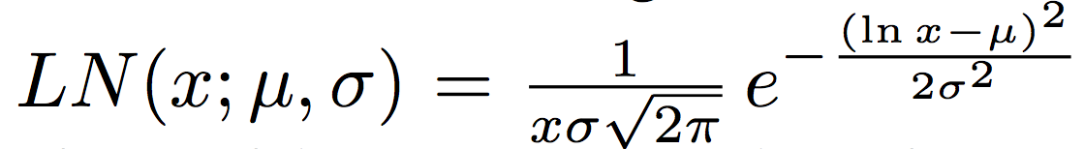
Workload Traces
Two schedulers: MaxEDF and MinEDF
Real workload trace
6 applications × 3 datasets on 66 nodes
Facebook workload
Use CDF from Zaharia et. al ^{[4]}
Fit log-normal distribution for task durations
Assume Poisson job arrivals
Deadline set to 1.5 times completion time given all resources
Measured relative deadline exceeded

Slide 19
Simulating MaxEDF and MinEDF
MinEDF achieves lesser RDE than MaxEDF

Slide 20
Conclusion
Need to design and evaluate new workload management strategies for Hadoop
SimMR – accurate, fast and useful
Assist administrators in performance analysis, new resource allocation schemas and configuring scheduler parameters
Future work
Account for locality
Scaling smaller dataset traces to simulate larger dataset ones
More sophisticated network modeling

Slide 21
Questions?
verma7@illinois.edu

Slide 22
Conclusion
Need to design and evaluate new workload management strategies for Hadoop
SimMR – accurate, fast and useful
Assist administrators in performance analysis, new resource allocation schemas and configuring scheduler parameters
Future work
Account for locality
Scaling smaller dataset traces to simulate larger dataset ones
More sophisticated network modeling
Email: verma7@illinois.edu

