Slide 1
ARIA: Automated Resource Inference and Allocation for MapReduce Environments
Abhishek Verma^{1,2}, Lucy Cherkasova², Roy H. Campbell¹
¹University of Illinois at Urbana-Champaign
²HP Labs

Slide 2





Unprecedented Data Growth
New York Stock Exchange generates about 1 TB of new trade data each day.
Facebook had 10 Billion photos in 2008 (1 PB of storage).
Now: 100 millions photos uploaded each week
Google
World wide web, 20 petabytes processed per day,
1 exabyte of storage under construction
The Internet Archive stores around 2PB, and it is growing at 20TB per month
The Large Hadron Collider (CERN) will produce ~15 PB of data per year.

Slide 3
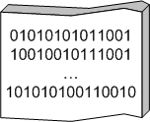
Large-scale Distributed Computing
…
. . .
How to program the beast?
…
…
…
DATA
. . .
…
Large data centers (x1000 machines): storage and computation
MapReduce and Hadoop (open source) come to rescue
Key technology for search (Bing, Google, Yahoo)
Web data analysis, user log analysis, relevance studies, etc.

Slide 4
MapReduce, Why?
Need to process large datasets
Data may not have strict schema:
i.e., unstructured or semi-structured data
Nodes fail every day
Failure is expected, rather than exceptional.
The number of nodes in a cluster is not constant.
Expensive and inefficient to build reliability in each application

Slide 5
MapReduce [Google, OSDI 04]
MapReduce is a programming model supported by a library of clustered computing system functions
Programming model
Map and reduce primitives borrowed from functional languages (e.g., Lisp)
Map applies the same computation identically on the partitioned data and reduce aggregates the map outputs
Library of clustered computing system functions
Automatic parallelization & job distribution (load balancing)
Fault-tolerance via job re-execution
Provides status and monitoring tools

Slide 6

MapReduce : Background
Map Stage
Reduce Stage
Input
records
k₁
v₁
k₁
v₁
k₁
v₁
Output
records
map
k₂
v₂
k₂
v₂
reduce
k₄
v₃
k₂
v₄
Split
sort
k₄
k₃
v₃
map
k₂
v₄
v₅
reduce
Split
k₃
k₄
v₅
k₃
v₅
v₃
shuffle
Notes:
Each map task is independent of other

Slide 7

Hadoop operation
Job
Scheduler
Task
Task
Task
MapReduce Layer
Location Information
JobTracker
TaskTracker
TaskTracker
File system Layer
NameNode
DataNode
DataNode
...
Disk
Disk
Master
Worker Node
Worker Node

Slide 8
Outline
Motivating example
Problem definition
Job profile
ARIA
Evaluation
Conclusion

Slide 9
Motivation
MapReduce applications process PBs of data across enterprise
Key challenge: controlling the allocation of resources in shared MapReduce environments
Many users require job completion time guarantees
No support from existing schedulers
FIFO, Fair Scheduler, Capacity Scheduler
In order to achieve Service Level Objectives (SLO), we need to answer:
When will the job finish given certain resources?
How much resources should be allocated to complete the job within a given deadline?

Slide 10
Motivating Example: Predicting completion time
Why is this difficult?
Application: Sort
Input: 8 GB randomly generated data
Resources: 64 Hadoop worker nodes
each with single map and reduce slot
DFS block size = 128MB
Number of map tasks = 8GB/128MB = 64
Number of reduce tasks = 64

Slide 11
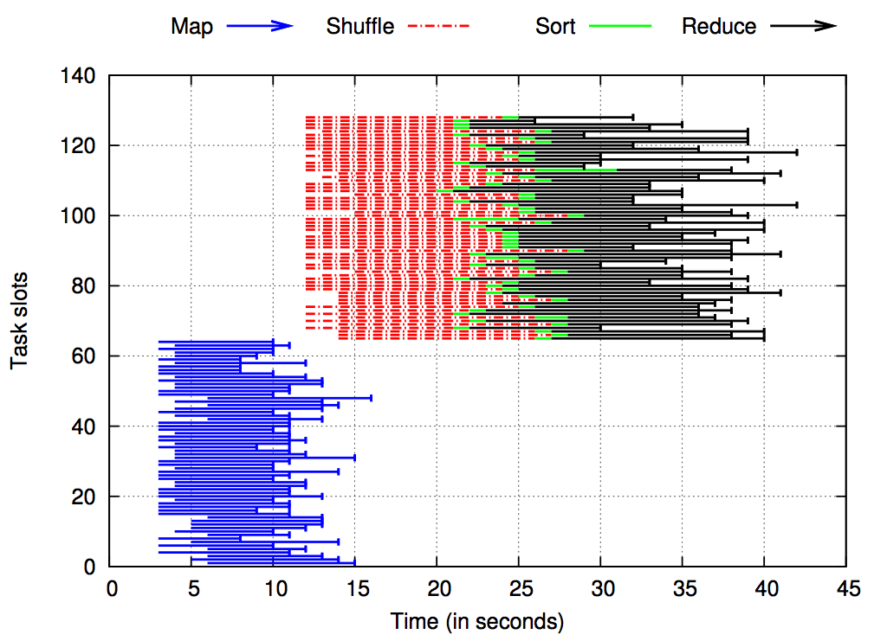
64 map and 64 reduce slots

Slide 12
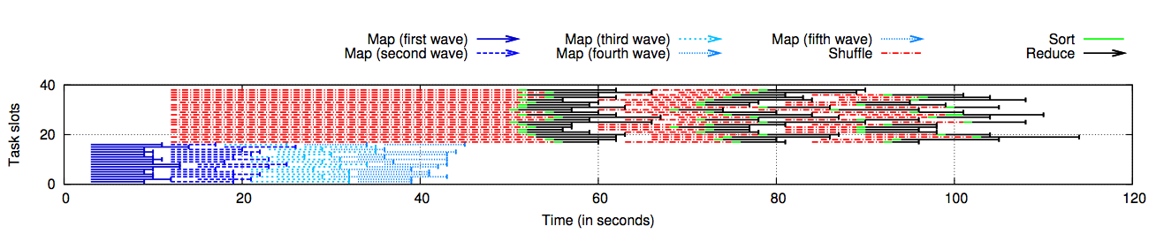
16 map and 22 reduce slots
Job execution can be very different depending on the amount of allocated resources

Slide 13
Problem Definition
For a given MapReduce application, can we extract performance invariants to characterize its different MapReduce stages that are:
independent of job execution style
independent of application’s input dataset size
Can we design a performance model that utilizes these invariants and uses them for predicting:
job completion time
amount of resources required to complete the job(s) within a given deadline(s)

Slide 14
Theoretical Makespan Bounds
Distributed task processing
with greedy assignment algorithm
assign each task to the slot with the earliest finishing time
Let be the duration of tasks processed by slots
be the average duration and
be the maximum duration of the tasks
Then the execution makespan can be approximated via
Lower bound is
Upper bound is

Slide 15
Illustration
Sequence of tasks: 1 4 3 2 3 1 2
1
Makespan = 4
Lower bound = 4
2
3
4
A different permutation: 3 1 2 3 2 1 4
1
2
Makespan = 7
Upper bound = 8
3
4

Slide 16
Our Approach
Most production jobs are executed routinely on new data sets
Measure the job characteristics of past executions
Each map and reduce task is independent of the other tasks
compactly summarize them in a job profile
Estimate the bounds of the job completion time (instead of trying to predict the exact job duration)
Estimating bounds on the duration of map, shuffle/sort, and reduce phases

Slide 17
Job Profile
Performance invariants summarizing job characteristics:
Map Stage
M_{min,avg,max}
Reduce Stage
Shuffle/Sort_{avg,max}
AvgInputSize
Selectivity
Reduce_{avg,max}
Selectivity
AvgInputSize

Slide 18
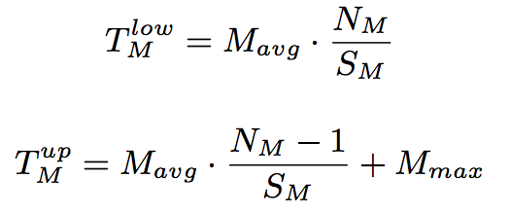
Lower and Upper Bounds of a Job Completion Time
Two main stages: map and reduce stages
Map stage duration depends on:
N_{M} -- the number of map tasks
S_{M} -- the number of map slots
Reduce stage duration depends on:
N_{R} -- the number of reduce tasks
S_{R} -- the number of reduce slots
Reduce stage consists of :
Shuffle/sort phase
“First” wave is treated specially (non-overlapping part with maps)
Remaining waves are “typical”
Reduce phase
Notes:
Change latex Nm/Sm

Slide 19

Solving the inverse problem
Given a deadline time T and the job profile, find the necessary amount of resources to complete the job within T.
Finding the set of minimal (map,reduce) slots to support the job execution within T:
Given number of map/reduce tasks
Find the number of map and reduce slots (S_{M}, S_{R}) such that S_{M}+S_{R} is minimum

Slide 20
Different bound curves
Find (S_{M}, S_{R}) using Lagrange multipliers

Slide 21
ARIA Implementation
Calculates (S_{M}, S_{R}) that need to be allocated to meet the job SLO
Profiles running or completed jobs
MySQL database stores past profiles keyed by (user, jobname)
Job Profiler
Slot Estimator
Profile Database
Listens for job submission, heartbeat events and schedules jobs EDF
SLO Scheduler
Keeps track of number of running map/reduce tasks and keeps them below allocated slots
Slot Allocator

Slide 22
SLO Scheduler Highlights
Performs jobs ordering: EDF
Computes required resource allocation for a job from its historic profile and a given deadline T
Automatic
Preserves data locality
Robust against runtime variability
profiles the job while it is running
dynamic adjustments of the allocation

Slide 23
Experimental Setup
66 HP DL145 machines
Four 2.39GHz cores
8 GB RAM
Two 160 GB hard disks
Two racks
Gigabit Ethernet
2 masters + 64 slaves
4 map and 4 reduce slots on each slave
Workload:
WikiTrends
WordCount, Sort, Bayesian classification, TF-IDF, Twitter

Slide 24
Are Job Profiles stable?
Job | Map Task Duration |  |  | Avg Input size (in MB) | Selectivity
 | Min | Avg | Max
Sept_{256,256} | 94 | 144 | 186 | 59.85 | 10.07
Oct_{256,256} | 86 | 142 | 193 | 58.44 | 9.98
Sept_{64,128} | 94 | 133 | 170 | 59.85 | 10.07
Oct_{64,128} | 71 | 132 | 171 | 58.44 | 9.98
Job | Shuffle |  | Reduce
 | Avg | Max | Avg | Max | Selecitivity
Sept_{256,256} | 121 | 152 | 16 | 33 | 0.37
Oct_{256,256} | 122 | 156 | 17 | 35 | 0.36
Sept_{64,128} | 122 | 152 | 15 | 139 | 0.37
Oct_{64,128} | 123 | 153 | 15 | 109 | 0.36

Slide 25
How accurate are completion time predictions?

Slide 26
Can we meet deadlines?

Slide 27
Meeting deadlines for a set of jobs
Load threshold for arrival (%) | SLO exceeded utility (%) | # of jobs with missed SLOs | Average Load (%)
105 | 7.62 | 1 | 29.27
100 | 4.58 | 1 | 27.34
95 | 0 | 0 | 26.46
90 | 0 | 0 | 25.63
Deadlines missed only under high load
More simulation results in the paper…

Slide 28
Conclusion
Proposed MapReduce job profiling is compact and comprised of performance invariants
Introduced bounds-based performance model is quite accurate: the job completion times are within 10% of measured ones
Robust prediction of required resources for achieving given SLOs
job completion times within 8% of their deadlines
Future work:
Comparison of different SLO-driven schedulers
Difficult effort: requires implementing schedulers
Running experiments take hours/days
Limited workload exposure
Good simulation environment is needed
With trace replay capabilities
Synthetic and real workload generator

Slide 29
Questions?

