Slide 1
Resource Provisioning Framework for MapReduce Jobs with Performance Goals
Abhishek Verma^{1,2}, Lucy Cherkasova², Roy H. Campbell¹
¹University of Illinois at Urbana-Champaign
²HP Labs

Slide 2





Unprecedented Data Growth
New York Stock Exchange generates about 1 TB of new trade data each day.
Facebook had 10 Billion photos in 2008 (1 PB of storage).
Now: 100 millions photos uploaded each week
Google
World wide web, 20 petabytes processed per day,
1 exabyte of storage under construction
The Internet Archive stores around 2PB, and it is growing at 20TB per month
The Large Hadron Collider (CERN) will produce ~15 PB of data per year.

Slide 3

Large-scale Distributed Computing
…
. . .
How to program the beast?
…
…
…
DATA
. . .
…
Large data centers (x1000 machines): storage and computation
MapReduce and Hadoop (open source) come to rescue
Key technology for search (Bing, Google, Yahoo)
Web data analysis, user log analysis, relevance studies, etc.

Slide 4
MapReduce, Why?
Need to process large datasets
Data may not have strict schema:
i.e., unstructured or semi-structured data
Nodes fail every day
Failure is expected, rather than exceptional.
The number of nodes in a cluster is not constant.
Expensive and inefficient to build reliability in each application

Slide 5

Hadoop operation
Job
Scheduler
Task
Task
Task
MapReduce Layer
Location Information
JobTracker
TaskTracker
TaskTracker
File system Layer
NameNode
DataNode
DataNode
...
Disk
Disk
Master
Worker Node
Worker Node

Slide 6
Outline
Motivation
Approach
Job Profile
Scaling Factors
Completion Time and Resource Provisioning Models
Taking Node Failures into Account
Evaluation

Slide 7
Motivation
MapReduce applications process PBs of data across enterprise
Many users have job completion time goals:
No support from current service providers on capacity planning, e.g. Elastic Map-Reduce
Need for useful performance models to estimate the required infrastructure size
In order to achieve Service Level Objectives (SLOs), we need to solve the following inter-related problems:
When will the job finish given certain resources?
How much resources should be allocated to complete the job within a given deadline?
Can we do application resource provisioning on the smaller data set?

Slide 8
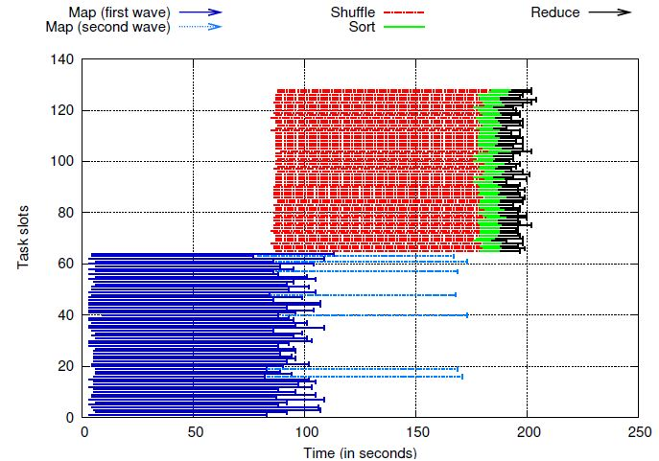
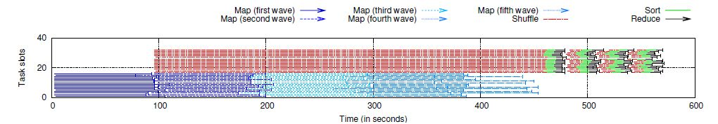

Predicting job completion time
Why is this difficult ?
Different amounts of resources can lead to different executions
Linear scaling? Not always!
580s / 4 vs 200s
Wikitrends: 64x64
Wikitrends: 16x16

Slide 9
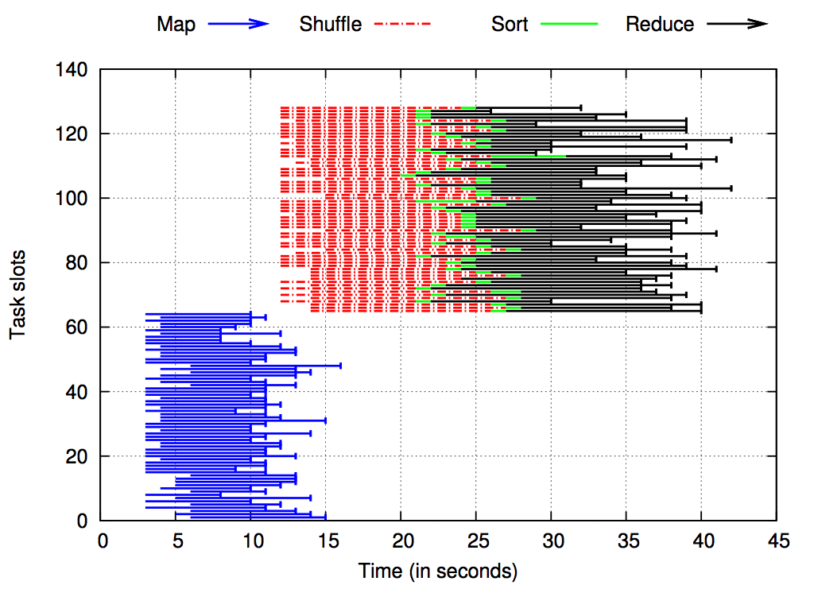
Different MapReduce Jobs – Different Job Profiles
Sort
Wikitrends

Slide 10
Theoretical Makespan Bounds
Distributed task processing
with greedy assignment algorithm
assign each task to the slot with the earliest finishing time
Let be the duration of tasks processed by slots
be the average duration and
be the maximum duration of the tasks
Then the execution makespan can be approximated via
Lower bound is
Upper bound is

Slide 11
Illustration
Sequence of tasks: 1 4 3 2 3 1 2
1
Makespan = 4
Lower bound = 4
2
3
4
A different permutation: 3 1 2 3 2 1 4
1
2
Makespan = 7
Upper bound = 8
3
4

Slide 12
Our Approach
Most production jobs are executed routinely on new data sets
Measure the job characteristics of past executions
Each map and reduce task is independent of the other tasks
compactly summarize them in a job profile
Estimate the bounds of the job completion time (instead of trying to predict the exact job duration)
Estimating bounds on the duration of map, shuffle/sort, and reduce phases

Slide 13
Caveats
“All models are wrong, some models are useful”
--- George Box
Map (Reduce) tasks perform independent data processing
Map and Reduce task durations only depend on input dataset size
Jobs have been executed previously
Or can be profiled on smaller dataset

Slide 14
Job Profile
Performance invariants summarizing job characteristics:
Map Stage
M_{min,avg,max}
Reduce Stage
Shuffle/Sort_{avg,max}
AvgInputSize
Selectivity
Reduce_{avg,max}
Selectivity
AvgInputSize

Slide 15
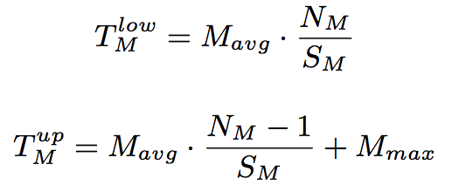
Lower and Upper Bounds of a Job Completion Time
Two main stages: map and reduce stages
Map stage duration depends on:
N_{M} -- the number of map tasks
S_{M} -- the number of map slots
Reduce stage duration depends on:
N_{R} -- the number of reduce tasks
S_{R} -- the number of reduce slots
Reduce stage consists of :
Shuffle/sort phase
“First” wave is treated specially (non-overlapping part with maps)
Remaining waves are “typical”
Reduce phase
Notes:
Change latex Nm/Sm

Slide 16
Scaling Factors
Build profile by executing on smaller dataset
Duration of map tasks not impacted
Larger data => greater number of map tasks
Each map task processes fixed amount of data
If number of reduce tasks kept constant,
Intermediate data processed per reduce task increases => longer durations
Reduce stage = shuffle + reduce phase
Shuffle duration depends on network performance
Reduce duration depends on reduce function and disk write speed

Slide 17
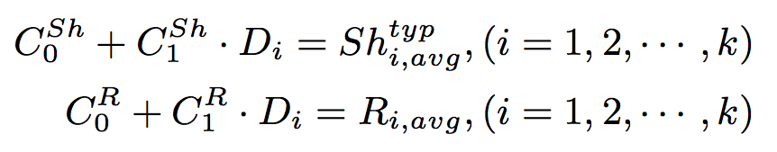
Scaling Factors Formalized
Perform k (> 2) experiments varying input dataset size
D_{i} = amount of intermediate data
Use linear regression to derive scaling factors
For shuffle and reduce phases separately
Per application

Slide 18

Solving the Inverse Problem
Given a deadline time T and the job profile, find the necessary amount of resources to complete the job within T.
Finding the set of minimal (map,reduce) slots to support the job execution within T:
Given number of map/reduce tasks
Find the number of map and reduce slots (S_{M}, S_{R})
that satisfy this equation

Slide 19

Impact of Failures
Commodity hardware => more failures
Performance depends on
Time of failure
Resources replenishable or not
Worker failure: faulty hard disk, process crash
Time of failure:
Map stage: recompute all (completed or in-progress) map tasks of the failed node
Reduce stage: recompute all in-progress reduce tasks of the failed node (and the shuffle phase of these reduce tasks too)

Slide 20
Experimental Setup
66 HP DL145 machines
Four 2.39 GHz cores
8 GB RAM
Two 160 GB hard disks
Two racks
Gigabit Ethernet
2 masters + 64 slaves
Workload
WordCount, Sort, Twitter, WikiTrends

Slide 21
Are Job Profiles stable?
Job | Map Task Duration |  |  | Avg Input size (in MB) | Selectivity
 | Min | Avg | Max
Sept_{256,256} | 94 | 144 | 186 | 59.85 | 10.07
Oct_{256,256} | 86 | 142 | 193 | 58.44 | 9.98
Sept_{64,128} | 94 | 133 | 170 | 59.85 | 10.07
Oct_{64,128} | 71 | 132 | 171 | 58.44 | 9.98
Job | Shuffle |  | Reduce
 | Avg | Max | Avg | Max | Selectivity
Sept_{256,256} | 121 | 152 | 16 | 33 | 0.37
Oct_{256,256} | 122 | 156 | 17 | 35 | 0.36
Sept_{64,128} | 122 | 152 | 15 | 139 | 0.37
Oct_{64,128} | 123 | 153 | 15 | 109 | 0.36

Slide 22
Predicted vs Measured completion times
Measured completion time is within 10% of average predicted time

Slide 23
WordCount Scaling Factors
Linear regression fits phase durations with R² > 95%

Slide 24
Predictions applying scaling factors
Scaling factors maintain accuracy of predictions

Slide 25
SLO-based Resource Provisioning
WordCount, Deadline = 8mins

Slide 26
Impact of Worker Failures

Slide 27
Conclusion
Proposed MapReduce job profiling is compact and comprised of performance invariants
Need 10% dataset for deriving accurate job profiles
Introduced bounds-based performance model is quite accurate: the job completion times are within 10-15% of measured ones
Robust prediction of required resources for achieving given SLOs
job completion times within 10-15% of their deadlines
Future work:
Performance modeling of DAGs of MapReduce jobs (Pig programs)

Slide 28
Questions?

Slide 29
Related Work
Polo et. al. [NOMS10] estimate progress of map stage alone
Ganapathi et. al. [SMDB10] use KCCA for hive queries
Starfish [CIDR11, VLDB11]
ARIA [ICAC11]
Tian and Chen [Cloud11]

Slide 30
Can we meet deadlines?

