Slide 1


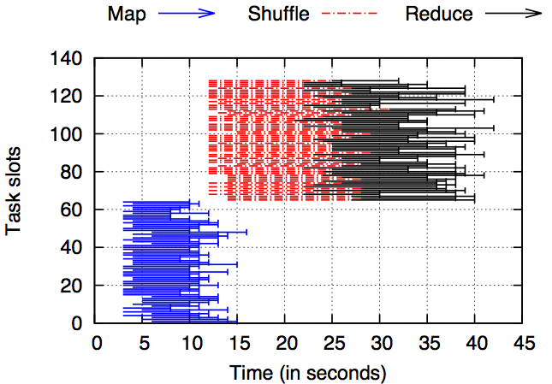
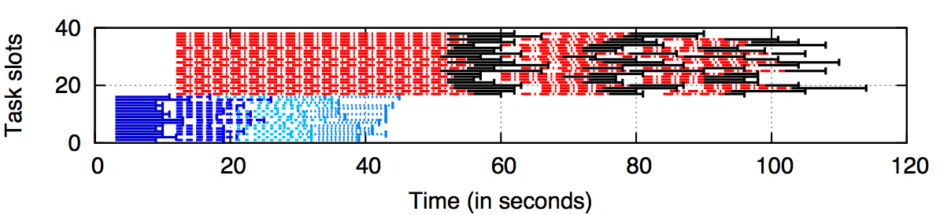



Three Pieces of the MapReduce Workload Management Puzzle
ARIA: Automated Resource Inference and
Abhishek Verma*, Ludmila Cherkasova#, Vijay S. Kumar#, Roy H. Campbell*
*{verma7, rhc}@illinois.edu University of Illinois at Urbana-Champaign, #{lucy.cherkasova, vijay.s.kumar}@hp.com HP Labs, Palo Alto
Motivation
Job Execution with Different Resources
Job Profiles and MapReduce Performance Model
Problem: Existing job schedulers do not support Service Level Objectives
Often MapReduce applications are a part of critical business pipelines and require job completion time guarantees (SLOs)
Goal: Design a workload management framework for efficient processing of MapReduce jobs with completion time goals in shared environments
Job Profiles compactly summarize performance metrics of different job stages collected from logs
Automatic Resource Inference and Allocation (ARIA) with novel performance models:
Can predict job completion time = f(resources)
Given a deadline for job, compute minimum resources
64 map slots
64 reduce slots
16 map slots
22 reduce slots
Three Pieces of the Puzzle
Job Scheduling using Different Mechanisms
Evaluation Setup and Workloads
Job Ordering
How to order jobs?
Tailoring amount of resources
How many slots to allocate?
Allocating spare resources
How to allocate and de-allocate spare resources?
Earliest Deadline First
Allocate all resources to the job with EDF
Min-EDF
Compute and allocate minimum resources
Min-EDF-WC
Allocate any spare resources among running jobs
When new job arrives, compute if enough slots will be released in the future to satisfy current job
If not, cancel spare tasks of the currently running jobs
Testbed Setup
66 HP machines: 2 masters + 64 workers
Four 2.39 GHz cores, 8 GB RAM, 2 x 160 GB hard disks
Workloads
Real testbed trace of 1000 jobs with combinations of: Wordcount, Sort, Bayesian classification, TF-IDF, WikiTrends, Twitter on 3 different datasets
Synthetic Facebook trace: generated using LogNormal distribution fit to 6 months of jobs
Job
Ordering
How much resources?
Allocating
spare resources
Simulator SimMR
Evaluation
Conclusion & Future Work
Replay traces using SimMR
Discrete event simulator replays job traces at task-level
Speed
Can replay two week workload in 2 seconds
Accuracy > 95%
Simulated job completion time within 5% of real completion time
All three mechanisms are required for deadline-based workload management
Dynamic resource adjustment
Compare expected behavior against observed behavior and adjust
Deal with stragglers
Input data skew
The simulation results with the synthetic Facebook trace are similar and reflect the same conclusions.
Notes:
Presentation Title
1

